Slide 1
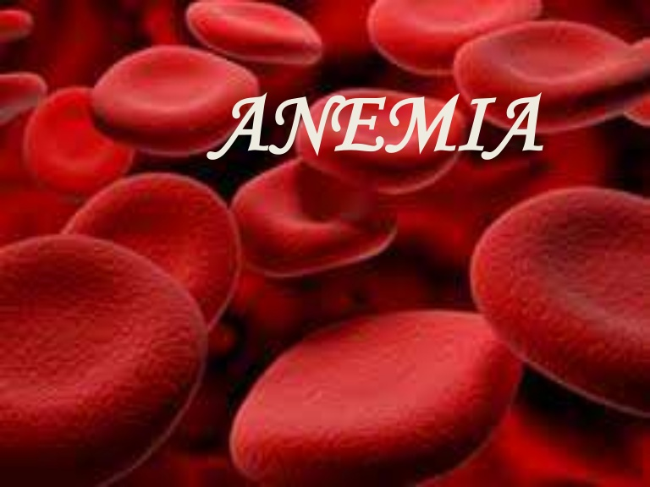

Slide 7
Requirements for Red Blood Cell Production
Erythropoeitin
Proteins, required for globin synthesis
Iron
Vitamin B12 and folic acid
Vitamin B6
Vitamin C
Thyroid hormones, estrogens and androgens

Slide 8
Symptoms and Signs of Anemia
None ( if slow or mild)
Fatigue
Breathlessness
Dizziness
Pale skin, mucous membranes
Jaundice (if hemolytic)
Tachycardia

Slide 9
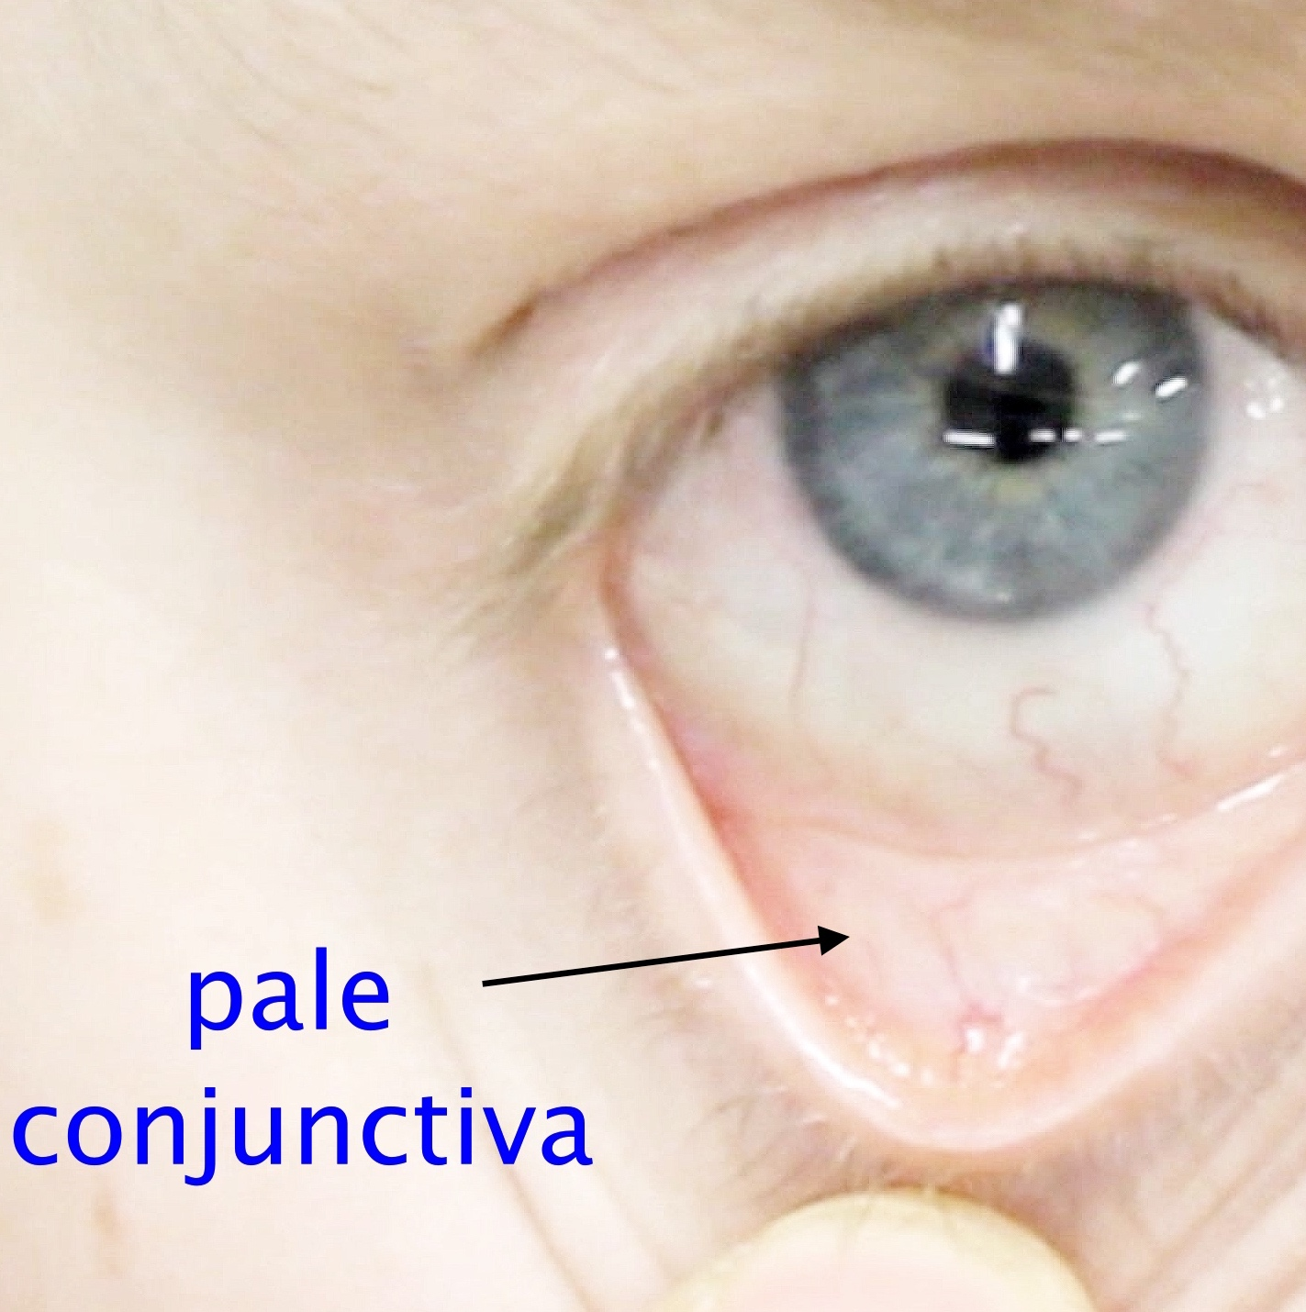

Slide 10
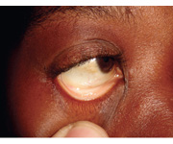

Slide 11
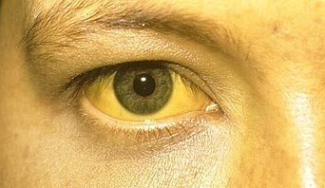

Slide 12
Iron Deficiency Anemia IDA

Slide 13
Etiology
Inadequate intake of iron & of food, which enhances iron absorption.
High intake of inhibitors of iron absorption
Hookworm infestation.
Blood loss (heavy menses & use of aspirin & NSAID).
High fertility rate in womem.
Low iron stores in newborns.

Slide 14
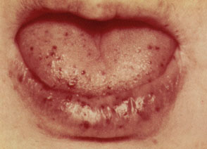
Hereditary hemorrhagic telengectasia

Slide 15
Iron Absorption
Haem iron is not affected by ingestion of other food items.
It has constant absorption rate of 20-30% which is little affected by the iron balance of the subject.
The haem molecule is absorbed intact and the iron is released in the mucosal cells.

Slide 16
Iron Absorption Inhibitor
Beverages like tea, coffee, cocoa .
A single cup of tea taken with meal reduces iron absorption by up to 11%.
Food containing phytic acid i.e. Bran, cereals like wheat, rice, maize & barely. Legumes like soya beans, black beans & peas.
Cow’s milk due to its high calcium & casein contents.

Slide 17
Iron Transport
Transferrin is the major protein responsible for transporting iron in the body.
Transferrin receptors, located in almost all cells of the body, can bind two molecules of transferrin.
Both transferrin concentration & transferrin receptors are important in assessing iron status.

Slide 18
Iron Absorption Promoters
Foods containing ascorbic acid like citrus fruits, broccoli & other dark green vegetables because ascorbic acid reduces iron from ferric to ferrous forms, which increases its absorption.

Slide 19
Storage of Iron
Tissues with higher requirement for iron
( bone marrow, liver & placenta) contain more transferrin receptors.
Once in tissues, iron is stored as ferritin & hemosiderin compounds, which are present in the liver, RE cells & bone marrow.
The amount of iron in the storage compartment depends on iron balance (positive or negative).
Ferritin level reflects amount of stored iron in the body & is important in assessing ID

Slide 20
Diagnosis of Iron Deficiency Anemia
Clinical: symptoms (fatigue, dizziness , palpitations..etc) & signs (pallor, smooth tongue, Koilonychia, & dysphagia in elderly women).
Laboratory
Stainable iron in bone marrow ( This is not done frequently now a days).
Response to iron supplements

Slide 21
Lab finding in IDA
Microcytic hypochromic anaemia
Low Hb level (< 11.0 g/dl)
Low MCV, MCH, MCHC
Low serum ferritin
High iron binding capacit
High Transferrin Receptors antibodies

Slide 23
Angular stomatitis in iron deficiency anemia

Slide 25
Treatment
Ferrous sulphate is commonly used in Rx & prevention of IDA because of good absorption & high bioavailability, but it has its drawbacks
GIT disturbances & staining of teeth are frequent
Effects on fortified foods may include:
Fat oxidation & rancidity
Colour changes
Metallic taste
Precipitation

Slide 26
Treatment
The haemoglobin should rise by around 10 g/L every 7–10 days and a reticulocyte response will be evident within a week.
A failure to respond adequately may be due to non-compliance, continued blood loss, malabsorption or an incorrect diagnosis.

Slide 27
Treatment
Patients with malabsorption or chronic gut disease may need parenteral iron therapy.
Previously, iron dextran or iron sucrose was used, but new preparations of iron isomaltose and iron carboxymaltose have fewer allergic effects and are preferred.

Slide 28
Prevention of IDA
Dietary modification
Food fortification
Iron supplementation

Slide 29
Prevention of IDA
Diet & nutrition education
eat more fruits and vegetable
no coffee or tea with meals
programmes should be targeted to
at risk groups
reduce phytic content of cereals and
legumes by fermentation

Slide 30
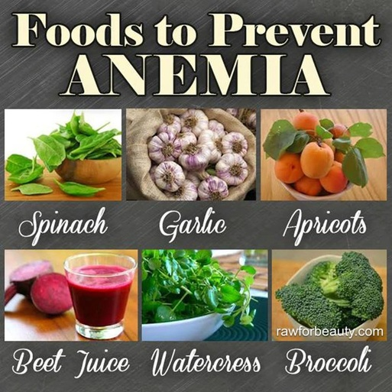

Slide 31
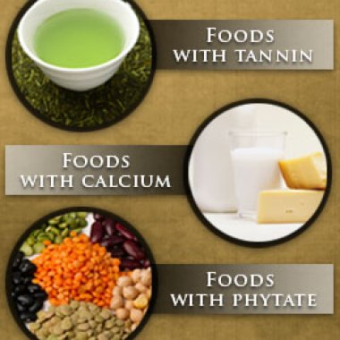

Slide 33
Anaemia of chronic disease
Anaemia of chronic disease (ACD) is a common type of anaemia, particularly in hospital populations.
It occurs in the setting of chronic infection, chronic inflammation or neoplasia.
The anaemia is not related to bleeding, haemolysis or marrow infiltration.

Slide 34
Anaemia of chronic disease
Is mild, with haemoglobin in the range of 85–115 g/L, and is usually associated with a normal MCV (normocytic, normochromic),
The serum iron is low but iron stores are normal or increased, as indicated by the ferritin or stainable marrow iron.

Slide 35
Pathogenesis
It has recently become clear that the key
regulatory protein that accounts for the
findings characteristic of ACD is hepcidin,
which is produced by the liver.

Slide 36
Hepcidin production is induced by proinflammatory cytokines, especially IL-6. Hepcidin binds to ferroportin on the membrane of iron-exporting cells, such as small intestinal enterocytes and macrophages, internalising the ferroportin and thereby inhibiting the export of iron from these cells into the blood.

Slide 37
Investigations to differentiate anaemia of chronic disease from iron deficiency anaemia
IDA Ferritin Iron TIBC Transferrin Soluble transferrin
saturation receptor
↓ ↓ ↑ ↓ ↑
Anaemia
of chronic
Disease ↑/
Normal .
↓/Normal

Slide 38
The iron remains trapped inside the
cells in the form of ferritin, levels of
which are therefore normal or high in
the face of significant anaemia.

Slide 39
Treatment
Inhibition or blockade of hepcidin is a
potential target for treatment of this
form of anaemia.

Slide 40
MACROCYTIC ANEMIAS
These are the anemias in which the RBC have an MCV of greater than 100fl
There are 2 groups of macrocytic anemias
Megaloblastic anemia
Non megaloblastic macrocytic anemia

Slide 41
NON MEGALOBLASTIC MACROCYTIC ANEMIAS
These are disorders in which the macrocytosis is not due to vitamin B₁₂ or folic acid deficiency
The conditions in which such round macrocytes are seen are
Reticulocytosis
Hypothyroidism / myxedema
Myelodysplastic syndrome
Scurvy (Vit-C dif)
Sideroblastic anemia
Liver disorders

Slide 42
MEGALOBLASTIC ANEMIA
Vitamin B₁₂ and folic acid are important nutrients required in the process of nuclear maturation.
They are required during erythropoiesis (during DNA synthesis)
These anemias may be caused because of a nutritional deficiency or impaired absorption mainly.

Slide 43
MEGALOPLASTIC ANAEMIA
Affect all marrow elements.
Neurologic symptoms in Vit. B12 deficiency (dorsal columns).
Ineffective erythropoiesis.
High indirect bilirubin.
Very high LDH.

Slide 44
Folic Acid:
It is a water soluble vitamin, necessary for the production of the RBC, WBC and platelets.
It is not synthesized in the body.
It is found in large number of green fresh vegetables, fruits.
Daily requirement:
The human body needs about 100-150 µg daily. Absorption:
It is absorbed in the Duodenum and Jejunum.
Transportation:
Weakly bound to albumin.

Slide 45
Metabolic Function
Purine synthesis
Conversion of homocysteine to methionine
( which also requires B12 )

Slide 46
Causes of folic acid deficiency
Diet
• Poor intake of vegetables
Malabsorption
• e.g. Coeliac disease
Increased demand
• Cell proliferation, e.g. haemolysis
• Pregnancy
Drugs
• Certain anticonvulsants (e.g. phenytoin)
• Contraceptive pill
• Certain cytotoxic drugs (e.g. methotrexate)

Slide 47
Investigation of folic acid deficiency
Diagnostic findings
• Serum folate levels may be low but are difficult to interpret
• Low red cell folate levels indicate prolonged folate deficiency and are probably the most relevant measure

Slide 48
Vitamin B12
This vitamin is synthesized in nature by micro-organism in the intestine of man and animals, but we can not obtain it from the bacteria in our bodies, because it is synthesizing in the large colon after the site of absorption and it is wasted in the faeces in about 5µg/day.
So we obtain it from animal food such as liver, kidney, meat and dairy products as milk and cheese.

Slide 49
Abundant in animal foods
Microorganisms are the ultimate origin of cobalamin.
It is stored in liver for many years.
It is efficiently reabsorbed from bile.
It is resistant to cooking and boiling.

Slide 50
Diary requirements:
The human body needs about 1-2 µg daily.
Absorption:
B12 is combined with glycoprotein called the intrinsic factor (IF), which is synthesized in the gastric cells. The absorption occurs in the distal ileum.
Transportation:
Transport by a protein synthesized in the liver called Transcobalamine II, which carry vitamin B12 to liver, nerves and bone marrow.

Slide 51
IMPAIRED ABSORPTION
INTRINSIC FACTOR DEFICIENCY due to chronic gastritis or antibodies against stomach cells.
- PERNICIOUS ANEMIA
- GASTRECTOMY
Malabsorption states
Diffuse intestinal diseases. Eg., lymphoma, systemic sclerosis
Competitive parasitic uptake – fish tapeworm
Bacterial overgrowth

Slide 52
Clinical features of megaloblastic anemia
Symptoms Signs
• Malaise (90%) Smooth tongue
• Breathlessness (50%) Angular Cheilosis
• Paraesthesiae (80%) Vitiligo
• Sore mouth (20%) Skin pigmentation
• Weight loss Heart failure
• Altered skin pigmentation Pyrexia
• Impotence
• Poor memory
• Depression
• Personality change
• Hallucinations
• Visual disturbance

Slide 53
Neurological findings in Vit.B12 deficiency anemia
Peripheral nerves
• Glove and stocking paraesthesiae
• Loss of ankle reflexes
Spinal cord
• Subacute combined degeneration of the cord
Posterior columns – diminished vibration sensation and
proprioception
Corticospinal tracts – upper motor neuron signs
Cerebrum
• Dementia
• Optic atrophy
Autonomic neuropathy

Slide 54
Haemoglobin Often reduced, may be very low
MCV Usually raised, commonly > 120 fL
Erythrocyte count Low for degree of anaemia
Blood film Oval macrocytosis, poikilocytosis,
red cell fragmentation, neutrophil
Hypersegmentation
Reticulocyte count Low for degree of anaemia
Leucocyte count Low or normal
Platelet count Low or normal
Investigations in megaloblastic anemia

Slide 55
Bone marrow Increased cellularity, megaloblastic
changes in erythroid series, giant
metamyelocytes, dysplastic
megakaryocytes, increased iron in
stores, pathological non-ring
sideroblasts
Serum ferritin Elevated
Plasma lactate
dehydrogenase (LDH)

Slide 56
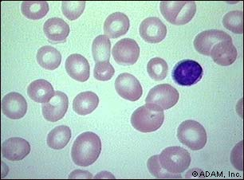

Slide 57
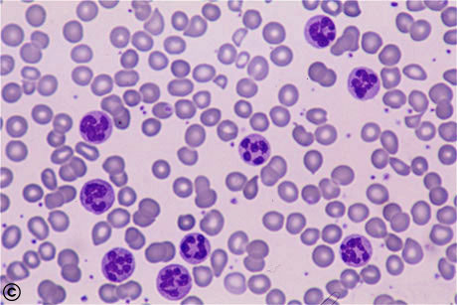
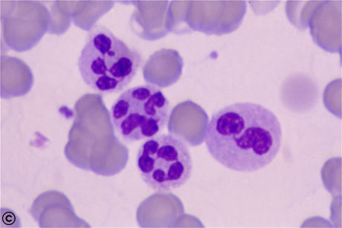
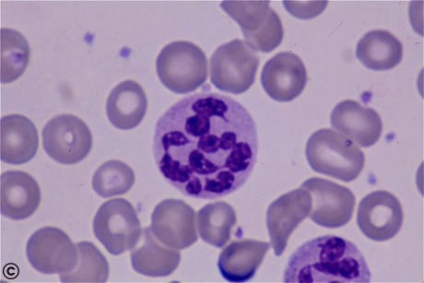

Slide 58
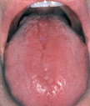

Slide 59
PERNICIOUS ANEMIA
Scandinavian countries more prevalent
Disease of elderly – 5th to 8th decades
Genetic predisposition.
Tendency to form antibodies against multiple self antigens

Slide 60
DIAGNOSTIC FEATURES
Moderate to severe megaloblastic anemia
Leucopenia with hypersegmented neutrophils
Mild to moderate thrombocytopenia
Mild jaundice due to ineffective erythropoiesis and peripheral hemolysis
Neurologic changes
Low levels of serum B₁₂
Elevated levels of homocysteine
Striking reticulocytosis after parenteral administration of vitamin B₁₂
Serum antibodies to intrinsic factor

Slide 65
Management of megaloblastic anaemia
If a patient with a severe megaloblastic anaemia is very ill and treatment must be started before vitamin B12 and red cell folate results are available, that treatment should always include both folic acid and vitamin B12.
The use of folic acid alone in the presence of vitamin B12 deficiency may result in worsening of neurological deficits.

Slide 66
Rarely, if severe angina or heart failure is present,
transfusion can be used in megaloblastic anaemia. The cardiovascular system is adapted to the chronic anaemia present in megaloblastosis, and the volume load imposed by transfusion may result in decompensation and severe cardiac failure.
In such circumstances, exchange transfusion
or slow administration of 1 U of red cells with diuretic
cover may be given cautiously.

Slide 67
Vitamin B12 deficiency
Vitamin B12 deficiency is treated with hydroxycobalamin
1000 μg IM for 6 doses 2 or 3 days apart, followed by
maintenance therapy of 1000 μg every 3 months for life.
The reticulocyte count will peak by the 5th–10th day
after starting replacement therapy. The haemoglobin
will rise by 10 g/L every week until normalised. The
response of the marrow is associated with a fall in
plasma potassium levels and rapid depletion of iron
stores.

Slide 68
If an initial response is not maintained and the
blood film is dimorphic (i.e. shows a mixture of microcytic and macrocytic cells), the patient may need additional iron therapy.
A sensory neuropathy may take 6–12 months to correct; long-standing neurological damage may not improve.

Slide 69
Folate deficiency
Oral folic acid 5 mg daily for 3 weeks will treat acute
deficiency and 5 mg once weekly is adequate maintenance therapy.
Prophylactic folic acid in pregnancy prevents
megaloblastosis in women at risk, and reduces the
risk of fetal neural tube defects .
Prophylactic supplementation is also given in chronic haematological disease associated with reduced red cell lifespan (e.g. haemolytic anaemias).

