Slide 1
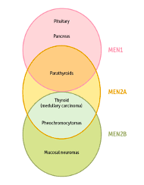
Multiple Endocrine Neoplasia (MEN syndrome)
Done by: Qais Abu-AL-Rub
Abdelrahman Nour
Raghad AL-Hajj-Hassan
Raghad AL-Qazaqqi
Supervised by : Dr. Ali Jadd

Slide 2
Introduction
Multiple endocrine neoplasias (MEN) are inherited as autosomal dominant syndromes characterized by hyperplasia and formation of adenomas or malignant tumors in different endocrine glands.
There are two main types, type 1 (MEN 1) and type 2 (MEN 2).

Slide 3
Endocrine tumors arising in the context of MEN syndromes have certain distinctive features that are not shared with their sporadic counterparts :
These tumors occur at a younger age
They arise in multiple endocrine organs , either synchronously or metachronously .
Even in one organ , the tumors often are multifocal .
These tumors are usually more aggressive and recur. in a higher proportion of cases than similar endocrine tumors that occur sporadically.

Slide 4
MEN 1
Pituitary tumors (prolactin or GH)
Pancreatic endocrine tumors —Zollinger-Ellison syndrome, insulinomas, VIPomas, glucagonomas (rare)
Parathyroid adenomas

Slide 5
MEN 2A
Parathyroid hyperplasia
Pheochromocytoma (secretes catecholamines)
Medullary thyroid carcinoma

Slide 6
MEN 2B
Pheochromocytoma
Medullary thyroid carcinoma
Mucosal neuromas A (oral/intestinal ganglioneuromatosis)
Associated with marfanoid habitus

Slide 7
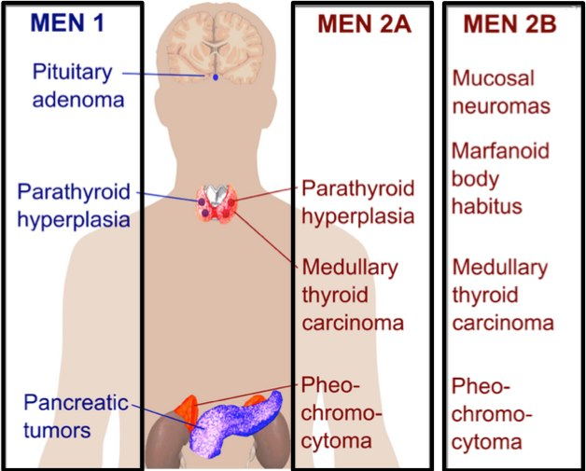
Notes:
drenal adenoma 30 %
Thyroid adenoma 15%

Slide 8
Multiple Endocrine Neoplasia type 1 (MEN 1) Wermer’s syndrome

Slide 9
Introduction
MEN 1 is characterized by the triad of 3 P`s :
Parathyroid hyperplasia (90%)
Pancreatic islet tumors (66%)
Pituitary tumors (50%)
The syndrome was first described by Wermer in 1954 and is therefore also called Wermer’s syndrome.
It is caused by germline mutations that lead to inactivation of the menin gene (tumor suppressor gene ), located on chromosome 11.

Slide 10
Epidemiology
The prevalence of the syndrome is estimated to be around 0.04–0.2 cases per 1000 population per year.
The disease is equally distributed between men and women.
Most of the mutation carriers identified in screening programmes are asymptomatic

Slide 11
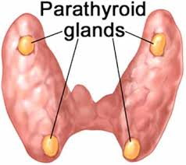
1- PARATHYROIDS
Primary hyperparathyroidism (pHPT) is the most common manifestation of MEN 1 (80-95% of patients) and it is usually the first manifestation of the disease.
MEN 1 pHPT is characterized by multiglandular disease so that all four parathyroids become hyperplastic in the course of the disease.

Slide 12
Clinical presentation:
Patients typically present with young onset (20–30 years of age) of symptomatic hyperparathyroidism and over 95% of patients will have PHPT before the age of 40 years.
The clinical presentation of MEN 1 pHPT is similar to that of the sporadic disease (painful Bones , renal Stones , abdominal Groans and psychic Moans ) .
most common in symptomatic disease is nephrolithiasis
Notes:
typical symptoms of hypercalcemia :
painful Bones , renal Stones , abdominal Groans and psychic Moans

Slide 13
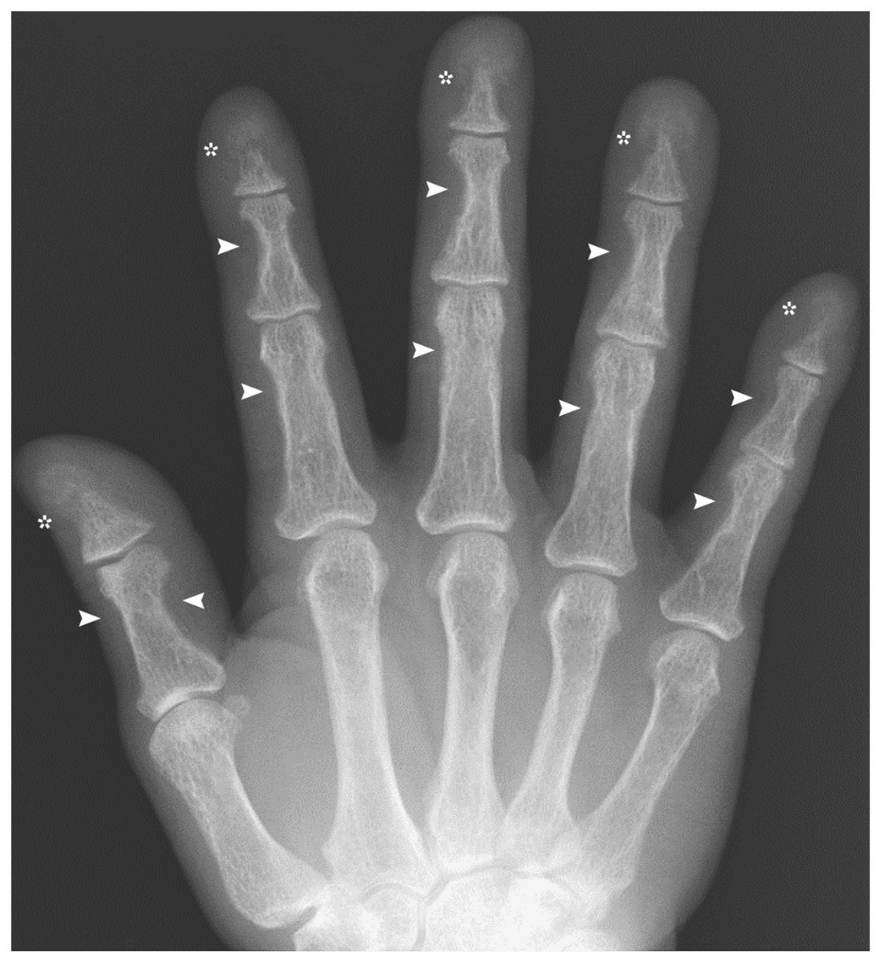
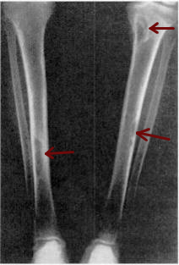
Subperiosteal bone resorption
- Pathognomonic sign for Hyperparathyroidism
Brown tumor
Osteitis fibrosa cystica

Slide 14
Diagnosis
Diagnosis is established by determination of parathyroid hormone (PTH) and calcium in serum and urine.
Typically have a markedly elevated 24-hour urine calcium excretion.
Alkaline phosphatase (skeletal) levels may be raised and ↓ Phosphate In blood.

Slide 15
Treatment
The indications for surgery in MEN 1 pHPT follow the same criteria as in sporadic disease but the choice of procedure is different.
Treatment options
Total parathyroidectomy
Subtotal parathyroidectomy
Notes:
Urinary tract calculi,
Reduced bone density
,High serum calcium
, All in younger age group
, Deteriorating renal function,
Symptomatic hypercalcaemia

Slide 16
Total parathyroidectomy
As multiglandular disease is present in cases.
It includes TOTAL four-gland parathyroidectomy,
the parathyroid glands that were resected, are sent for pathological examination.
After confirmed to be diffuse hyperpolarized, the diffuse hyperpolarized parts were frozen, sliced into 1∼2 mm³ sections.
After that, 20∼30 slices were separately incubated into the patients’ forearm muscles (BRACHIORADIALIS)

Slide 17
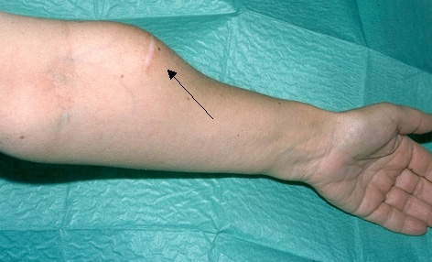
While the gland does not function immediately, it will develop a new blood supply and will typically start working within 4-6 weeks.
The patient will need to take both calcium and calcitriol (Vitamin D) pills and occasionally intravenous (IV) calcium until the auto transplant starts working.
If recurrence develops, excision of
a portion of the grafted parathyroid
tissue under local anesthesia

Slide 18
Selective resection of enlarged glands is obsolete “no longer done” because of the high rates of recurrence
3-3.5 of gland is removed (SUBTOTAL) parathyroidectomy, leaving the remnant parathyroid in situ in the neck
Eliminates higher risk of permanent hypocalcemia
Associated morbidity if there is recurrence

Slide 19
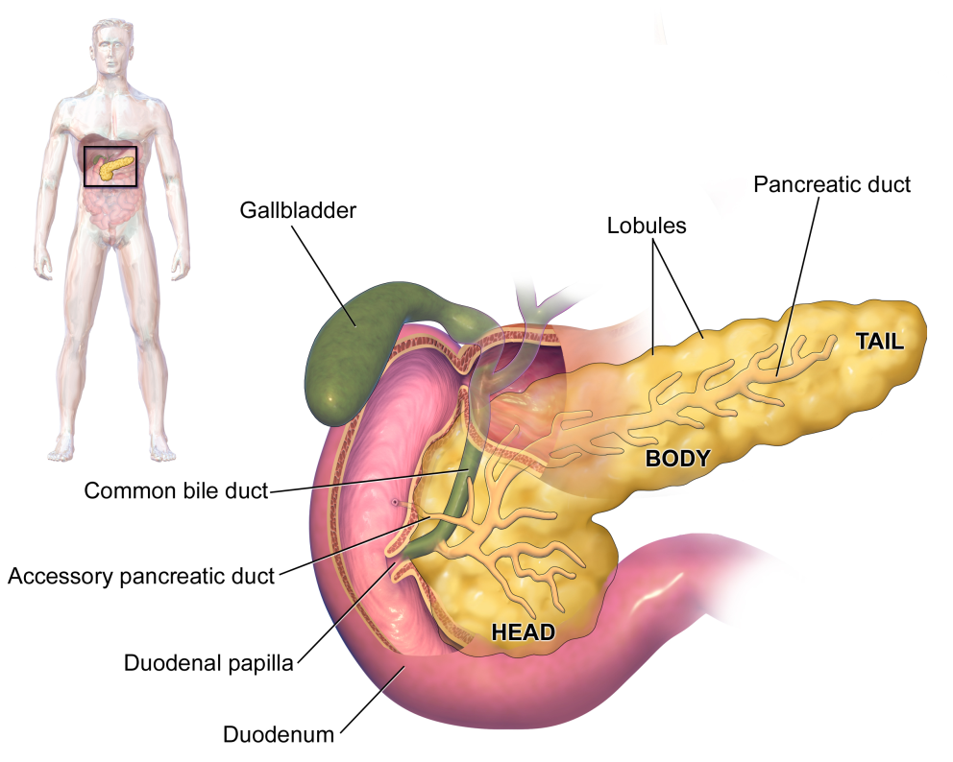
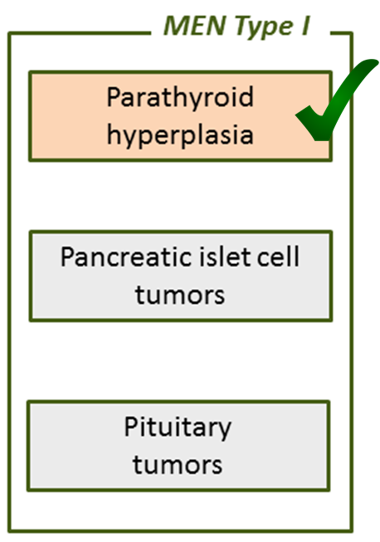
2- Pancreas Endocrine Tumors ( PET )

Slide 20
PETs (Pancreas Endocrine Tumors ) occur in around 50–60% of MEN 1 patients , and are the leading cause of death in MEN 1
PETs is divided into
Functioning
Insulinoma
Gastrinoma
Others : VIPomas, glucagonomas and somatostatinomas (rare)
Non-functioning

Slide 21
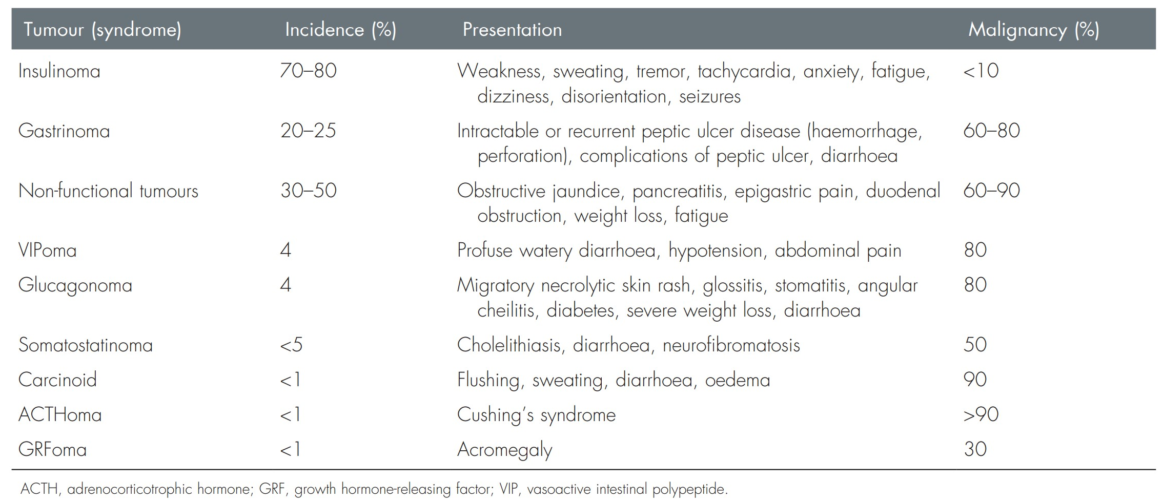

Slide 22
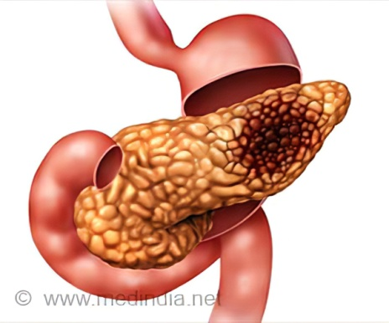
Insulinoma
It is insulin-producing tumor arising from beta cells
the most frequent of all the functioning PETs
diagnosed in all age groups with the highest incidence found in the fourth to the sixth decades. Women slightly more frequently affected
Whipple’s triad :
1- symptoms of hypoglycemia after fasting or exercise,
2- plasma glucose levels <2.8 mmol/L ( normal = 3.9 – 5.6 mmol/L )
3- relief of symptoms on intravenous administration of glucose

Slide 23
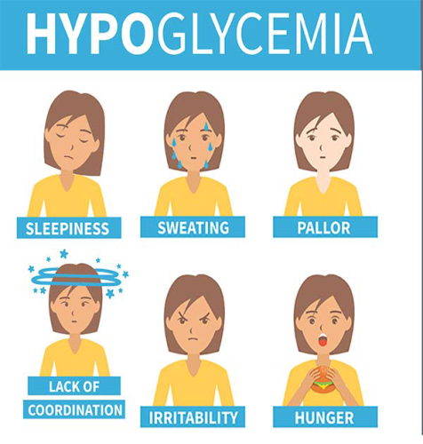
Symptoms :
characterized by episodic nature of the hypoglycemic attacks is caused by intermittent insulin secretion by the tumor.
This leads to central nervous system symptoms such as diplopia, blurred vision, confusion, abnormal behavior and amnesia.
Some patients develop loss of consciousness and coma.
The release of catecholamines produces symptoms such as
sweating, weakness, hunger, tremor, nausea, anxiety and
Palpitation .

Slide 24
Management :
fasting test that may last for up to 72 hours is regarded as the most sensitive test. Usually, insulin, proinsulin, C-peptide and blood glucose are measured in 1- to 2-hour intervals
endoscopic ultrasound (EUS), CT scan and abdominal ultrasound is done for preoperative localization
Insulinoma is treated by surgical resection (Most insulinomas are not cancerous )
patients who are unable or unwilling to undergo surgery , chemotherapy or Diazoxide (suppress insulin secretion) can be used

Slide 25
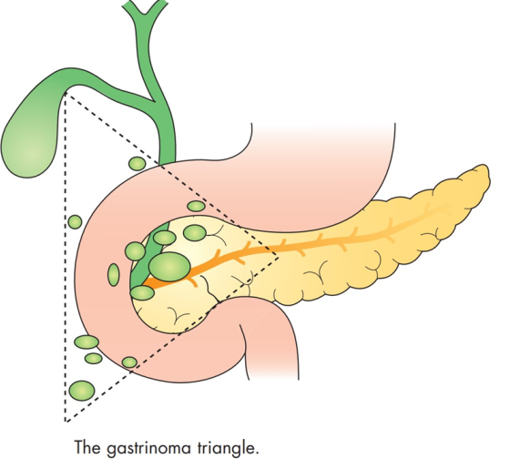
Gastrinoma (Zollinger–Ellison syndrome)
Gastrinoma is non-beta islet cell tumor of the pancreas that produced gastrin , causing gastric hypersecretion of HCL , which will cause fulminating ulcer in the stomach, duodenum or atypical sites and recurrent ulceration despite ‘adequate’ therapy
more common in males than in females. The mean age at the onset of symptoms is 38 years
Mainly (90%) located in 3 areas (Gastrinoma triangle) :
head of the pancreas
the superior and descending portion of the duodenum and
the relevant lymph nodes .

Slide 26
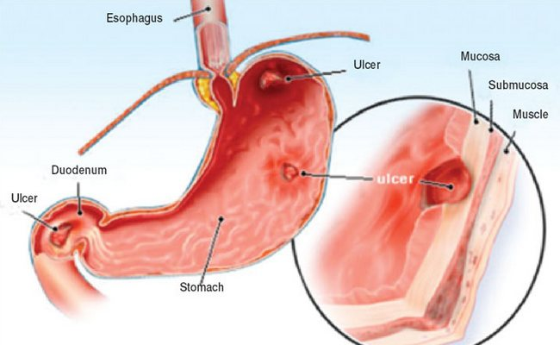
Symptms :
Gastrinoma symptoms is related to the large volume of gastric acid secretion :
peptic ulcer
GERD
Abdominal pain
Diarrhea

Slide 27
Management :
Diagnosis is confirmed if gastric pH is below 2.5 and a serum gastrin concentration above 1000 pg/mL (normal less than 100 pg/mL)
Pancreatic gastrinomas are detected by EUS , CT scan and MRI
can be treated effectively with proton pump inhibitors (PPI) but the definite treatment is surgically by resection of the tumor with peripancreatic lymph node dissection and the duodenum
Systemic chemotherapy is utilized in patients with diffuse metastatic gastrinomas .

Slide 28
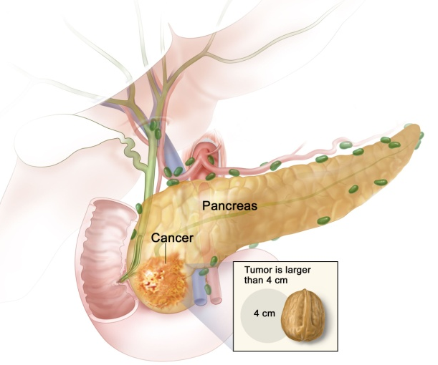
Non-functional pancreatic endocrine tumors (NF-PET)
NF-PET usually arise in the head of pancreas and do not cause a clinical syndrome .
Patients usually present late because of the lack of a clinical/ hormonal marker of tumor activity
70 % of all NF-PETs are malignant. NF-PETs have a
worse prognosis compared to functioning PETs

Slide 29
Symptoms :
patients with NF-PETs present with various non-specific symptoms, including jaundice, abdominal pain, weight loss and pancreatitis.
In some cases liver metastases are the first presentation
Management :
The combination of elevated chromogranin A and pancreatic polypeptide measurements is diagnostic of NF-PET
NF-PET is treated by aggressive surgical approach , This may require partial pancreaticoduodenectomy and resection of liver metastases
When surgical excision is not possible, chemotherapy is used

Slide 30
3. Pituitary adenoma
-Occurs in up to 70% of patients.
-Most commonly a prolactinoma .
-2nd most common : GH secreting adenoma .
-Pituitary adenomas not seen in other MEN syndromes .
-pituitary disease = MEN 1

Slide 31
Symptoms are due to hypersecretion of hormones or compression of adjacent structures.
visual disturbances | Large adenomas
amenorrhea and galactorrhea in women hypogonadism in men | Prolactinomas
acromegaly | GH secreting tumor
Cushing’s disease | ACTH secreting tumors

Slide 32
Treatment
Prolactinomas : dopamine agonist such as bromocriptine or cabergoline
GH screting tumours : octreotide and lanreotide
rapidly enlarging, nonfunctional macroadenomas that are unresponsive to medical therapy : Trans-sphenoidal pituitary microsurgery or radiation therapy

Slide 33
Multiple Endocrine Neoplasia type 2 (MEN 2)

Slide 34
Men Type II
Type IIA
the most common tumors and their incidences:
Medullary thyroid carcinoma (100%); Calcitonin secreted
Pheochromocytoma (>33%); Catecholamine excess
Hyperparathyroidism (≈50%); Hypercalcemia

Slide 35
Pheochromocytoma
Tumor of the adrenal MEDULLA and sympathetic ganglion that produces catecholamines (norepinephrine > epinephrine).
occurs in approximately 50% of patients with MEN2. The frequency of pheochromocytoma depends upon the specific underlying RET mutation
pheochromocytomas in MEN2 occur earlier than sporadic forms. Although they may develop as early as 8 to 12 years of age, the mean age of presentation is 25 to 32 years, depending on the mutation .
It is unusual for pheochromocytoma to precede the development of MTC and be the initial manifestation of MEN2.

Slide 36
Rarely, pheochromocytoma may be the first manifestation of MEN2 , In such patients, symptoms are similar to those in patients with sporadic pheochromocytomas and may include attacks of anxiety, headache, diaphoresis , palpitations, or tachycardia
However, only approximately one-third had hypertension at the time of diagnosis
Sporadic pheochromocytomas are almost always unilateral . In contrast, pheochromocytomas in MEN2 have been reported to be bilateral in approximately 30 to 100 percent of patients . Thus, once the diagnosis of pheochromocytoma in MEN2 is established, the possibility of bilateral disease must be carefully evaluated.

Slide 37
Clinical presentation
Classic triad — The classic triad of symptoms in patients with a pheochromocytoma consists of episodic headache, sweating, and tachycardia , Approximately one-half have paroxysmal hypertension; most of the rest have either primary .hypertension or normal blood pressure
Diagnostic work-up includes measurement of urinary catecholamines, abdominal CT or MRI

Slide 38
Diagnosis :
diagnostic tests :
Urine screen: VanillylMandelic Acid (VMA), metanephrine, and normetanephrine (all breakdown products of the catechols)
Urine/serum epinephrine/norepinephrine levels
other common lab findings?
Hyperglycemia (epinephrine increases glucose, norepinephrine decreases insulin)
Polycythemia (resulting from intravascular volume depletion)
tumor localization tests?
CT scan, MRI, PET scan

Slide 39
Treatment :
preoperative/medical treatment :
Increase intravascular volume with α-blockade (e.g., phenoxybenzamine or prazosin) to allow reduction in catecholamine-induced vasoconstriction and resulting volume depletion; treatment should start as soon as diagnosis is made ± β-blockers
Surgical treatment :
Adrenalectomy for pheochromocytoma can be performed via laparotomy, laparoscopy.
Unilateral or bilateral subtotal resection may be feasible, which retains the healthy part of the gland and prevents postoperative dependence on cortisol and mineralocorticoid supplementation .
Further phaeos can develop in the remnants that are left so continued surveillance is required .

Slide 40
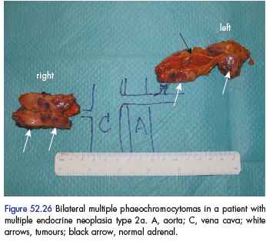

Slide 41
Medullary thyroide cancer (MTC)
Derived from parafollicular c-cells located superolateraly in the thyroide lobes.
75% sporadic : 80% unilateral and typical age of presentation is in the fourth and sixth decades of life .
25% inherited (MEN2 syndrome) : 90% bilateral, present earlier (MEN2A-associated MTC, the peak incidence of index cases is in the third decade of life, and it is usually earlier in MEN2B. Specific RET mutations are associated with characteristic age-specific penetrance of MTC )
- clinical presentation : manifestations of both is similar.
Most common presentation is that of a solitary thyroid nodule or cervical lymphadenopathy
70 % of patients have clinically detectable cervical lymph node involvement
15 % have symptoms of upper aerodigestive tract compression or invasion (dysphagia or hoarseness),
5 to 10 % have distant metastatic disease (liver, lung, bones,less often, brain and skin).
Paraneoplastic Systemic symptoms may occur : due to calcitonin (diarrhea,facial flushing), occasional tumors secrete (ACTH), causing ectopic Cushing's syndrome.

Slide 42
The goal in patients with known RET mutations (but without clinically apparent disease) is to perform a prophylactic thyroidectomy before MTC develops or when it is still confined to the thyroid gland, the Recommended age to begin annual screening (Annual physical examination, neck ultrasound, and measurement of serum calcitonin) and the thyroidectomy depend on the risk of MTC development which depends on specific mutated RET codon.

Slide 43
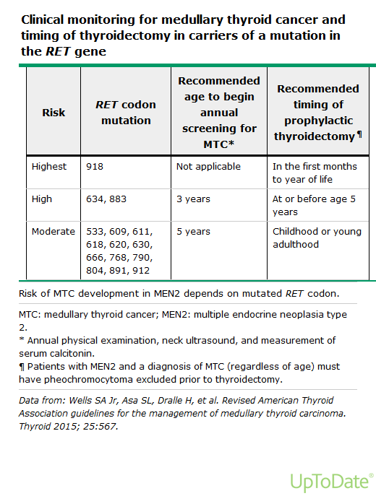

Slide 44
Diagnosis of MTC
fine-needle aspiration (FNA) biopsy of the thyroid nodule
If the clinical suspicion for MTC is high (eg, patient with diarrhea, flushing, and a thyroid nodule), calcitonin can be measured in the washout of the FNA biopsy needle.
thyroid lobectomy for a suspicious or indeterminate FNA biopsy.
… WHATS NXT ?!!
Its not possible to destiguish sporadic from familial disease at initial presentation, hence all new patients with MTC diagnosis need full evaluation.
evaluation should include :
1.serum calcitonin,
2.carcinoembryonic antigen (CEA), 3.ultrasonography of the neck
4.genetic testing for germline RET mutations,
5.biochemical evaluation for coexisting tumors:
(Serum calcium =to rule out hyperparathyroidism)
(Plasma fractionated metanephrines (initial screen for pheochromocytoma)
Note :Normal plasma fractionated metanephrines exclude a symptomatic catecholamine-secreting neoplasm, but mildly elevated values of normetanephrine could be falsely positive, in which case additional evaluations including 24-hour urinary fractionated metanephrines, catecholamines, and adrenal imaging may be required to effectively rule in or rule out pheochromocytoma prior to surgery.

Slide 45
Total thyroidectomy rather than unilateral lobectomy is the preferred surgical approach. Up to 10 %of sporadic and all patients with inherited MTC have bilateral or multifocal disease
extent of cervical lymph node dissection depends on the findings on preoperative ultrasound as well as intraoperative identification of lymph node metastases.
After thyroidectomy, it is important to evaluate patients to determine if surgery was curative.serum calcitonin and carcinoembryonic antigen (CEA) to assess for cure. Subsequent management depends upon these values.

Slide 46
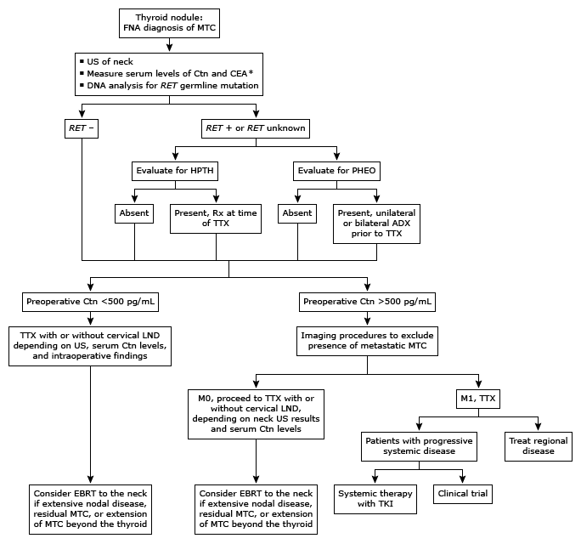

Slide 47
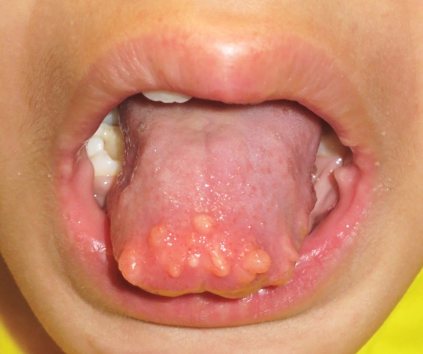
For MEN2B only :
Mucosal neuroma :
Proliferation of neural tissue
Flesh colored nodules involving the lips and tongue, and intestinal ganglioneuromas.
There is no specific treatment.
Marfanoid habitus :
development abnormalities, a decreased upper/lower body ratio, skeletal deformations (kyphoscoliosis or lordosis), joint laxity,, and myelinated corneal nerves.
Unlike patients with Marfan syndrome, MEN2B patients do not have ectopia lentis or aortic abnormalities

Slide 48
Thank you

