Slide 1
Experiment 8:
Aspirin Synthesis
and Analysis
(تحضير وتحليل الأسبرين)
BY
PROF. KAMAL A MOMANI
Laboratory of General and Organic Chemistry,
Chem 0303003
Chemistry Department Mutah University
Jordan
November 19 2022

Slide 2
Objectives:
To synthesize aspirin
To determine the purity of the synthesized aspirin
or a commercial aspirin tablet
https://youtu.be/oSk-2CQM6zE
Synthesis of Aspirin

Slide 3
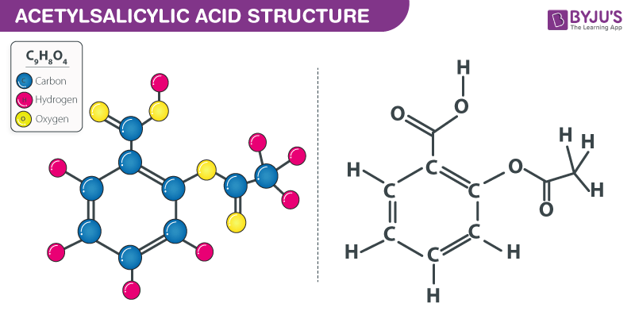
Aspirin is a leading commercial pain reliever, first synthesized in a pure and stable form by Felix Hoffman in 1897.

Slide 4
Introduction: Chemical background
Pure aspirin, chemically called acetylsalicylic acid, is both an organic ester and an organic acid. It appears as a white crystalline powder.
Aspirin is one of the safest and most effective medicines and is widely used medication, thus is displayed on the WHO’s List of Essential Medicines
It is used widely as a painkiller such as headache (مسكن للألم, analgesic), as a fever-reducing drug (دواء خافض للحمى , antipyretic). It is most widely used in medication to treat pain, inflammation, and fever.
When ingested, acetylsalicylic acid (ASA) remains intact in the acidic stomach, but in the basic medium of the upper intestinal tract, it forms the salicylate and acetate ions
The analgesic action (عمل مسكن) of aspirin is due to the salicylate ion.

Slide 5
Question. Identifther medical applications of aspirin. Select one or more:
Fever-reducer
Pain killer
Anticoagulant
Anti - histamine
Anti - inflammability

Slide 6
Preparation Of Aspirin
Aspirin (180.2 g/mole) is prepared by reacting salicylic acid (138.1 g/mole) with acetic anhydride (102.1 g/mole). Aspirin, like many other organic acids, is a weak monoprotic acid (حمض احادي البرتون)

Slide 7
Determination of the purity of an aspirin sample or commercial aspirin tablet
1) Determination of melting point of ASA.
Qualitative analysis, the purity of an aspirin sample can be determined from its melting point (135°C for pure aspirin). The melting point of a substance is essentially independent of atmospheric pressure, but it is always lowered by the presence of impurities (a colligative property of pure substances. The degree of lowering of the melting point depends on the nature and the concentration of the impurities.
2) Determination by acid–base titration:
Direct titration of ASA with standard solution of NaOH to the endpoint of indicator
Phenolphthalein indicator : an acid–base indicator that is colorless at a pH less than 8.2 and pink at a pH greater than 10.

Slide 8
Titration of ASA with NaOH titrant
At the endpoint of titration:
Since, one mole of NaOH reacts with one mole of acetylsalicylic acid (ASA or 1 mol ASA/1 mol OH–), then
mol acetylsalicylic acid (ASA) = mol NaOH X 1/1 = V_{NaOH} × M_{NaOH}
Mass of ASA (g) = mol ASA x 180.2 g ASA /1 mol ASA
% purity (m/m) = (g ASA/g aspirin sample) x 100

Slide 9
Experimental Procedure (الأجراء العملي)
Procedure overview (نظرة عامة على الإجراء):
Crystalline aspirin is synthesized and then purified by recrystallization. The melting point and the percent purity of the aspirin are determined, the latter by titration with a standardized NaOH solution.
Be aware of the number of significant figures when recording data.
Aspirin (Preparation) synthesis
It is safest to prepare the aspirin in a fume hood (خزانة الابخرة).
Step 1. Mix the starting materials and heat
weigh ~2 g (±0.01 g) of salicylic acid in a dry 125-mL Erlenmeyer flask. Add 4–5 mL of acetic anhydride. (Caution: Acetic anhydride is a severe eye irritant—avoid skin and eye contact.), then swirl the flask to wet the salicylic acid crystals.
Add 5 drops of conc H₂SO₄ (Caution: H₂SO₄ causes severe skin burns) to the mixture and gently heat the flask in a boiling water bath for 5–10 minutes. H₂SO₄ is added as a catalyst which speed up the reaction.

Slide 10
Boiling water bath for the dissolution of the acetylsalicylic acid crystals

Slide 11
Step 2. Cool to crystallize the aspirin
Remove the flask from the hot water bath, add ~10 mL of deionized ice water to decompose any excess acetic anhydride in the reaction mixture.
Keep the flask in an ice bath to cool the mixture and to speed crystallization. Stirring infrequently to decompose residual acetic anhydride.
Step 3. filtration, and washing of solid aspirin
Set up a vacuum filtration apparatus and turn it on (next Figure). Seal the filter paper with water in the Büchner funnel (قمع بوشنر).
Pour (decant, /صب/سكب) the mixture onto the filter. Repeat until the transfer of the crystals to the vacuum filter is complete.
Wash the aspirin crystals on the filter paper with 10 mL of ice-cold water to minimize the loss of the product
Maintain the vacuum for a while to dry the crystals

Slide 12
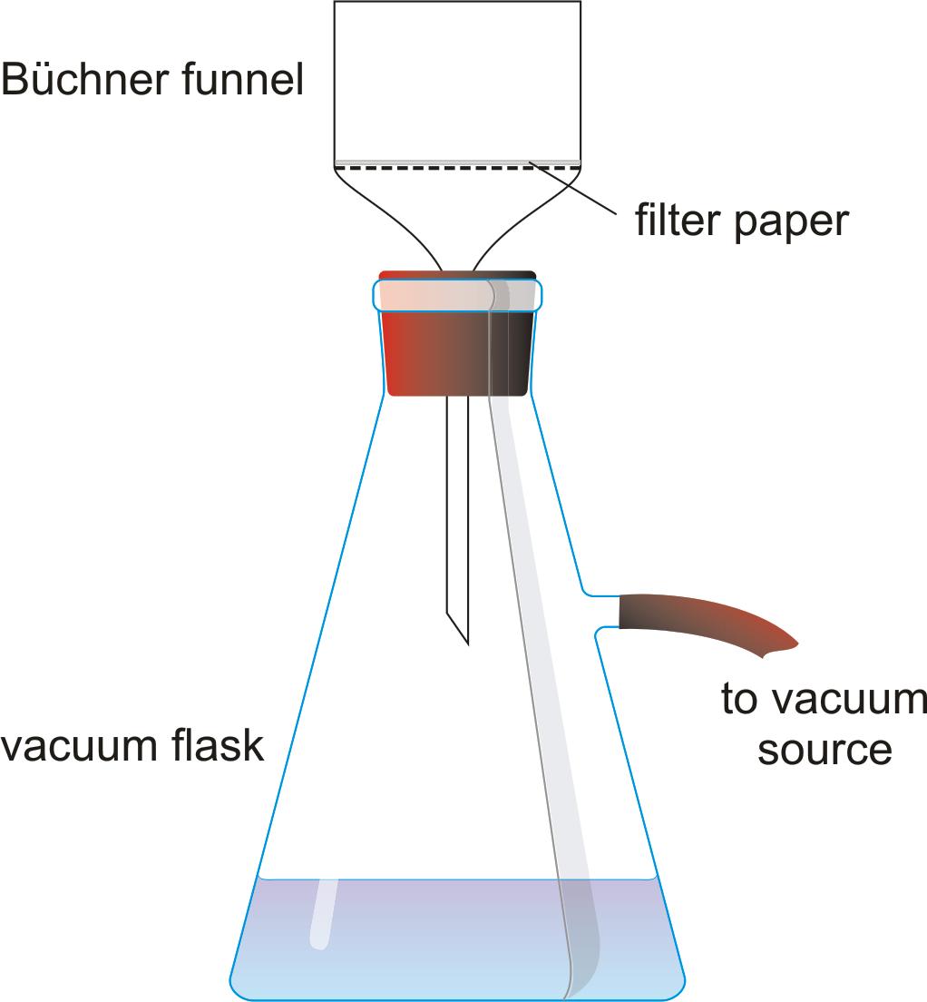
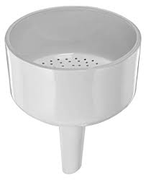
Vacuum filtration apparatus Buchner funnel

Slide 13
Step 4. Recrystallize the aspirin: to purify the aspirin crystals
Transfer the crystals from the filter paper(s) to a 100-mL beaker. Add 10 mL ethanol. Warm the mixture in a 60°C water bath (Caution: No flame—use a hot plate or a hot water bath). Pour 50 mL of 60°C water into the solution and heat the solution to dissolve the solid, do not boil
Cover the beaker with a watch glass, remove it from the heat, and set it aside to cool slowly to room temperature. Then set the beaker in an ice bath. Beautiful needlelike crystals (بلورات تشبه الإبرة) of acetylsalicylic acid form.
Step 5. filteration. Vacuum filter the crystals on filter paper
Wash the crystals with two 10-mL volumes of ice water. Place the filter paper and aspirin sample on a watch glass and allow them to air-dry.
Step 6. Correct for residual solubility.
The solubility of acetylsalicylic acid is ~0.25 g per 100 mL of water. Correcting for this inherent loss of product due to the wash water. Weigh the aspirin crystals, this is the Experimental yield of aspirin. Calculate the percent yield.
% percent yield = (theoretical yield (g)/ actual yield (g) )x100

Slide 14
B. Melting Point (m.p) of the Aspirin Sample
The m.p of the aspirin sample can be determined with either a commercial
m.p apparatus or with the apparatus shown in next Figure.
Step 1. Prepare the sample. Fill a capillary m.p tube to a depth of 1 cm with the recrystallized aspirin. Attach the tube to a 360°C thermometer with a rubber band. As the m.p for aspirin is greater than 100°C, a cooking oil must be used for the heating bath.
Step 2. Determine the melting point.
Gently heat the oil bath at a rate of ~5°C / minute until the aspirin melts. (Caution: The oil bath is at a temperature greater than 100°C—do not touch!). Cool the bath and aspirin to just below this approximate m.p until the aspirin in the tube solidifies; at a slower ~1°C /minute rate, heat again until it melts; this is the m.p of your aspirin.

Slide 16
Step 3. A purity check of the sample (فحص نقاء العينة).
If the m.p of your prepared aspirin sample is less than 130°C, repeat recrystallize the sample for the purpose of increasing its purity.
Step 4. Repeat the m.p measurement.
Cool the bath and aspirin to just below the m.p until the aspirin in the tube solidifies; at a 1°C per minute rate; heat again until it melts.

Slide 17
C. Aspirin Analysis: % Acetylsalicylic acid in the Aspirin tablet
Step 1. Prepare the Aspirin Sample for Analysis.
Crush commercial aspirin tablet (500 mg) and transfer it to clean 250-mL Erlenmeyer flask. Add 10 mL of 95% ethanol, then, 50 mL of deionized water, and swirl to dissolve the aspirin. Add 2 drops of phenolphthalein indicator.
Step 2. titrate the sample
Rinse the clean burette and fill it with a standardized 0.1 M NaOH solution. Record the exact molarity of standard NaOH solution on the report sheet.
Slowly add the NaOH solution from the 50.00 mL burette to the aspirin sample until the endpoint is reached (faint pink color). The color should persist for 30 seconds. Read and record the final volume of NaOH in the burette.
Repeat the titration. Three trials are to be completed in the analysis of the aspirin.

Slide 18
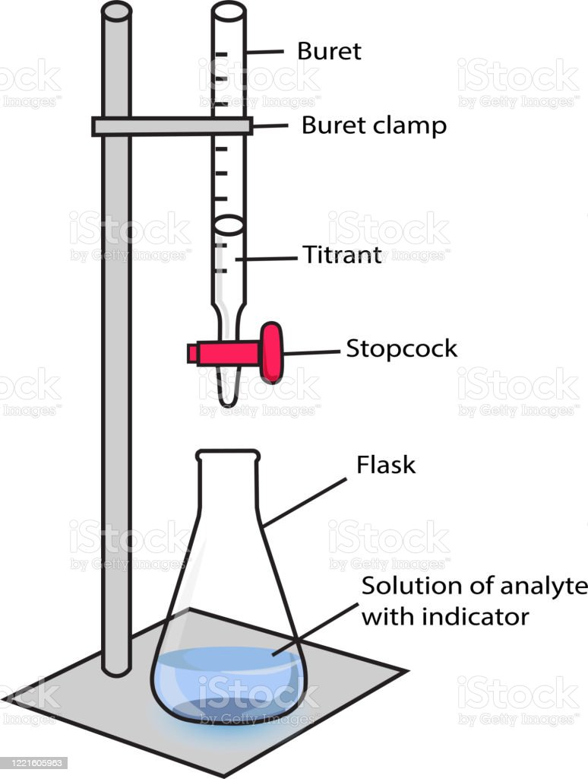
Apparatus for acid/base titration. The titrant in the buret is a standard solution of NaOH, while in the Erlenmeyer flask is the solution of aspirin sample with phenolphthalein indicator

Slide 19
Step 3. chemical stoichiometry
Calculate the mass of acetylsalicylic acid (g) for the titrimetric analysis.
Calculate the percent purity of aspirin sample (%)
Calculate the average percent purity of aspirin sample (%)
CLEANUP: Discard the NaOH titrant into a properly labeled bottle; rinse the buret with several 5-mL volumes of tap water, followed by two 5-mL volumes of deionized water.
Caution: NaOH is corrosive. Handle with care. In case of contact with skin, rinse the area with large amounts of water and notify your instructor. Wear goggles at all times in the chemistry laboratory.

Slide 20
Experiment 8. Prelaboratory Assignment. Aspirin Synthesis and Analysis
1.*** Experimental Procedure, Part A.1. In the experiment, 2.00 g of salicylic acid (molar mass = 138.1 g/mol) reacts with an excess amount of acetic anhydride
Calculate the theoretical yield of acetylsalicylic acid (molar mass = 180.2 g/mol) for this synthesis.
b. After completing the Experimental Procedure, a mass of 1.78 g of acetylsalicylic acid was recovered. What is the experimental yield for its synthesis? Express the yield with the correct number of significant figures.
2. Experimental Procedure, Part A.5. Recrystallizing the aspirin removes some (or all) of the impurities in the sample. Explain how the recrystallization process performs this function.
3. Experimental Procedure, Part B.3. The melting point of the prepared aspirin in this experiment will most likely be less than (but not greater than) that of pure aspirin. Explain. See Experiment 14.
4. Identify the five cautions cited in the Experimental Procedure for this experiment.

Slide 21
5***. A 0.421-g sample of aspirin prepared in the laboratory is dissolved in 95% ethanol, diluted with water, and titrated to the phenolphthalein endpoint with 17.3 mL of 0.114 M NaOH.
How many moles of acetylsalicylic acid (molar mass 180.2 g/mol) are present in the sample?
b. Calculate the percent purity of acetylsalicylic acid in the aspirin sample.

Slide 23
Post Laboratory Questions
Part A.1. According to LeChâtelier’s principle, explain why it is necessary to add the conc H₂SO₄ during the preparation of the acetylsalicylic acid. Also see equation 19.1.
2. Part A.1. Anhydride means “without water.” Suppose 1 M H₂SO₄ were substituted for the conc H₂SO₄. Would the yield of acetylsalicylic acid be increased, decreased, or unaffected by the substitution? Explain.
3.*** Part A.2. The acetic anhydride has been in the stockroom for several years and was not tightly sealed. As a result of the storage, will the yield of acetylsalicylic acid be reported as too high, too low, or unaffected? Explain.
4.*** Part A.2. All washings of the acetylsalicylic acid are with deionized ice water. What is the purpose of washing the acetylsalicylic acid with ice water rather than room temperature water?
5. Part A.4. Some of the aspirin passed through the filter into the filtrate. How does the aspirin in the filtrate differ from that collected on the filter paper?
6. *** Part A.5. The product crystals are dissolved in a minimum volume of ethanol. Is acetylsalicylic acid more soluble in ethanol or water? Explain.

Slide 24
7. Part B.2. Would the product isolated after Part A.4 have a higher or lower melting point than that isolated afte Part A.6? Explain.
8. *** Part C.2. The molar concentration of the NaOH solution is recorded as being 0.1 M instead of the actual molar concentration of 0.151 M. If the recorded concentration is used to calculate the purity of the aspirin sample, will the percent purity be reported too high or too low? Explain.
9. Give one reasonable explanation for why a student might achieve less than 100% yield. (Assume calculations are correct.)
10. A student found that his titration had taken 10.00 mL of 0.1002 M NaOH to titrate 0.132 g of aspirin. Calculate his percent purity. Give a possible explanation of what might have affected his percent purity
11. Give one possible explanation for a student who obtains over 100% yield. (Assume calculations are correct.

