Slide 1
Pneumonias
Associate Professor of Chest diseases
Dr.Samah M. Shehata

Slide 2
Case no. 1
35 y Old Male
Hx of fever, chest pain and productive cough since one week..
RA O2 sat 93
RR 30/M
HR 120/M
Temp 39 c
Bp 110/75
Lung sounds reveal a dullness in right side , and bronchial breath sounds

Slide 3
Case no. 2
68 y old Male DM , HPT,IHD
Hx of productive cough
Fever since 3days
Fully consc. RA O2 sat 95
RR 28 /m ,HR 110/m
Temp 38.5 c , Bp 100/60
Lung sounds reveal a dullness in right base, and bronchial breath sounds with fine crepitations in right posterior lung base. He is not wheezing. The rest of his exam is normal.

Slide 4
Pneumonias – Classification…..
CAP
Community Acquired
HAP
VAP
Ventilator Acquired
Hospital Acquired

Slide 5
Types of Pneumonia
Community-Acquired (CAP)
Hospital-Acquired Pneumonia (HAP)
Pneumonia that develops after 2-3 days of hospitalization
Includes:
Ventilator-Associated Pneumonia (VAP)

Slide 6
Community Acquired Pneumonia (CAP)
An acute infection of the pulmonary parenchyma that is associated with some symptoms of acute infection, accompanied by the presence of an acute infiltrate on a chest radiograph, OR auscultatory findings consistent with pneumonia, in a patient not hospitalized or residing in a long term care facility for > 14 days before onset of symptoms.

Slide 7
Community Acquired Pneumonia (CAP)
Epidemiology
4-5 million cases annually
~500,000 hospitalizations – 20% require admission
~45,000 deaths
Probably highest incidence in <5 and >65 yrs
Fewest cases in 18-24 yr group
Mortality disproportionately high in >65 yrs

Slide 8
CAP – Pathogenesis
Inhalation
Aspiration
Hematogenous

Slide 9
CAP – The Pathogens Involved

Slide 10
Diagnosis of pneumonia

Slide 11
Fever/chills | 85%
Dyspnea | 70%
Purulent sputum | 50%
Chest pain | 40%
Hx:
P/E: most useful in predicting severity. Physical exam may reveal fever, tachypnea, tachycardia.
Lung exam; increased tactile fremitus, dullness to percussion, increased breath sounds, presence of crackles
CXR is gold standard - may be normal in up to 7% on admission; assume pneumonia present if convincing hx and focal P/E

Slide 12
CAP – The Two Types of Presentations
Classical
Atypical
Sudden onset of CAP
High fever, shaking chills
Pleuritic chest pain, SOB
Productive cough
Rusty sputum, blood tinge
Poor general condition
High mortality up to 20% in patients with bacteremia
S.pneumoniae causative
Gradual & insidious onset
Low grade fever
Dry cough .
Confusion
Diarrhea. Abdominal pain
Low mortality 1-2%; except in cases of Legionellosis
Mycoplasma, Chlamydiae,Legionella, Ricketessiae, Viruses are causative

Slide 13
Streptococcus pneumonia (Pneumococcus)
Most common cause of CAP
About 2/3 of CAP are due to S.pneumoniae
These are gram positive diplococci
Typical symptoms (e.g. malaise, shaking chills fever, rusty sputum, pleuritic chest pain, cough)
Lobar infiltrate on CXR
May be Immuno suppressed host
25% will have bacteremia – serious effects
Notes:
Predisposing factors: anorexia, ETOH, HIV, sickle cell disease, splenectomy, hematologic diseases

Slide 14
a patient with Legionella pneumonia may complain predominantly of diarrhea, fever, headache, confusion, and myalgia
For Mycoplasma pneumoniae infection, extrapulmonary manifestations such as myringitis, encephalitis, uveitis, iritis, and myocarditis may be present.
However, only rarely does the clinical history clearly suggest a specific etiologic diagnosis

Slide 15
S. aereus CAP – Dangerous
This CAP is not common; Multi lobar Involvement
Post Influenza complication.
Compromised host, Co-morbidities, Extreme of age
CA MRSA – A Problem; CA MSSA also occurs
Empyema and Necrosis of lung with cavitations
Multiple Pyemic abscesses, Septic Arthritis
Hypoxemia, Hypoventilation, Hypotension common
Vancomycin, Linezolid are the drugs for MRSA

Slide 16
CAP – Laboratory Tests
CBC with Differential
BUN and Creatinine
Liver enzymes
Serum electrolytes
Oxygen saturation
ABG
Gram stain of sputum
Culture of sputum
blood cultures
Septic work up

Slide 17
Chest X-ray Diagnosis ,prognosis , pathogens…….
RUL
LUL
Lingula
RUL
LUL
RML
Lingula
LLL
RML
RLL
RLL
LLL

Slide 18
Chest X-ray – Pneumonia

Slide 19
Chest X-ray – Pneumonia

Slide 20
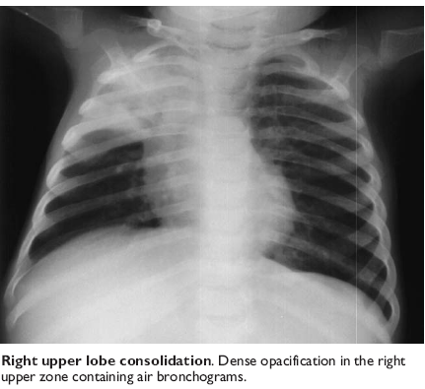
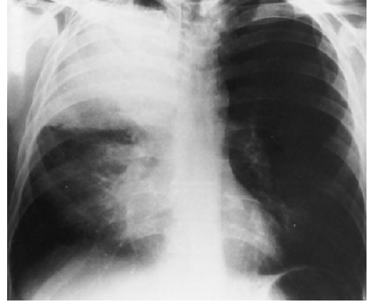

Slide 21
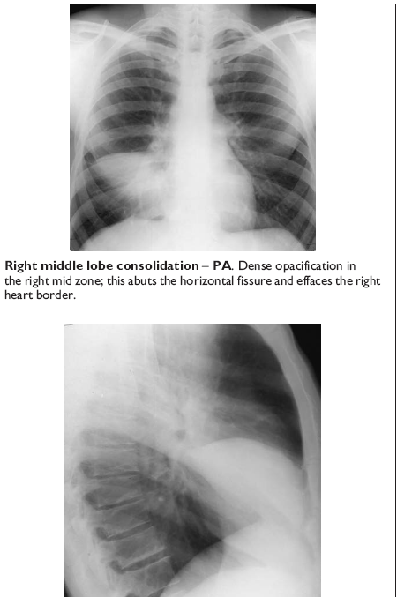
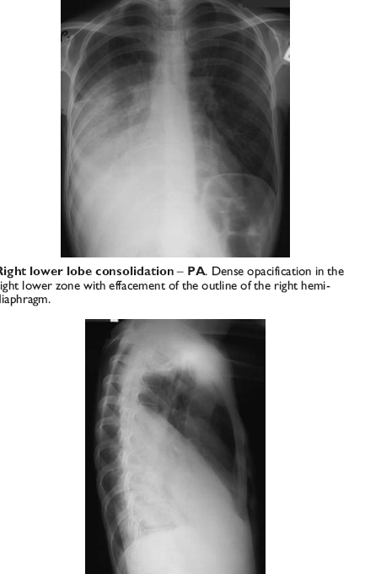

Slide 22
Rare Types of Pneumonia
Legionella Pneumonia
Pscittacosis
Diffuse - Bil

Slide 23
Infiltrate Patterns and Pathogens
CXR Pattern | Possible Pathogens
Lobar | S.pneumo, Kleb, H. influ, Gram Neg
Patchy | Atypicals, Viral, Legionella
Interstitial | Viral, PCP, Legionella
Cavitatory | Anerobes, Kleb, TB, S.aureus, Fungi
Large effusion | Staph, Anaerobes, Klebsiella

Slide 25
CAP – Risk Factors for Hospitalization
Older, Unemployed, No social support
Asthma, COPD; Steroid or bronchodilator use
Chronic diseases, Diabetes, CHF, Neoplasia
Amount of smoking.

Slide 26
CAP – Risk Factors for Mortality….
Age > 65
Bacteremia (for S. pneumoniae)
S. aureus, MRSA , Pseudomonas
Extent of radiographic changes
Degree of immuno-suppression
Amount of alcohol consumption

Slide 27
CAP – Complications…
Hypotension and septic shock
3-5% Pleural effusion; Clear fluid + pus cells
1% Empyema thoracis pus in the pleural space
Lung abscess – destruction of lung .
Septicemia – Brain abscess, Liver Abscess
Multiple Pyaemic Abscesses

Slide 28
CAP – Management Guidelines
Proper diagnosis :Hx, P/E, CXR
Decision to hospitalize based on prognostic criteria – PSI , CRB65, CURB 65,.. scores
Pathogen directed antimicrobial therapy whenever possible
Prompt initiation of Antibiotic therapy

Slide 29
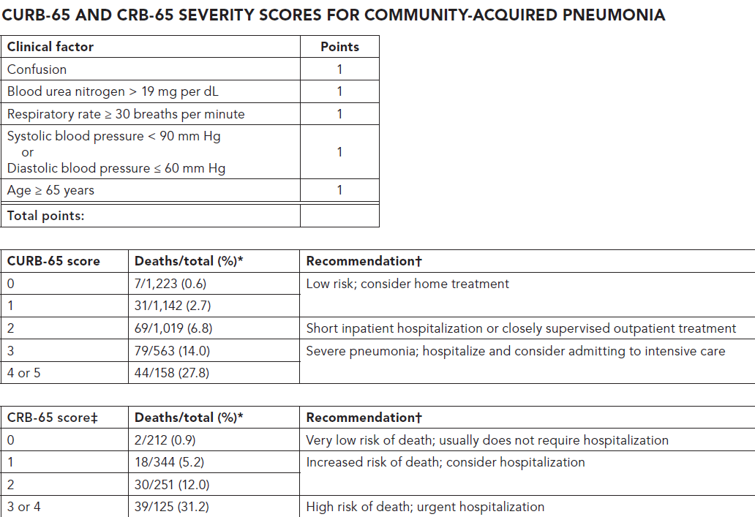

Slide 30
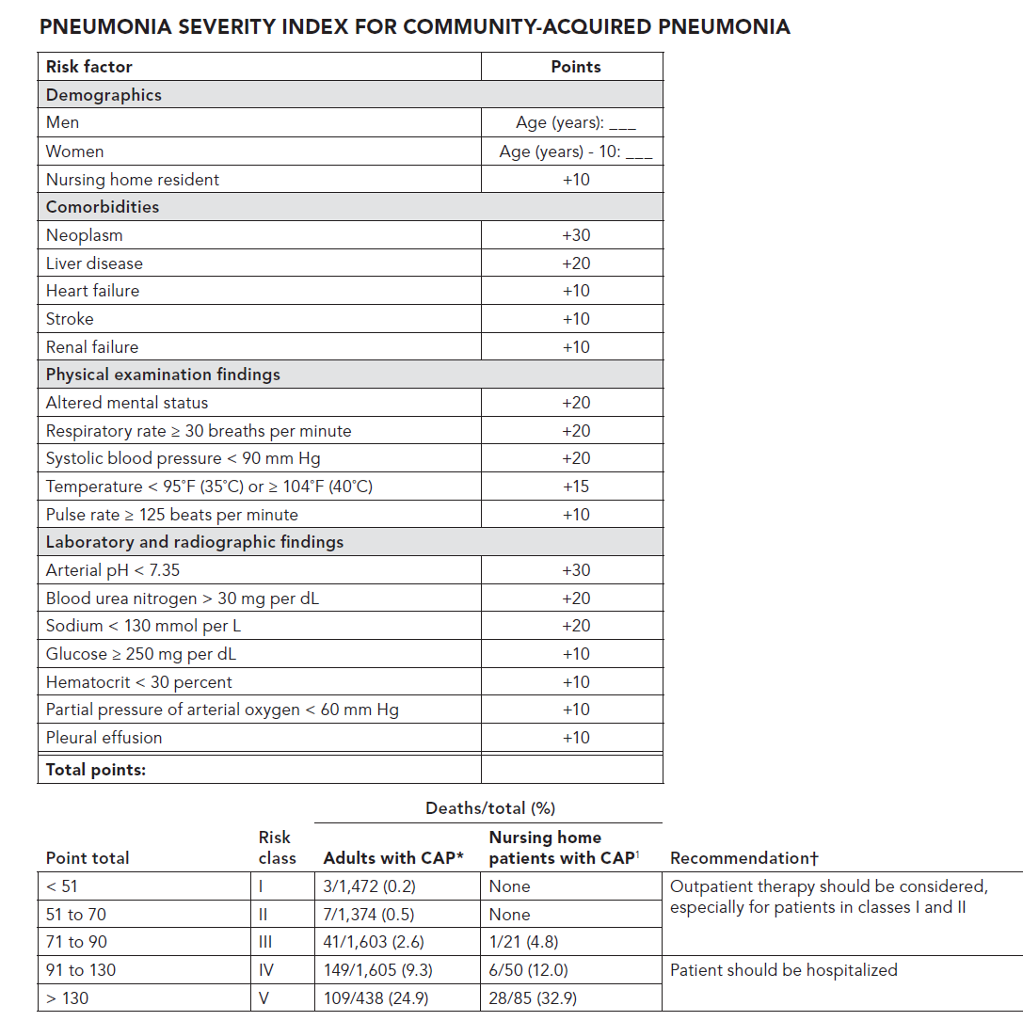

Slide 31
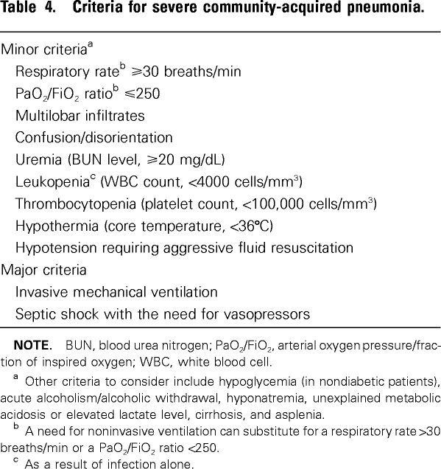
ICU admission = one major or 3 minor

Slide 32
CAP – Evaluation of a Patient
Hx. P/E, CXR
No Infiltrate Nor clinical signs of CAP
Alternate Dx.
Infiltrate or Clinical evidence of CAP
Evaluate need for Admission
Medical Ward
Out Patient
ICU Adm.
PSI & CURB 65

Slide 34
Outpatient treatment
CURB-65 (0 or 1) who is Previously healthy no comorbidity and no risk factors for drug-resistant
Amoxicillin OR amoxicillin + clavulanic acid OR
A macrolide {azithromycin (500 mg once daily), clarithromycin (500 mg twice daily), or erythromycin} (strong recommendation; level I evidence)

Slide 35
In-patient ward treatment….
CURB-65 (0 or 1) plus any of the followings: {Presence of comorbidities, such as chronic heart, lung, liver, or renal disease; diabetes mellitus; alcoholism; malignancies; asplenia; use of immunosuppressing drugs; use of antimicrobials within the previous 3 months…….}.
2. CURB-65 (2)
A respiratory fluoroquinolone (moxifloxacin, gemifloxacin, or levofloxacin [750 mg once daily]) (strong recommendation; level I evidence)
OR
A B-lactam plus a macrolide (strong recommendation; level I evidence)

Slide 36
B-lactam antibiotics (IV doses) (High-dose amoxicillin [e.g., 1 g 3 times daily] OR amoxicillin-clavulanate [1.2 g (2-3) times daily] is preferred; alternatives include ceftriaxone (1-2 g once daily) and cefuroxime [1.5 g (2-3) times daily];

Slide 37
Inpatient, ICU treatment ……
A b-lactam (cefotaxime, ceftriaxone, or ampicillin-sulbactam) plus either azithromycin (level II evidence) or a fluoroquinolone (level I evidence) (strong recommendation) (For penicillin-allergic patients, a respiratory fluoroquinolone and aztreonam are recommended.)
or
If MRSA is suspected, vancomycin (15 mg/kg IV every 12 hours, in seriously ill patients, a loading dose of 25 to 30 mg/kg may be given, OR linezolide
For Pseudomonas infection, use antipseudomonal b-lactam (piperacillin-tazobactam, cefepime,imipenem, or meropenem) PLUS either ciprofloxacin or levofloxacin (750-mg dose) or aminoglycosides.

Slide 38
Survival (%)
Each hour of delay carries 7.6% reduction in survival
Delay in treatment (hours) from hypotension onset

Slide 39
Early treatment (within 48 h of the onset of symptoms) with oseltamivir or zanamivir is recommended for influenza A and B . (Strong recommendation; level I evidence.)
Use of oseltamivir and zanamivir is not recommended for patients with uncomplicated influenza with symptoms more than 48 h (level I evidence), but these drugs may be used to reduce viral shedding in hospitalized patients or for influenza pneumonia. (Moderate recommendation; level III evidence.)

Slide 40
Patients should demonstrate some improvement in clinical parameters by 72 hours, although fever may persist with lobar pneumonia.
Cough from pneumococcal pneumonia may not clear for a week.
Abnormal chest radiograph findings usually clear within four weeks but may persist for7- 12 weeks in older individuals and those with underlying pulmonary disease

Slide 41
Switch to Oral Therapy
Four criteria
Improvement in cough, dyspnea & clinical signs
Afebrile on two occasions 8 h apart
WBC decreasing towards normal
Functioning GI tract with adequate oral intake
If overall clinical picture is otherwise favorable, hemodynamically stable; can switch to oral therapy while still febrile.

Slide 42
Duration of Therapy
Afebrile for at least 48 to 72 h
No > 1 CAP-associated sign of clinical instability
For patients with low or moderate severity and uncomplicated pneumonia, 7 days of appropriate antibiotics is recommended.
For those with high severity microbiologically-undefined pneumonia, 7–10 days treatment is proposed.
14 or 21 days; if S. aureus or Gram-negative enteric bacilli pneumonia is suspected or confirmed.

Slide 43
Risk factors for treatment failure include :
Aspiration pneumonia .
Neoplasia .
Neurologic disease.
Multilobar pneumonia .
Infection with MRSA, Legionella, or gram-negative bacilli .
High Pneumonia Severity Index (PSI) (>90) .
Antibiotic-resistant pathogen .
Cavitation, pleural effusion .
Liver disease .
Leukopenia .

Slide 44
Patient can be discharged home if all the following criteria:
Curb score 0-1 , PSI score Class I
Able to eat and drink
Pulse ≤100 beats per min
Respiratory rate ≤30 per min
Normal Systolic blood pressure according to the age and BP baseline .
Oxygen saturation ≥94 percent or if the resident had chronic obstructive pulmonary disease (COPD) ≥90 percent.
Social support and home care .

Slide 45
CAP – Management summery……
CURB-65 scoring and Classification of cases
Early hospitalization,when indicated
Arterial oxygenation assessment in the first 24 h
Blood culture collection in the first 24 h prior to Abx.
Early antibiotic administration within 4-6 hours
Empiric antibiotic as per guidelines
Change Abx. as per pathogen & sensitivity pattern
Pneumococcal & Influenza vaccination; Smoking

Slide 46
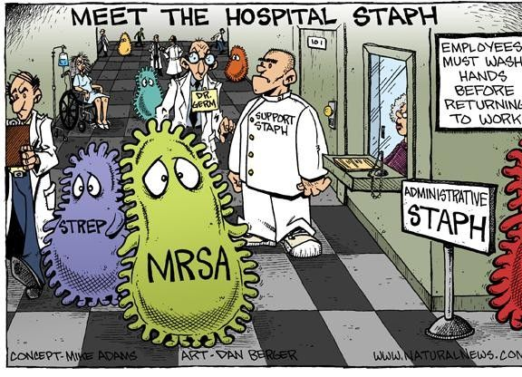
HAP & VAP

Slide 47
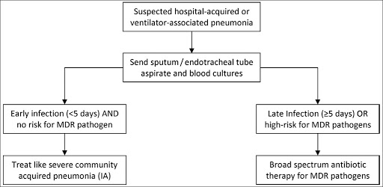

Slide 48
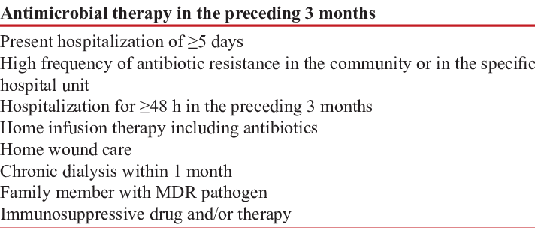

Slide 49
Common pathogens in early onset HAP,VAP

Slide 51
