Slide 1
GASTROINTESTINEAL SYSTEM
THE PERITONEUM
Dr. Aiman Qais Afar
Surgical Anatomist
College of Medicine /University of Mutah

Slide 2
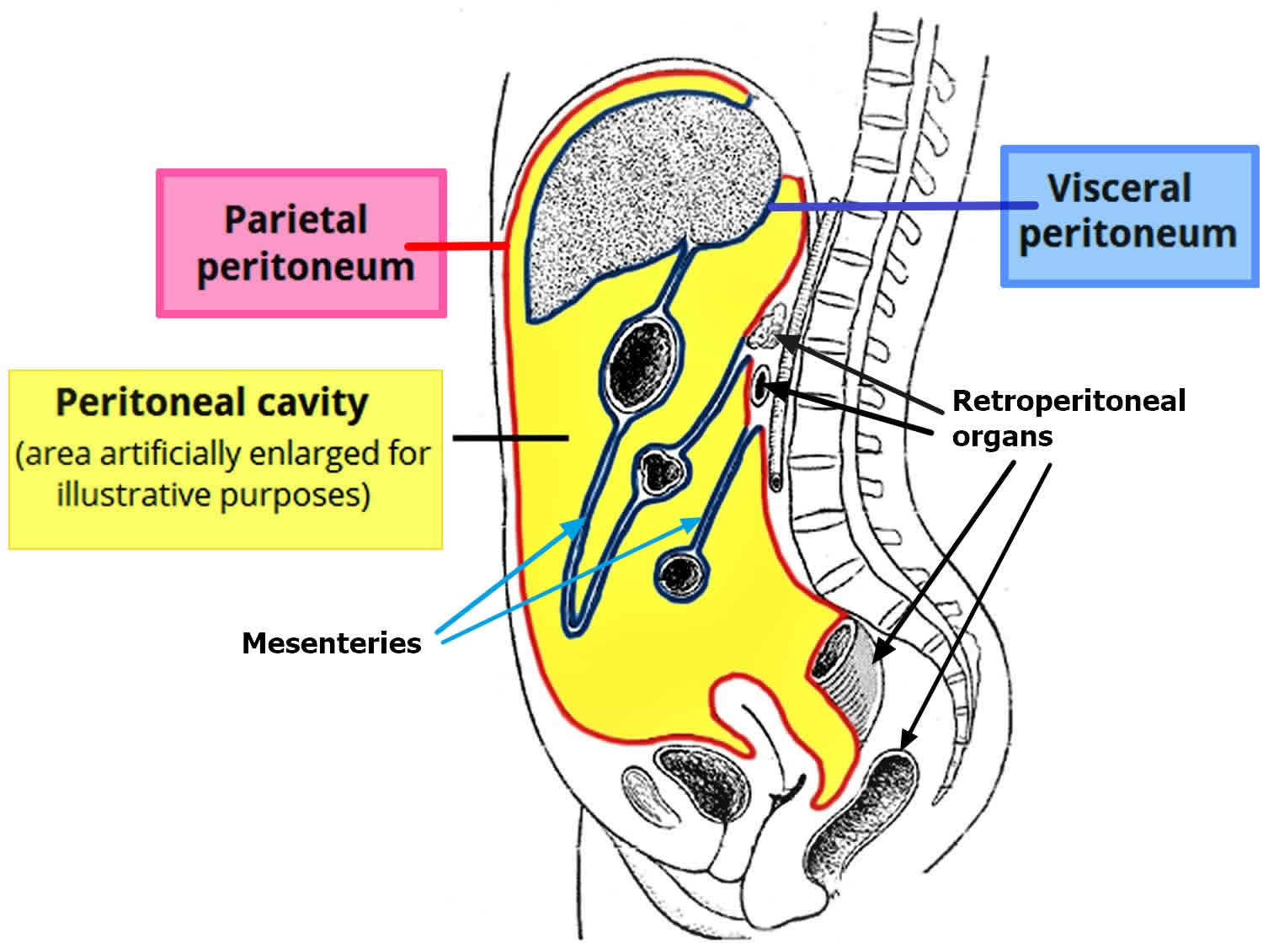
PERITONEUM
General Arrangement
The peritoneum is a thin serous membrane that lines the walls of the abdominal and pelvic cavities and clothes the viscera .
The peritoneum can be regarded as a balloon against which organs are pressed from outside
The parietal peritoneum lines the walls of the abdominal and pelvic cavities
The visceral peritoneum covers the organs.

Slide 3
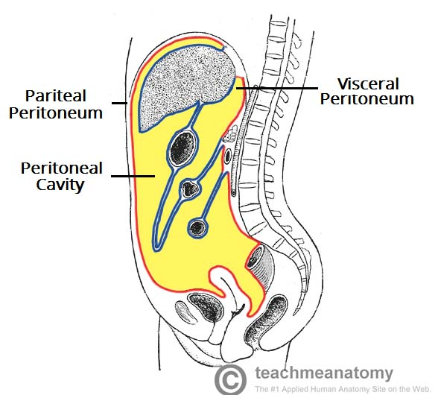
PERITONEUM
General Arrangement
The potential space between the parietal and visceral layers, (which is in effect the inside space of the balloon), is called the peritoneal cavity.
In males, this is a closed cavity,
In females, there is communication with the exterior through the uterine tubes, the uterus, and the vagina

Slide 4
PERITONEUM
Between the parietal peritoneum and the fascial lining of the abdominal and pelvic walls is a layer of connective tissue called the extra peritoneal tissue
In the area of the kidneys this tissue contains a large amount of fat, which supports the kidneys

Slide 5
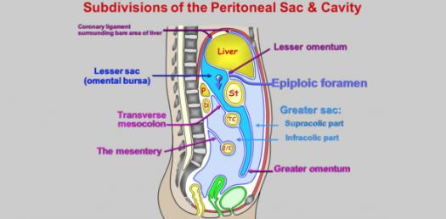
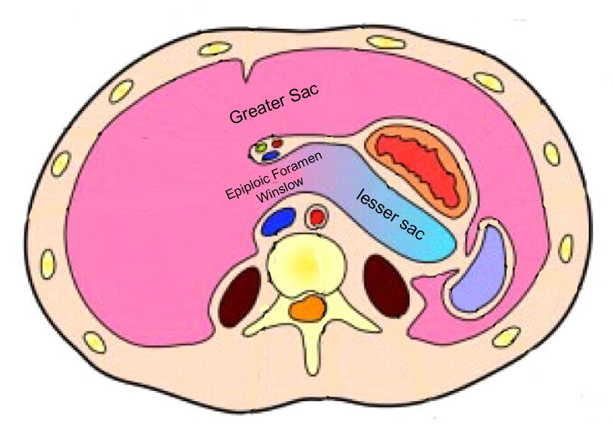
PERITONEUM
The peritoneal cavity is the largest cavity in the body and is divided into two parts:
The greater sac is the main compartment and extends from the diaphragm down into the pelvis.
The lesser sac is smaller and lies behind the stomach.

Slide 6
PERITONEUM
General Arrangement
The greater and lesser sacs are in free communication with one another through an oval window called the opening of the lesser sac, or the epiploic foramen.
The peritoneum secretes a small amount of serous fluid, the peritoneal fluid, which lubricates the surfaces of the peritoneum and allows free movement between the viscera.

Slide 7
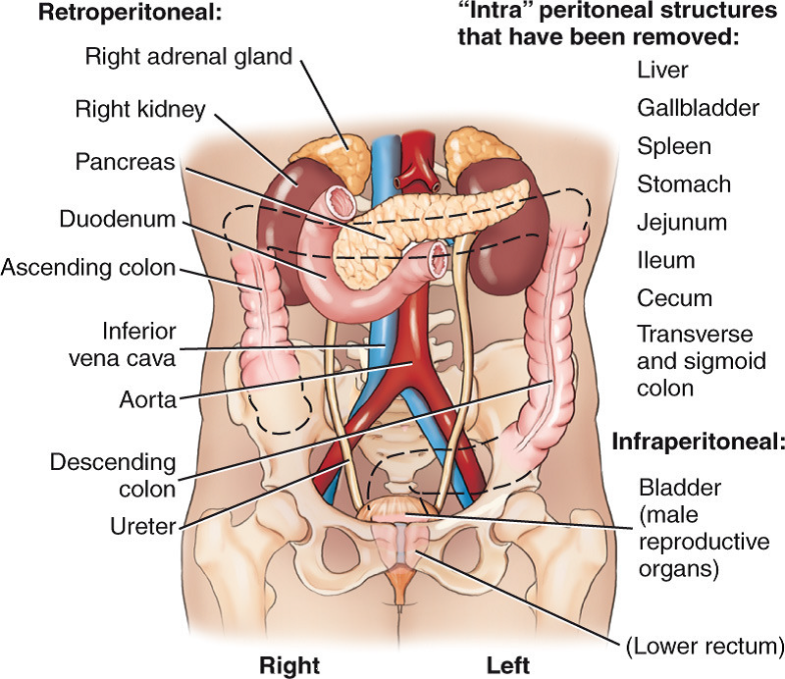
Intraperitoneal and Retroperitoneal Relationships
Intraperitoneal organ when it is almost totally covered with visceral peritoneum like stomach, spleen, jejunum, ileum.
Retroperitoneal organ lie behind the peritoneum and are only partially covered with visceral peritoneum like pancreas ,ascending and descending colon

Slide 8
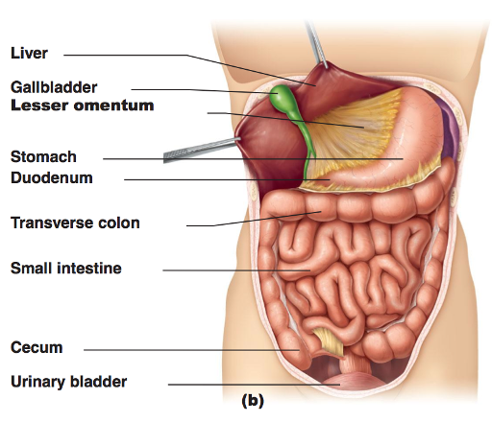
Intraperitoneal and Retroperitoneal Relationships
No organ, however, is actually within the peritoneal cavity.
An intraperitoneal organ, such as the stomach, appears to be surrounded by the peritoneal cavity, but it is covered with visceral peritoneum and is attached to other organs by Omenta.

Slide 9
Peritoneal Ligaments
Peritoneal ligaments are two-layered folds of peritoneum
That connect an organ with another organ or to the abdominal wall.
The liver, is connected to the diaphragm by the falciform
ligament, the coronary ligament, and the right and left triangular ligaments

Slide 10
Peritoneal Ligaments
Liver to the stomach by the hepatogastric ligament, the membranous portion of the lesser omentum.
To duodenum by the hepatoduodenal ligament, the thickened free edge of the lesser omentum, which conducts the portal triad: portal vein, hepatic artery, and bile duct

Slide 11
Peritoneal Ligaments
The stomach is connected to the:
Inferior surface of the diaphragm by the gastrophrenic ligament.
Spleen by the gastrosplenic ligament, which reflects to the hilum of the spleen.
Transverse colon by the gastrocolic ligament, the apron-like part of the greater omentum, which descends from the greater curvature, turns under, and then ascends to the transverse colon.

Slide 12
Omenta
An omentum is a double-layered extension or fold of peritoneum that passes from the stomach and proximal part of the duodenum to adjacent organs in the abdominal cavity.

Slide 13
Omenta
The greater omentum
is a prominent, four-layered peritoneal fold that hangs down like an apron from the greater curvature of the stomach and the proximal part of the duodenum. After descending, it folds back and attaches to the anterior surface of the transverse colon and its mesentery.

Slide 14
Omenta
The greater omentum
One important function of the greater omentum is to attempt to limit the spread of intraperitoneal infections.

Slide 15
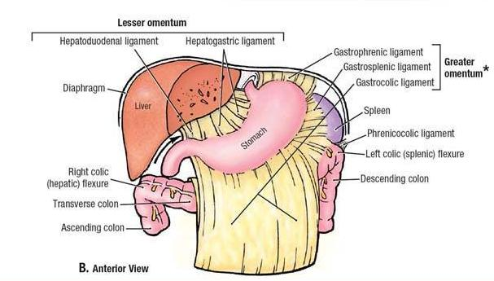
Omenta
The lesser omentum
Is a much smaller, double-layered peritoneal fold that connects the lesser curvature of the stomach and the proximal part of the duodenum to the liver
It also connects the stomach to a triad of structures that run between the duodenum and liver in the free edge of the lesser omentum

Slide 16
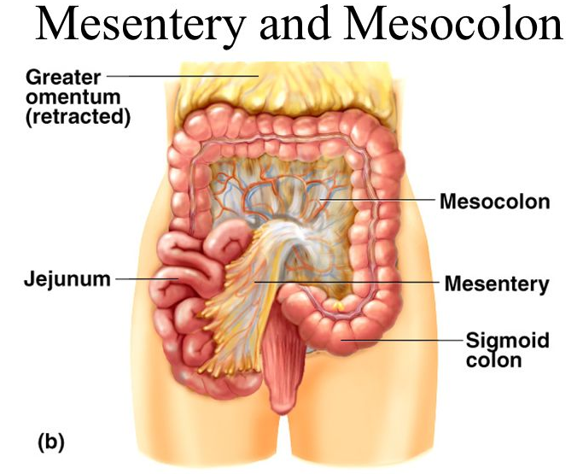
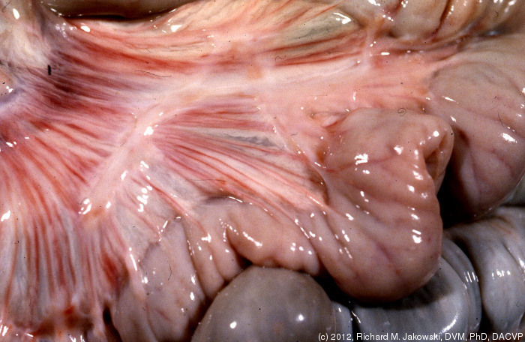
Mesenteries
A mesentery is a double layer of peritoneum that occurs as a result of the invagination of the peritoneum by an organ and constitutes a continuity of the visceral and parietal peritoneum
It provides a means for neurovascular communications between the organ and the body wall
A mesentery connects an intraperitoneal organ to the body wall—usually the posterior abdominal wall (e.g., mesentery of the small intestine)

Slide 17
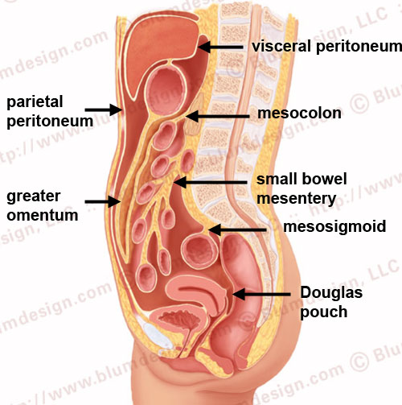
Mesenteries

Slide 18
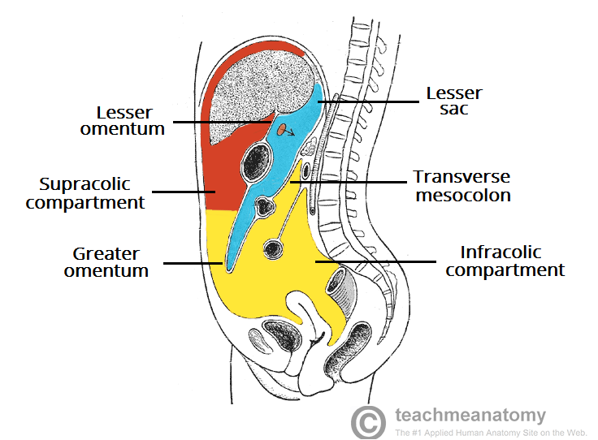
Subdivisions of Peritoneal Cavity
The transverse mesocolon (mesentery of the transverse colon) divides the abdominal cavity into:
A supracolic compartment, containing the stomach, liver, and spleen
An infracolic compartment, containing the small intestine and ascending and descending colon.

Slide 19
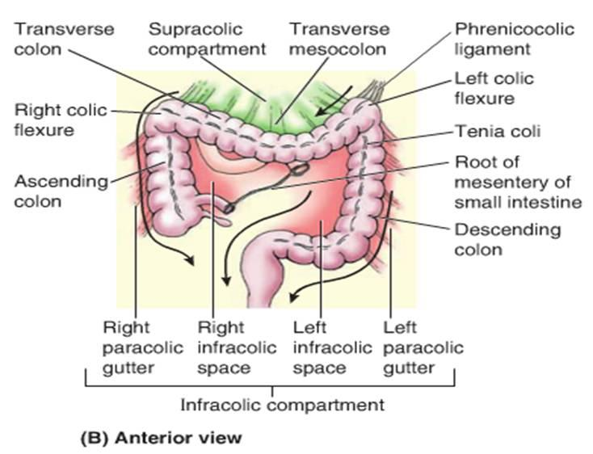
Subdivisions of Peritoneal Cavity
The infracolic compartment lies posterior to the greater omentum and is divided into right and left infracolic spaces by the mesentery of the small intestine..
Free communication occurs between the supracolic and the infracolic compartments through the paracolic gutters

Slide 20
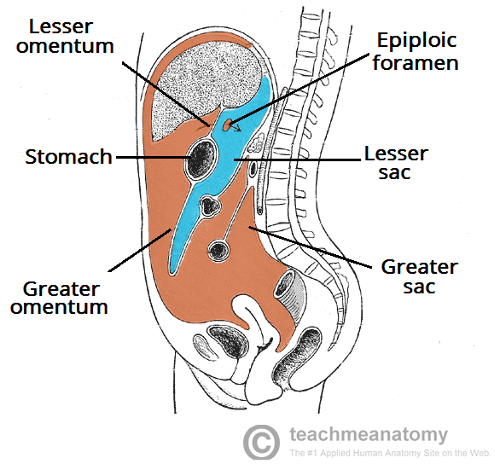
Peritoneal Pouches, Recesses, Spaces, and Gutters
Lesser Sac
The lesser sac lies behind the stomach and the lesser omentum.
It extends upward as far as the diaphragm and downward between the layers of the greater omentum.

Slide 21
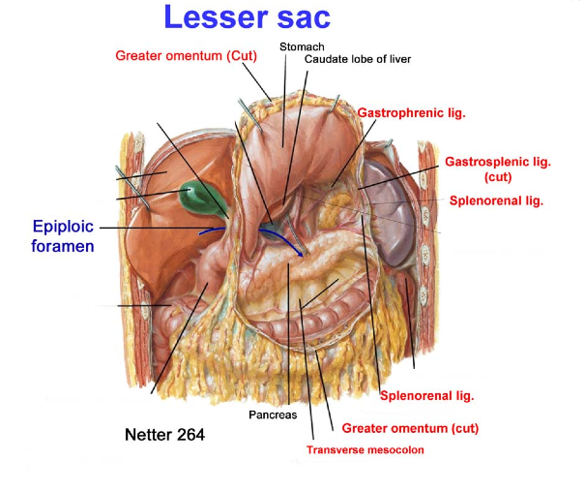
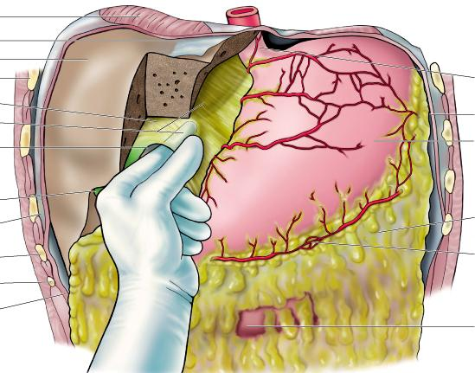
Peritoneal Pouches, Recesses, Spaces, and Gutters
Lesser Sac
The left margin of the sac is formed by the spleen and the gastrosplenic omentum and splenicorenal ligament.
The right margin opens into the greater sac (the main part of the peritoneal cavity) through the opening of the lesser sac, or epiploic foramen.

Slide 22
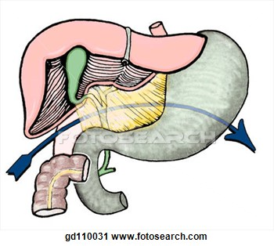
Peritoneal Pouches, Recesses, Spaces, and Gutters
Lesser Sac
The opening into the lesser sac (Epiploic Foramen) has the following boundaries:
Anteriorly: Free border of the lesser omentum, the bile duct, the hepatic artery, and the portal vein.
Posteriorly: Inferior vena cava
Superiorly: Caudate process of the caudate lobe of the liver
Inferiorly: First part of the duodenum

Slide 23
Peritoneal Pouches, Recesses, Spaces, and Gutters
Subphrenic Spaces
The right and left anterior subphrenic spaces lie between the diaphragm and the liver, on each side of the falciform ligament .
The right posterior subphrenic space lies between the right lobe of the liver, the right kidney, and the right colic flexure

Slide 24
Subphrenic Spaces

Slide 25
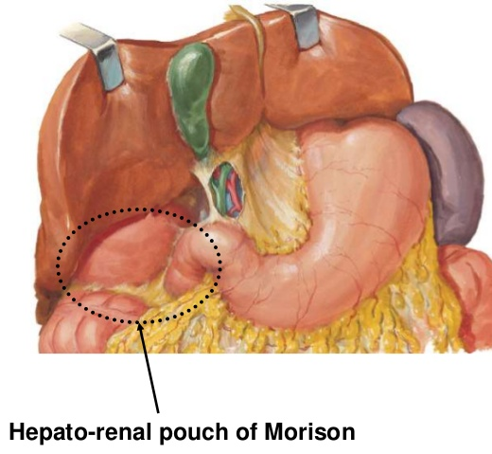
Subphrenic Spaces
The hepatorenal recess (hepatorenal pouch; Morison pouch) is the posterosuperior extension of the subhepatic space, lying between the right part of the visceral surface of the liver and the right kidney and suprarenal gland.

Slide 26
The hepatorenal recess is a gravity-dependent part of the peritoneal cavity in the supine position; fluid draining from the omental bursa flows into this recess
The hepatorenal recess communicates anteriorly with the right subphrenic recess
Recall that normally all recesses of the peritoneal cavity are potential spaces only, containing just enough peritoneal fluid to lubricate the adjacent peritoneal membranes

Slide 27
Peritoneal Pouches, Recesses, Spaces, and Gutters
Paracolic Gutters
The paracolic gutters lie on the lateral and medial sides of the ascending and descending colons, respectively .
The subphrenic spaces and the paracolic gutters are clinically important because they may be sites for the collection and movement of infected peritoneal fluid.

Slide 28
Peritonitis and Ascites ???
Fluid in Omental Bursa ???
Abdominal Paracentesis ???

Slide 29
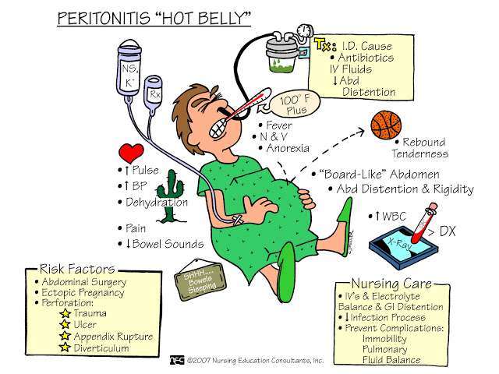

Slide 30
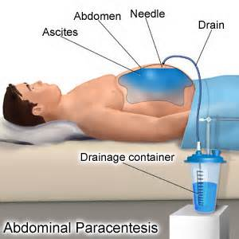
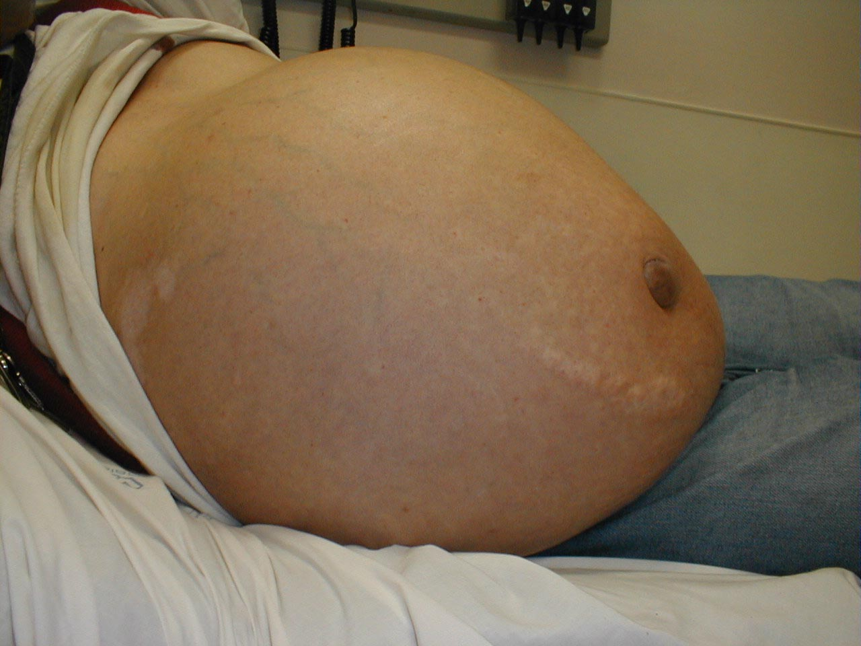
Peritonitis and Ascites ???
Abdominal Paracentesis ???

Slide 31
Nerve Supply of the Peritoneum
The parietal peritoneum is sensitive to pain, temperature,
touch, and pressure.
The parietal peritoneum lining the anterior abdominal wall is supplied by the lower six thoracic and first lumbar nerves.
The central part of the diaphragmatic peritoneum is supplied by the phrenic nerves; peripherally, the diaphragmatic peritoneum is supplied by the lower six thoracic nerves
The parietal peritoneum in the pelvis is mainly supplied by the obturator nerve, a branch of the lumbar plexus.

Slide 32
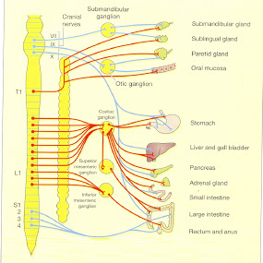
Nerve Supply of the Peritoneum
The visceral peritoneum is sensitive only to stretch and tearing and is not sensitive to touch, pressure, or temperature
It is supplied by autonomic afferent nerves that supply the viscera or are traveling in the mesenteries.
Overdistention of a viscus leads to the sensation of pain.
The mesenteries of the small and large intestines are sensitive to mechanical stretching

Slide 33
Dr. Aiman Q. Afar
Thursday 25 March 2021

