Slide 1
Fungal & Amoebic Meningitis NS1 Module 2019-2020
Dr. Mohammad Odibate

Slide 2
Introduction
Amoeba are sigle celled protozoa.
Most protozoa are free-living and have little or no impact on human health.
They are found throughout the environment, particularly in soil and water.
However, there are three free-living amoeba that have been associated with serious human infections.

Slide 3
Pathogenic free-living amoeba
Three genera have been associated with disease in humans.
These are:
Acanthamoeba spp. and Balamuthia mandrillaris:
Causing Granulomatous Amebic Encephalitis (GAE).
Naegleria fowleri (brain-eating amoeba):
Causing Primary Amebic Meningoencephalitis (PAM)

Slide 4
Pathogenic free living amoebae are
Naegleria fowleri
Acanthamoeba species
Causative parasite of
Causative parasite of
Granulomatous amoebic encephalitis
keratitis
Chronic granulomatous infection of the skin.
Primary amoebic meningo-encephalitis.

Slide 5
Distribution
Acanthamoeba species are found worldwide:
Most commonly in soil, dust, fresh water, marsh, and sea water.
In swimming pools, hot tubs and drinking water systems (e.g., slime layers in pipes and taps)
In heating, ventilating and air conditioning (HVAC) systems and humidifiers.
Balamuthia mandrillaris:
Found in soil.
Naegleria fowleri:
Is a heat-loving (thermophilic).
Commonly found around the world in warm fresh water (e.g., lakes, rivers, hot springs).
In soil.

Slide 6
Transmission
N. fowleri:
Occurs when water containing amebae enters the nose.
Trophozoites penetrate the nasal tissue and migrating to the brain via the olfactory nerves causing PAM.
Acanthamoeba spp:
The trophozoites are the infective forms.
Through eye, the nasal passages, cuts or skin wounds or by being inhaled into the lungs, it can invade the CNS by hematogenous dissemination in individuals with compromised immune systems. .
When enter the eye they can cause severe keratitis in healthy individuals, particularly contact lens users.
Balamuthia mandrillaris:
When dust containing the trophozoites enter the respiratory system or through the skin, it can invade the CNS by hematogenous dissemination causing GAE or disseminated disease, or skin lesions in individuals with compromised immune systems.

Slide 7
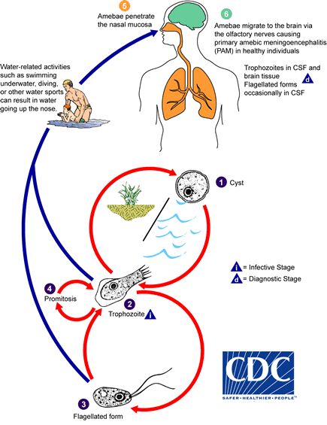
Transmission-
N. fowleri

Slide 8
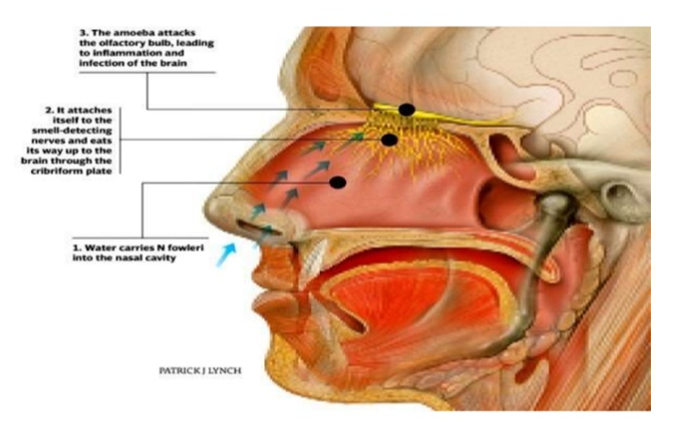
Transmission
N. fowleri

Slide 9
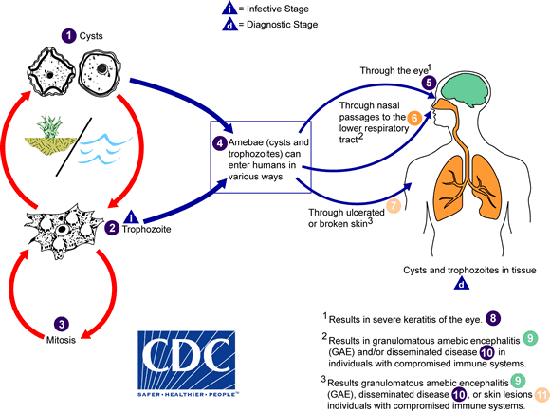
Transmission
Acanthamoeba spp & Balamuthia mandrillaris

Slide 10
Incubation Period and Illness Duration
Naegleria fowleri:
Incubation period: Symptoms start 1-14 days (median 5 days) after exposure.
Duration of illness: Death occurs 1-18 days (median 5 days) after symptoms begin
B. mandrillaris and Acanthamoeba spp:
Incubation period: Weeks to months (or longer).
Duration of illness: Weeks to months

Slide 11
Communicability of Amebic meningitis/encephalitis
Amebic meningitis/encephalitis is not spread from person-to-person (except in the case of transmission through transplantation of organs from an infected donor).

Slide 12
Clinical Illness-(PAM)
Primary Amebic-Meningoencephalitis (PAM)
Clinical Case Definition:
An infection presenting as meningoencephalitis or encephalitis.
The clinical course:
Stage 1 Symptoms: begin within 1 to 14 days post amebic exposure and include severe headache, fever, nausea and vomiting.
Stage 2 Symptoms: include stiff neck, confusion, lack of attention to people and surroundings, loss of balance, seizures, and hallucinations.
After the start of symptoms, death usually occurs within 1 to 18 days (median 5 days) of onset of stage 2 symptoms. Final cause of death is brain swelling and deterioration of tissue.

Slide 13
Laboratory Diagnosis- (PAM)
Head CT scanning or MRI
Lumber puncture for CSF analysis
Culture of CSF
Fluorescent antibodies test
PCR
sensitive diagnostic test
Trophozoite & cyst
The primary diagnostic tool
Help in detection of the numerous trophozoites in brain tissue
Should precede lumber puncture if signs of increased intracranial pressure were found.
1- CSF is purulent ( no bacteria), ↑ neutrophils, RBCs, protein levels & ↓ glucose level.
2- Trophozoite and flagellate form were found in CSF.

Slide 14
Treatment- (PAM)
Medical:
Amphotericin B intrathecally in severe cases +Miconazole (IV injection) + Rifampicin (orally).
Surgical:
Hydrocephalus may necessitate shunting.

Slide 15
Clinical Illness
Granulomatous amebic encephalitis (GAE)
Clinical Case Definition
An infection presenting as meningoencephalitis or encephalitis.
GAE can include general symptoms and signs of encephalitis.
Laboratory Confirmation:
Same as Naegleria

Slide 16
Treatment- (GAE)
Medical:
Ketoconazole and amphotericin B (alone or in combination).
Sulfadiazine may be indicated.
Surgical:
Same as Naegleria.
Severity of PAM and GAE
More than 95% of PAM and GAE cases are fatal.

Slide 17
Control Measures
Naegleria fowleri
Avoid water-related activities in bodies of warm freshwater during periods of high water temperature and low water levels.
Hold the nose shut or use nose clips when taking part in water-related activities.
Balamuthia mandrillaris and Acanthamoeba spp. :
There are no specific prevention and control measures.
Recommend that anyone experiencing symptoms be evaluated by a physician.
They mainly affects those who are immunocompromised.

Slide 18
Fungal meningitis (Cryptococcosis)
It is a fatal fungal disease caused by Cryptococcus neoformans.
General characters of C. neoformans:
Yeast cells, oval in shape with a gelatinous capsule.
Found in soil contaminated with the excreta of birds specially pigeons' feces.
It is an opportunistic fungus affecting mainly immunosupressed persons specially AIDS patients.

Slide 19
Cryptococcosis-Risk groups
Diseases as AIDS, lymphoma, sarcoidosis, liver cirrhosis, lung & heart diseases.
Long term corticosteroids therapy.
Diabetes.
Pregnancy.
Cryptococcosis- Mode of infection
Infection occurs by inhaling microscopic airborne spores of this fungus.
Infection does not spread from person to person.

Slide 20
Cryptococcosis-Pathogenesis & Symptomatology
Depending on the virulence of the yeast strain and the immune status of the host, C. neoformans can either cause latent infection (in which the yeast cells remain dormant in the body) or symptomatic disease.
Treatment
Combination of amphotericin B and flucytocine.

Slide 21
Clinical pictures
Respiratory symptoms (pneumonia like illness)
Dissemination of the infection mainly with AIDS
Fever, cough, chest pain & dyspnea
To CNS causing meningoencephalitis
To skin, eyes, bones & joints
Headache, fever.
Neck pain.
Nausea and vomiting.
Sensitivity to light
Mental status range from confusion to coma.
If left untreated, cryptococcal meningoencephalitis may lead to brain damage, hearing loss & hydrocephalus

Slide 22
Diagnosis
Specimens: Sputum, CSF, blood
Microscopic Examination
Blood or CSF culture
Detection of Cryptococcous antigen in CSF by
PCR
Dipstick test
A new method for detecting Cryptocoocal antigen in patient's serum
CSF examination by using India ink showing the oval yeast surrounded by unstained capsule.
Latex agglutination test & ELISA.
Rapid & sensitive methods for diagnosis
Rapid (takes 10 minutes), sensitive & inexpensive

