Slide 1
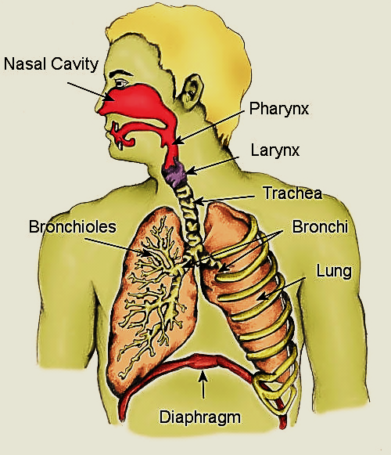
Introduction to The respiratory system 2023 Professor Dr. Hala El-mazar

Slide 2
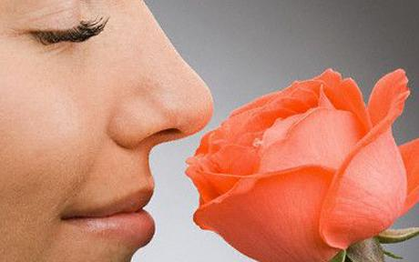
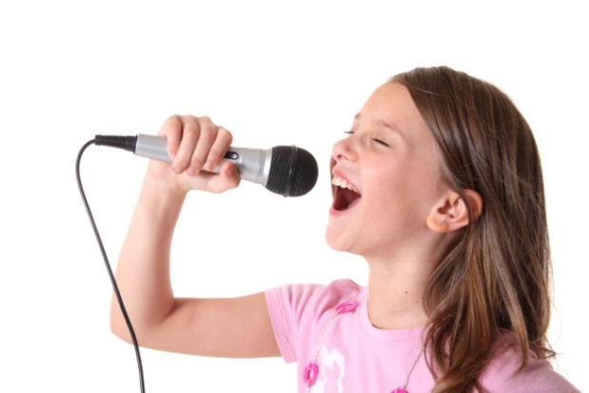
By studying the respiratory system we learn about:
structures involved in inspiration of air, gas exchange, expiration of CO₂
Structures associated with
chemoreceptors of sense of smell
Phonation

Slide 3
Respiratory
system
Conducting
portion
Conducts , Filter
Warms & moistens air
Respiratory
portion
Gas exchange & secretion of surfactant

Slide 4
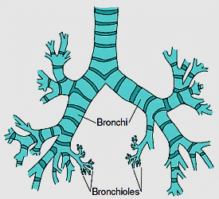
A- The conducting portion includes:
Nasal cavity
pharynx
Larynx
Trachea
Primary bronchi (RT +LT)
2ry , 3ry bronchi
Bronchioles
Terminal bronchioles
Function of conducting portion:
Conduction of air
Conditioning of air

Slide 5
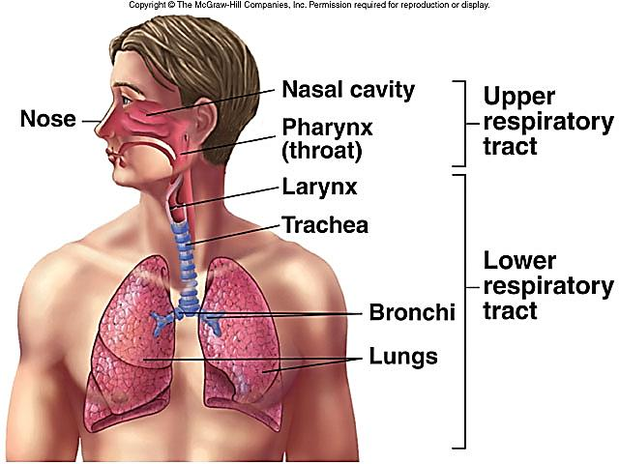
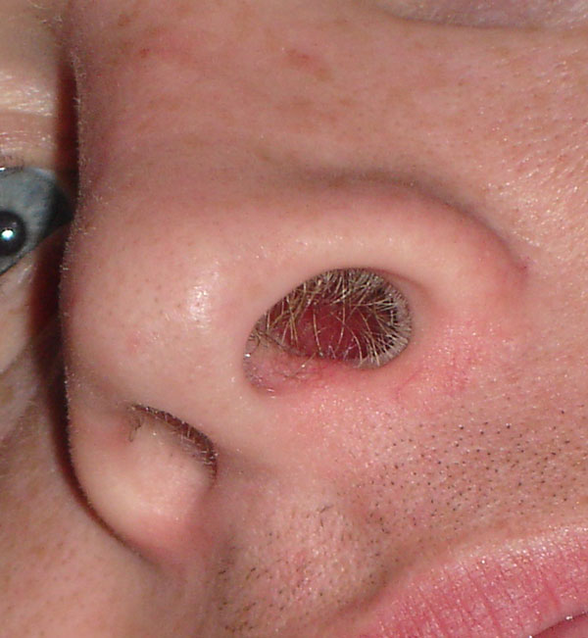
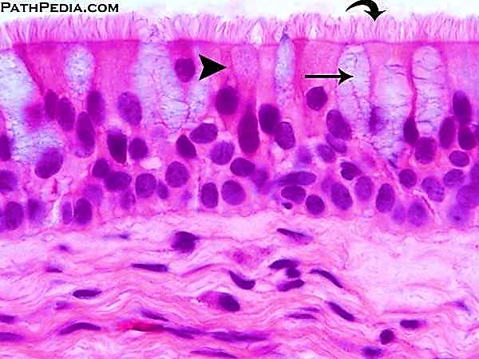
Structure / Function of conducting portion:
1- Conduction of air:
Cartilages to prevent collapse,
Elastic & smooth ms. fibers for flexibility
2- Conditioning of air:
Nasal hairs: clean & trap large particles
Capillaries: adjust temperature
Respiratory mucosa: adjust moisture
& filters air

Slide 6
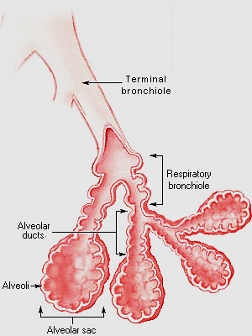
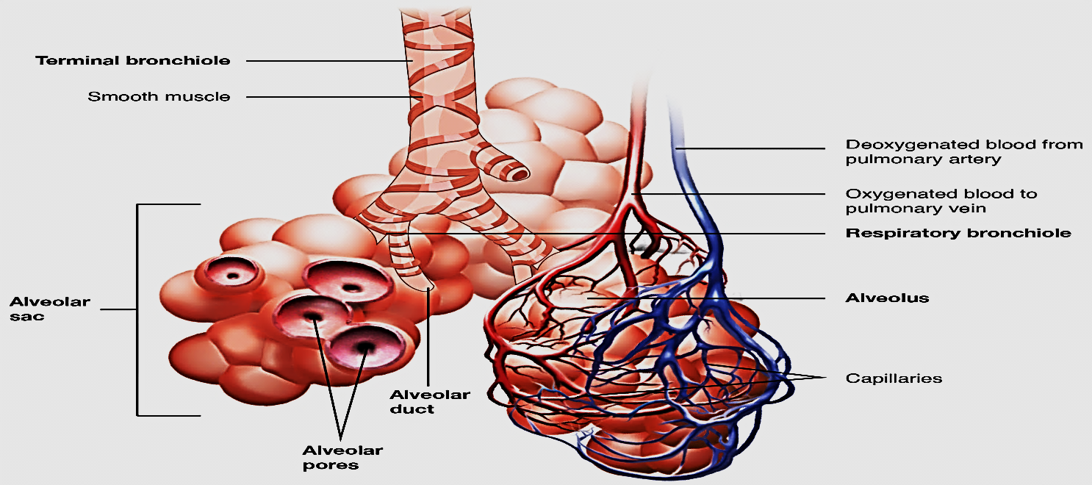
B- The respiratory portion includes:
Respiratory bronchioles
Alveolar ducts
Alveolar sacs
Alveoli
Function of respiratory portion:
O₂/CO₂ exchange take place between blood & inspired air

Slide 7
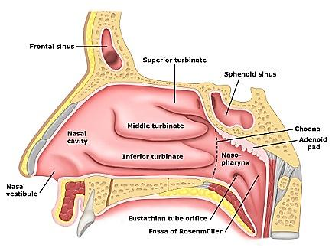
A- Conducting portion
Nasal cavities: each consists of:
1- vestibule
2- nasal fossa:
¤ Respiratory area
¤ Olfactory area
Vestibule:
Is the anterior part
Formed of skin + sebaceous gland + hair
Lined with keratinizes stratified squamous epithelium

Slide 8
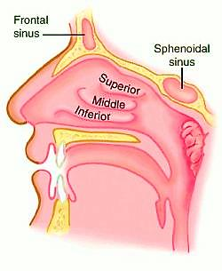
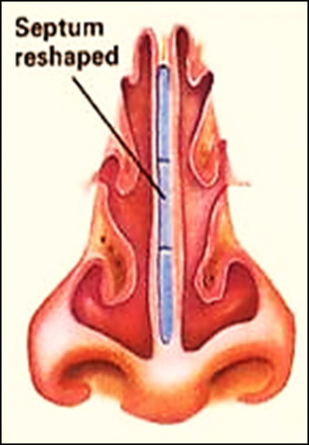
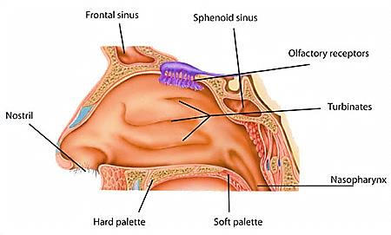
Nasal fossae:
2 cavities separated by nasal septum
Their lateral walls contain
3 bony projections
(conchae) superior, middle, inferior
Superior one covered e Olfactory epithelium
Middle & inferior covered e Respiratory epithelium
The conchae increase the surface
area for better conditioning of
the inspired air

Slide 9
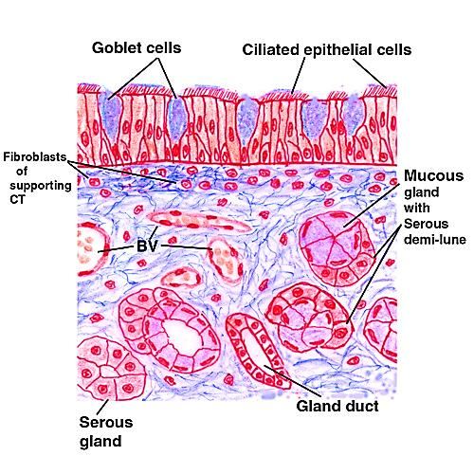
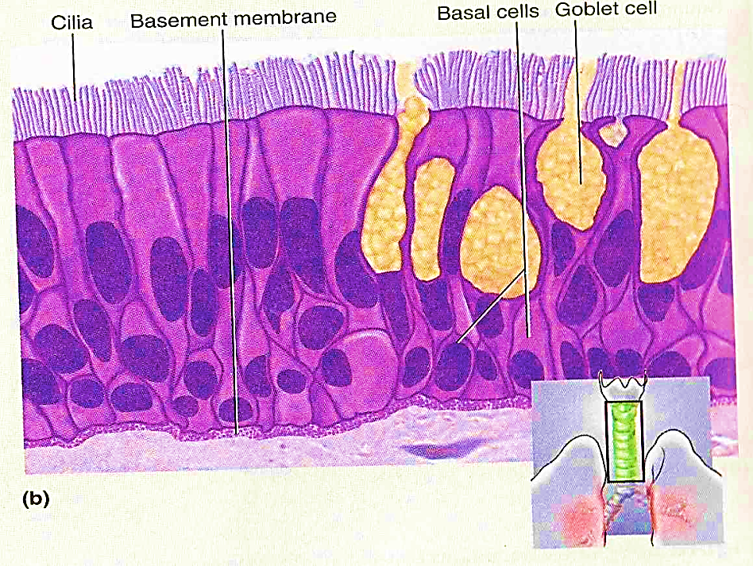
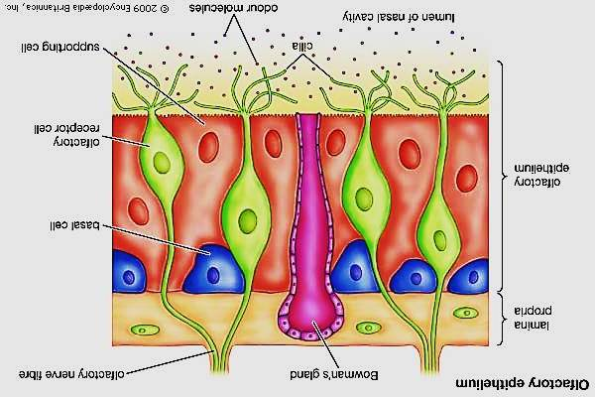
Q:What is the difference between the respiratory & olfactory epithelium?
The respiratory epithelium:
Pseudostratified columnar ciliated e goblet cells
The olfactory epithelium:
Pseudostratified columnar e chemoreceptors & NO goblet cells

Slide 10
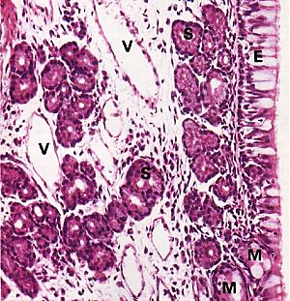
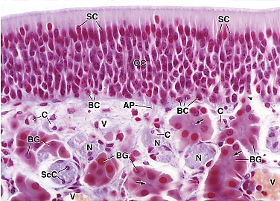
Respiratory mucosa
Epithelium
Lamina propria
Nasal glands (M & S)
Blood vessels
Olfactory mucosa
Epithelium
Lamina propria
Olfactory glands (S only)
Blood vessels

Slide 11
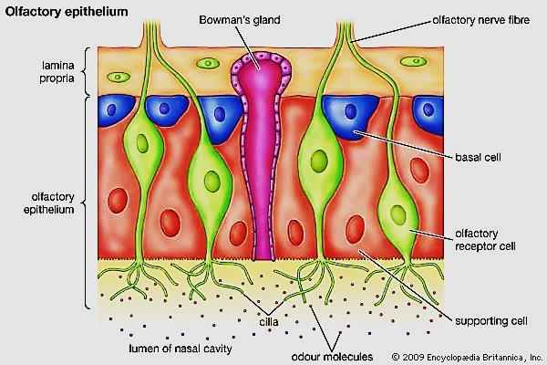
The olfactory epithelium
Covers the roof of nasal cavities & superior
conchae.
Contains chemoreceptors of smell
3 cell types are present:
Olfactory receptor neurons
Supporting (sustentacular) cells
Basal cells
The olfactory mucosa consists of:
1- The epithelium rests on 2- lamina propria which contains:
BV & olfactory nerve fibers
Bowman’s glands, secrete serous fluid @ constant flow→ surface

Slide 12
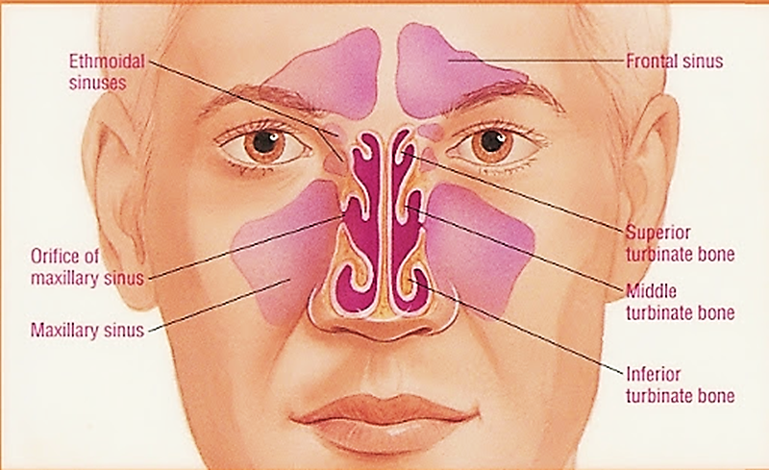
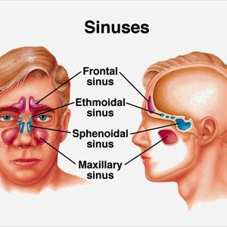
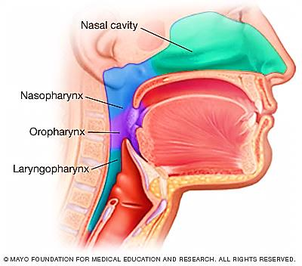
Paranasal sinuses (4 pairs)
Frontal, ethmoidal, Sphenoidal, maxillary
Air-filled spaces open in nasal cavity
Lined e thin respiratory epithelium e few goblet cells , which is very adherent to the periosteum
Nasopharynx
Lined e respiratory epithelium

Slide 13
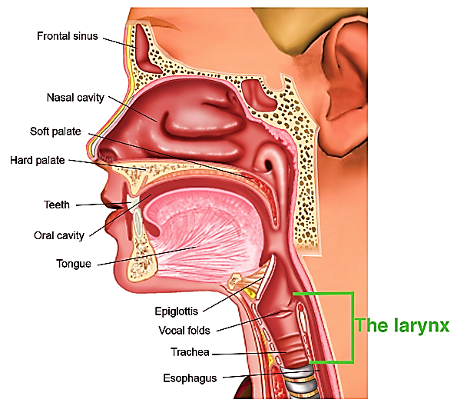
Larynx (voice box):
At the beginning of trachea
Its beginning is guarded by epiglottis
Has 2 functions:
Production of voice (vocal cords)
Prevent food from entering the trachea
(epiglottis has elastic cartilage in its
lamina propria)
Lined e respiratory epithelium

Slide 14
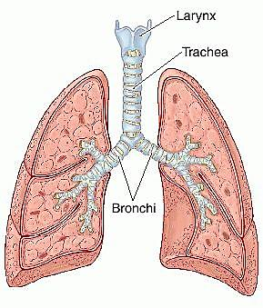
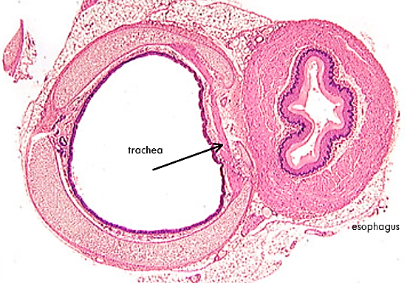
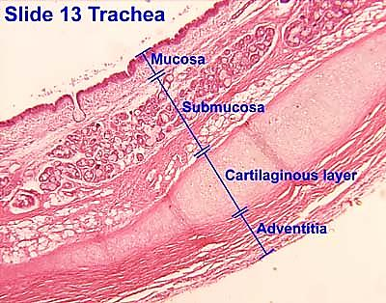
Trachea
Tube extends from larynx & ends by
dividing into 2 bronchi
Kept open by about 20 C- shaped
Cartilage rings (hyaline cartilage)
Its wall is formed of 4 layers:
Mucosa
Submucosa
Hyaline cartilage
adventitia

Slide 15
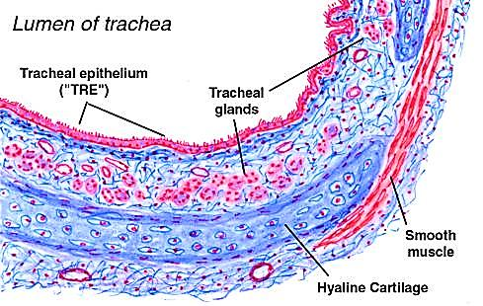
Wall of trachea:
Mucosa: respiratory epithelium + lamina propria
Submucosa: loose CT. contain
tracheal glands
Cartilage layer: C- shaped cartilage
rings, the gap between cartilage ends
connected by elastic ligament &
Trachialis ms (smooth ms)
Adventitia: dense CT

Slide 16
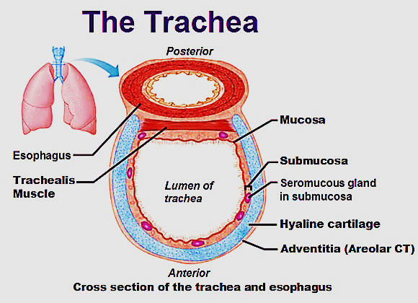

Slide 17
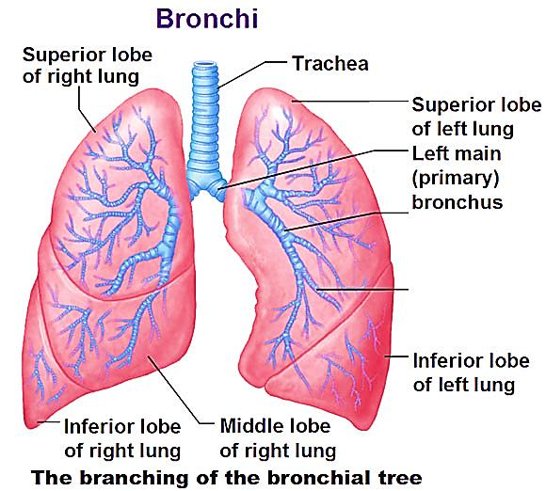
Bronchial tree
Primary (Extra pulmonary) bronchi
Secondary (Intra-pulmonary) bronchi
Bronchioles
Terminal bronchioles
1ry bronchi: RT & LF→ similar to trachea
(but cartilage is a complete ring)
2ry bronchi: within the lung → divide into 3ry bronchi
Its wall is formed of 4 layers (NO Submucosa):
Mucosa
Musculosa
Cartilage plates (isolated plates)
Adventitia

Slide 18
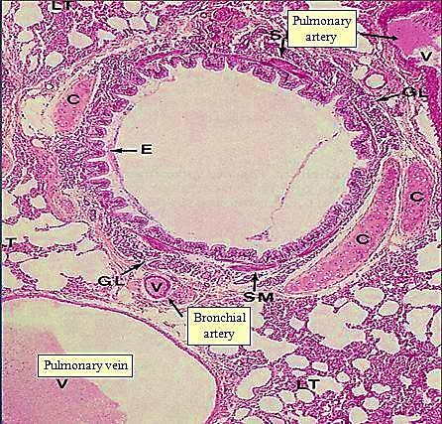
Structure of 2ry & 3ry bronchi
Mucosa: respiratory epith +↓goblet cells
lamina propria has MALT
(mucosa associated lymphatic tissue)
Musculosa: spiral layers of
smooth ms. encircling the
mucosa
Cartilage plates:
adventitia:
Structure of 2ry bronchi

Slide 19
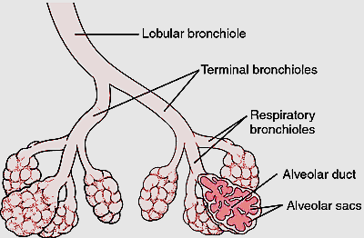
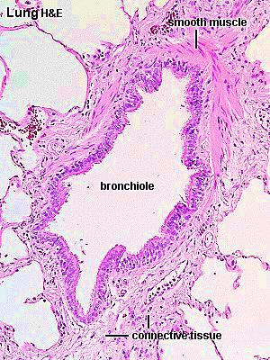
Bronchioles
Small airways ↓ 0.5 mm
Its wall has No (submucosa, cartilage,
lymphatic nodules)
Its wall formed of 3 layers
Mucosa:
Simple columnar ciliated+ Clara cells
Musculosa:
complete layer of circularly arranged s.ms.
Adventitia:
CT layer

Slide 20
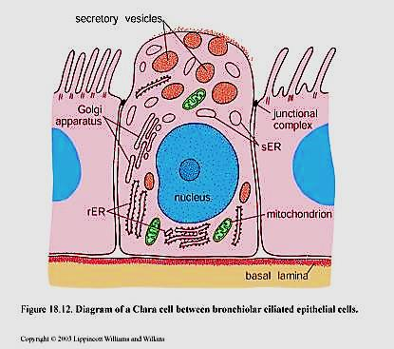
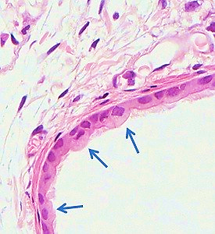
Clara cells
Dome- shaped apex , non- ciliated,
Cytoplasm has lots of secretory granules (not mucus) basal rER, apical sER
They act as stem cells
They play a role in degradation of inhaled toxins (sER)
Secrete surfactant –like which prevent collapse of bronchioles
Has defensive role

Slide 21
Terminal bronchioles:
The smallest & last part of conducting portion
Lining epithelium: simple cubical p. ciliated + Clara cells

Slide 22
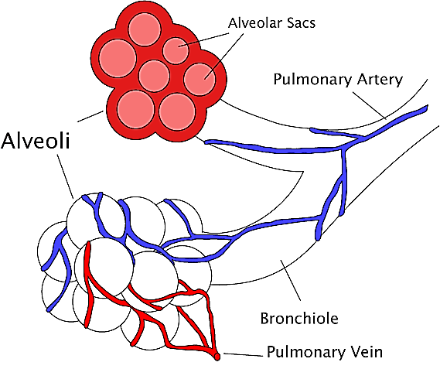
B- respiratory portion
Is where gas exchange takes place
Includes:
Respiratory bronchioles
Alveolar ducts
Alveolar sacs
Alveoli

Slide 23
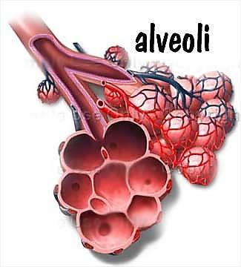
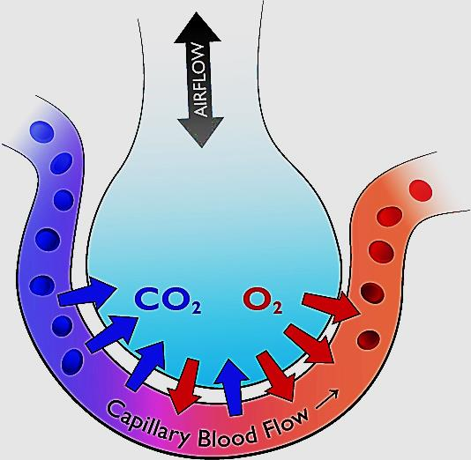
Alveoli
Sac like structures
Responsible for gas exchange
They separated by thin septa called
inter-alveolar septa
Lined with 2 type of cells:
Type I pneumocyte
Type II pneumocyte

Slide 24
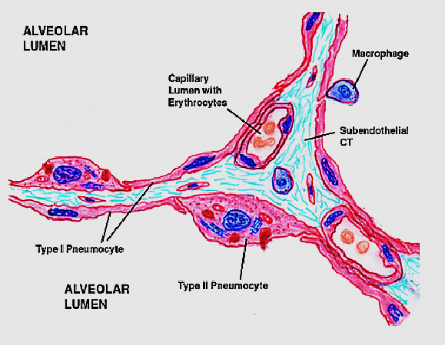
Type I pneumocytes
Type II pneumocytes
Most cells (97%)
Flat simple squamous cells e flat nuclei
Function: Gas exchange
3%
Cuboidal cells e central nuclei & foamy cytoplasm
Function: Secrete surfactant + stem cells
Have ACE2 receptors where Covid-19 spikes attack

Slide 25
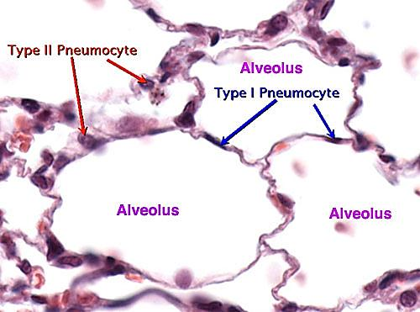
Type I and type II pneumocytes

Slide 26
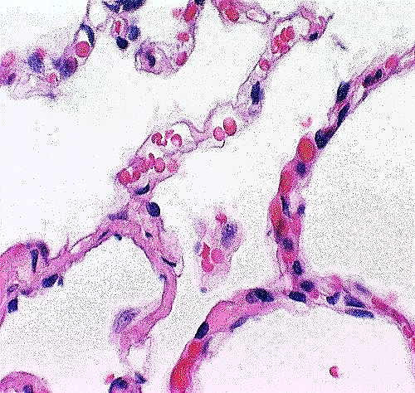
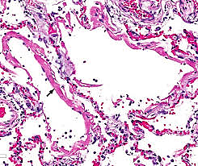
Interalveolar septa
Delicate walls separate adjacent alveoli
Have richest capillary network
Where Gas exchange Take place
Contains Blood –air barrier
Contains extravasated leucocytes
(monocytes), which will migrate
through the wall → to the lumen
and become alveolar macrophages
( arrow A)
This septa is destructed in emphysema & Covid - 19
A
A

Slide 27
Thank you

