Slide 1
Genomic DNA Extraction
Dr. Nesrin Mwafi
Biochemistry & Molecular Biology Department
Faculty of Medicine, Mutah University

Slide 2
Part II
The Principle of DNA Extraction

Slide 3
The principle of DNA Extraction
There are three basic steps in DNA extraction:
Cell lysis with digestive solution to expose the DNA. Lysis buffer contains detergents/surfactants such as SDS (sodium dodecyl sulphate) to disrupt both cellular and nuclear membranes (make holes in the membrane)
-
-
-
-
-
Cell Lysate

Slide 4
The principle of DNA Extraction
Inactivate endogenous nucleases like DNases. Actually, this is can be done by adding proteases like proteinase K
Add also chelating agents (e.g. EDTA) which sequester Ca⁺² and Mg⁺² required for nuclease activity.
On the other hand, RNases are usually added to the sample to get rid of RNA if we want to extract DNA
To extract RNA, we add RNA guard to protect our RNA from endogenous and exogenous RNases

Slide 5
The principle of DNA Extraction
Purification of DNA from proteins, RNA, detergents, salts and reagents found in cell lysate:
Ethanol precipitation using ice-cold ethanol or isopropanol
Phenol/chloroform extraction
Minicolumn purification
Magnetic beads

Slide 6
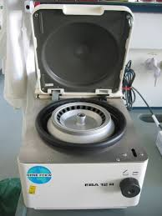
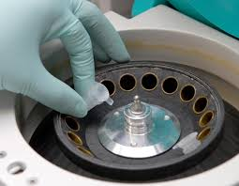
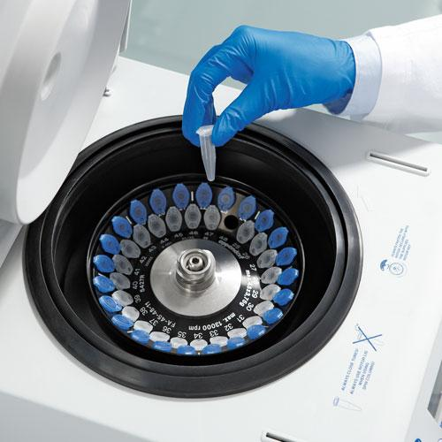
The principle of DNA Extraction
Ethanol precipitation:
DNA (polar molecule) is insoluble in absolute ethanol or isopropanol (anti-solvent) so it will aggregate together forming a pellet upon centrifugation
Centrifuge

Slide 7
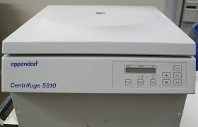
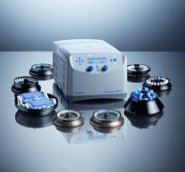
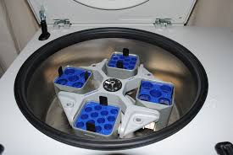
Centrifuge

Slide 8
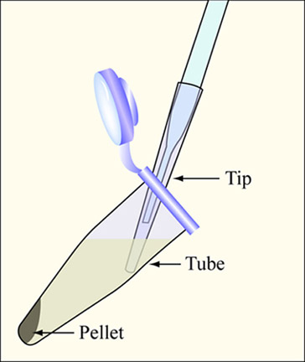
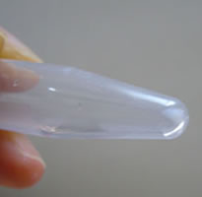
The principle of DNA Extraction
Ethanol precipitation:
DNA is insoluble in absolute ethanol or isopropanol (anti-solvent) so it will aggregate together forming a pellet upon centrifugation
After centrifugation, a pellet of crude DNA is formed

Slide 9
The principle of DNA Extraction
To enhance precipitation of DNA in presence of 95-100% ethanol, the solution should contain positive ions such as sodium acetate
The role of this salt is to neutralize the negative charge on DNA backbone so reduces its hydrophilicity and improves its precipitation
(use the right concentration !!!! 0.3M, pH = 5.2)
Too much sodium acetate, the salt will co-precipitate with DNA and too little will result in incomplete recovery of DNA

Slide 10
The principle of DNA Extraction
The pellet is washed with 70% ethanol to remove some salts present in the left over supernatant and bound to DNA
Air dry the pellet (5-10 min) then redissolve in ultrapure or Milli-Q, Millipore water (DNase/ RNase free water)
Store purified DNA in
Eppendorf tube at -20C

Slide 11
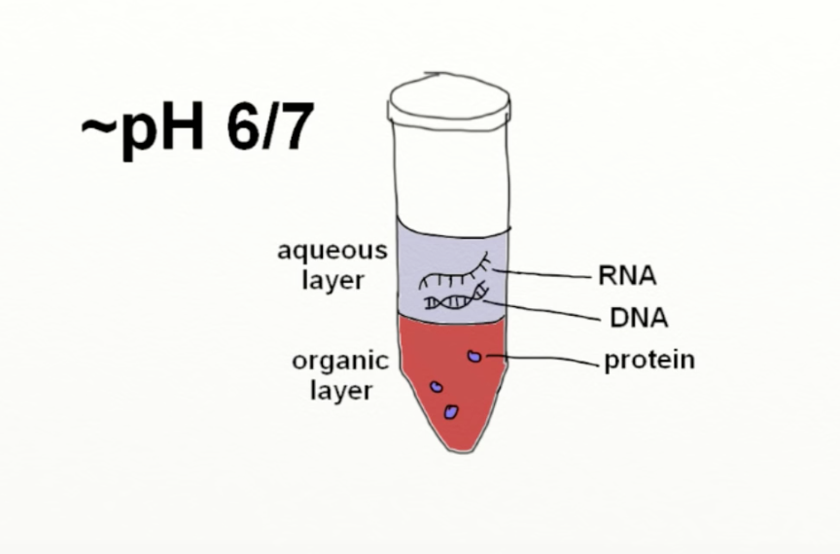
The principle of DNA Extraction
Phenol/ chloroform extraction:
Equal volume of phenol/chloroform added to an aqueous solution of lysed cells
Centrifugation yields two phases: the upper aqueous phase (containing the nucleic acids DNA and RNA) and the lower organic phase (containing the lipids and denatured proteins)
The upper layer is removed with pipette tip carefully
Add phenol/chloroform
and centrifuge

Slide 12
The principle of DNA Extraction
Minicolumn purification:
which depends on the binding and adsorption of nucleic acids to a solid phase (e.g. silica, SiO₂)
(Spin-column based nucleic acid purification)

Slide 13
The principle of DNA Extraction
Minicolumn purification:
After cell lysis, inactivate endogenous nucleases (e.g. DNases) with proteinase K enzyme and chelating agents (e.g. EDTA)
Add binding solution to cell lysate, mix and centrifugate
Washing and column elution(with TE buffer or DNase/ RNase free water)

Slide 14
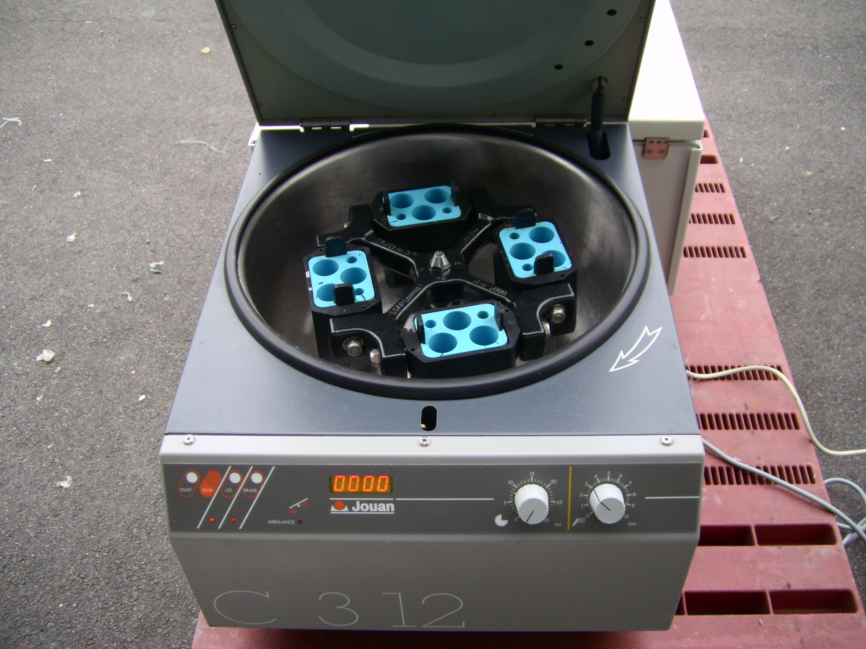
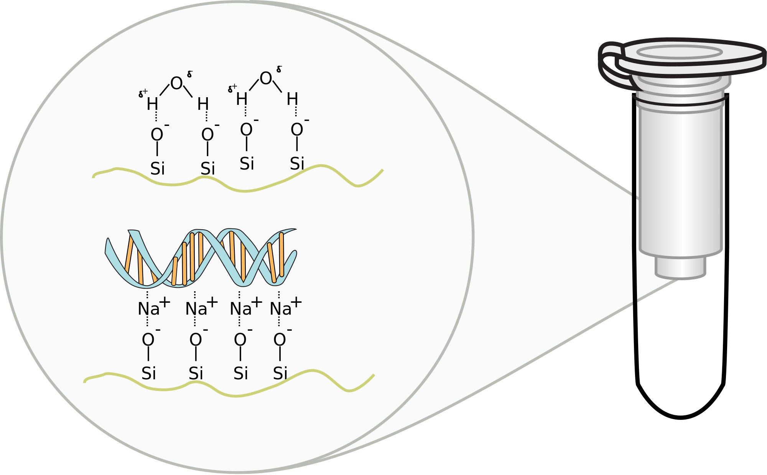
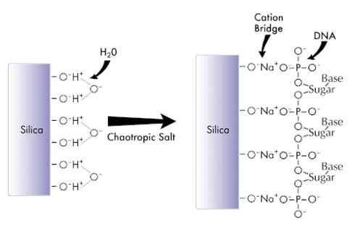
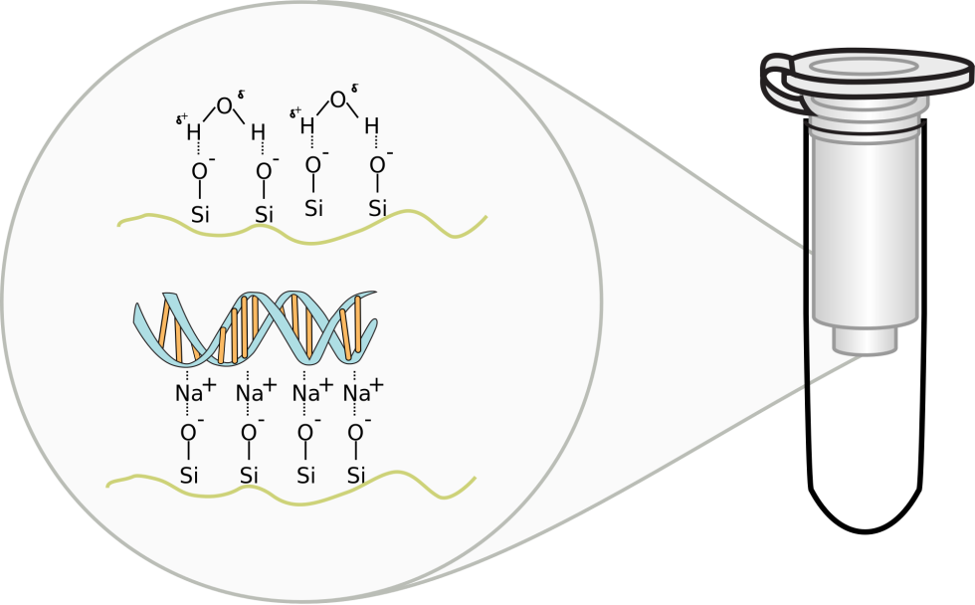
Binding of DNA to Silica membrane
(SiO2)
Spin column-based nucleic acid purification
Binding solution consists of :
1. Chaotropic salt like guanidinium hydrochloride
2. Sodium acetate salt (act as bridge)

Slide 15
Binding and Elution

Slide 16
The principle of DNA Extraction
Magnetic Beads-based DNA/RNA extraction:
Quick and efficient for direct separation of crude DNA or RNA from sample
No need for centrifugation, separation by applying of magnetic field
Various types of magnetic particles are commercially available working in manual or automated mode (save time and money in case of large numbers of samples and avoid the risk of cross-contamination during the traditional methods)

