Slide 1
Spinal injuries
Sara Al-momani
Taqwa Lasasmeh

Slide 2
Overview

Slide 10
Spinal cord injury (SCI)
Spinal cord injury (SCI) is an insult to the spinal cord resulting in a change, either temporary or permanent, in the cord’s normal motor, sensory, or autonomic function. Patients with SCI usually have permanent and often devastating neurologic deficits and disability.
The most important aspect of clinical care for the SCI patient is preventing complications related to disability. Supportive care has shown to decrease complications related to mobility.

Slide 11
Epidemiology
Incidence 2-5/100000.
Although the majority of spinal injuries do not affect the cord or spinal root , about 10%will result in quadriplegia or paraplegia.
Most of the serious spinal cord injuries are consequence of RTA .
Other major causes are : water sport , horse riding accidents and injuries following skiing.

Slide 12
Pathophysiology
Spinal cord injury (SCI), as with acute stroke, is a dynamic process. In all acute cord syndromes, the full extent of injury may not be apparent initially.
Incomplete cord lesions may evolve into more complete lesions. More commonly, the injury level rises 1 or 2 spinal levels during the hours to days after the initial event.
A complex cascade of pathophysiologic events related to free radicals, vasogenic edema, and altered blood flow accounts for this clinical deterioration.
Normal oxygenation, perfusion, and acid-base balance are required to prevent worsening of the spinal cord injury.

Slide 13
Spinal cord injury can be sustained through different mechanisms,
with the following 3 common abnormalities leading to tissue damage:
.….Destruction from direct trauma
…..Compression by bone fragments, hematoma, or disk material
…..Ischemia from damage or impingement on the
spinal arteries
Edema could ensue subsequent to any of these types of damage

Slide 14
Signs and symptoms
The extent of injury is defined by the American Spinal Injury Association (ASIA) Impairment Scale (modified from the Frankel classification), using the following categories [3, 4] :
A = Complete: No sensory or motor function is preserved in sacral segments S4-S5 [5]
B = Incomplete: Sensory, but not motor, function is preserved below the neurologic level and extends through sacral segments S4-S5
C = Incomplete: Motor function is preserved below the neurologic level,
and most key muscles below the neurologic level have a muscle grade of less than 3
D = Incomplete: Motor function is preserved below the neurologic level,
and most key muscles below the neurologic level have a muscle grade that is greater than or equal to 3
E = Normal: Sensory and motor functions are normal

Slide 15
Spinal injuries
Spinal cord injuries
Complete lesions
Incomplete lesions
Bony injuries
Thoraco-lumbar spine injuries
Cervical spine injuries

Slide 16
Bony injuries
Cervical spine injuries
flexion rotation injuries
Thoraco-lumbar spine injuries
flexion rotation injuries
compression injuries
compression injuries
hyperextension
hyperextension

Slide 17
Cervical spine injuries 1-flexion rotation injuries :
Most frequent type of injury to the cervical spine
C5/C6 is the most common site
RTA , diving
Usually one or both of the posterior facets are sublaxed or dislocated , and may be locked in this position .
There is extensive posterior ligament damage and these injuries are usually unstable .
The spinal cord may be compressed and distracted sustaining both direct damage and vascular impairment from involving the anastomotic segmental vessels .
Injury is on nerve root

Slide 18
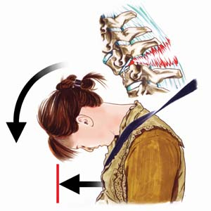

Slide 19
2- compression injuries :
The vertebral body is decreased in height and may be comminuted with the posterior aspect of the body encroaching upon the spinal canal.
C5/C6 is the most common site .
Usually stable because the posterior bony elements and longitudinal ligaments are intact.
When combined with rotation force in flexion
“ teardrop” fracture may occur with separation of a small antero-inferior fragment from the vertebral body .

Slide 20
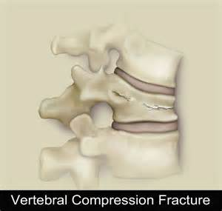

Slide 22
3- hyperextension :
Most common in older age group and in patients with spinal canal stenosis .
Bony injury is usually not demonstrated and the major damage is to the anterior longitudinal ligament secondary to hyperextension .
Central cervical cord syndrome is the most common neurological impairment.
Most of injuries result in incomplete cord damage resulting from compression of the cord between the degenerative body and disc anteriorly and the hypertrophic ligamintum flavum protruding posteriorly .
It is nearly stable .

Slide 23
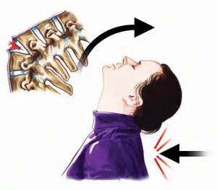

Slide 24
Thoracolumbar spine injuries 1- flexion rotation injuries :
Most frequently at T12/L1 and result in anterior dislocation of T12 on L1 vertebral body .
There is disruption of the posterior longitudinal ligament and posterior bony elements
Unstable and usually result in complete neurological deficit of either the spinal cord conus or cauda equina.

Slide 25
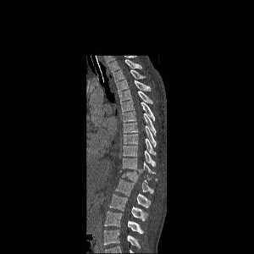

Slide 26
2- compression injuries :
Common .
Vertebral body is decreased in height .
Usually stable .
Neurological damage is uncommon .

Slide 27
3- hyperextension injuries :
Very uncommon .
It involve the anterior longitudinal ligament , rupture of the intervertebral disc and fracture through the involved vertebral body anteriorly
Unstable and usually cause severe cord injury.

Slide 28
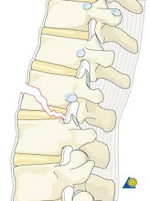

Slide 29
4- open injuries :
May result from stab injuries or gunshot
wounds resulting in cord damage due to the blast injury , vascular damage and/or cord penetration by the missile or bony fragment .

Slide 30
Spinal cord injury

Slide 31
spinal cord injury
Complete lesions
motor deficit
sensory deficit
Incomplete lesions
Autonomic deficit
Anterior cord lesion
central spinal cord lesion
brown sequard syndrome:
Posterior cord syndrome

Slide 32
Complete lesions
The most sever consequence of spinal trauma is complete transverse myelopathy in which all neurological function is absent below the level of the lesion causing either paraplegia or quadriplegia , depending on the level .
There will be also impairment of autonomic function including bladder and bowel .

Slide 34
1- motor deficit :
Injuries to the spinal cord will cause upper motor neuron paralysis characterized by loss of voluntary function , increased muscle tone and hyperreflexia.
Injury to the lumber spine causing cauda equina injuries result in lower motor neuron paralysis characterized by reduced muscle tone , wasting and loss of reflexes .
Combination of upper and lower motor neuron lesion result from thoracolumber injury involving the conus medullaris and cauda equina .

Slide 35
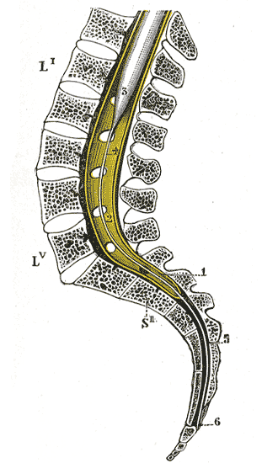
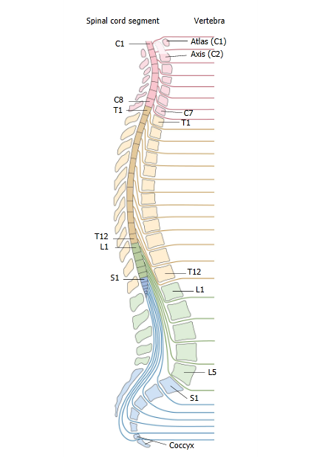

Slide 36
2- sensory deficit :
In complete lesion the afferent long tracts carrying the various sensory modalities are interrupted at the level of the lesion , abolishing sensory appreciation of pain , temperature , touch , position and tactile discrimination below the lesion .
Visceral sensation is also lost .
Occasionally there is a level of abnormally increased sensation , hyperaesthesia and hyperalgesia at or just below the lesion .

Slide 37
3- Autonomic deficit :
Vasomotor control: cervical and high thoracic lesion above the sympathetic outflow at T5 may cause hypotension . Interruption of the sympathetic splanchnic vasomotor control will initially cause a severe postural hypotension as a result of impaired venous return.
Temperature control: the patient with complete spinal lesion will not have satisfactory thermal regulation as there will be impairment of the autonomic mechanism for vasoconstriction and vasodilatation .

Slide 38
Incomplete lesion
A) Anterior cervical spinal cord lesion :
Due to compression of the anterior aspect of the spinal cord .
Causes damage to the corticospinal and spinothalamic tracts , with motor paralysis(paraplegia,quadriplagia) below the level of the lesion and loss of pain , temperature and touch sensation but relative preservation of light touch , proprioception and position sense , which are carried in the posterior colomns.

Slide 39
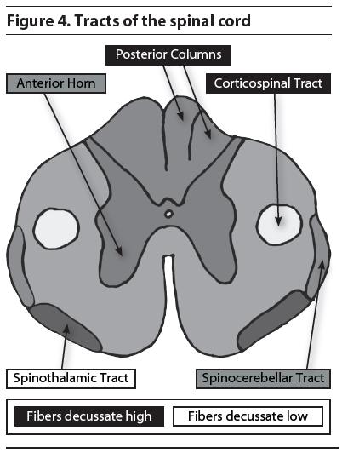

Slide 40
B) central spinal cord lesion :
Usually due to hyperextension injury mainly in elderly.
Tract affected : grey matter mainly
Effect : loss of motor function mainly in upper limbs with loss of sensation in the upper limbs more than lower limbs ??
Because the orientation of fibres in grey matter , upper limbs fibres are located more centraly than the lower .

Slide 41
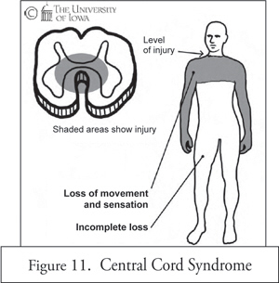
Notes:
41

Slide 42
C) brown sequard syndrome:
Causes : penetrating injury
Hemisection of spinal tract
Effects :
1- Ipsilateral loss of motor function (paralysis)
2- Ipsilateral loss of vibration sensation , proprioception .
3- contralateral loss of pain ,temperature sensations.

Slide 43
D) Posterior cord syndrome
Caused by hyperextension compressing or trauma to the posterior column and posterior grey horns ( sensory).
Effects:
1- Loss of proprioception
2- loss of vibration sensation
3- loss of two point discrimination
4- loss of light touch

Slide 44
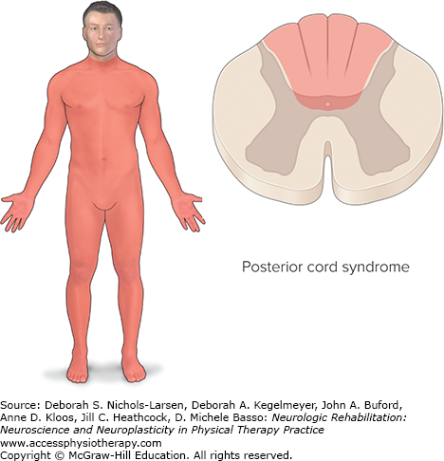

Slide 45
Management of the spinal injuries
General principles :
1- prevention of further injury to the spinal cord.
2- reduction and stabilization of bony injuries.
3- prevention of complication resulting from spinal cord injury .
4- rehabilitation .

Slide 46
Initial treatment :
1- caution in turning and lifting the patient to avoid inflicting additional damage .
2-before moving the patient sufficient help should be available to provide horizontal stability and longitudinal traction .
3- spinal flexion must be avoided
4-Temporary collar in cervical spine injury .
5-look for other injuries : chest , abdomen or limbs.

Slide 47
6- loss of sympathetic tone may result in peripheral vasodilatation which is treated by intra vascular volume expanded , alpha adrenergic stimulators , iv atropine .
7- body temperature must be preserved in cold weather and the patient must not be overheated in warm weather .
8- NG tube to avoid problems associated with vomiting due to gastric stasis and paralytic ileus.
9- urinary catheter , although intermittent catheterization may become preferable later .
10- prophylaxis for DVT with low dose heparin or LMW

Slide 48
Radiological investigation
Plain cervical spine x-ray and CT will show the bone injuries.
MRI is also helpful in showing the associated cord , soft tissue and ligamentous pathology.
If cervical spine injury is suspected but the plain x-ray and CT show no abnormality , the X-ray should be carefully repeated in flexion and extension to exclude instability due to ligamintous damage.

Slide 49
Spinal reduction and stabilization
open surgery may be necessary to reduce the fracture subluxation with overriding and locked facet joints .

