Slide 1
VIRAL SKIN INFECTIONS
By:
Prof. Dr. Ghada Fahmy Helaly

Slide 2
There are some viruses that get sign and symptoms to the skin but it is not their targete (may be the target or not
Some viruses make localized skin condition( Carry leisoin to skin Hsv / Hpv).
Whereas anther viruses may make exanthems which mean (Rash) is very common in childhood viral infection (unique sign of disease as meastes , chicken pox ,infectiosum by parvovirus and infantum)
another syndrome ( virus enter and Infect certain system but part of pathological form is in skin as ebola

Slide 3
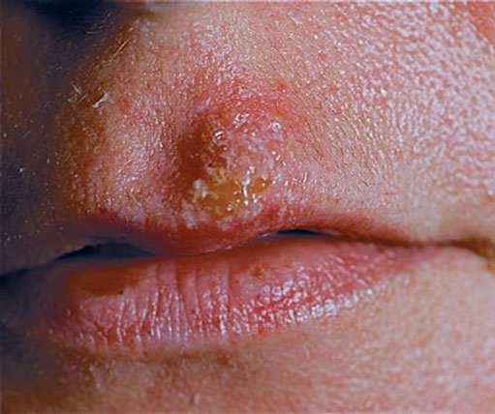
Herpes Simplex Virus (HSV)
HSV-1 and HSV-2 are distinguished by two main criteria: antigenicity and location of lesions.
HSV-1: acute gingivostomatitis, recurrent herpes labialis (cold sores), keratoconjunctivitis (keratitis),herpetic whitlow and encephalitis.
HSV-2: herpes genitals, neonatal herpes, and aseptic meningitis.
Diseases:

Slide 4
Herpes Simplex Virus :
There are2 types of HSV ,We distinguish can between they by: antigenicity + Location of lesion. x Locations Type 1 above Waist (upper partof the body)
Type 2 below waist (lower part transmitted sexually result in genital herpes
What is the Diseases?
Type 1 acute gingivostomatitis (in mouth+ oropharyngeal) \ may cause ulcer in Cornia\ herpitic whitlow transmitted by sucking child from mouth to skin or in dentist
Type 2 because it cause herpes gental it may reach to nechatal by delivery leading to aseptic meningitischameter of virion-t is a lange virenno polymen in virion because it is DNA vins Human consider as natural hostTransmission Type 1) Contact with resicales ② Fluid inside
Type 2 during delivery (from mother to baby)
Pathogenesis
there are initial vesicular lesions
in Type 1 month/ face \macules junction
In Type 2- genital are a ganglion varies ac according to to the type of virusesxlatent infectionſ no replications when viruses allow transcription to Some thing that help they to stay / no integration
DNA enter + circulise inside nucles +transcription to latency associated transcripse
Recurrences induce in Sunlight\never \ stress \exams / pressurer / Female menstrual every month

Slide 5
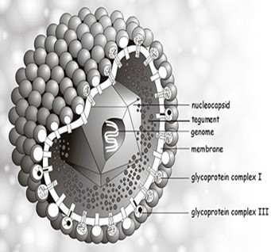
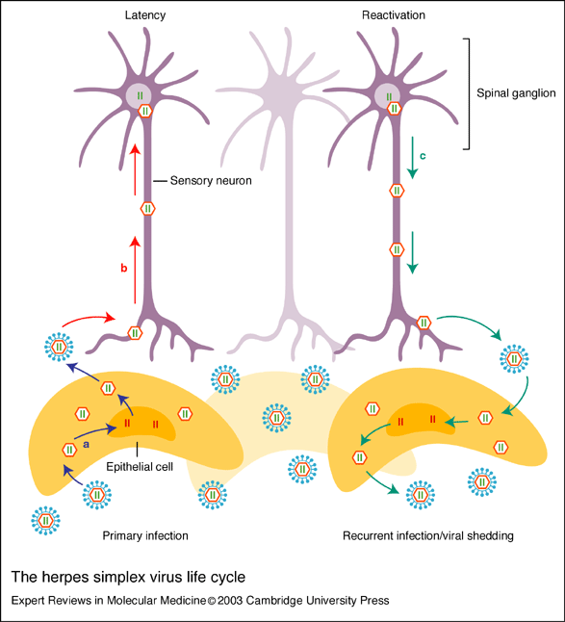
Enveloped - Icosahedral nucleocapsid- Linear ds.DNA.
HSV1: Saliva or direct contact
HSV2: Sexual contact , passage through the birth canal.
Pathogenesis: Initial vesicular lesions??
- HSV1 latent in sensory (trigeminal) ganglia.
- HSV2, latent in sensory (lumbar or sacral) ganglion cells.
Recurrences occur in skin innervated by affected sensory nerve. (less sever than primary infection)
Dissemination to internal organs(depressed CMI). Occur in immunocompromised

Slide 6
Laboratory Diagnosis:
Cytopathic effect (CPE) in cell culture. Isolation
Tzanck smear see vesicle by scraping
A rise in antibody titer (primary infection).
HSV encephalitis ---- a PCR assay.
Treatment and Prevention:
Protection from exposure to vesicular lesions.
Avoiding the specific inciting agent.
Acyclovir. Decrease recurrene
Neonatal infection ---cesarean section.
No vaccine.
What is the type of cell in Cytopathic effect? maltinuclucted gaint cell + intra nuclear inclusion

Slide 7
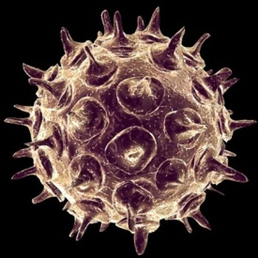
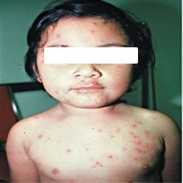
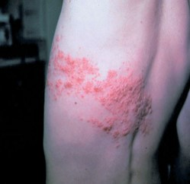
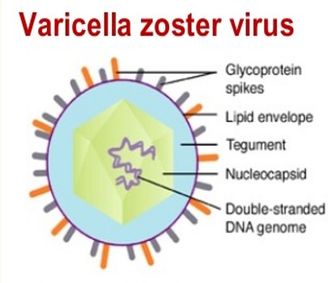
Varicella-Zoster Virus
Varicella (chickenpox) in children and zoster (shingles) in adults.
Enveloped , icosahedral nucleocapsid and linear double-stranded DNA. No virion polymerase.
One serotype.
Varicella respiratory droplets.
Zoster ??
Oropharynx blood the skin.
latent in the sensory ganglia.

Slide 8
Varicella-Zoster virus (Herpes 3)
-Causing2 pathological manifestation
1)varicella chicken pox( children) but if an adult infect for the first time will have also chicken pox.
The First primary Contact with the virus cause Chicken pox If the viars enter and become latent 》
Cause In adult (if recurrence ) > Zoster * one serotype means it easy to make vaccine.
2)Zoster reactivation by recurrent Infectionlantent occur in dorsal root ganglion Zoster
●years later may Change to zoster
Diagnosis :Tzanck smear
+ TreatmentVZIG → varicella Zoster immunoglobulin play a role

Slide 9
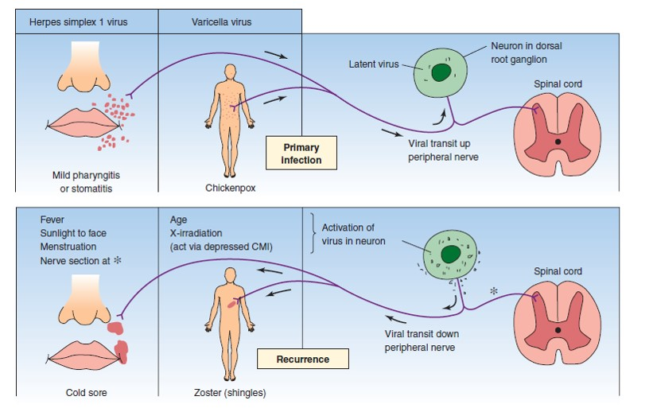
Diagnosis: Clinically.
CPE in cell culture
Smear.??
A four-fold or greater rise in Ab. titer.
Treatment and Prevention: - Live, attenuated vaccine
- VZIG.??
Acyclovir -- immunosuppressed individuals

Slide 10
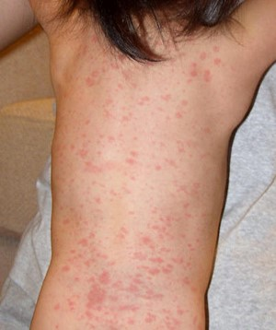
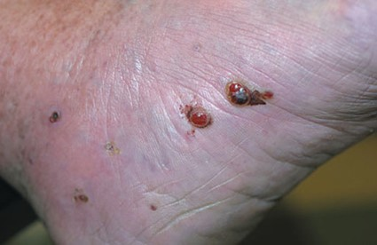
Human Herpes virus 8
Human herpes viruses 6 and 7
Exanthem subitum (roseola infantum) in young children between 6 months and 2 years old
Rapid onset fever and an immune-mediated generalized rash.
Kaposi’s sarcoma, especially in AIDS patients.
Transmitted sexually.
Kaposi’s sarcoma

Slide 11
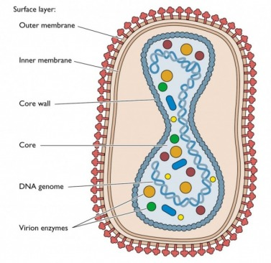
Smallpox Virus
Smallpox. - One serologic type.
Enveloped virus with linear double-stranded DNA.
DNA-dependent RNA polymerase in virion.
Transmitted by Respiratory droplets or direct contact. (with the lesion which present in skin)
Skin lesions: macule, papule, vesicle, pustule, crust.
Laboratory Diagnosis:
Cell culture
“Pocks” on chorioallantoic membrane.
Electron microscopy
Viral antigens in the vesicle fluid.
Prevention: vaccine contains live, attenuated vaccinia virus.(intradermal)

Slide 12
Human herpes viruses At first, it is asymptomic or may cause fever for baby (3-5) days then feverstarting decrease and + appear rash in trunk then limbs and face (maculopapular rash) and may be with encephalitis.
-latent virus
* Herman Herpes virus 8
Kaposi's Sarcoma abnormal tissue growth in skin (it is patches) Purple red coloured , contains from blood vessel + Cancer cell + blood cells
* small pox
-very large virus
* Why small pox has DNA dependent RNA poly merase in its virion?! Because its replication occur in cytoplasm-cause infection in respiratory tract, then to lymph node causing primary viremia in blood liver spleen exist from it and cause viremia , finally to skin causing Secondary and get its lesion macule....., + cause very sever disfigurement after healing

Slide 13
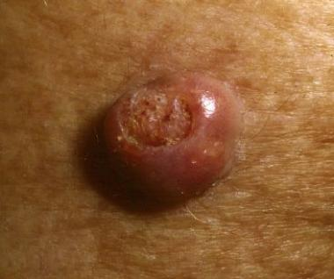
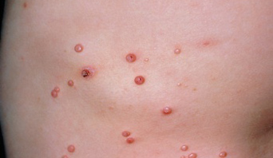
Molluscum Contagiosum Virus
Causes molluscum contagiosum.
Pinkish, papular skin lesions with an umbilicated center.
Transmitted by direct contact.or maybe sexually
Diagnosis: clinically.
Cidofovir: Extensive lesions in immunocompromised patients.large
-may present around eye
-if it transmitted sexually present in genital organ

Slide 14
Molluscum Contagiosum
-one of the virus Smallpox viruses
Human papallomavirus
-genital wart called condylomata acaminata (if it is transmitted sexually)

Slide 15
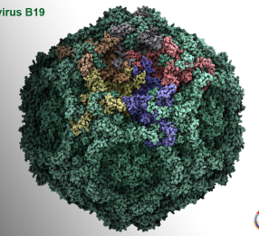
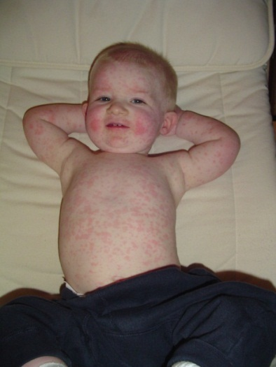
Parvovirus B19
Usually asymptomatic,
-has reticular pattern .
-disappear after (9-10)day,+ may be recurrence
Can cause slapped cheek syndrome [erythema infectiosum (fifth disease)], aplastic anemia, arthritis, and hydrops fetalis.
-confluent rash occur on arms,legs and trunk a rash as lace(دانتيل)
Non-enveloped - icosahedral symmetry- ssDNA
There is one serotype.
Respiratory droplets and transplacental erythroblastswhich is the precursor of erythroblast Cardiac faluire. Death
Laboratory Diagnosis: ELISA for IgM).
-can cause aplastic animea,arithritis in adult +hydro if it is transmitted transplacental from mother to baby

Slide 16
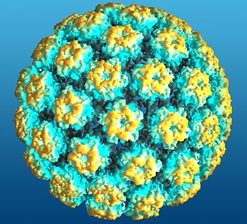
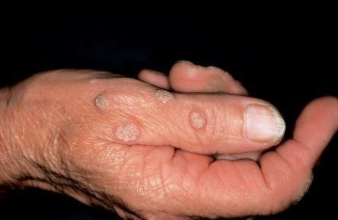
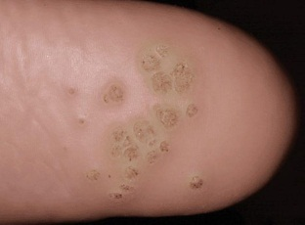
Human Papillomavirus
Papillomas (cutaneous warts)
Condylomata acuminata (genital warts); Cancer cervix and penis.
Non-enveloped - icosahedral - circular dsDNA.
There are at least 60 types
By Direct contact of skin or genital lesions.
Two early viral genes, E6 and E7??(cause encoding certain protein inhibit activity of protein encoded p53 +RB gene )
Laboratory Diagnosis:
- Clinically - Finding koilocytes (squamous epithelial cells inside it,there is cytoplasmic vacul)in the lesions.
- DNA hybridization tests.

Slide 17
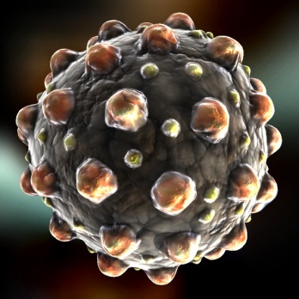
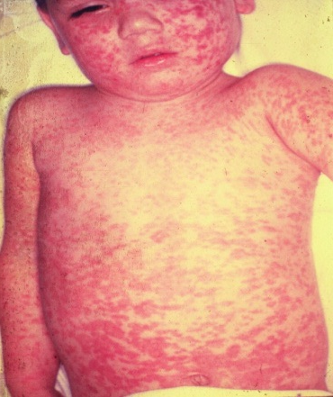
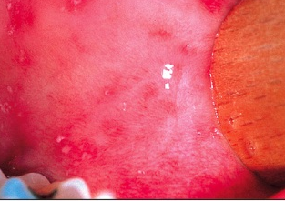
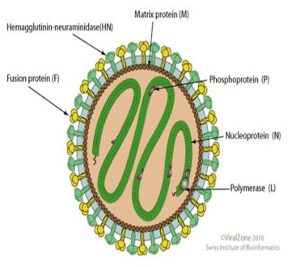
Measles Virus
Measles: Maculopapular rash , Koplik spots on buccal mucosa. Complications: encephalitis, pneumonia, SSPE
Enveloped(paramyxovirus)– helical nucleocapsid
SS negative-polarity RNA. It has a single serotype.
Transmitted by Respiratory droplets.
Diagnosis: Clinical - Serologic tests and PCR
Live, attenuated vaccine. (MMR)

Slide 18
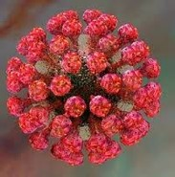
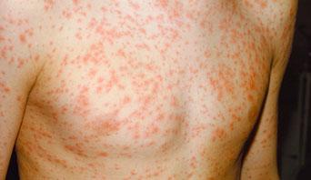
Rubella Virusالحصبه الالمانيه
Disease: Rubella: subclinical or symptomatic.
3- to 5-day rash (start in face then spread to the body)and swollen neck and sub-occipital lymph nodes.
More severe in adults, complicated by arthralgia, arthritis, and encephalitis
Single serotype.
Enveloped - icosahedral nucleocapsid - ss positive-polarity RNA.
Respiratory and trans-placental, first trimester(26w)🡪 congenital malformations . So absorbtion is important Congenital rubella syndrome
Diagnosis: IgM, IgG antibody, PCR assay.
Live, attenuated Vaccine. (MMR)
*in second trimester (No infection )
*befor rash,there are prodromal symptoms ,fever ,headache , pink eye , running nose
*if the fetus born congenital malformation(deafness,eye abnormality,retinal,congenital heart,hepatomegalopathy,rash,intellectnal dysfunction,micricephaly

