Slide 1
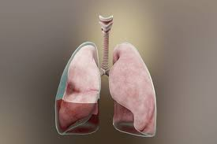
Pleural effusion
Presented by:
Raneem Zead AL-Ayaydah
Batool Abo AL-Asaman
Ahlam Majed AL-Sloot
Supervised by:
Dr.Waleed Ibraheem

Slide 2
Pleural effusion
The accumulation of serous fluid within the pleural space is termed pleural effusion.
The accumulation of frank pus is termed empyema, that of blood is haemothorax , and that of chyle is a chylothorax.

Slide 3
Pleura is serous membrane which folds back onto itself to form a two layered membranous pleural sac.
The outer pleura (partial pleura) : attached to chest wall.
The inner pleura (visteral pleura):cover the lung and adjoinin
structures.
The pleural space :a potential space because the two pleura are
adhere to each other (through a thin film of serous fluid of only few
milliliters of pleural fluid around 0.13 ml/kg) .

Slide 5
Pathophysiology:
In general, pleural fluid accumulates as a result of either increased hydrostatic pressure or decreased
osmotic(oncotic) pressure (‘transudative’ effusion, as seen in cardiac, liver or renal failure),
or from caused by increased permeability of pleural surfaces or decreased lymphatic flow from pleural
surface because of damage to pleural membranes or vasculature (‘exudative’effusion).

Slide 7
Classification:

Slide 8
Causes:
Tansudative:
Is caused by systemic factors
Increase in hydrostatic pressure (e.g. chf)
Decrease oncotic pressure (e.g.
nephrotic syndrome or cirrhosis )
Because these diseases are systemic they usually cause bilateral and equal effusion
Exudative:
Is caused by inflammation leading to a form of increased microvascular pressure due to disease of pleura or injury in the adjacent lung (e.g. pneumonia or malignancy) causing
increased capillary permeability or decreased lymphatic drainage

Slide 9
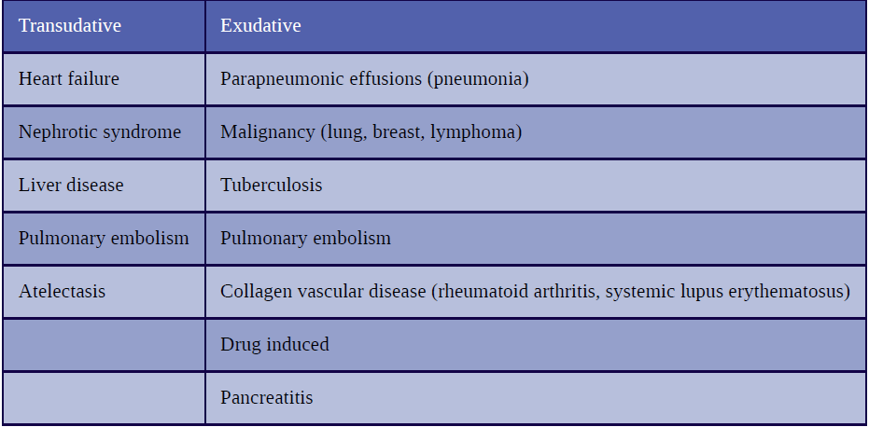

Slide 10
Unable to remain the fluid with-in intravascular space
hydrostatic
pressure /
oncotic pressure
Fluid shift interstitial space
Effusion

Slide 11
fluid shift into interstitial space
Initiation of inflammatory reaction
Vasodilation increase capillary permeability
leak of plasma protein
decrease oncotic pressure
Invasion of microbes

Slide 12
Clinical presentation
Notes :
If the patient has minimal effusion with minimal lung compression he might not have any symptoms
When the effusion is moderate to large size or caused by inflammation symptoms are present
It may also lead to respiratory failure in some cases
Note that symptoms are related to the underlying cause of effusion

Slide 13
Signs and symptoms:
Dyspnea
Cough
Peripheral edema
Pleuritic chest pain:
Results from pleural irritation and raises the likelihood of an exudative etiology. Analysis of pain:
Pain may be mild or severe.
Described as sharp or stabbing.
Exacerbated with deep inspiration.
Pain may be localized to the chest wall or referred to the ipsilateral shoulder or
upper abdomen.

Slide 14
Physical examination
Physical examination should focus on finding the cause and assessing the degree of respiratory compromise .
Physical findings accrue at effusion >300 ml

Slide 15
Inspection :
Tachypnea
Absent or diminished movements off affected side Fullness of chest with bulging of intercostal spaces
Palpation:
Asymmetrical chest expansion, with diminished or delayed expansion on the side of the effusion.
decreased tactile fremitus
Mediastinal shift away from the effusion (effusion of >1000ml)

Slide 16
Percussion :
Stony dullness to percussion.
Auscultation:
Absent of breathing sounds over the effusion
Vocal resonance absent
There may be signs of pneumonia ( bronchial breathing , crackles)

Slide 17
Investigation

Slide 18
Thoracentesis
Radiological investigation

Slide 19
CXR
PA and lataral
US
More accurat than plain chest X-ray for determining the presence of fluid.
CT scan
Is indicated where malignant disease is suspected.
More reliable than CXR for detecting effusion.

Slide 20
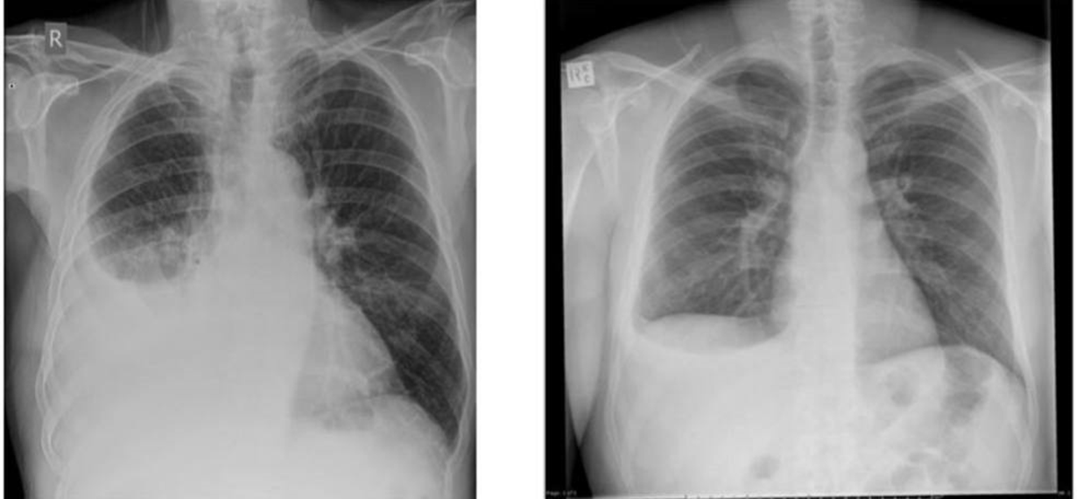
Rt sided plural effusion

Slide 21
Lt sided pleural effusion

Slide 22
CXR (PA and lateral)
Blunting of costophrenic angle
About 250 mL of pleural fluid must accumulate before an effusion can be detected. (only obliteration of the costophrenic angel)
Lateral decubitus films: more reliable than PA and lateral CXRs for detecting small pleuraleffusions; can also determine whether fluid is free flowing or loculate.
Tracheal and mediastinal shifts are seen in massive effusion
A curved shadow at lung base that ascend on the chest wall toward the axilla, fluid appear totrack up the lateral chest wall (meniscus sign)

Slide 23
CT scan

Slide 24
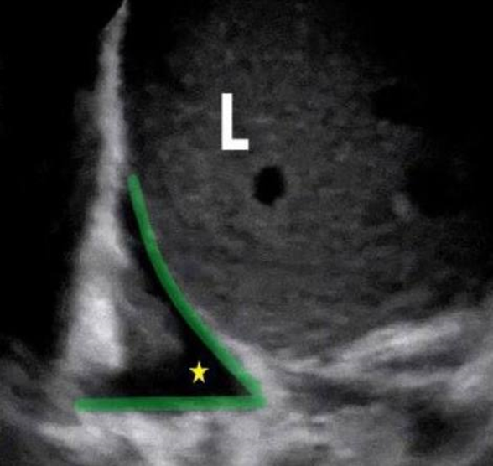
US
Us with minimal Rt sided plural effusion

Slide 25
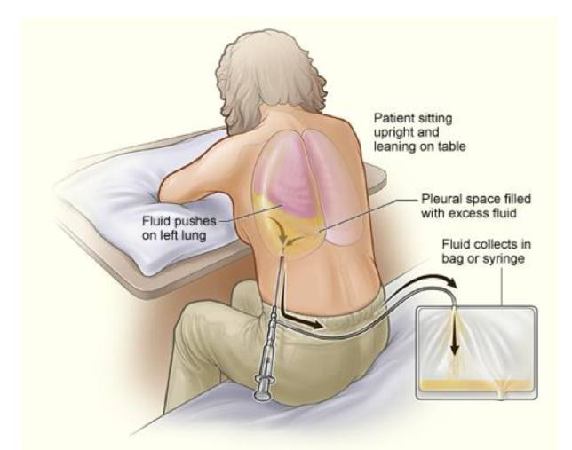
2-Thoracentesis
is a procedure that drains fluid or
air from the space between the
lungs and the wall of the chest
(the pleural space). It is done
using a hollow needle or a plastic
tube inserted through the chest
wall. Normally only a small
amount of fluid is in the pleural
Space and is done in the most

Slide 26
2-Thoracentesis
Thoracentesis is indicated for evaluation of all new pleural effusions. It provides a diagnosis in 75% of patients, and even when it is not diagnostic it provides important clinical information as it Helps to differentiate between exudates and transudates Therapeutic -drainage provides relief for large effusions.
Pneumothorax is a complication seen in 10% to 15% of thoracenteses, but it requires treatment with a chest tube in < 5% of cases.

Slide 27
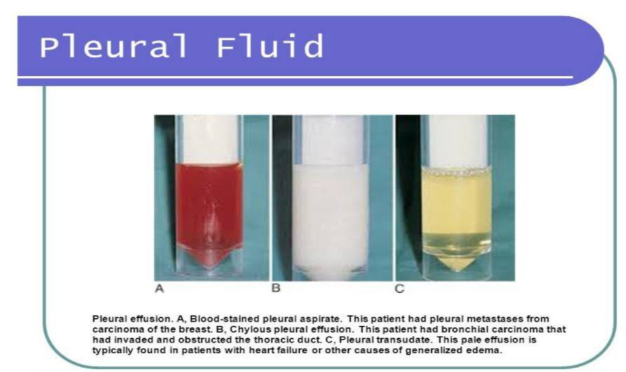
transudates are clear, and without odor.
Frankly purulent fluid indicates an empyema ..
A milky fluid suggests a chylothorax:lymph in the pleural space.
Grossly bloody fluid may result from trauma, malignancy, post pericardiotomy syndrome, or
asbestos-related effusion
Elevated pleural fluid amylase esophageal rupture, pancreatitis ,malignancy.
Exudative effusion that are primary lymphcytic :TB
PH<7.3 : parapneumonic effusion or empyema

Slide 28
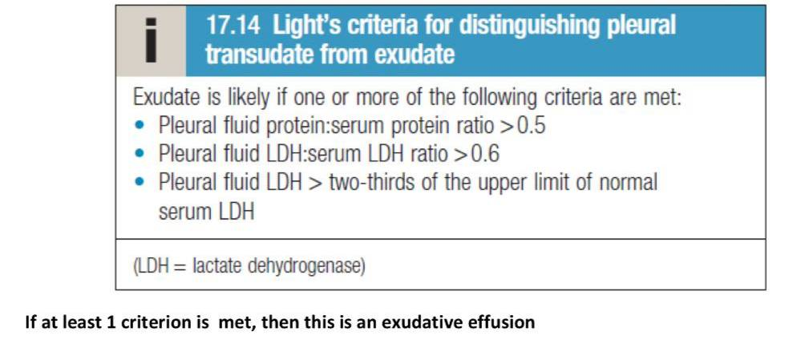

Slide 29
Note: In cases of hemothorax or empyema ,chest-tube ; drainage is a must ; because blood and pus are very irritant and will lead to fibrosis if not treated rapidly.
Parapneumonic effusion:
Divided into three types:
Uncomplicated parapneumonic effusions: The fluid may be cloudy or clear, and it doesn't contain bacteria. PPE will get better when you take antibiotics to treat pneumonia.
Complicated parapneumonic effusions: Bacteria have traveled from the lungs into the pleural space, causing a buildup of fluid and white blood cells. The fluid is cloudy. It will need to be drained.
Empyema.: Thick, whitish-yellow pus builds up in the pleural space. This can if happen if pneumonia isn't treated quickly enough.

Slide 30
management
Treat the cause Pneumonia : antibiotics CHF: diuretics malignancy
Pleural fluid aspiration
Wide bore needle
Intercostal drainage under water seal
Thoracic surgery : needs VATS

Slide 31
