Slide 1
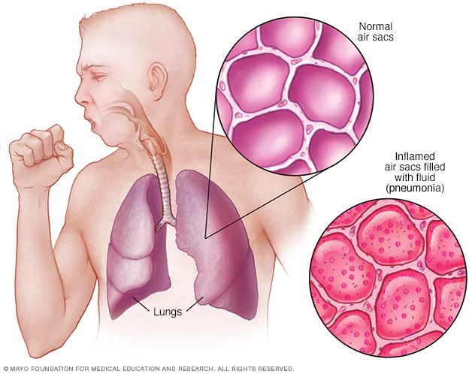
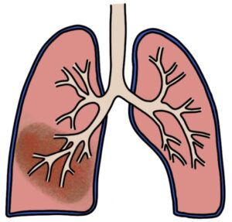
Pneumonias
BY: Mahmoud Atalla

Slide 2
Pneumonia Classification
There are four classifications of pneumonia:
o Community-acquired pneumonia (CAP)
o Aspiration pneumonia
o Hospital-acquired pneumonia (HAP)
o Ventilator-associated pneumonia (VAP)

Slide 3
Community Acquired Pneumonia (CAP)
An acute infection of the pulmonary parenchyma that is associated with some symptoms of acute infection, accompanied by the presence of an acute infiltrate on a chest radiograph, OR auscultatory findings consistent with pneumonia, in a patient not hospitalized or residing in a long term care facility for > 14 days before onset of symptoms.

Slide 4
Clinical finding
+
or
SYMPTOM
X-ray finding

Slide 5
Aspiration pneumonia: Pneumonia can be caused by aspiration of either oropharyngeal or gastrointestinal contents

Slide 6
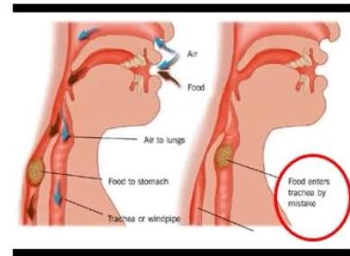
Hospital-acquired pneumonia (HAP): defined as pneumonia that occurs 48 hours or more after admission, up to 14 days after discharge .

Slide 7
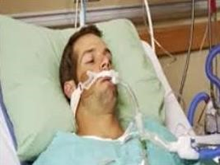
Ventilator-associated pneumonia (VAP): requires endotracheal intubation for at least 48 hours before the onset of pneumonia

Slide 8
Community Acquired Pneumonia (CAP)
Epidemiology
4-5 million cases annually
~500,000 hospitalizations – 20% require admission
~45,000 deaths
Probably highest incidence in <5 and >65 yrs
Fewest cases in 18-24 yr group
Mortality disproportionately high in >65 yrs

Slide 9
CAP – The Pathogens Involved

Slide 10
Streptococcus pneumoniae colonizes the nasopharyngeal flora in up to 50% of healthy adults and may colonize the lower airways in individuals with chronic bronchitis and it possesses many virulence factors, enhancing its ability to cause infection in the respiratory tract
Notes:
Moraxella catarrhalis is a more common cause of pneumonia in the very young and the very old

Slide 11
Viral pneumonia
In adults, the most common viruses that cause pneumonia are influenza A and B and rhinoviruses
children, viral pneumonia is more commonly caused by respiratory syncytial virus (RSV), influenza A, and parainfluenza
Notes:
but can also be caused by adenoviruses, enteroviruses, cytomegalovirus, varicella-zoster virus, herpes simplex virus, and others.

Slide 12
Pneumonia owing to aspiration of oral contents is caused by a variety of anaerobes. (Bacteroides spp.)
Notes:
(Bacteroides spp., Fusobacterium spp., Prevotella spp., and anaerobic gram-positive cocci) as well as Streptococcus spp. Moraxella catarrhalis and Eikenella corrodens may be involved but much less frequently

Slide 13
Diagnosis of pneumonia

Slide 14
Hx:
Fever/chills | 85%
Dyspnea | 70%
Purulent sputum | 50%
Chest pain | 40%

Slide 15
P/E: most useful in predicting severity. Physical exam may reveal fever, tachypnea, tachycardia.
Lung exam; increased tactile fremitus, dullness to percussion, increased breath sounds, presence of crackles
CXR is gold standard - may be normal in up to 7% on admission; assume pneumonia present if convincing hx and focal P/E

Slide 16
CAP – The Two Types of Presentations
Typical
Atypical
Sudden onset of CAP
High fever, shaking chills
Productive cough
Rusty sputum, blood tinge
Poor general condition
High mortality up to 20% in patients with bacteremia
S.pneumoniae causative
Gradual & insidious onset
Low grade fever
Dry cough .
Confusion
Diarrhea. Abdominal pain
Low mortality 1-2%; except in cases of Legionellosis
Mycoplasma , Chlamydiae,
Legionella, Ricketessiae, Viruses

Slide 17
Streptococcus pneumonia (Pneumococcus)
Most common cause of CAP
About 2/3 of CAP are due to S.pneumoniae
These are gram positive diplococci
Typical symptoms (e.g. malaise, shaking chills fever, rusty sputum, pleuritic chest pain, cough)
Lobar infiltrate on CXR
May be Immuno suppressed host
25% will have bacteremia – serious effects
Notes:
Predisposing factors: anorexia, ETOH, HIV, sickle cell disease, splenectomy, hematologic diseases

Slide 18
a patient with Legionella pneumonia :
may complain predominantly of diarrhea, fever, headache, confusion, and myalgia
Notes:
However, only rarely does the clinical history clearly suggest a specific etiologic diagnosis

Slide 19
For Mycoplasma pneumoniae :
extrapulmonary manifestations such as myringitis, encephalitis, uveitis, iritis, and myocarditis may be present.

Slide 20
S. aereus CAP – Dangerous
This CAP is not common; Multi lobar Involvement
Post Influenza complication.
Compromised host, Co-morbidities, Extreme of age
Empyema and Necrosis of lung with cavitations
Multiple Pyemic abscesses, Septic Arthritis
Hypoxemia, Hypoventilation, Hypotension common
Vancomycin, Linezolid are the drugs for MRSA

Slide 21
CAP – Laboratory Tests
CBC with Differential
BUN and Creatinine
Liver enzymes
Serum electrolytes
ABG
Gram stain of sputum
Culture of sputum
blood culture
CRP
urinalysis

Slide 22
LAB (cont.)
Do a sputum Gram stain and culture in patients with:
• severe or unresponsive CAP.
• COPD.
• cavitary infiltrates.
• a pleural effusion.

Slide 23
Blood cultures should be done on patients with:
• sepsis
• severe or unresponsive CAP
• COPD
• liver disease
• cavitary infiltrates
• asplenia
• a pleural effusion
• leukopenia
• a positive pneumococcal urine antigen test.

Slide 24
Chest X-ray – Pneumonia

Slide 25
Chest X-ray – Pneumonia

Slide 26
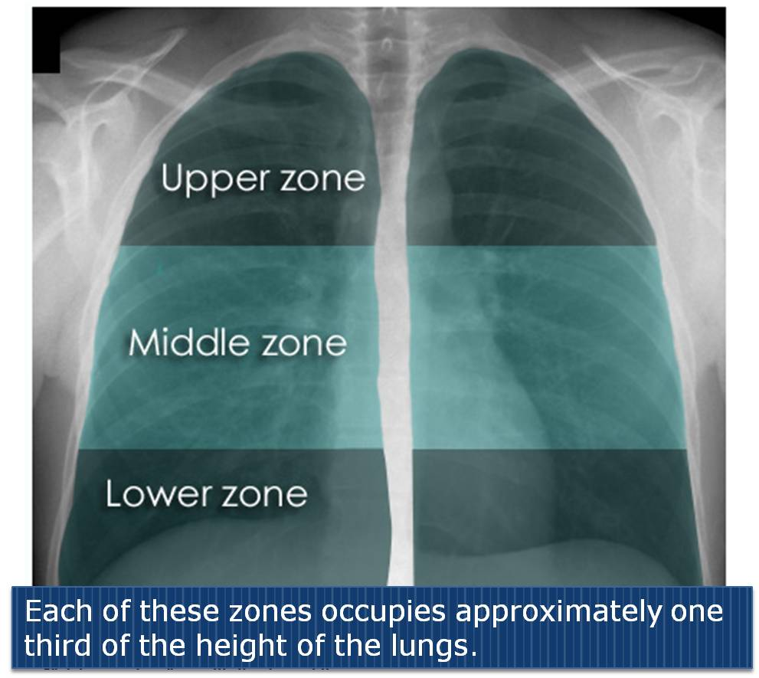

Slide 27
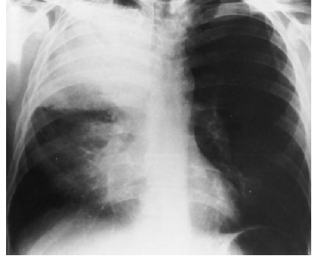

Slide 28
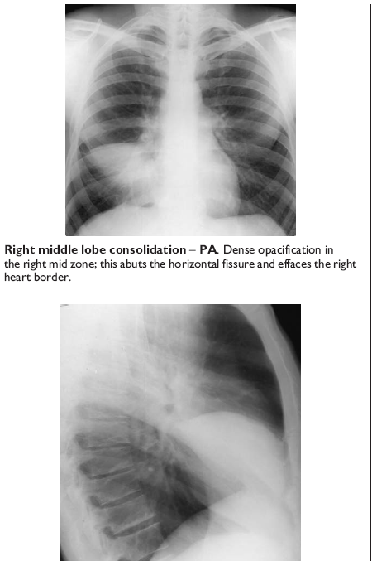
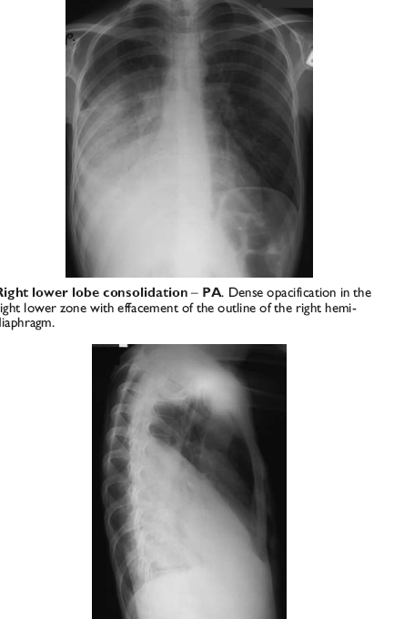

Slide 29
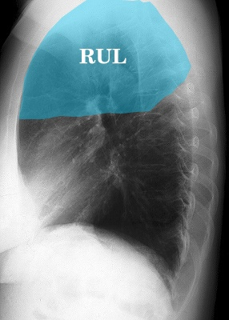
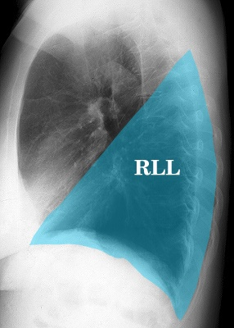
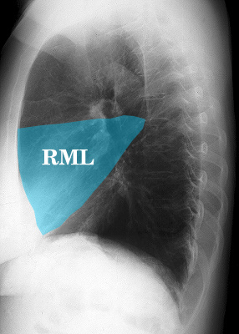

Slide 30
Infiltrate Patterns and Pathogens
CXR Pattern | Possible Pathogens
Lobar | S.pneumo, Kleb, H. influ.
Patchy | Atypicals, Viral, Legionella
Interstitial | Viral, Legionella
Cavitatory | Anerobes, Kleb, TB, S.aureus, Fungi
Large effusion | Staph, Anaerobes, Klebsiella

Slide 33
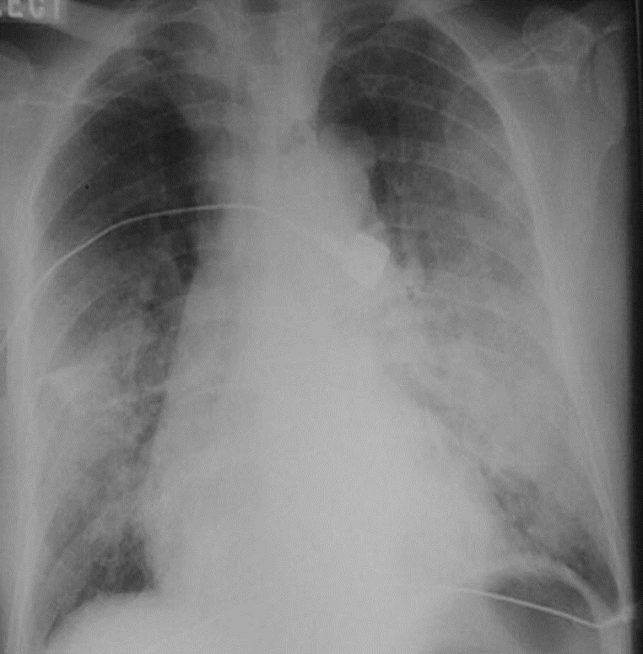

Slide 34
CAP – Risk Factors for Hospitalization
Steroid use
Chronic diseases: Diabetes, CHF.
Neoplasia
Heavy smoking
Old Age
Unemployed
No social support
Asthma
COPD

Slide 35
CAP – Risk Factors for Mortality….
Age > 65
Bacteremia (for S. pneumoniae)
S. aureus, MRSA , Pseudomonas
Extent of radiographic changes
immuno-suppression
Amount of alcohol consumption

Slide 36
CAP – Complications…
Hypotension and septic shock
Pleural effusion
Empyema
Lung abscess – destruction of lung .
Septicemia
Multiple Pyaemic Abscesses
Notes:
Pyaemia (or pyemia) is a type of sepsis that leads to widespread abscesses of a metastatic nature. It is usually caused by the staphylococcus bacteria by pus-forming organisms in the blood. Apart from the distinctive abscesses, pyaemia exhibits the same symptoms as other forms of septicaemia
Pleural effusion; Clear fluid + pus cells

Slide 37
CAP – Management Guidelines
Proper diagnosis :Hx, P/E, CXR
Decision to hospitalize based on prognostic criteria – PSI , CRB65, CURB 65,.. scores
Pathogen directed antimicrobial therapy whenever possible
Prompt initiation of Antibiotic therapy

Slide 38
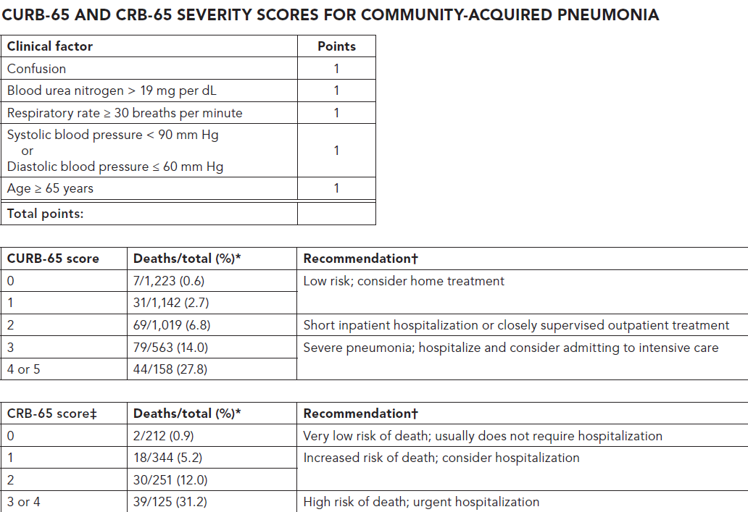

Slide 39
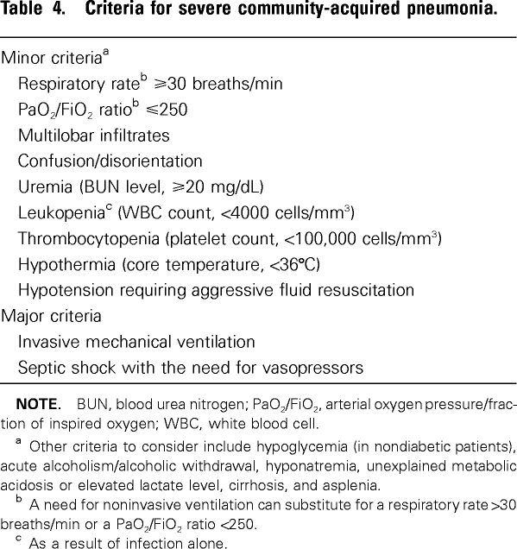
ICU admission = one major or 3 minor

Slide 41
Outpatient treatment
CURB-65 (0 or 1) who is Previously healthy no comorbidity and no risk factors for drug-resistant
Amoxicillin (500 mg 3 times daily orally) OR
amoxicillin + clavulanic acid
OR
A macrolide {azithromycin (500 mg once daily), clarithromycin (500 mg twice daily), or erythromycin}

Slide 42
In-patient ward treatment….
1. CURB-65 (2)
2. CURB-65 (0 or 1) plus any of the followings: {Presence of poorly conrolled comorbidities, such as chronic heart, lung, liver, or renal disease; diabetes mellitus; alcoholism; malignancies; asplenia; use of immunosuppressing drugs; use of antimicrobials within the previous 3 months…….}.

Slide 43
In-patient ward treatment….

Slide 44
A B-lactam plus a macrolide (strong recommendation; level I evidence)
OR
A respiratory fluoroquinolone (moxifloxacin, gemifloxacin, or levofloxacin [750 mg once daily]) (strong recommendation; level I evidence)
Notes:
gemifloxacin [320 mg orally daily])
moxifloxacin [400 mg IV or orally daily]

Slide 45
*amoxicillin [e.g., 1 g 3 times daily] *amoxicillin-clavulanate [1.2 g (2-3) times daily] *ceftriaxone (1-2 g once daily) *cefuroxime [1.5 g (2-3) times daily]
B-lactam antibiotics (IV doses) High-dose

Slide 46
Inpatient, ICU treatment ……
A b-lactam (cefotaxime, ceftriaxone, or ampicillin-sulbactam) plus either azithromycin or a fluoroquinolone) (For penicillin-allergic patients, a respiratory fluoroquinolone and aztreonam are recommended.)
or
If MRSA is suspected, vancomycin (15 mg/kg IV every 12 hours, in seriously ill patients, a loading dose of 25 to 30 mg/kg may be given, OR linezolid (600 mg IV every 12 hours).
For Pseudomonas infection, use antipseudomonal b-lactam (piperacillin-tazobactam, cefepime,imipenem, or meropenem) PLUS either ciprofloxacin or levofloxacin (750-mg dose) or Aminoglycosides (gentamicin, tobramycin, or amikacin)
Notes:
ceftriaxone (1 to 2 g IV daily),
cefotaxime (1 to 2 g IV every 8 hours)
azithromycin (500 mg once daily)
ampicillin-sulbactam (3 g IV every 6 hours)
aztreonam (2 g IV every 8 hours)
ertapenem [1 g IV daily])
Meropenem (1 g every 8 hours) or
●Cefepime (2 g every 8 hours) or
●Ceftazidime (2 g every 8 hours; activity against pneumococcus more limited than agents listed above)
●Ciprofloxacin (400 mg every 8 hours)
linezolid (600 mg IV every 12 hours).

Slide 47
Patients should demonstrate some improvement in clinical parameters by 72 hours, although fever may persist with lobar pneumonia.
Cough from pneumococcal pneumonia may not clear for a week.
Abnormal chest radiograph findings usually clear within four weeks but may persist for7- 12 weeks in older individuals and those with underlying pulmonary disease

Slide 48
Switch to Oral Therapy
Four criteria
Improvement in cough, dyspnea & clinical signs
Afebrile on two occasions 8 h apart
WBC decreasing towards normal
Functioning GI tract with adequate oral intake
Notes:
If overall clinical picture is otherwise favorable, hemodynamically stable; can switch to oral therapy while still febrile

Slide 49
Duration of Therapy
For patients with low or moderate severity and uncomplicated pneumonia, 7 days of appropriate antibiotics is recommended.
For those with high severity microbiologically-undefined pneumonia, 7–10 days treatment is proposed.
14 or 21 days; if S. aureus or Gram-negative enteric bacilli pneumonia is suspected or confirmed.

Slide 50
Patient can be discharged home if all the following criteria:
Curb score 0-1 Able to eat and drink
Pulse ≤100 beats per min
Respiratory rate ≤30 per min
Normal Systolic blood pressure according to the age and BP baseline .
Oxygen saturation ≥94 percent or if the resident had chronic obstructive pulmonary disease (COPD) ≥90 percent.
Social support and home care .

Slide 52
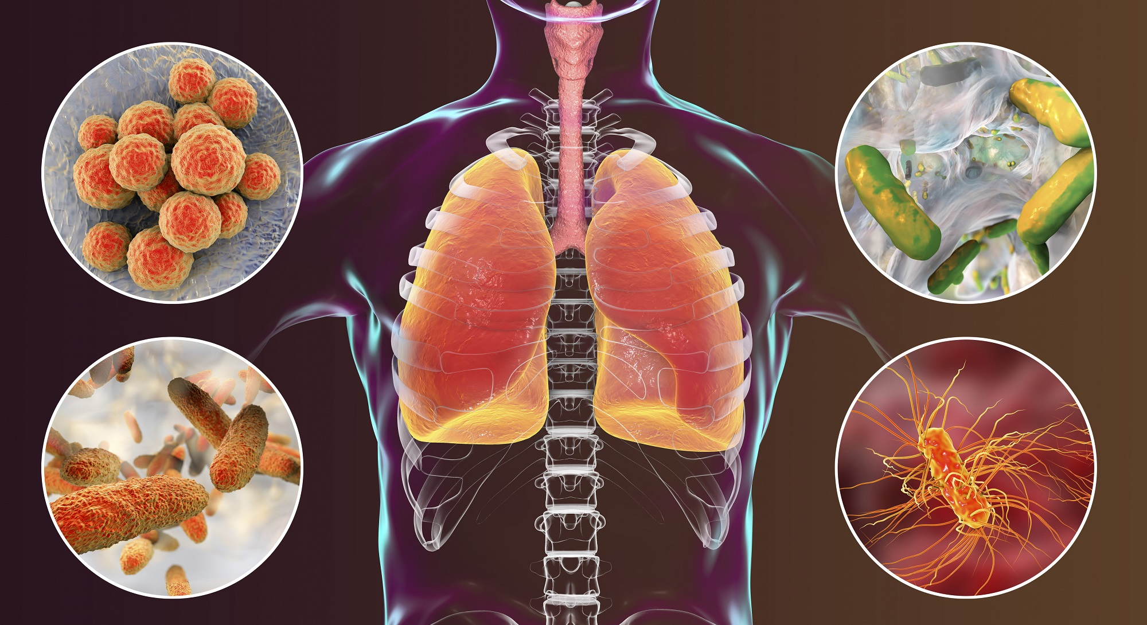
Hospital-Acquired Pneumonia and COVID-19
BY: Maisoon Irshead

Slide 53
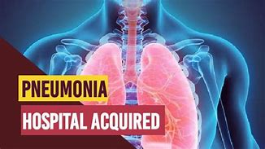
Hospital-Acquired Pneumonia (HAP)
Pneumonia that develops after 2-3 days of hospitalization up to 14 days after discharge
Includes:
Ventilator-Associated Pneumonia (VAP) same as HAP but on mechanical ventilator ,endotracheal intubation
requires endotracheal intubation for at least 48 hours before the onset of pneumoni

Slide 54
HAP and VAP may be caused by a wide spectrum of organisms.
The organisms implicated in early-onset HAP (occurring within 4–5 days of admission) are similar to those involved in CAP In patients who have received no previous antibiotics, co-amoxiclav or cefuroxime represents a sensible choice. If the patient has received a course of recent antibiotics, then piperacillin/tazobactam or a third-generation cephalosporin should be considered.

Slide 55
Late-onset HAP is more often attributable to Gram-negative
bacteria (e.g. Escherichia coli, Pseudomonas aeruginosa,
Klebsiella spp. and Acinetobacter baumannii),
Staph. aureus(including meticillin-resistant Staph. aureus (MRSA)) and
anaerobes, and the choice of antibiotics ought to cover these
possibilities.

Slide 56
• HAP and VAP pathogens are influenced by risk factors for multidrug resistant (MDR) bacteria.

Slide 58
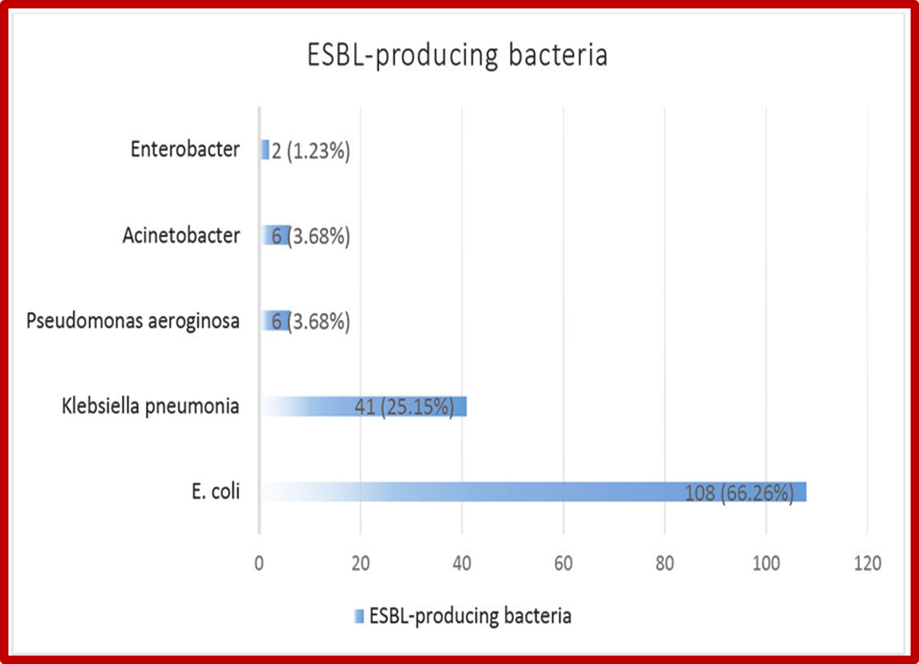
MDR organisms include
extended spectrum β-lactamase (ESBL) and/ or
carbapenemase-producing enteric gram-negative bacilli,
Pseudomonas aeruginosa, Acinetobacter spp.,
MRSA

Slide 59
PHARMACOLOGY THERAPY FPR HAP/VAP
The principles of management are similar to those of CAP, focusing on adequate oxygenation, appropriate fluid balance and antibiotics.
Empirical selection of antimicrobiaL therapy for VAP & HAP is broad spectrum; however once culture and susceptibility information is available, the therapy should be narrowed (deescalation) to cover the identified pathogen(s).
Factors important to the empirical selection of antibiotics are: 1-risk of mortality,2- MRSA risk factors, 3-intravenous use of antibiotics in the prior 90 days
The empirical selection antibiotic must cover p.aeruginosa and when cover it mean cover all the pathogen.

Slide 62
Viral Pneumonia
Viruses that can lead to pneumonia include:
Influenza (flu) A and B viruses, the most common causes in adults
Respiratory syncytial virus (RSV), which is more common in infants and children than in adults
Coronaviruses, including SARS-CoV-2, the new virus that causes COVID-19
Rhinoviruses, parainfluenza viruses, and adenoviruses, which can also cause pinkeye

Slide 63
Clinical suspicion of COVID-19 should therefore be considered in any individual with new-onset fever, persistent cough, dyspnea, smell or taste disturbance, myalgia, and gastrointestinal disturbance.

Slide 64
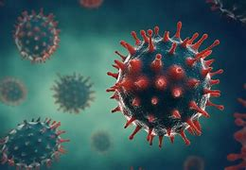
severe acute respiratory syndrome coronavirus 2 (SARS-CoV-2).
SARS-CoV-2 is an enveloped positive-strand RNA virus
It rapidly spread, resulting in a global pandemic.
The SARS-CoV-2 spike proteins have a high affinity for the angiotensin-converting enzyme 2 (ACE2) receptor on human cells
This allows viral entry into the cell by endocytosis or fusion of the viral envelope with the host cell's lipid membrane.
The virus enters type 2 pneumocytes via the ACE2 receptor and undergo replication
release inflammatory mediators including interleukins (IL-1, IL-6, IL-8, IL-10 and IL-12), tumor necrosis factor-α (TNF-α)
The inflammatory response attracts neutrophils, CD4 helper T cells and CD8 cytotoxic T cells which enter the lung parenchyma to destroy the virus. In so doing, they also cause widespread collateral damage to the lung tissue culminating in acute respiratory distress syndrome (ARDS)

Slide 65
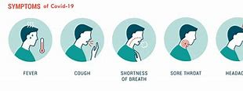
●Cough
●Fever (subjective or >100.4°F/38°C)
●Myalgia
●Headache
●Dyspnea
●Sore throat
●Diarrhea
●Nausea/vomiting
●Loss of smell or taste, abdominal pain, and rhinorrhea

Slide 66
The incubation period from the time of exposure until the onset of symptoms is three to five days on average, partly depending on the variant, but it may be as long as 14 days.

Slide 67
Multisystem complications of severe COVID-19 are common and include acute kidney and liver injury, arterial and venous thromboembolism, and central and peripheral nervous system complications. Cardiovascular complications of COVID-19 include myocarditis, dysrhythmias, heart failure, acute

Slide 68
Several complications of COVID-19 have been described:
Respiratory failure
Cardiac and cardiovascular complications
Thromboembolic complications
Neurologic complications
Inflammatory complications
Secondary infections

Slide 69
Laboratory abnormalities
Lymphopenia
•Thrombocytopenia
•Elevated liver enzymes
•Elevated lactate dehydrogenase (LDH)•Elevated inflammatory markers (eg, C-reactive protein [CRP], ferritin) and inflammatory cytokines (ie, interleukin 6 [IL-6] and tumor necrosis factor [TNF]-alpha)
•Elevated D-dimer (>1 mcg/mL)
•Elevated prothrombin time (PT)
•Elevated troponin
•Elevated creatine phosphokinase (CPK)
•Acute kidney injury

Slide 70
IMAGING FINDINGS
Chest radiographs may be normal in early or mild disease, Common abnormal radiograph findings were consolidation and ground-glass opacities, with bilateral, peripheral, and lower lung zone distributions; lung involvement increased over the course of illness, with a peak in severity at 10 to 12 days after symptom onset.

Slide 71
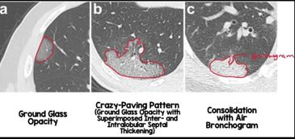
Chest CT:
Ground-glass opacifications
Ground-glass opacifications with mixed consolidation
Adjacent pleural thickening
Interlobular septal thickening
Air bronchograms
crazy paving pattern
(ground-glass
opacifications with
superimposed
septal thickening)

Slide 72
Typical CT imaging features for COVID-19. Unenhanced thin-section axial images of the lungs in a 52-year-old man with a positive RT-PCR (A to D) show bilateral, multifocal rounded (asterisks) and peripheral ground-glass opacity (arrows) with superimposed interlobular septal thickening and visible intralobular lines ("crazy-paving"). Routine screening CT for diagnosis or exclusion of COVID-19 is currently not recommended.

Slide 73
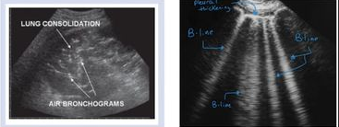
Lung ultrasound when other imaging resources are not readily available. thickening, discontinuation, and interruption of the pleural line; B lines visible under the pleura that appear discrete, multifocal, or confluent; patchy, strip, and nodular consolidations; and air bronchogram signs in the consolidations

Slide 74
SPECIFIC DIAGNOSTIC TECHNIQUES
Test category | Primary clinical use | Specimen type | Performance characteristics | Comments
NAATs (including RT-PCR) | Diagnosis of current infection | Respiratory tract specimens | High sensitivity and specificity . false-negative rate ranges from <5 to 40% | Time to perform the test ranges from 15 minutes to 8 hours
Serology (antibody detection) | Diagnosis of prior infection (or infection of at least 3 to 4 weeks' duration) | Blood | Detectable antibodies generally take several days to weeks to develop; IgG usually develops by 14 days after onset of symptoms. | Time to perform the test ranges from 15 minutes to 2 hours.
Antigen tests | Diagnosis of current infection | Nasopharyngeal or nasal swabs | less sensitive than nucleic acid tests. highest in symptomatic individuals | Time to perform the test is <1 hour.

Slide 76
Defining disease severity
in the absence of dyspnea. Most of these patients do not need hospitalization.
f patients develop dyspnea, that raises concern that they have at least moderate severity disease
but the presence of any of the following features indicates severe disease:
●Severe dyspnea (dyspnea at rest, and interfering with the ability to speak in complete sentences)
•Oxygen saturation on room air of ≤90 percent, regardless of severity of dyspnea
•Concerning alterations in mentation (eg, confusion, change in behavior, difficulty in rousing) or other signs and symptoms of hypoperfusion or hypoxia (eg, falls, hypotension, cyanosis, anuria, chest pain suggestive of acute coronary syndrome)

Slide 77
for severe disease and were hospitalized
Approach to patients with no oxygen requirement – For such patients who have clinical or laboratory risk factors for severe disease and were hospitalized for COVID-19, we suggest remdesivir. Individuals who have risk factors but were hospitalized for other reasons (ie, have incidental SARS-CoV-2 infection) may be eligible for monoclonal antibody therapy, similar to high-risk outpatients. For patients without any risk factors, care is primarily supportive. All patients warrant close monitoring for disease progression n.

Slide 79
Adult Outpatients
For adult outpatients with nonsevere COVID-19 and risk factors for progression to severe disease, we recommend early treatment with one of the following agents rather than no therapy for unvaccinated individuals and individuals expected to have an inadequate vaccine response .We also suggest treatment with one of these agents rather than no therapy for other vaccinated individuals with nonsevere COVID-19 and risk factors for progression to severe disease :
•Nirmatrelvir/ritonavir
•Monoclonal antibody therapy active against prevalent variants
•Remdesivir
For those who cannot use or access any of these agents, molnupiravir is an option; however, it may not be as effective and is potentially teratogenic.
All of these agents should be administered as soon as possible after symptom onset.

