Slide 1
Tracheostomy
By : mohammed khalid abd-alfattah

Slide 2
01. Anatomy
02. Tracheastomy overview
03. Tracheastomy indications
04. Tracheastomy tubes

Slide 3
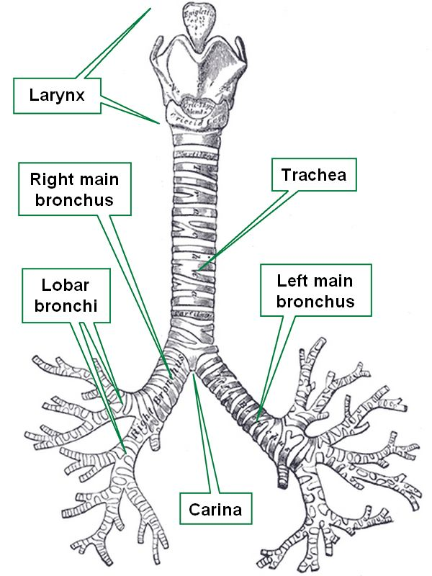
INTRODUCTION
The trachea, is a cartilaginous tube that connects the larynx to the bronchi of the lungs, allowing the passage of air, and it extend from the larynx and branches into the two primary bronchi.
Notes:
lower border of the cricoid cartilage at the level of the 6th cervical vertebra
The patency of the trachea is maintained by a series of 15–20 U-shaped cartilages.

Slide 4
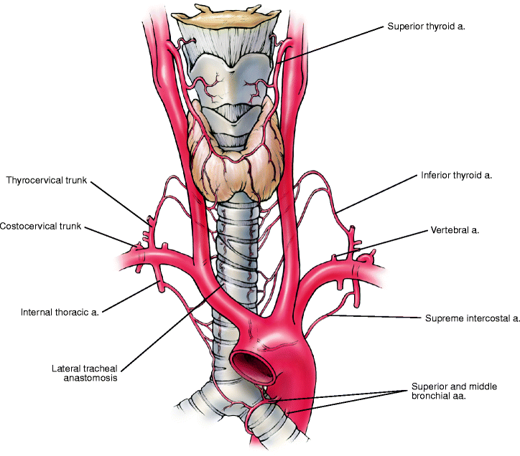
It begins as a continuation of the larynx at the lower border of the cricoid cartilage at the level of the 6th cervical vertebra , it descends in the midline of the neck …
In the thorax it ends at the carina by dividing into right & left main bronchi at the level of the sternal angle opposite to the disc between T4/5
So it extend from C6-T4/5.
The upper part of trachea receives and drains blood through the inferior thyroid arteries and veins;^{[2]} the lower trachea receives blood from bronchial arteries.
The lymphatic vessels of the trachea drain into the pretracheal nodes that lie in front of the trachea, and paratracheal lymph nodes that lie beside it
Notes:
In adult , the trachea is about (11.5cm) in length and nearly (2.5cm) in diameter.
In infants , the trachea is about (4 to 5 cm)

Slide 5
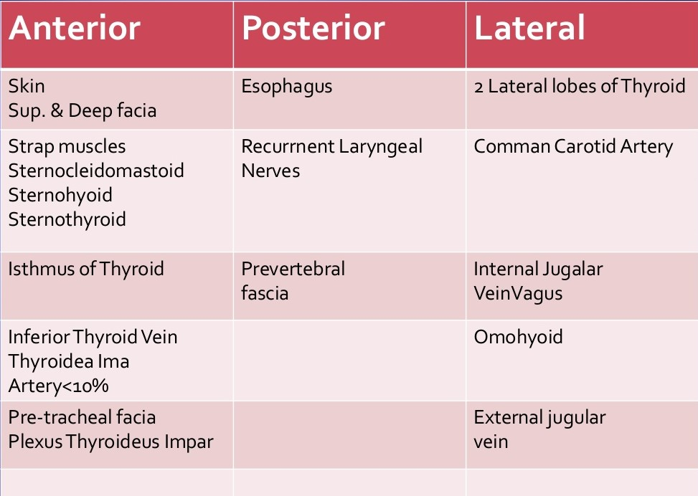
Trachea cervical Relations
Trachea is Lying partly in the neck and partly in the thorax,

Slide 6
Tracheastomy

Slide 7
WHAT IS tracheostomy means ?
A tracheostomy is a operative procedure under GA — either temporary or permanent — that involves creating an opening in the neck in order to place a tube into a person's windpipe. The tube is inserted through a cut in the neck below the vocal cords. This allows air to enter the lungs.
The resulting opening can serve independently as an airway or as a site for a tracheal tube or tracheostomy tube to be inserted; this tube allows a person to breathe without the use of the nose or mouth.
Notes:
tracheostomy usually between the second and third ring cartilages

Slide 8
What is the difference between a permanent and temporary tracheostomy?
A tracheostomy may be temporary or permanent, depending on the reason for its use.
If it is temporary, it will be removed when no longer needed and the incision allowed to heal or its surgically closed, If the tracheostomy is permanent, the hole will stay open. However, the opening tends to narrow with time, and further surgery may be needed to widen the opening.
Temporary tracheostomy differs from the permanent in that there is still a communication between the pharynx and the lower airway via larynx, while in the permanent type the larynx is removed and the only access of the lower airway is via the tracheostome.
Notes:
One of the most indection for permanent tracheostomy is total laryngectomy

Slide 9
Indications for tracheostomy
There is three main indication for tracheostomy:-
To bypass upper airway obstruction.
Retained secretions
Respiratory insufficiency

Slide 10
A. Respiratory obstruction
Some causes of upper airway obstruction:-
Congenital
Subglottic or upper tracheal stenosis.
Laryngeal web.
Trauma
Prolonged endotracheal intubation.
Neck injuries, gunshot wounds and cut throat, laryngeal fracture.
Infections
Acute epiglottitis.
Laryngotracheobronchitis.
Malignant tumors
vocal cord paralysis
Notes:
Malignancy : advanced tumors of larynx, tongue and pharynx.
Vocal cord paralysis : post op complications thyroidectomy, cardiac, or esophageal surgery

Slide 11
B. Retained secretions
Inability to cough
• Coma of any cause, e.g. head injuries, cerebrovascular accidents, narcotic overdose
• Paralysis of respiratory muscles, e.g. spinal injuries, polio, Guillain-Barre
syndrome, myasthenia gravis
• Spasm of respiratory muscles, tetanus, eclampsia, strychnine poisoning
Painful cough
• Chest injuries, multiple rib fractures, pneumonia
Aspiration of pharyngeal secretions

Slide 12
C. Respiratory insufficiency
Chronic lung conditions :-
emphysema, chronic bronchitis, bronchiectasis, atelectasis

Slide 13
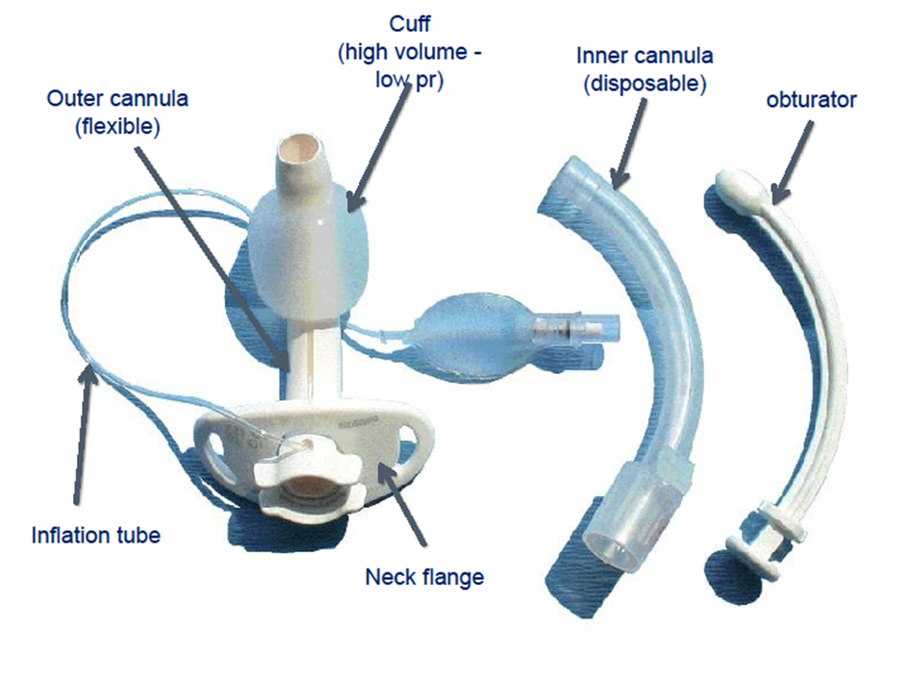
Tracheostomy Tubes
A tracheostomy (trach) tube is a curved tube that is inserted into a tracheostomy stoma (the hole made in the neck and windpipe (Trachea)). There are different types of tracheostomy tubes that vary in certain features for different purposes. These are manufactured by different companies. However, a specific type of tracheostomy tube will be the same no matter which company manufactures them..

Slide 14
A commonly used tracheostomy tube consists of three parts:-
outer cannula:-
The outer cannula is the outer tube that holds the tracheostomy open.
inner cannula:-
The inner cannula fits inside the outer cannula. It has a lock to keep it from being coughed out, and it is removed for cleaning.
Obturator :-
The obturator is used to insert a tracheostomy tube. It fits inside the tube to provide a smooth surface that guides the tracheostomy tube when it is being inserted.

Slide 15
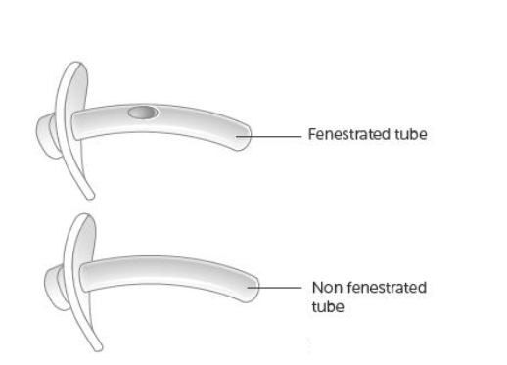
Types of tracheal tubes
Material :-
Metal (silver-stainless steel)
Plastic (polyvinyl chloride)
Silicon
Cuffed or non cuffed
Single or double tubes
Fenestrated or non fenestrated tubes
Notes:
There are different types of tracheostomy tubes available and the patient should be given the tube that best suits his/her needs. The frequency of these tube changes will depend on the type of tube and may possibly alter during the winter or summer months. Practitioners should refer to specialist practitioners and/or the manufacturers for advice.

Slide 17
Thank you

Slide 18
Tracheostomy lubna sameer

Slide 19
Botanical Method
Herbarium
Botanical Garden
ICN
Percutaneous tracheostomy
Surgical tracheostomy
Cricothiroidectomy

Slide 20
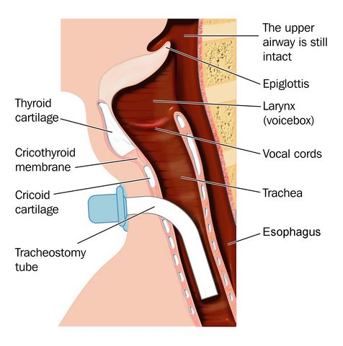
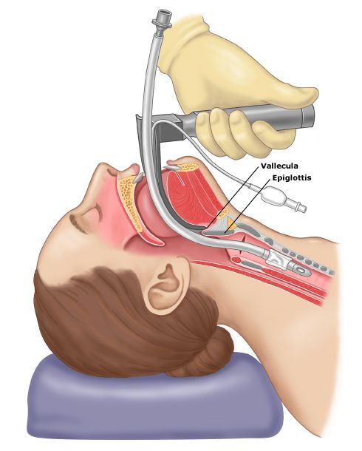
TRACHEOSTOMY VERSUS INTUBATION
Notes:
Airway access for mechanical ventilation can be provided either by a translaryngeal endotracheal or tracheostomy tube. During episodes of acute respiratory failure, patients are generally ventilated through an endotracheal tube. Changing to a tracheostomy tube is often considered when the need for mechanical ventilation is expected to be prolonged.

Slide 21
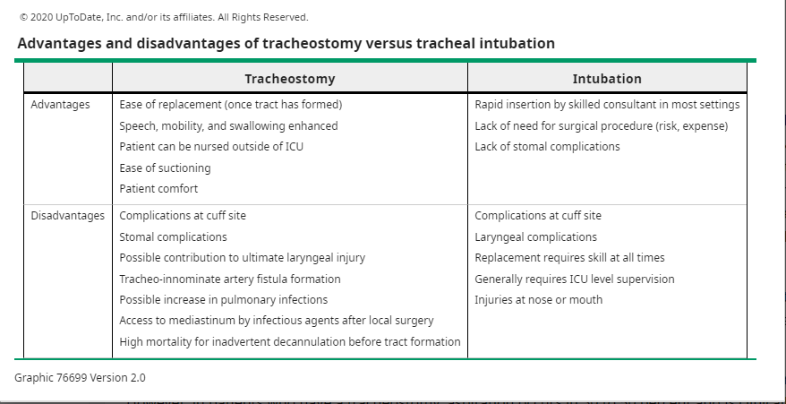

Slide 22
Airway access for mechanical ventilation can be provided either by
a translaryngeal endotracheal or tracheostomy tube.
During episodes of acute respiratory failure, patients are generally ventilated through an endotracheal tube. Changing to a tracheostomy tube is often considered when the need for mechanical ventilation is expected to be prolonged.
Many clinicians believe that patients should not be ventilated via an endotracheal tube for longer than three weeks unless they are either unstable or unlikely to benefit from tracheostomy This view is based upon the observation that tracheostomy enhances nursing care, improves patient comfort, reduces the need for sedation, and improves patient communication .
Additionally, prolonged translaryngeal intubation can be associated with a significant degree of laryngeal injury.

Slide 23
Percutaneous tracheostomy
Bedside procedure that maybe easily performed in the ICU or patient bedside ..
The major principle is dilatation over dilatation

Slide 24
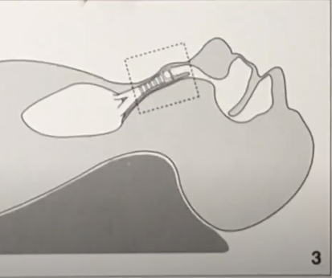
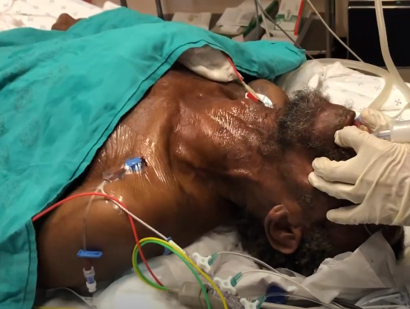
1-Patient Positioning:
The patient should be placed supine with towels under the should blades so that the neck is fully extended.
Notes:
the patient is placed in a supine position. A rolled up towel is placed under the shoulder to extend the neck, so, the trachea can be easily palpated and the cricoid cartilage is pulled superiorly. This enhances the distance between the sternal notch and the cricoid cartilage allowing easier access to trachea.

Slide 25
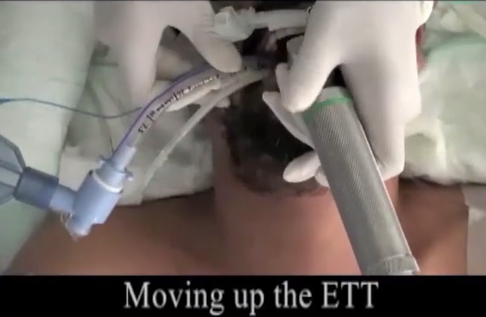
2-Withdraw Endotracheal Tube:

Slide 26
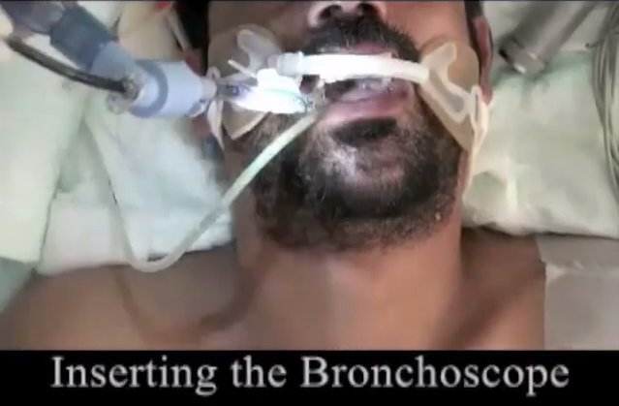
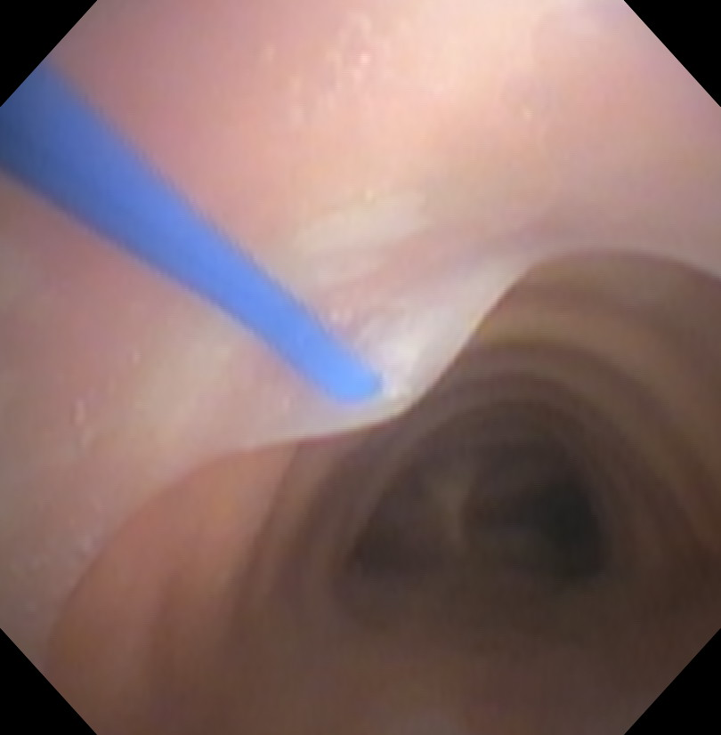
The bronchoscope is fed through the endotracheal tube but kept with the tube itself.

Slide 27
2-local anesthetic infiltration +Skin Incision:
The neck should be carefully palpated and the anatomy should identified (thyroid cartilage, cricoid cartilage, and 2-3 tracheal rings).
Consider labelling the landmarks with a permanent marker. The ideal location of the tracheostomy would be
between the 1st and 3rd tracheal ring.
Use ultrasound to identify an large vessels in the area. Once you have identified your location, a horizontal skin incision made about 2-3 cm in length.

Slide 28
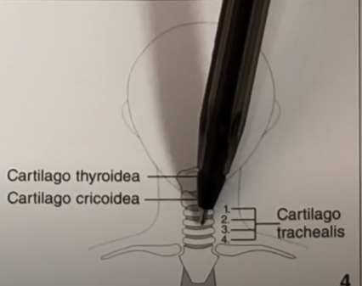
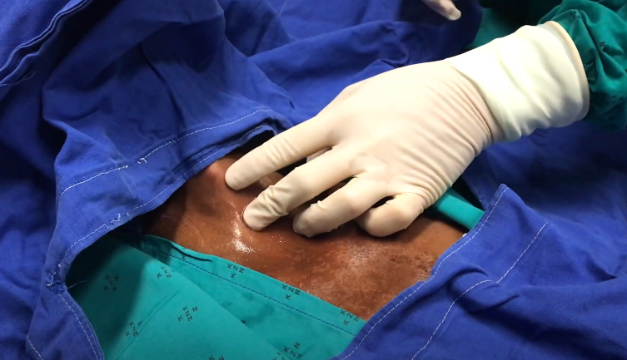
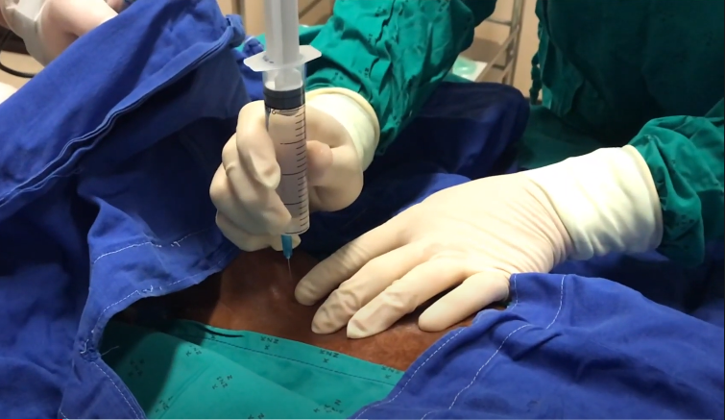
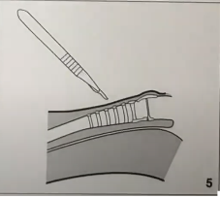
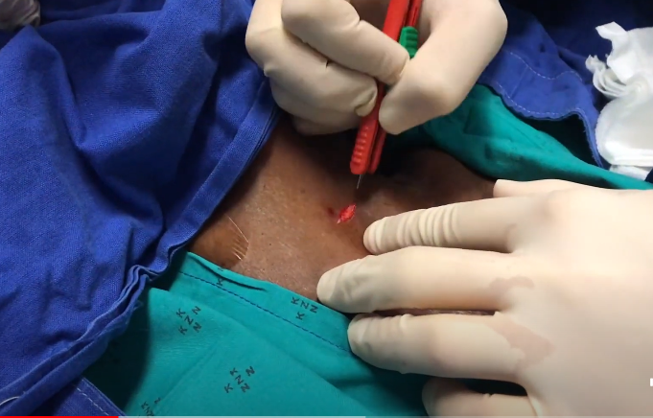
Notes:
The neck should be carefully palpated and the anatomy should identified (thyroid cartilage, cricoid cartilage, and 2-3 tracheal rings).
Consider labelling the landmarks with a permanent marker. The ideal location of the tracheostomy would be
between the 1st and 3rd tracheal ring.
Use ultrasound to identify an large vessels in the area. Once you have identified your location, a horizontal skin incision made about 2-3 cm in length.

Slide 29
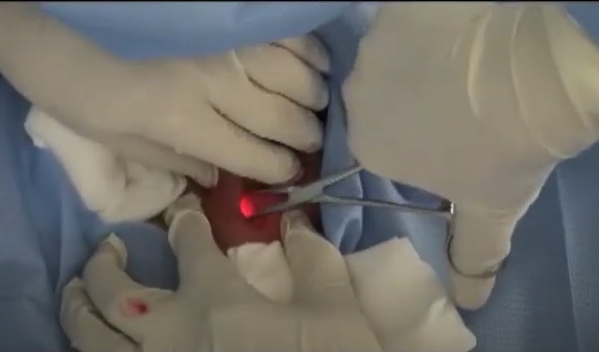
3-Dissection
The pretracheal tissue is cleared by blunt dissection with a mosquito (Kelly clamp), until the trachea is clearly palpable. It need not be fully visualized.

Slide 30
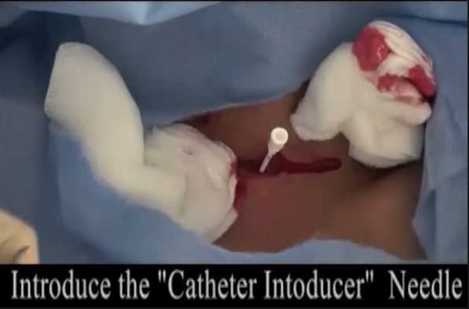
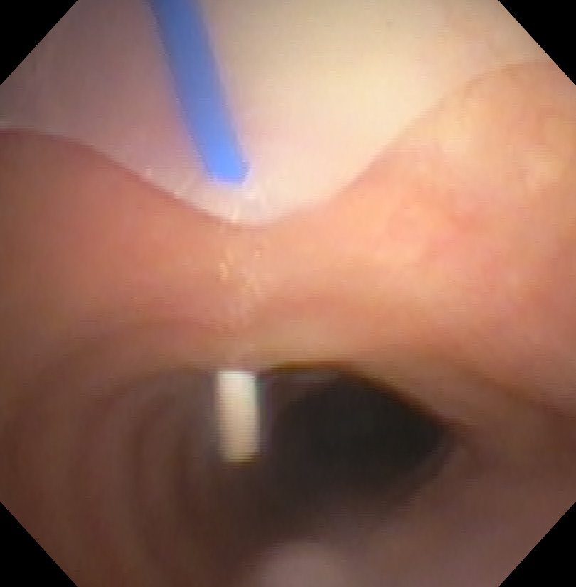
Tracheal Puncture:
Once you have endotracheal tube withdrawn far enough, the introducer needle is then used to puncture the anterior wall of the trachea under direct bronchoscopic visualization.

Slide 31
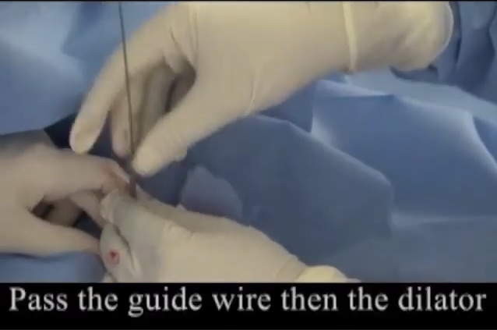
Feed the Wire
A guidewire is fed through the catheter. On the bronchoscope, it should be seen going distally down the trachea towards the carina

Slide 32
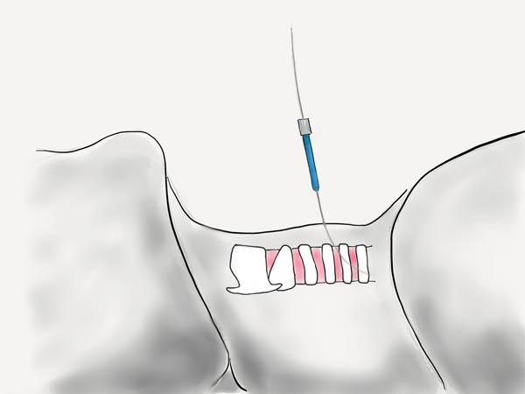
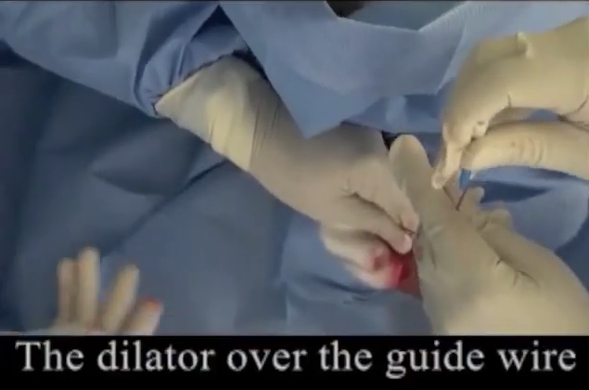
First Dilator
The catheter is removed over the wire leaving it in place. The first small blue dilator is used to dilate the track

Slide 33
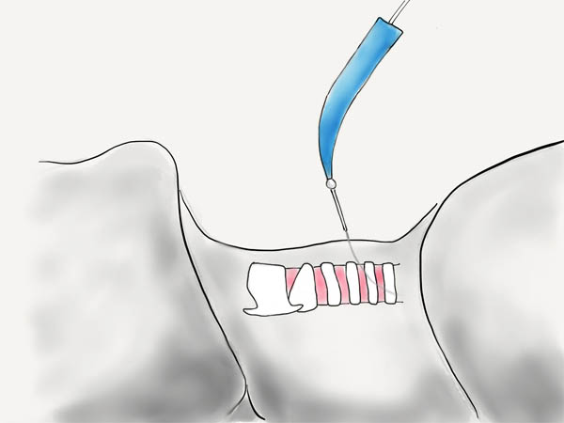
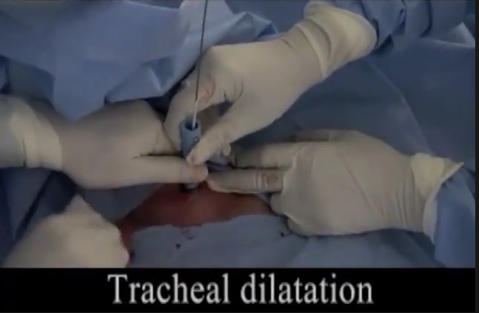
Progressive Dilator
The large progressive dilator is then used to further dilate the track over the extended catheter

Slide 34
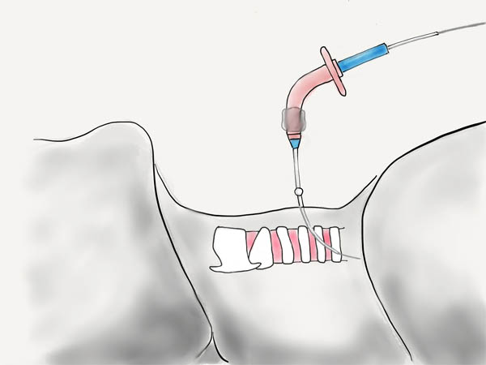
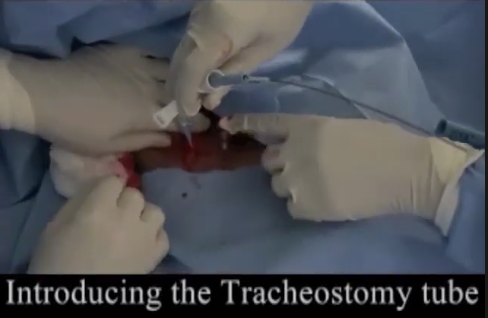
Tracheostomy Tube
Notes:
The tracheostomy tube should be inflated and the inner cannula insert. You should inspect the site for any cuff leak.

Slide 35
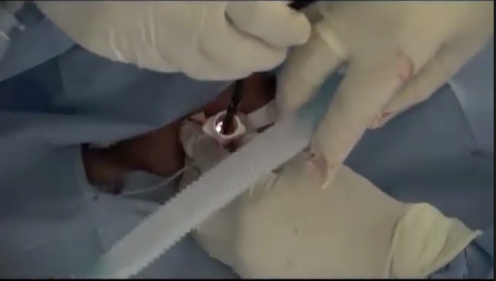
Notes:
The bronchoscope should be removed from the endotracheal tube, and placed down the tracheostomy tube to visualize the carina. Only then should the endotracheal tube be removed.

Slide 36
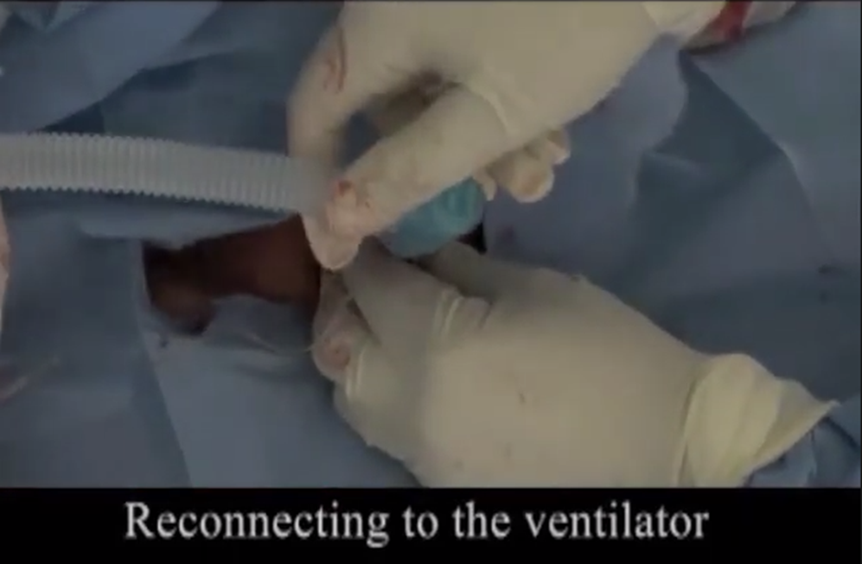

Slide 37
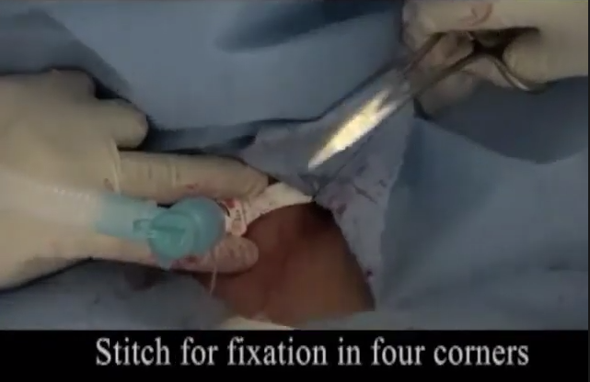
Notes:
The tracheostomy tube is secured to the skin with sutures and the tracheostomy tape.

Slide 38
Contraindications
Relative contraindications to percutaneous tracheostomy include:
age under 15 years; uncorrectable bleeding diathesis; gross distortion of the neck from hematoma, tumor, thyromegaly, or scarring from previous neck surgery; documented or clinically suspected tracheomalacia; evidence of infection in the soft tissues of the neck; obese and/or short neck which obscures landmarks; and inability to extend the neck because of cervical fusion, rheumatoid arthritis, or other causes of cervical spine instability
Notes:
Contraindications include :
1.unstable cervical spine
2.inability to identify anatomic landmarks (in obese , thick neck )
3.refractory coagulopathy

Slide 39
less expensive..less time..reduce tissue trauma typically performed sooner (because an operating room does not have to be scheduled) ICU , Bed Side Tracheostomy Under the vision of Bronchoscope through endotracheal tube In addition, overall complications may be less frequent with percutaneous tracheostomy than surgical tracheostomy

Slide 40
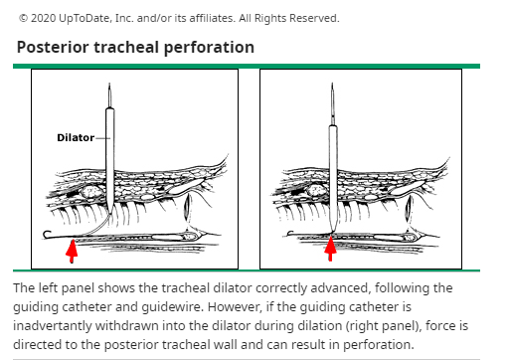
even though percutaneous tracheostomy has an increased risk of anterior tracheal injury and posterior tracheal wall perforation

Slide 41
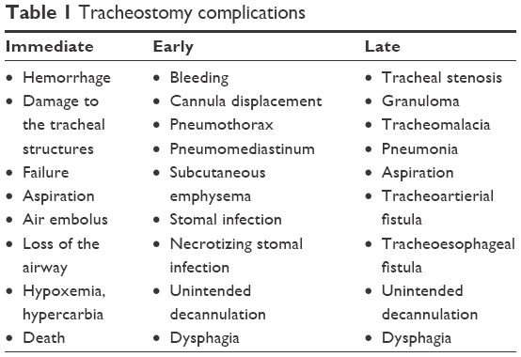
COMPLICATIONS
Notes:
Subcutaneous emphysema and pneumothorax imperfect positioning of fenestrated cannula and posterior wall perforation are possible mechanisms for these complications [109]. Swelling of the posterior tracheal wall can cause symptomatic compression of the tracheal tube even a week after tube placement
Tracheal stenosis and malacia – Patients undergoing long-term mechanical ventilation by tracheostomy can develop symptoms of tracheal obstruction due to the development of granulation tissue..Stenosis of the trachea below the glottis, but superior to the tracheal stoma, has been reported following tracheostomy and is more commonly seen with fenestrated tracheostomy tubes
Tracheoarterial fistula – Massive hemorrhage due to a tracheoarterial fistula is the most devastating complication. from low-positioned tracheostomy tubes ..The development of a tracheoarterial fistula is a life-threatening complication Tracheoarterial fistulas are due to erosion from the tube tip or cuff into the anterior wall of the trachea resulting in a fistulous communication with the innominate artery as it passes anteriorly across the trachea. Patients may develop a "sentinel" bleed followed by massive hemoptysis.
Reduced phonation

Slide 42
Surgical tracheostomy
Notes:
surgical dissection down to trachea, creation of window in trachea with insertion of tracheostomy tube for ventilation..pt under ga in operating room

Slide 43
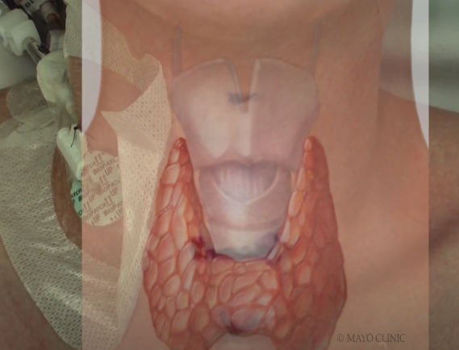
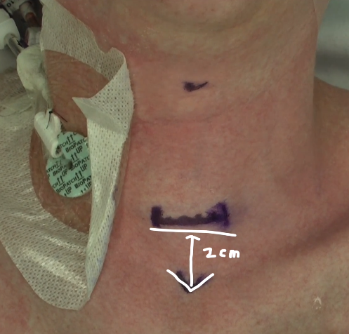
The neck is placed in extended position. The skin is prepared with antiseptic solution and appropriate surgical drapes are placed maintaining sterility. The thyroid notch, the lower border of the cricoid cartilage and the suprasternal notch are marked
Notes:
a patient is positioned supine. Surgical landmarks, from superior to inferior, include the thyroid notch, the cricoid cartilage, and the sternal notch
1cm above supra notch or 2cm below cricoid cartilage
Incision 1 cm below the cricoid or halfway between the cricoid and the sternal notch.

Slide 44
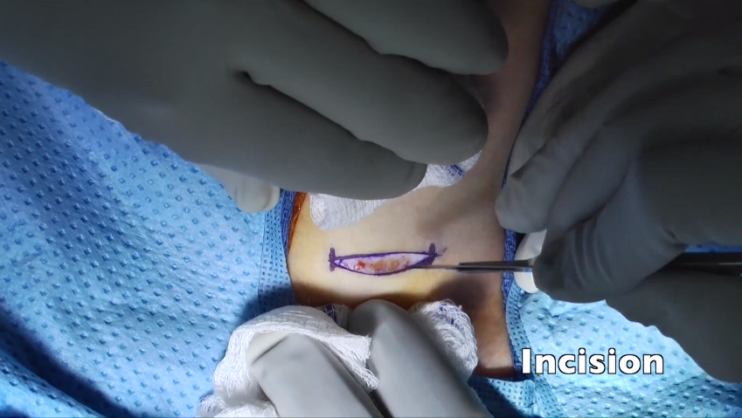
A transverse incision through skin is made half way between the inferior border of the cricoid cartilage and the sternal notch. The size is usually 3 cm
Notes:
Incision 1 cm below the cricoid or halfway between the cricoid and the sternal notch.

Slide 45
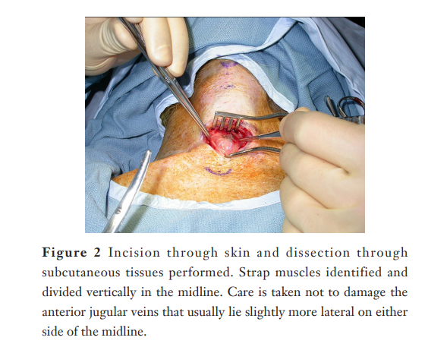
Retractors are placed, the skin is retracted, and the strap muscles are visualized in the midline.
The muscles are divided along the raphe, then retracted laterally
Notes:
Midline vertical incision from the region of the cricothyroid membrane inferiorly toward the suprasternal notch with dividing strap muscles

Slide 46
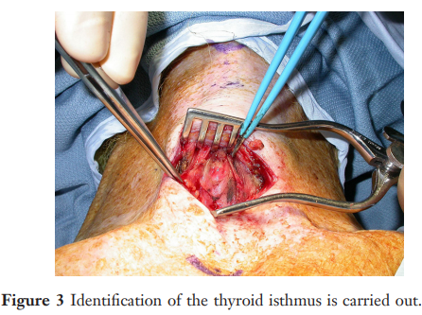
The thyroid isthmus lies in the field of the dissection.
Typically, the isthmus is 5 to 10 mm in its vertical dimension,
mobilize it away from the trachea and retract it
Notes:
Division (or retraction) of thyroid isthmus inferiorly

Slide 47
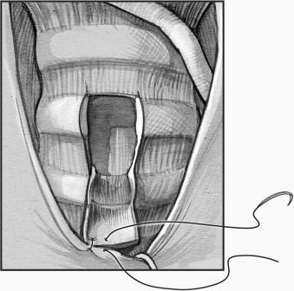
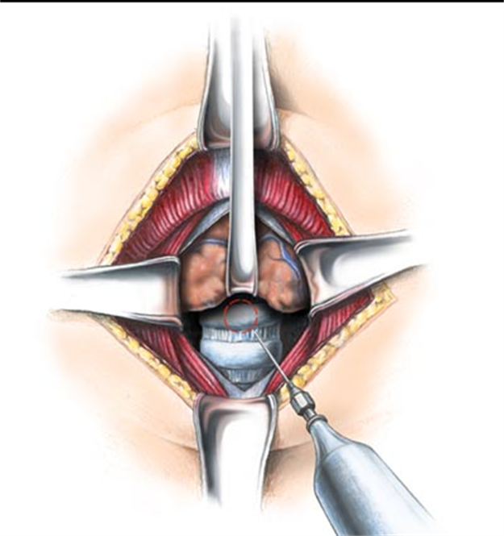
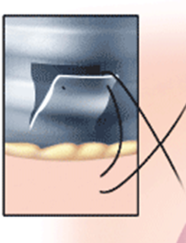
Notes:
then place the tracheal incision in the second or third tracheal interspace
Divede 2nd tracheal ring

Slide 48
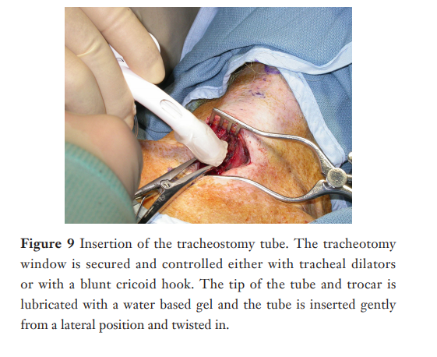
Notes:
Then insert the tube at the same time you withdraw the ett

Slide 49
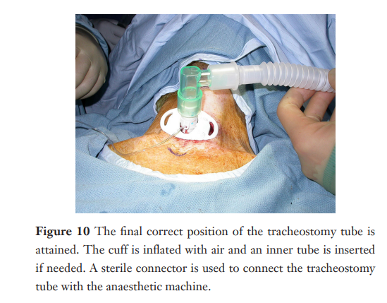
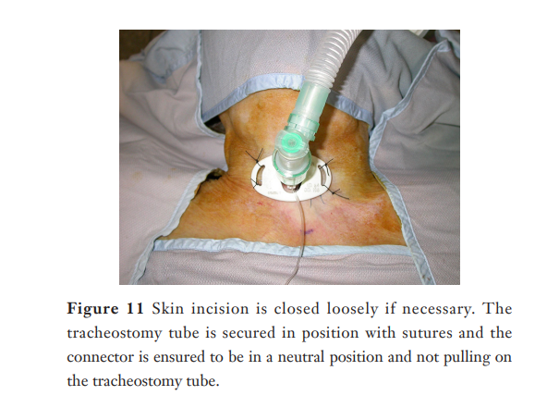
Notes:
Ceck the cuff is well inflated ..after3 days change the cuffed(aspiration prevention ) one to uncuffed one to prevent stenosis

Slide 50
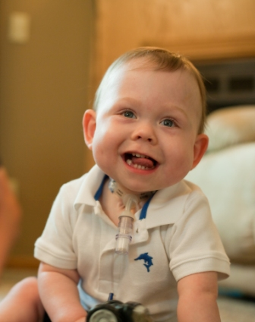
Pediatric Tracheostomy
Vertical incision in trachea BTW 2nd and 3rd ring.
No excision of ant. Wall of trachea
Secure the tube with neck by two sutures

Slide 51
Complications :
*bleeding
*emphysema
*tracheal stenosis
*Injury to (recurrent laryngeal nerve ..isthmus.. thyroid cartilage )
*wound infection
*tracheostomy scar
Notes:
Children, post head trauma, burn pts, & seriously debilitated pts are more susceptible to complications.
The most common complications are hemorrhage, followed by tube obstruction, then tube dislodgement.

Slide 52
Postoperative care of tracheostomy
A chest x ray is often taken, especially in children, to check whether the tube has become displaced or if complications have occurred.
Antibiotics may prescribed to reduce the risk of infection.
If the patient can breathe without a ventilator, the room is humidified; otherwise, if the tracheotomy tube is to remain in place, the air entering the tube from a ventilator is humidified.
Swallowing : Evaluate the patient's risk of aspiration before feeding begins.
Regular suction every hour to avoid obstruction

Slide 53
Position
Adult patients in the postoperative period should usually be sitting well propped up; care must be taken in infants that the chin does not occlude the tracheostomy and the neck should be extended slightly.
* Tube changing
Tube changing should be avoided if possible for 2 or 3 days, after which the track should be well established and the tube can be changed easily.
Cuffed tubes need particular attention, with regular deflation of the cuff to prevent pressure necrosis.
The amount of air in the cuff should be the minimum required to prevent an air leak.
Notes:
*urgent (cuffed tube )..used for 4 days then put the permanent (uncuffed tube )
*use of tube for long duration may lead to tracheal stenosis

Slide 55
Closure of tracheostomy
Remain closure of tube for 24/48 h >and lock for o2 sat
Before we close it we must ensure that there’s adequate breathing in the absence of tracheostomy.
If the tracheostomy is temporary, the tube will eventually be removed.
Healing will occur quickly, leaving a minimal scar.
Occasionally a stricture, or tightening, of the trachea may develop, which may affect breathing.
If the tracheostomy tube is permanent, the hole remains open and further surgery may be needed to widen the opening, which narrows with time.
Notes:
Closure after temporary tube :just put a gooze and monitor the patient for 2 -3 hours ,it will heal spontaneously

Slide 56
Cricothiroidectomy
Mini-tracheostomy
Cricothyrotomy is a procedure that involves placing a tube through an incision in the cricothyroid membrane (CTM) to establish an airway for oxygenation and ventilation . emergency incision ..temporary airway 30 minute
Notes:
It is an emergency incision through the skin & cricothyroid membrane to secure pt’s airway during an emergency situation.
It is only a temporary airway for life-saving situations. It is not suitable for prolonged ventilation due to its small size. A definitive airway (ETT or tracheostomy) must be performed later in hospital for adequate ventilation.

Slide 57
Indications
Cricothyrotomy is most commonly performed when a "can't intubate, can't oxygenate" (CICO) situation is encountered during advanced airway management and nonsurgical upper airway techniques have been unsuccessful in restoring oxygenation. Sometimes, during emergency airway management, cricothyrotomy is performed as a primary technique when other nonsurgical options are not felt to be appropriate due to clinical circumstances
Conditions associated with a difficult airway that may necessitate cricothyrotomy include:
massive hemorrhage, profound emesis, trismus, obstructing lesions (eg, tumor, polyp), upper airway occlusion (foreign body, edema, anaphylaxis), and a broad array of traumatic and congenital deformities.
Notes:
Sever facial and nasal injury which prevent intubation ..massive trauma

Slide 58
Contraindication :
*Inability to identify anatomical land marks
*tumor
*acute laryngeal disease
*small children less than 10 years

Slide 59
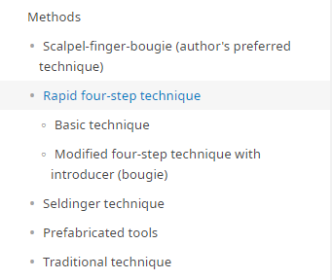
Rapid four-step technique
Basic technique — The rapid four-step technique can be done quickly and requires only a scalpel (number 11 or 20 blade if available), hook, and cuffed tracheostomy tube
For this technique, stand at the head of the patient in the same position as when performing endotracheal intubation. Next, perform the following four steps in sequence:

Slide 60
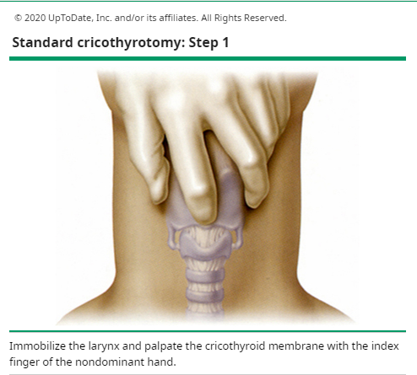
Step 1: Identify the CTM by palpation

Slide 61
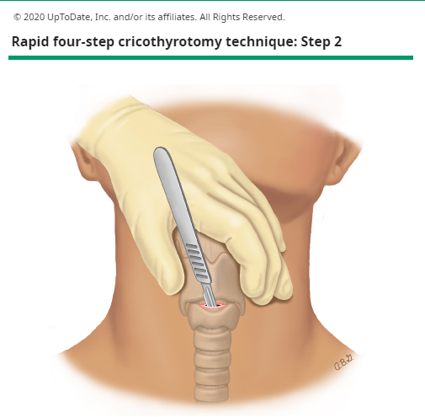
Step 2: Make a single horizontal stab incision through the skin, subcutaneous tissue, and CTM with the scalpel
The size of the skin incision is approximately 3 cm

Slide 62
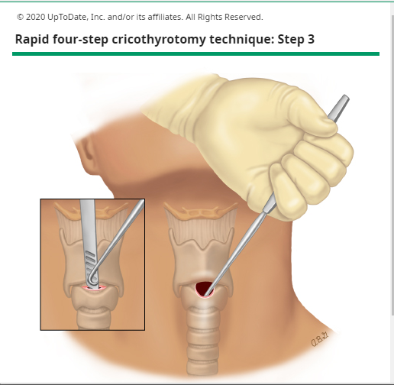
Step 3: Place the hook –
Prior to removal of the scalpel, the hook is placed and directed inferiorly to engage the cricoid cartilage. Caudal traction is used to stabilize the larynx
This marks a significant change from the standard method, in which the tracheal hook is placed under the thyroid cartilage. Also in contrast with the standard technique, this step does not require an assistant to manage the hook

Slide 63
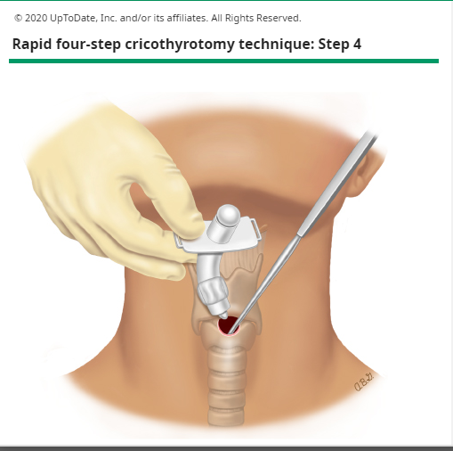
Step 4: Insert the tracheostomy tube into the trachea

Slide 64
Thank you

