Slide 1
Dysphagia
Done by:
Mohammed mohawesh
Bara’ lasasmeh
Mohammed Quran
Tasneem maaitah

Slide 2
Contents :
Definition
Physiology of swallowing
Associated Symptoms
Classification
Risk factors & complicaton
Diagnosis & Management

Slide 3
Definition
➤
Diﬃculty swallowing (dysphagia) means it takes more time and eﬀort to move food or liquid from the mouth to the stomach. Dysphagia may also be associated with pain. In some cases, swallowing may be impossible.
Occasional diﬃculty swallowing, which may occur when eat too fast or don’t chew food well enough, usually isn’t cause for concern, persistent dysphagia may indicate a serious medical condition requiring treatment.
➤

Slide 4
Physiological process of swallowing :
1. Oral phase : Food bolus formation, number of process which result in food entering safely into the oropharynx.
Nerve involved: Facial nerve, trigeminal nerve.
2. Pharyngeal phase : Tongue covers the oropharynx,
Epiglottis closes the airway,
Upper esophageal sphincter relaxes allowing the food to move into the esophagus.
Nerve involved : glossopharyngeal nerve.
3. Esophageal phase: Lower esophageal sphincter relaxes to receive the bolus
Nerve involved: vagus nerve.

Slide 5
-Therefore, Inability to swallow is caused by:
A problem with the strength or coordination of the muscles required to move material from the mouth to the stomach
A fixed obstruction somewhere between the mouth and stomach
Occasionally a combination of both processes
NOTE**
-Solid bolus need peristaltic waves to move.
-Residual liquid bolus usually moved by gravity alone if the person is standing .

Slide 6
Associated Symptoms
Signs and symptoms may include:
Having pain while swallowing (odynophagia)
Having the sensation of food getting stuck in your throat or chest or behind your sternum
Drooling (salivation)
Being hoarse
Regurgitation (Bringing food back up)
Having frequent heartburn
Having food or stomach acid back up into your throat(reflux)
Unexpectedly losing weight
Coughing or gagging when swallowing
Having to cut food into smaller pieces or avoiding certain foods because of trouble swallowing

Slide 7
Classification of dysphagia
Oropharyngeal Dysphagia
Esophageal Dysphagia

Slide 8
Oropharyngeal dysphagia
➤
The inability to propel a food bolus successfully from the hypopharyngeal area through the upper esophageal sphincter into the esophageal body is called oropharyngeal or transfer dysphagia.
Oropharyngeal disorders aﬀect the initiation of swallowing at the pharynx and upper esophageal sphincter.
The patient has diﬃculty initiating swallowing and complains of choking, nasal regurgitation or tracheal aspiration.
With processes that aﬀect the mouth, hypopharynx, and upper esophagus, the patient is often unable to initiate a swallow and repeatedly has to attempt to swallow.
➤
➤
➤
Dysphagia that occurs immediately or within 1 second of swallowing suggests an oropharyngeal abnormality

Slide 9
Causes of oropharyngeal dysphagia
1. Neuromuscular Causes:
Amyotrophic lateral sclerosis
CNS tumors (benign or malignant) Dysfunction of the UES or pharynx Multiple sclerosis
Muscular dystrophy Myasthenia gravis Parkinson’s disease
Polymyositis or dermatomyositis Stroke

Slide 10
2. Structural Causes:
Carcinoma
Infections of pharynx or neck Osteophytes and other spinal disorders Prior surgery or radiation therapy Proximal esophageal web
Thyromegaly Zenker’s diverticulum

Slide 11
Esophageal dysphagia
➤
Esophageal dysphagia refers to the sensation of food sticking or getting hung up in the base of your throat or in your chest after you've started to swallow.
Esophageal disorders cause dysphagia by obstructing the lumen or by aﬀecting motility.
Patients complain of food ‘sticking’ after swallowing, although the level at which it is felt correlates poorly with the true site of obstruction. Swallowing of liquids is normal until strictures become extreme.
➤
➤

Slide 12
Causes of esophageal dysphagia
1. Motility (Neuromuscular) Disorders:
Primary:
Achalasia
Distal esophageal spasm
3.Hypercontractile (jackhammer) esophagus
4.Hypertensive LES
5.Nutcracker (high-pressure) esophagus
Secondary:
Chagas’ disease
Reflux-related dysmotility
Scleroderma and other rheumatologic disorder

Slide 13
2. Structural (Mechanical) Disorders:
Intrinsic
Carcinoma and benign tumors
Diverticula
3.Eosinophilic esophagitis
Esophageal rings and webs
Foreign body
Lower esophageal (Schatzki) ring
7.Medication-induced stricture Peptic stricture
Extrinsic
Mediastinal mass
Spinal osteophytes
Vascular compression

Slide 15
Risk factors & complications

Slide 16
Risk factors for dysphagia:
Aging. Due to natural aging and normal wear and tear on the esophagus and a greater risk of certain conditions, such as stroke or Parkinson's disease, older adults are at higher risk of swallowing diﬃculties. But, dysphagia isn't considered a normal sign of aging.
Certain health conditions. People with certain neurological or nervous system disorders are more likely to experience diﬃculty swallowing.
Complications:
Diﬃculty swallowing can lead to:
Malnutrition, weight loss and dehydration. Dysphagia can make it diﬃcult to take in adequate nourishment and fluids.
Aspiration pneumonia. Food or liquid entering your airway when you try to swallow can cause aspiration pneumonia, because the food can introduce bacteria to the lungs.
Choking. When food gets stuck in the throat, choking can occur. If food completely blocks the airway, and no one intervenes with a successful Heimlich maneuver, death can occur.

Slide 17
Diagnosis & Management

Slide 18
Diagnosis
X-ray with a contrast material (barium X-ray).
Show changes in the shape of the esophagus and can assess the muscular activity.
2.Dynamic swallowing activity
Swallow barium-coated foods of different consistencies. This test provides an image of these foods as they travel through the mouth and down to the throat.
3. Endoscopy
4. Esophageal muscle test (monometry)
a small tube is inserted into the esophagus and connected to a pressure recorder to measure the muscle contractions of the esophagus as they swallow.
5. Imaging scans

Slide 19
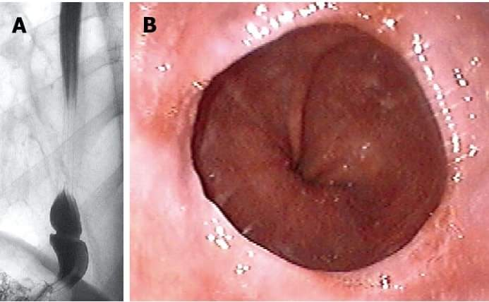
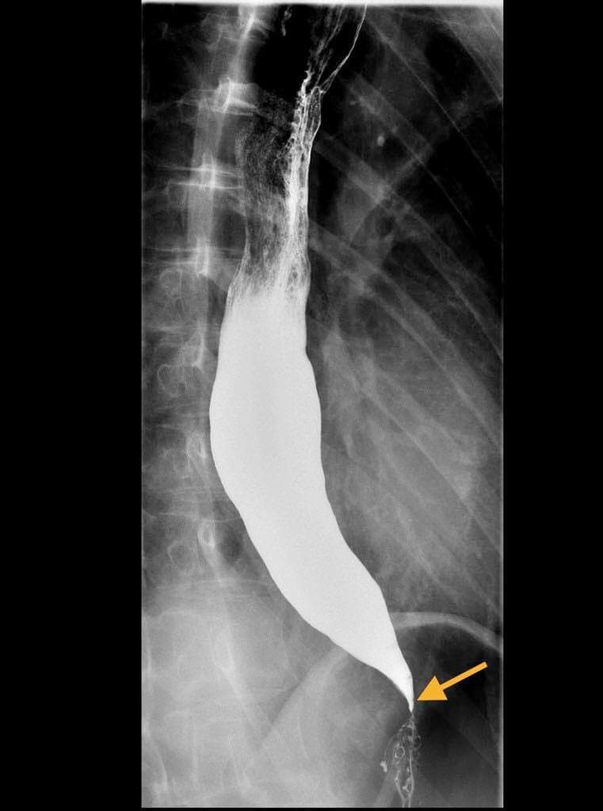
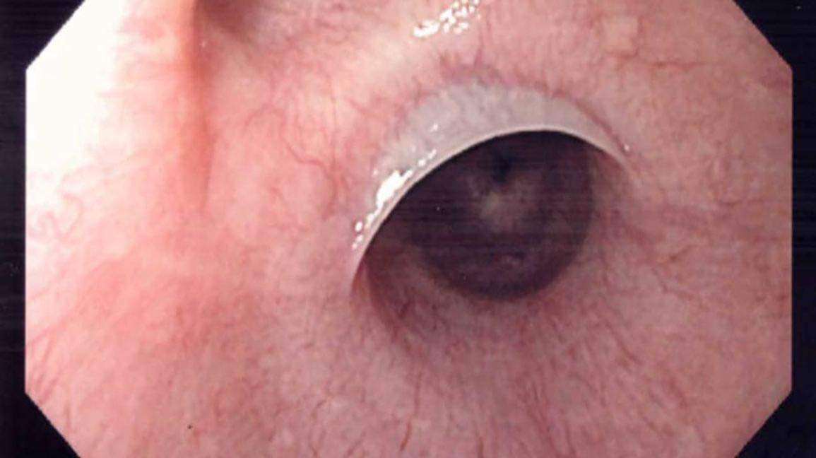
Lower esophageal (schatzki) ring
Achlasia
Esophageal web

Slide 20
Management
--For oropharyngeal dysphagia, the doctor may refer the patient to a speech or swallowing therapist, and therapy may include:
Learning exercises. Certain exercises may help coordinate swallowing muscles or restimulate the nerves that trigger the swallowing reflex.
Learning swallowing techniques. The patient may be taught exercises and new swallowing techniques to help compensate for dysphagia caused by neurological problems such as Alzheimer's disease or Parkinson's disease.
--Treatment approaches for esophageal dysphagia may include:
Esophageal dilation. For a tight esophageal sphincter (achalasia) or an esophageal stricture, an endoscope may be used with a special balloon attached to gently stretch and expand the width of the esophagus or pass a flexible tube or tubes to stretch the esophagus (dilation).
Surgery. For an esophageal tumor, achalasia or pharyngoesophageal diverticulum, the patient may need surgery to clear the esophageal path.
Medications.

Slide 21
Thank you

