Slide 1
Small and Large Intestinal pathology, part 2
DR Sura Al Rawabdeh MD
April 12 2023

Slide 2
Diseases of the intestines
Intestinal obstruction
Vascular disorders
Malabsorptive diseases and infections
Inflammatory bowel disease.
Polyps and neoplastic diseases

Slide 3
Intestinal obstruction
Mechanical obstruction:
Intussusception
Hernias.
Adhesions.
Volvulus
Tumors.
Diverticulitis
Infarction
Non-mechanical obstruction
Hurschsprung disease
Neurological disorders.
Drugs….etc

Slide 4
Clinical picture of intestinal obstruction.
Abdominal pain
Distention
Vomiting
Constipation.
Acute or chronic.

Slide 5
80% of mechanical obstructions
Robbins Basic Pathology 10th edition

Slide 6
Intussusception
Segment of the intestine constricted by a wave of peristalsis, telescopes into the immediately distal segment.
Once trapped, invaginated segment is propelled by peristalsis, and pulls mesentery with it.
Most common cause of intestinal obstruction in children younger than
2years of age.
Untreated progresses to infarction.

Slide 7
Causes of intussusception
< 2years : Idiopathic in most cases.
Peyer patches hyperplasia (rotavirus vaccine, viral infections)
Meckles diverticulum (ileum)
Old children & adults: Intraluminal mass or tumors

Slide 11
Clinical features:
Abdominal swelling
Vomiting
Passing stools mixed with blood and mucus (currant jelly stool)
Pain.

Slide 12
Management
Contrast enemas in uncomplicated idiopathic cases.
Surgery if complicated or if masses are the leading point.

Slide 13
Hirschsprung Disease
Congenital defect in colonic innervations
Congenital aganglionic megacolon
More common in males
More severe in females
Risk increase in siblings.
Typical presentation:
Neonatal failure to pass meconium
Obstructive constipation.

Slide 14
Pathogenesis
During embryogenesis
Disrupted migration of neural crest cells from cecum to rectum.
Lack of Meissner submucosal plexus and the Auerbach
myenteric plexus.
Failure of coordinated peristaltic contractions.
Mutations in RET: in familial cases and 15% of sporadic
Other genes and environmental factors play role.

Slide 15
Morphology
Rectum always involved.
Extent is variable.
Most cases in rectosigmoid.
Macroscopic
Aganglionic region normal or contracted
Proximal normal segment progressively dilated.
Diagnosis: BIOPSY, microscopic.

Slide 17
Robbins Basic Pathology 10th edition

Slide 18
ganglion cells
http://www.pathologyoutlines.com

Slide 19
Complications
Enterocolitis
Fluid and electrolyte disturbances
Perforation
Peritonitis
Treatment:
Surgical resection of aganglionic segment and anastomosis of normal segments.

Slide 20
VASCULAR DISORDERS OF BOWEL
Ischemic Bowel Disease
Hemorrhoids

Slide 21
Hemorrhoids
Dilated anal and perianal collateral vessels that connect the portal and caval
venous systems.
Predisposing factors:
Constipation and straining
Venous stasis of pregnancy,
Portal hypertension.
External and internal hemorrhoids

Slide 22
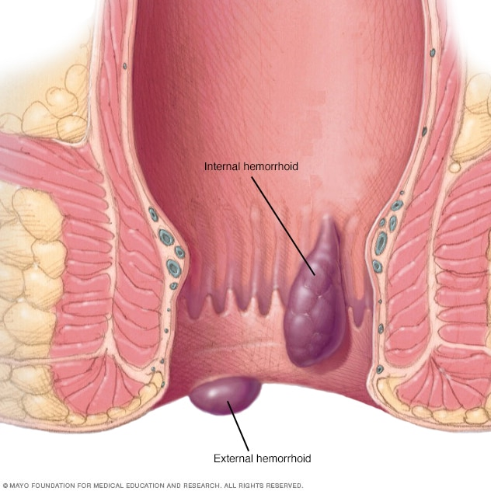
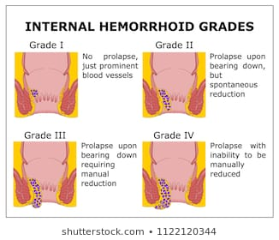

Slide 23
Microscopic findings
Dilated, thick walled, congested submucosal vessels and sinusoidal spaces, often with thrombosis; variable hemorrhage into connective tissue
Dilated spaces may show exuberant vascular proliferation confined to vessel known as papillary endothelial hyperplasia
Internal hemorrhoids are lined by rectal or transitional mucosa, external hemorrhoids have a squamous lining
Surface may show ulceration

Slide 24
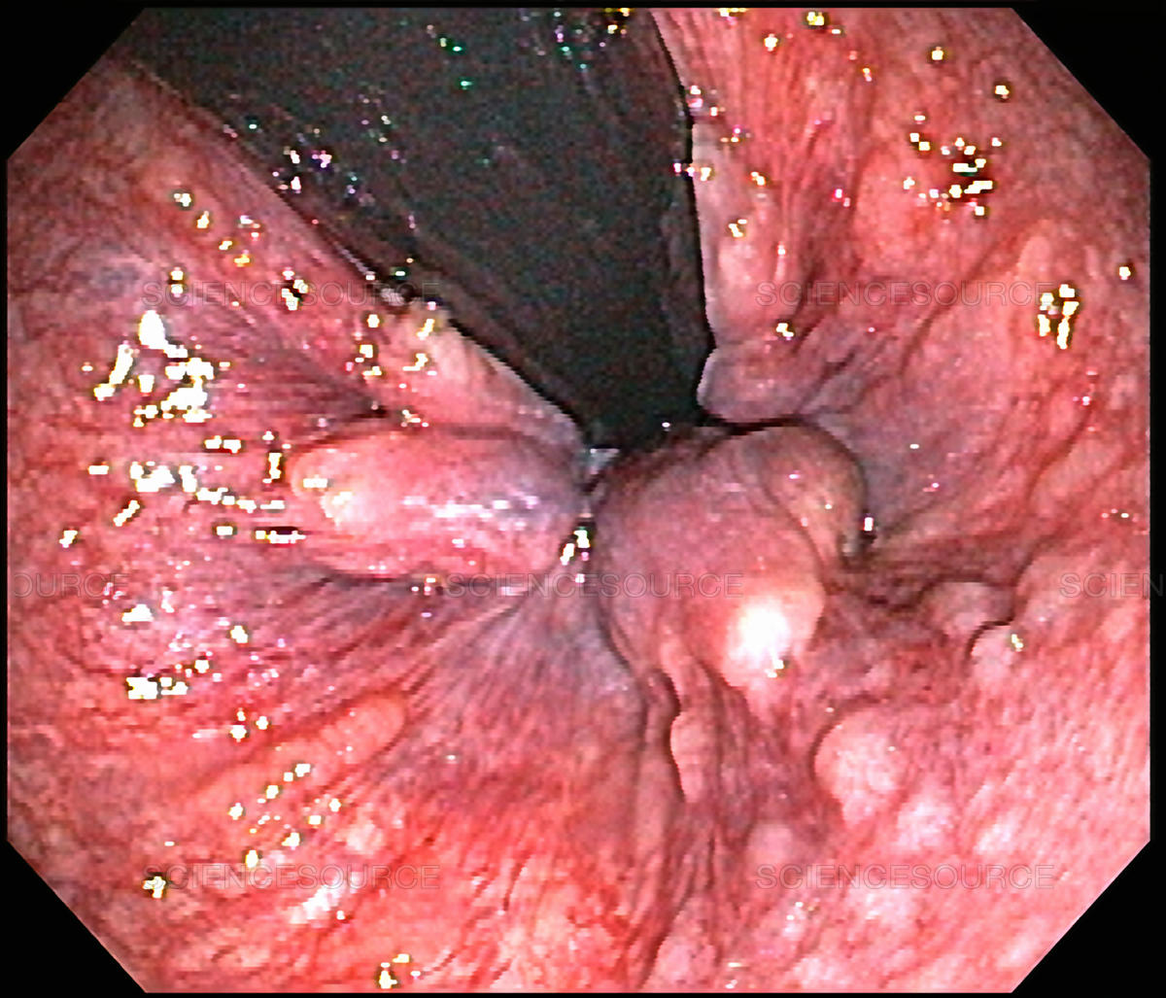
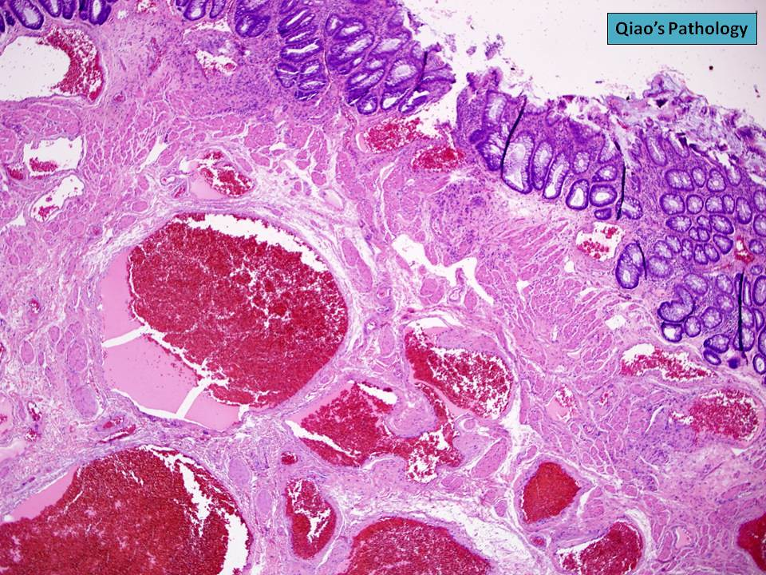

Slide 25
Clinical features
Patients usually have painless bleeding, noticing blood in the toilet or on lavatory paper
Patients may experience pain or discomfort, especially with thrombosis, strangulation or ulceration
Anemia from hemorrhoids is unusual - patients should undergo hematologic evaluation
Clinically four grades:
First degree, anal cushions that slide down past dentate line with straining at stool, that bleed with defecation
Second, anal cushions that prolapse with straining, but reduce spontaneously
Third, hemorrhoids that remain outside of the anal canal unless manually replaced
Fourth, hemorrhoids that cannot be reduced

Slide 26
DIARRHEAL DISEASE
Diarrhea: increase in stool mass, frequency or fluidity (more than 200 grams per day
In severe cases, stool volume can exceed 14 L per day and, without fluid resuscitation, result in death.
Worldwide, diarrheal diseases account for greater than 700,000 deaths of children under 5 years of age, making them the second leading cause of death in this age group.
Painful, bloody, small-volume diarrhea is known as dysentery.
Diarrhea is a common symptom of many intestinal diseases, including those due to infection, inflammation, ischemia, malabsorption, and nutritional deficiency

Slide 27
DIARRHEAL DISEASE
It can be classified into four major categories:
1• Secretory diarrhea is characterized by isotonic stool and persists during fasting.
2• Osmotic diarrhea, such as that occurring with lactase deficiency, is due to osmotic forces exerted by unabsorbed luminal solutes more concentrated than plasma, and the condition abates with fasting.
3• Malabsorptive diarrhea caused by inadequate nutrient absorption is associated with steatorrhea and is relieved by fasting.
4• Exudative diarrhea is due to inflammatory disease and characterized by purulent, bloody stools that continue during fasting.

Slide 28
Malabsorptive Diarrhea
Malabsorption manifests most commonly as chronic diarrhea
Characterized by defective absorption of fats, fat- and water-soluble vitamins, proteins, carbohydrates, electrolytes
Chronic malabsorption causes weight loss, anorexia, abdominal distention,
borborygmi, and muscle wasting.
A hallmark of malabsorption is steatorrhea, characterized by excessive fecal fat
and bulky, frothy, greasy, yellow, or clay-colored stools.

Slide 29
Malabsorptive Diarrhea
Pancreatic insufficiency.
Celiac disease
Crohn disease
Cystic Fibrosis
Lactase (Disaccharides) Deficiency
Abetalipoproteinemia
Infectious Enterocolitis
Inflammatory bowel diseases…..

Slide 30
Malabsorptive diarrhea
Defect in one of the following:
Intraluminal digestion, in which proteins, carbohydrates, and fats are broken down into absorbable forms
• Terminal digestion, which involves the hydrolysis of carbohydrates and peptides by disaccharidases and peptidases, respectively, in the brush border of the small-intestinal mucosa
• Transepithelial transport, in which nutrients, fluid, and electrolytes are transported across and processed within the small-intestinal epithelium
• Lymphatic transport of absorbed lipid

Slide 31
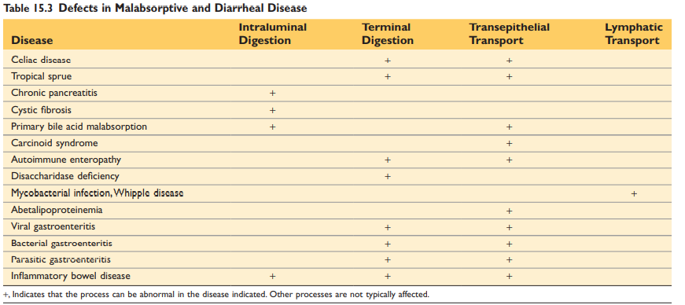

Slide 32
Manifestations:
Weight loss, anorexia,
Flatus, abdominal distention,
Borborygmi, Muscle wasting
Anemia and mucositis (iron, pyridoxine (VB6), folate, or vitamin B12
deficiency)
Bleeding (vitamin K deficiency)
Osteopenia and tetany (calcium, magnesium, or vitamin D deficiency)
Neuropathy (vitamin A or B12 deficiency)
Skin and endocrine disorders.

Slide 33
Cystic Fibrosis
Mutations in cystic fibrosis transmembrane conductance regulator (CFTR)
Individuals with cystic fibrosis have defects in intestinal and pancreatic ductal ion transport.
This abnormality interferes with bicarbonate, sodium, and water secretion, ultimately resulting in inadequate luminal hydration.
The viscous luminal contents may result in meconium ileus, which is present in up to 10% of newborns with cystic fibrosis.

Slide 34
Cystic Fibrosis
In the pancreas the ducts are plugged by thick mucus.
This leads to obstruction, low-grade chronic autodigestion of the pancreas, and eventual exocrine pancreatic insufficiency in more than 80% of patients.
The result is failure of the intraluminal phase of nutrient absorption, which can be effectively treated in most patients with oral enzyme supplementation.

Slide 35
Celiac Disease
Celiac disease, also known as celiac sprue or glutensensitive enteropathy, is an immune-mediated enteropathy triggered by the ingestion of gluten-containing cereals, such as wheat, rye, or barley, in genetically predisposed individual
Genetically predisposition, HLA-DQ2 or HLA-DQ8.
Treatment: gluten free diet.
Association with: type 1 diabetes, thyroiditis, and Sjogren syndrome

Slide 36
Pathogenesis
Celiac disease is an intestinal immune reaction to gluten, the major storage protein of wheat and similar grains.
Gluten is digested by luminal and brush border enzymes into amino acids and peptides, including a 33–amino acid gliadin peptide that is resistant to degradation by gastric, pancreatic, and small-intestinal proteases
Gliadin is delaminated by tissue transglutaminase and is then able to interact with HLA-DQ2 or HLA-DQ8 on antigen-presenting cells and be presented to CD4+ T cells.
These T cells in lamina propria produce cytokines that likely contribute to the tissue damage and characteristic mucosal histopathology

Slide 38
Serology:
Anti- tissue transglutaminase antibodies
Anti-gliadin antibodies.
Anti -endomysial antibodies

Slide 40
MORPHOLOGY
Second portion of the duodenum or proximal jejunum.
Triad: intraepithelial lymphocytosis (CD8+ T cells), crypt hyperplasia, and villous atrophy.
Lamina propria: lymphocytes, plasma cells, eosinophils…….
IEL & villous atrophy are not pathognomonic, seen in viral enteritis.
Diagnosis: Clinical, histologic and serologic correlation.

Slide 42
webpathology

Slide 43
Clinical Features
Children 6-24 months : classical or non classical symptoms
Classical: Irritability, abdominal distention, anorexia, diarrhea, failure to thrive, weight loss, or muscle wasting
Non-classical: abdominal pain, nausea, vomiting, bloating, or constipation.
Blistering skin lesion, dermatitis herpetiformis, in 10% of Pnts.

Slide 44
Dermatitis herpetiformis.

Slide 45
Clinical Features
Adults (30-60 years)
Anemia: iron deficiency
B12 and folate deficiency: less common.
Diarrhea , bloating, and fatigue.
Missed diagnosis: Silent celiac or latent celiac.
Increased risk of enteropathy associated T cell lymphoma & Small intestinal adenocarcinoma

Slide 46
Diagnosis:
Non invasive serologic tests:
Most sensitive:
Anti tissue transglutaminase antibody, IgA
Anti deamidated gliadin antibodies, IgA & IgG
Most specific, but less sensitive
Antiendomysial antibody.
Invasive tests: small bowel biopsy.

Slide 47
Lactase (Disaccharidase) Deficiency
Osmotic diarrhea
Lactose remains in the gut lumen.
Lactase found at apical brush border membrane
Normal biopsy findings.
Two types:
Congenital : AR, genetic mutation, rare, explosive diarrhea, watery, frothy stools & abdominal distention, after milk ingestion
Acquired : follow viral or bacterial enteritis, downregulation of gene, after
childhood.

Slide 48
Abetalipoproteinemia
Beta apolipoproteins are very large apolipoproteins. They are critically important for the secretion and formation of chylomicrons (CMs) and VLDL.
Abnormalities that impede this process result in abetalipoproteinemia and hypobetalipoproteinemia
Autosomal recessive, rare.
The underlying defect is a mutation in the microsomal triglyceride transfer protein (MTP) responsible for lipoprotein and fatty acid export from mucosal cells.

Slide 49
Abetalipoproteinemia
Infants w/ failure to thrive, diarrhea, and steatorrhea
Lack of absorption of fat and fat soluble vitamins
Inability to secrete triglyceride-rich lipoproteins.
Transepithelial transport defect of TG and FAs.
Monoglycerides and triglycerides accumulate in epithelial cells.

Slide 51
Acanthocytosis is a hallmark feature of this disease.
Acanthocytes are abnormally spiked RBCs due to the defective phospholipid cell membrane.
They are also seen in liver dysfunction

Slide 52
The end
Good luck

