Slide 1
Treatment of convulsive status epilepticus in adults

Slide 2
Status epilepticus (SE)
is a single seizure lasting more than five minutes or two or more seizures within a five-minute period without the person returning to normal between them

Slide 3
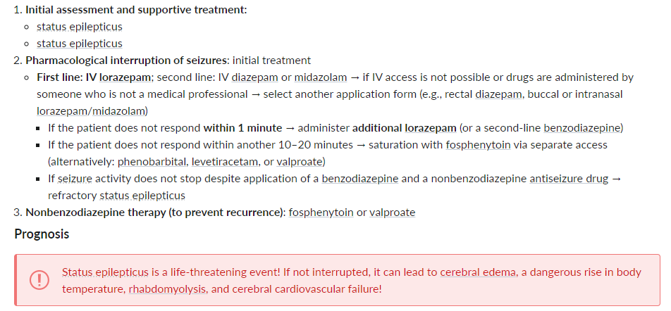

Slide 4
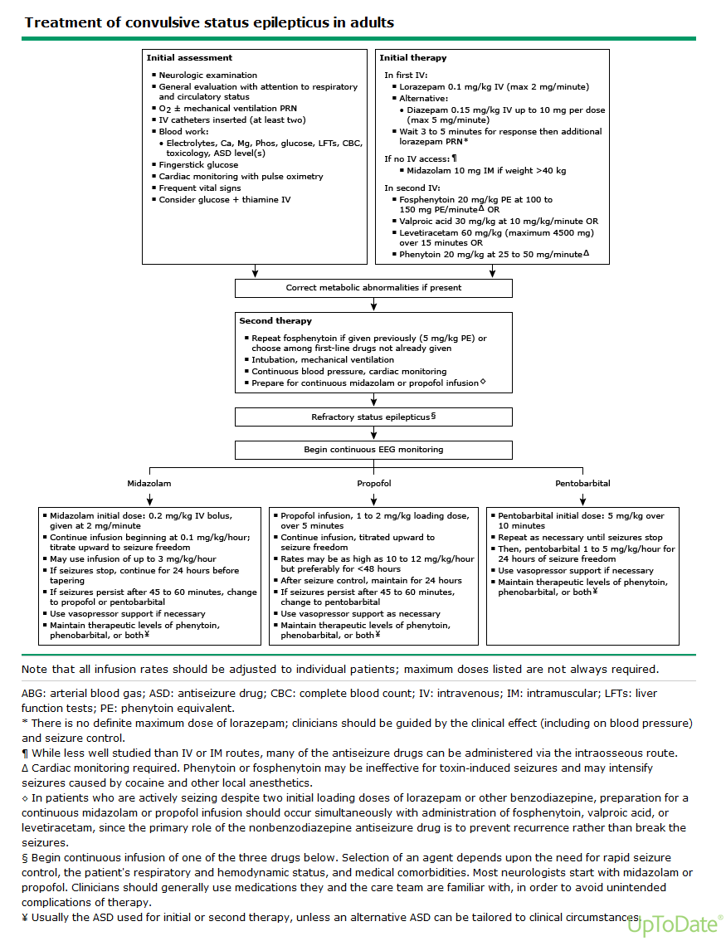

Slide 5
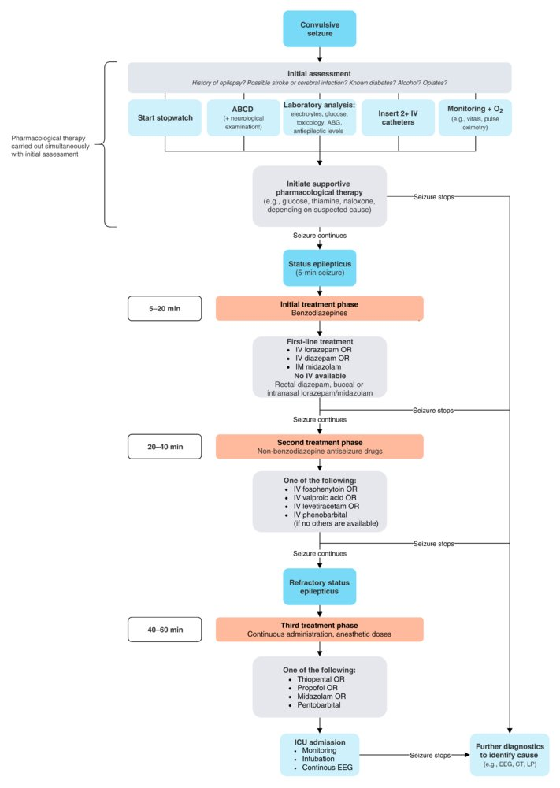

Slide 6
Thank you
LUBNA SAMEER
References :
UPTODATE
AMBOSS

