Slide 1
Second Year Endocrine system Biochemistry
Mutah University
Faculty of Medicine

Slide 2
Endocrine system Steroidogenesis lecture 6 (43 slide) (I. adrenal steroidogenesis)
Dr. Eman Shaat
Professor of Biochemistry & Molecular Biology

Slide 3
Adrenal steroids: A review
The adrenal glands are located immediately superior to the kidneys.
There is an adrenal cortex and adrenal medulla.
Steroids are made in the 3 zones of the adrenal cortex:
Mineralocorticoids: Zona glomerulosa
Glucocorticoids: Zona fasciculata
Androgens: Zona reticularis.
Types of steroid hormones:
Glucocorticoids: cortisol is the major representative in most mammals.
Mineralocorticoids: aldosterone being most prominent.
Androgens: such as testosterone.
Estrogens: including estradiol and estrone.
Progesteron (progestins).

Slide 4
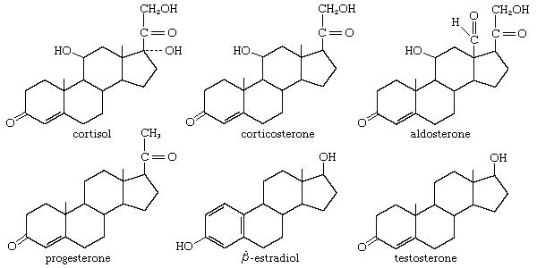
Steroid hormones: chemical structure
C21
C21
2OH
3OH
C21
2OH
No OH
C21
C18
C19

Slide 5
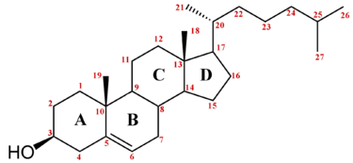
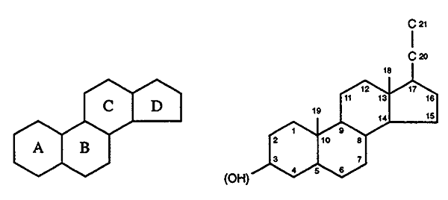
Steroid hormones: structure
All steroid hormones are derived from cholesterol and differ only in the ring structure and side chains attached to it.
Cholesterol:
27 C.
OH at C3 (B).
Double bond between C5,6
Numbering scheme

Slide 6
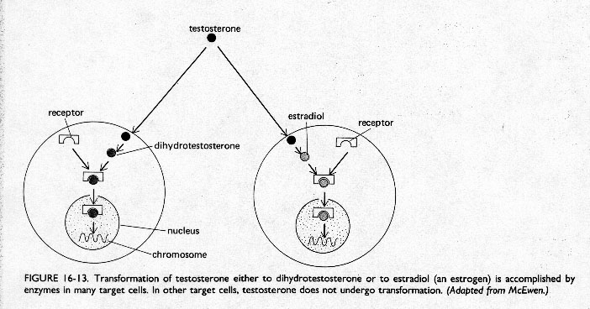
Steroid hormones: Characteristics
Steroid hormones: produced in the adrenal cortex, testis, ovary, and some peripheral tissues (adipose tissue, the brain).
All steroids are lipid soluble and thus are freely permeable to membranes so are not stored in cells.
Steroid hormones are not water soluble so have to be carried in the blood complexed to specific binding globulins.
Corticosteroid binding globulin carries cortisol
Sex steroid binding globulin carries testosterone and estradiol.
Only unbound hormones can diffuse into target cell.
In some cases a steroid is secreted by one cell and is converted to the active steroid by the target cell:
an example is androgen which secreted by the gonad and converted into estrogen in the brain.

Slide 7
How does the synthesis of steroids differ from that of peptide hormones?
While peptide hormones are encoded by specific genes, steroid hormones are synthesized from the enzymatic modification of cholesterol.
Thus, there is no gene which encodes ex, aldosterone.
As a result:
- There are far fewer different types of steroid hormones than peptide hormones.
- Steroid structures are the same from species to species.
- The regulation of steroidogenesis involves control of the enzymes which modify cholesterol into the steroid hormone of interest.
Steroid hormones are slower acting and have longer half-life than peptide hormones.

Slide 8
Steroid hormones: mechanism of action
Enzymes which produce steroid hormones from cholesterol are located in mitochondria and smooth endoplasmic reticulum (ER).
Interact with cytoplasmic or nuclear receptors
Activate DNA for protein synthesis.
Steroid hormones: function
Steroid hormones play important roles in:
- carbohydrate regulation (glucocorticoids)
- mineral balance (mineralocorticoids)
- reproductive functions (gonadal steroids)
Steroids also play roles in inflammatory responses, stress responses, bone metabolism, cardiovascular fitness, behavior, cognition, and mood.

Slide 9
Steroid hormones: function
Product | Functions
Progesterone | prepares uterus lining for implantation of ovum
Glucocorticoids (cortisol) (produced in adrenal cortex) (catabolic steroid) | promote gluconeogenesis; favor breakdown of fat and protein (fuel mobilization); anti-inflammatory
Mineralocorticoids (aldosterone) (produced in adrenal glands) | maintains blood volume and blood pressure by increasing sodium reabsorption by kidney
Androgens (strongest = testosterone) (produced in testes primarily but weak androgens in adrenal cortex) (anabolic steroid) | development of male secondary sex characteristics; prevents bone resorption
Estrogen (produced in ovaries primarily but also in adipose cells of males and females) | development of female secondary sex characteristics; prevents bone resorption; increase HDL & dec.LDL

Slide 10
Steroidogenesis: Steroid hormone precursor
All mammalian steroid hormones are formed from Cholesterol via Pregnenolone.
Steroidogenic enzymes:
Common name
"Old" name
Current name
Side-chain cleavage enzyme; desmolase
P450_{SCC}
CYP11A1
3 beta-hydroxysteroid dehydrogenase
3 β-HSD
3 β-HSD
17 alpha-hydroxylase/17,20 lyase
P450_{C17}
CYP17
21-hydroxylase
P450_{C21}
CYP21A2
11 beta-hydroxylase
P450_{C11}
CYP11B1
Aldosterone synthase
P450_{C11AS}
CYP11B2
Aromatase
P450_{aro}
CYP19

Slide 11
Role of cholesterol in steroid synthesis
The first enzymatic step in the production of ANY steroid hormone begins with enzymatic modification of cholesterol.
The cholesterol precursor comes from:
In situ from acetyl-CoA. (small proportion)
Cholesterol ester stores in intracellular lipid droplets.
Plasma (LDL; most common source). uptake of cholesterol-containing low density lipoproteins (LDL). Much of this cholesterol is estrified in the adrenal and stored in cytoplasmic lipid droplets.
Lipoproteins taken up from plasma are most important when steroidogenic cells are chronically stimulated.

Slide 12
Steroidogenesis: Step 1
All mammalian steroid hormones are formed from Cholesterol via Pregnenolone.
The first step is the conversion of cholesterol to pregnenolone, which occurs in the mitochondria.
This reaction is carried out by the enzyme, cytochrome P450 side chain cleavage (P450scc). (also called desmolase, or CYP11A1). Carbons 20 and 22 are sequentially oxidized followed by oxidative cleavage of the bond between them.
This is a rate limiting, nonreversible enzymatic step in the initiation of steroid biosynthesis.
This step occurs in adrenal, ovary, and testis.

Slide 13
CH3
ACTH
(cAMP)
O2 + NADPH
+ isocaproaldehyde (6C)
Conversion of cholesterol to pregnenolone: Step 1

Slide 14
I. Adrenal Steroidogenesis [after 1st step] 1. Mineralocorticoid synthesis. 2. Glucocorticoid synthesis. 3. Adrenal androgens

Slide 15
I. Adrenal Steroidogenesis
Next, pregnenolone can be converted (in smooth ER) into three different pathways, depending upon whether the cell wants to make mineralcorticoids, glucocorticoids, or androgens.
17α−hydroxylase
lyase
pregnenolone 17α-hydroxypregnenolone dehydroepiandrosterone
progesterone androstenedione
C. androgens [ZR]
B. glucocorticoids
A. mineralocorticoids (cortisol) [ZF]
(aldosterone) [ZG]
3β-hydroxysteroid dehydrogenase
21-hydroxylase
11 β-hydroxylase
18 hydroxylase/oxidase

Slide 16
I. Adrenal steroidogenesis
What determines which pathway is taken?
Each step of the pathway is regulated by a specific enzyme. For ex., 18- hydroxylase and hydroxysteroid dehydrogenases, which are required for aldosterone synthesis are found only in the zona glomerulosa cells, so that the biosynthesis of this mineralocorticoid is confined to this region.
Different zones of the adrenal cortex have different relative activities of enzymes, resulting in different chemical reactions taking place.
Adrenal steroid biosynthesis involves the shuttling of precursors between mitochondria and the ER

Slide 17
Transport of cholesterol
Much of the taken cholesterol is esterified and stored in lipid droplets.
Upon stimulation of the adrenal zona fasciculata by ACTH (cAMP second messenger), or the adrenal zona glomerulosa by angiotensin II (IP3 / Ca2+ and DAG) ---------> an esterase is activated and the free cholesterol is formed.
3. Cholesterol is mostly located associated with the external mitochondrial membrane. The conversion of cholesterol to steroids occurs in the internal mitochondrial membrane.
Cholesterol get from the external membrane to the internal membrane via: Steroidogenic acute regulatory protein (StAR).
ACTH:
Activates an esterase to form free cholesterol from CE.
Increase cholesterol uptake by increasing the number or affinity of LDL receptors.
Induce StAR protein

Slide 18
I. Adrenal Steroidogenesis 1. Mineralocorticoids: biosynthesis
Occurs in Zona glomerulosa [ZG].
All mammalian steroid hormones are formed from cholesterol via pregnenolone (step 1)
Biosynthesis of mineralocorticoids:
Pregnenolone is converted to progesterone by 3β-hydroxysteroid DH (3 β -OHSD) and D5-D4 isomerase (step 2)
Progesterone is hydroxylated at C21 to form 11-deoxycorticosterone (DOC). DOC is an active (Na+-retaining) mineralocorticoid (step 3).
Next hydroxylation is at C11 producing corticosterone (step 4).
18-Hydroxylase acts on corticosterone to form aldosterone (step 5).

Slide 19
I. Adrenal Steroidogenesis 1. Mineralocorticoids: biosynthesis
Zona glomerulosa does not have the smooth ER enzyme 17 α-hydroxylase.
Zona glomerulosa has 18-hydroxylase (Aldosterone synthase) enzyme which acts on corticosterone to form 18-OH corticosterone then to aldosterone.
11-Deoxycorticosterone(DOC) is active mineralocorticoid.
Corticosterone has glucocorticoid activity but weak mineralocorticoid action.

Slide 20
I. Adrenal Steroidogenesis 1. Mineralocorticoids: regulation, transport and metabolism of Aldosterone
The main stimulator of aldosterone production is angiotensin II, not ACTH.
Zona glomerulosa is regulated by K+ and angiotensin II.
ACTH does have a trophic (stimulatory) effect on the zona glomerulosa, preventing atrophy.
There is no specific aldosterone carrier protein
As a result, most aldosterone is biologically available, and only low levels of aldosterone release are required each day. The circulating half life of aldosterone is very short.
Aldosterone is metabolized in the liver, conjugated with glucoronide and excreted in the urine.

Slide 21
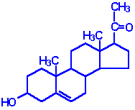
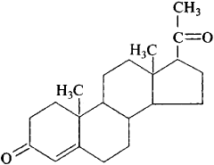
1. Mineralocorticoid : Step 2
Pregnenolone
Progesterone
3β (OH)steroid dehydrogenase( 3β-OHSD) &
∆5-4 isomerase
[ ER]

Slide 22
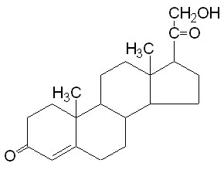
1. Mineralocorticoid : Step 3
Progesterone
11-deoxycorticosterone
(DOC) mineralocorticoid
21 hydroxylase
[ER]

Slide 23
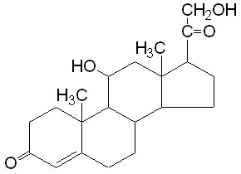
1. Mineralocorticoid : Step 4
11-deoxycorticosterone
Corticosterone
glucocorticoid & weak minera
11
11β-hydroxylase
[mitochondria]

Slide 24
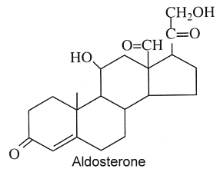
1. Mineralocorticoid : Step 5
18
Corticosterone
Aldosterone
18-hydroxylase
18-hydroxysteroid dehydrogenase
(Aldosterone synthase)

Slide 25
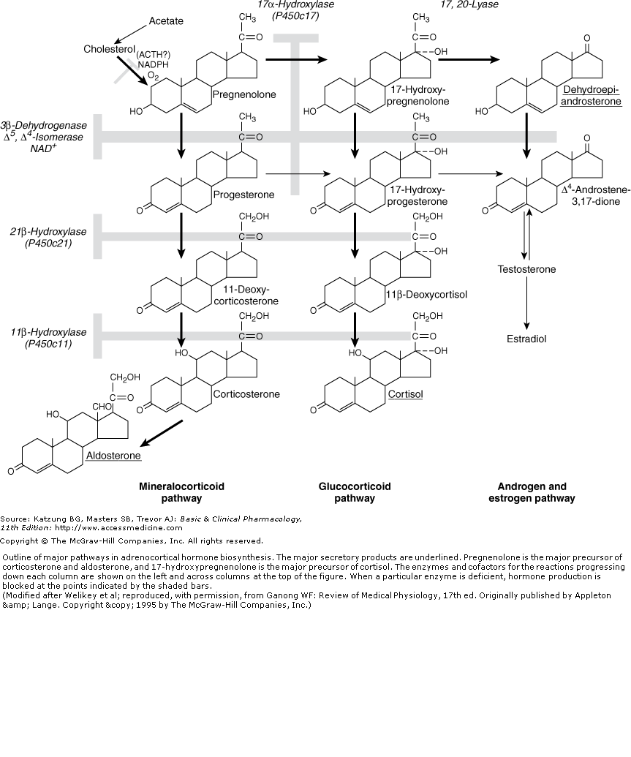
Steroid synthesis: 2. glucocorticoid
B
ZF
A
B
ZF

Slide 26
I. Adrenal Steroidogenesis 2. Glucocorticoids: biosynthesis
Occurs in the Zona fasiculata [ZF] and Zona reticularis [ZR] of adrenal cortex.
All mammalian steroid hormones are formed from cholesterol via pregnenolone (step1).
Biosynthesis of glucocorticoids (A & B pathways):
A. pathway:
Pregnenolone is converted to progesterone by 3β-hydroxysteroid DH (3 β -OHSD) and D5-D4 isomerase (step 2).
Progesterone is hydroxylated at C21 to form 11-deoxycorticosterone (DOC).
Next hydroxylation is at C11 producing Corticosterone. (it has glucocorticoid & weak mineralocorticoid action).
…………………………………………………………………
B. pathway:
17α-Hydroxylase acts upon either progesterone or pregnenolone to form 17 α - hydroxyprogesterone and/or 17 α -hydroxypregnenolone.
17 α -hydroxyprogesterone is hydroxylated at C21 to form 11-deoxycortisol.
11-deoxycortisol is then hydroxylated at C11 to form Cortisol.

Slide 27
I. Adrenal Steroidogenesis 2. Glucocorticoid: biosynthesis
Cortisol is the most potent natural glucocorticoid hormone in humans.
Cortisol release is primarily under ACTH.
3 hydroxylases are needed for cortisol synthesis on position:
C17 by 17α-hydroxylase, (acts rapidly; present in ER)
C21 by 21-hydroxylase, (acts rapidly; present in ER)
C11 by 11-hydroxylase, (acts slowly; present in mitochondria).
If C 11 is hydroxylated first, the action of 17α- hydroxylase is impeded and mineralocorticoid pathway is followed ( forming corticosterone or aldosterone depending on the cell type).

Slide 28
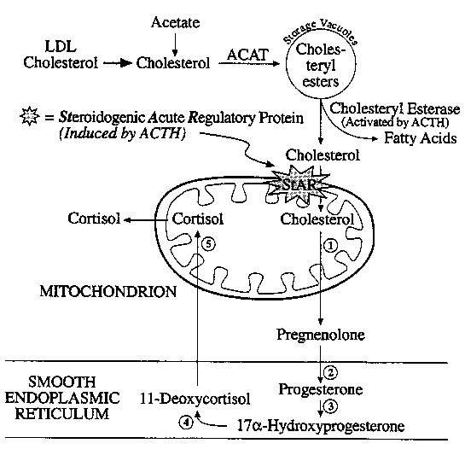
Adrenal steroid biosynthesis involves the shuttling of precursors between mitochondria and ER

Slide 29
I. Adrenal Steroidogenesis 2. Glucocorticoid: regulation, transport and metabolism of cortisol
The majority of cortisol is bound to cortisol binding globulin; CBG (transcortin). Only 5% of circulating cortisol is in free form.
CBG is produced by the liver. Production of CBG is increased by estradiol.
Cortisol has a half-life of about 90 minutes.
Cortisol is metabolized in the liver, where it is conjugated to a glucuronic acid. Conjugation increases solubility in water and thus can be excreted via the kidneys.

Slide 30
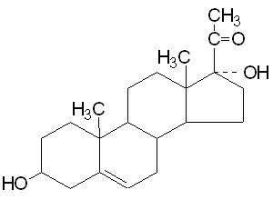
2. Glucocorticoid: B. synthesis pathway Step 2
Pregnenolone
17(OH) pregnenolone
17
17α-hydroxylase
[ER]

Slide 31
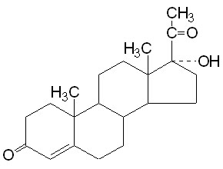
2. Glucocorticoid: B. synthesis pathway Step 3
17 (OH) pregnenolone
17 (OH) progesterone
3β (OH)steroid dehydrogenase &
∆5-4 isomerase
[ER]

Slide 32
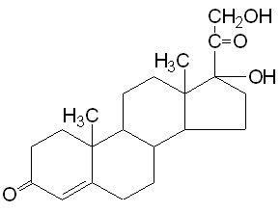
2. Glucocorticoid: B. synthesis pathway Step 4
17 (OH) progesterone
11-Deoxycortisol
21-hydroxylase
[ER]

Slide 33
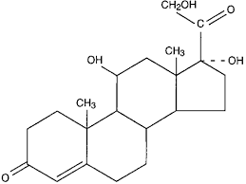
2. Glucocorticoid: B. synthesis pathway Step 5
11-Deoxycortisol
Cortisol
11
11β-hydroxylase
[mitochondria]

Slide 34
I. Adrenal Steroidogenesis 3. Adrenal androgens: biosynthesis
Produced in the zona reticularis [ZR].
The major androgen produced by adrenal cortex is dehydroepiandrosterone (DHEA).
Most of 17-hydroxy pregnenolone follows glucocorticoid pathway.
Few of 17-hydroxy pregnenolone follows androgen pathway.
17α-hydroxylase + 17, 20 lyase = dual-function protein.
Lyase activity is important in both adrenals and gonads. Lyase acts exclusively on 17-hydroxy containing molecules.
hhh adrenal androgens if >>> glucocorticoid synthesis by lack of hydroxylases (adrenogenital syndrome)

Slide 35
I. Adrenal Steroidogenesis 3. Adrenal androgens: regulation and metabolism
Production is stimulated by ACTH.
Main product: androstenedione
In females, adrenal androgens may play roles in development of axillary and pubic hair & libido.
[In men, androgens from the testis serve these functions].
Adrenal androgens may also be peripherally converted (in adipose tissue, for example) into testosterone and estrone.
Androstene-dione is more potent than DHEA.
Reduction of androstene-dion at C17 results in formation of testosterone which is the most potent adrenal androgen. Small amounts are produced in the adrenal, but most of this conversion occurs in testes.

Slide 36
3. Adrenal androgens: Step 2
Pregnenolone 17(OH) pregnenolone
17α-hydroxylase
17

Slide 37
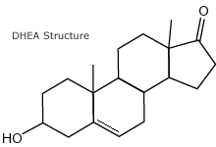
3. Adrenal androgens: Step 3
17 (OH) pregnenolone Dehydroepiandrosterone
(DHEA)
17,20 lyase
17

Slide 38
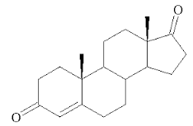
3. Adrenal androgens: Step 4
Dehydroepiandrosterone
Androstene-dione
3β (OH)steroid dehydrogenase &
∆5-4 isomerase

Slide 39
3. Adrenal androgens: Step 3\\
Pregnenolone 17- (OH) pregnenolone
Cortisol
Androstene-dione
17α-hydroxylase
3β-HSD & isomerase
21 hydroxylase
11 hydroxylase
17,20 lyase
DHEA

Slide 40
Steroid synthesis: overall

Slide 41
Adrenal diseases: Congenital adrenal hyperplasia
Deficiency in :
3β-HSD (type II),
11β-hydroxylase, or
21-hydroxylase activity
blocks cortisol formation, leading to increased ACTH (less negative feedback)
- Result: Increased formation of androstenedione or DHEA (which is converted to androstenedione by 3β-HSD type I in liver)

Slide 42
Congenital adrenal hyperplasia
↑↑
↑↑
↑↑
↓↓ cortisol
↑↑ ACTH

Slide 43
Best wishes
Dr.Eman Shaat

