Slide 1
Urinary Incontinence Dr. Ahlam Al-Kharabsheh
Lower urinary tract disorders divide into :
Emptying and Storage (as Urinary incontinence )
Edited By : Noor Al-huda Esam Al-Karaki
Doctor's notes were added in dark purple color
OBS & GYN Department 2021

Slide 2
Urinary incontinence
The involuntary leakage of urine.
**It remains undetected and undertreated worldwide despite its
substantial impact on affected individuals.→ 1-hesitation of seeking medical help 2- lack of knowledge according to treatment options other than surgery
In a US survey, only 45% of women who reported urinary incontinence occurring
at least once a week sought care for their incontinence symptoms.
The prevalence of incontinence in women is high
In older than 65, the prevalence of urinary incontinence is 20%.
High morbidity → Fractures in case of Rushing to the bathroom
For younger and middle-aged women ( 20-45 years ), the prevalence is 5-10%.
45-65 years → 10%
**Urinary incontinence has profound effects on quality of life and is associated with depression and anxiety, work impairment,social isolation, and sexual dysfunction
Leakage during intercourse , specially with women with one type of incontinence , called : coital incontinence ( urge ) .
Socially : it’s a chronic condition progressive increasing in severity and frequency → affect the quality of life

Slide 3
Anatomy of the urinary system:
Normal Urethral Closure
- Normal urethral closure is maintained by a combination of intrinsic & extrinsic factors:
The extrinsic factors:
The levator ani muscles ( 3rd line ,main pelvic floor muscle ), the endopelvic fascia (2nd line ) , & their attachments to the pelvic sidewalls through arcus tendineus line ( white line ) & the urethra + anterior vaginal wall which is the first line of sport .
The intrinsic factors includes:
the striated muscle of the urethral wall
vascular congestion of the submucosal venous plexus
the smooth muscle of the urethral wall & associated blood vessels
the epithelial coaptation of the folds of the urethral lining

Slide 4
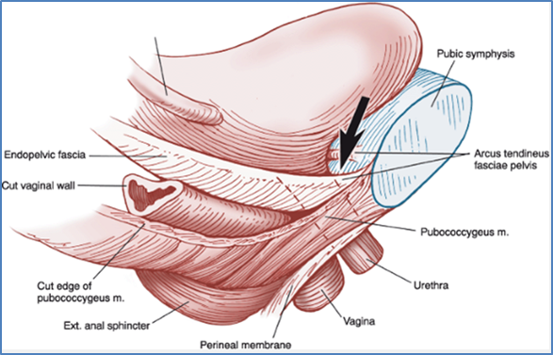
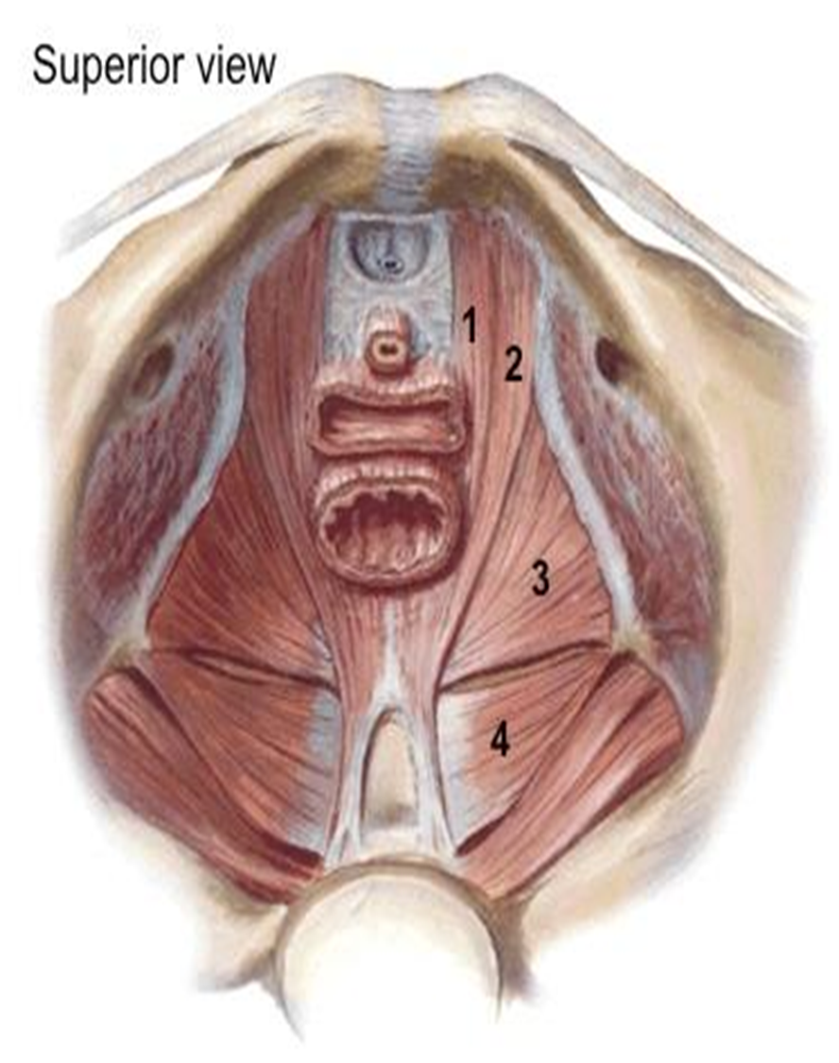
Endopelvic fascia : completely surround vagina. And partially around urethra with difference in thickness , it’s thicker and more dense around the proximal part ( involuntary ) than the distal urethral part ( Voluntary )
→ Endopelvic fascia anatomically : posterior to suspensory ligaments , Anterior to pubic bone and lateral to vagina
→ Urethra : short striated smooth muscle 4-5 cm , just above the vaginal opening .
Levator ani muscles :1- Puborectalis 2- Pubococcygeus
3-Ilio-coccygeus
4-coccygeus
Innervated by : pedundal nerve from sacral plexus S2-S4 which is the most common affected nerve during labor in reversible manner usually , in severe cases → irreversible ( rare )
5
6
7

Slide 5
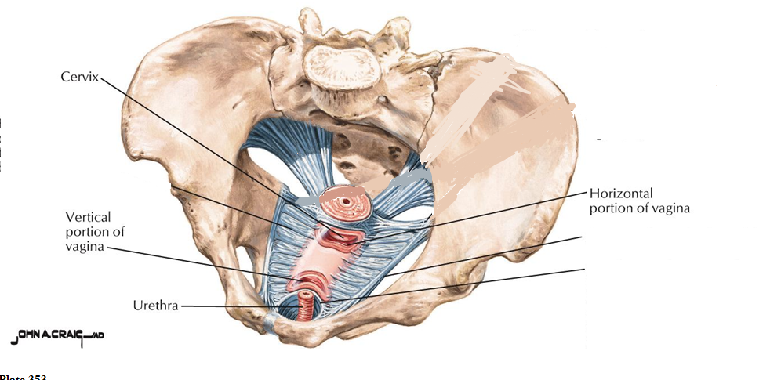
Uterosacral ligament
Cardinal ligament
8
6
8

Slide 6
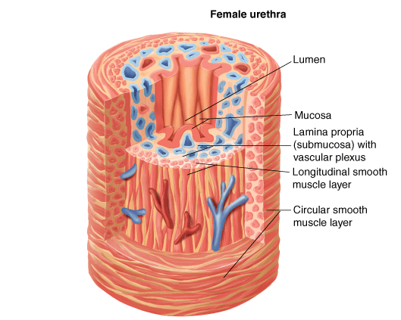
With menopause , female loses epithelia folds ( rugae ) → decrease in blood supply within venous plexus so the incidence of incontinence increases with age

Slide 7
The Bladder
The bladder is a low-pressure system that expands to accommodate increasing
volumes of urine without an appreciable rise in pressure.
- Filling :
During bladder filling, there is an accompanying increase in muscle fiber recruitment of the pelvic floor & urethra → increase in outlet resistance. The bladder muscle (the detrusor) should remain inactive during bladder filling, without involuntary contractions
- Micturition:
When the bladder has filled to a certain volume, fullness is registered by tension-stretch receptors, which signal the brain to initiate a micturition reflex → this reflex is permitted or not permitted by cortical control mechanisms, depending on the social circumstances & the state of the patient's nervous system.
→Normal voiding is accomplished by voluntary relaxation of the pelvic floor & urethra, accompanied by sustained contraction of the detrusor muscle, leading to complete bladder emptying

Slide 8
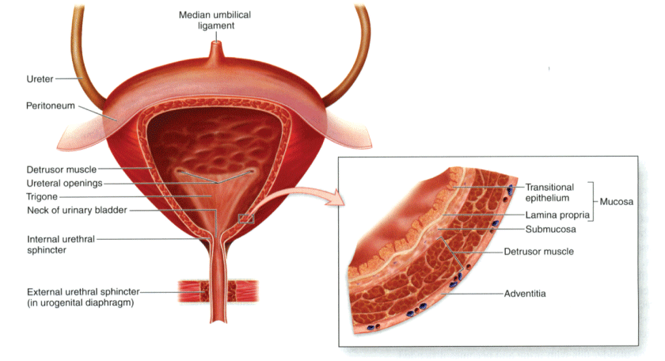
Continuous with detrusor muscle , Involuntary : parasympathetic and sympathetic systems
Somatic : voluntary

Slide 9
Innervations
- The lower urinary tract receives its innervation from three sources:
Sympathetic nervous system
Parasympathetic nervous system
The neurons of the somatic nervous system (external urethral sphincter)
The sympathetic nervous system:
- Originates in the thoraco-lumbar spinal cord, principally T11 through L2-L3
- Acts on two types of receptors:
Alpha-receptors → in the urethra & bladder neck → increases urethral tone & thus promotes closure
Beta-receptors → in the bladder body → decreases tone in the bladder body
The parasympathetic nervous system:
Controls bladder motor function — bladder contraction & bladder emptying
Originates in the sacral spinal cord, primarily in S2 to S4
The somatic nervous system
The somatic innervation of the pelvic floor, urethra, & external anal sphincter originates in the sacral spinal cord, primarily in S2 to S4

Slide 10
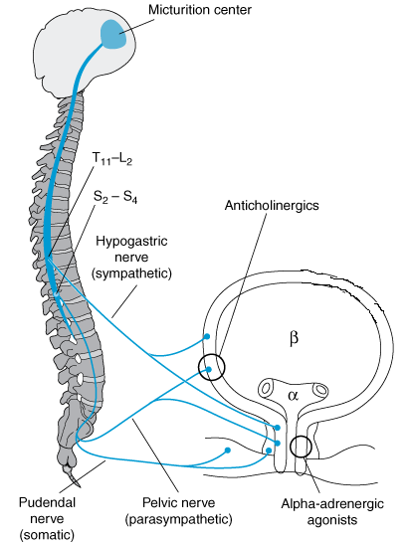
→Bladder is normally under inhibitory effect of micturating center in pons or medulla →responds to inhibitory effect from cortex →stimulation of Sympathetic (T11-L3) and release of Nor-Adrenaline and bind on beta 3 receptors of bladder wall :relaxation of muscle
on alpha 1 on the internal sphincter : contract and close it ,
→inhibit the effect of pudendal nerve: close the external sphincter
maximum bladder capacity and stretching signals reach the micturating center on cortex and ask the higher center to release the inhibitory effect and activate the parasympathetic system → Ach on M3 receptor on the wall of bladder → contractions of detrusor muscle and open sphincters→ start urination in a proper environment

Slide 11
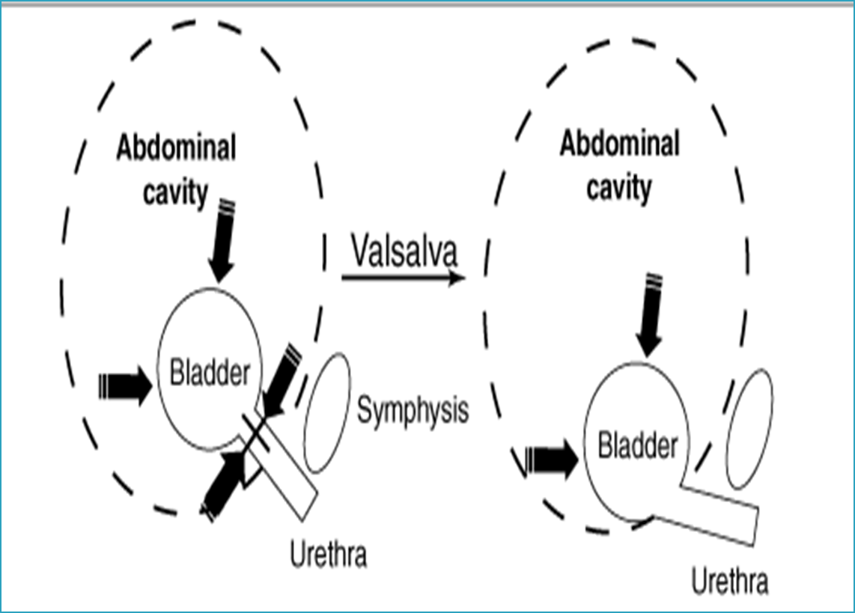
Classification: There are many cause of urinary incontinence divided into urethral and extra-urethral ( other openings ) causes. 1-Urethral causes Stress incontinence:
First theory Pressure-Transmission Theory
Second one : vaginal hammock theory
Adequate pelvic floor muscle support
urethral hypermobilization
no pressures difference

Slide 12
Urethral causes
Stress incontinence:
The most common type , Young and middle age
Patient have involuntary leakage of urine that occurs with sneezing, coughing, laughing, or anytime an increase in intra-abdominal pressure exceeds urethral sphincter closure mechanisms
Stress incontinence may be provoked by minimal or no activity when there is severe sphincter dysfunction→ continuous leaking
Causes
. Damage of the nerve supply of the pelvic floor , urethral sphincter and damage to pelvic floor muscle during vaginal delivery. (Prolonged second stage, large babies and instrumental deliveries cause the most damage.))
→ problem with intrinsic factors ( epithelium , urethral muscles , sphincters ) → Atrophy due to menopause ,Chronic raise in intra abd pressure (cough , obesity, constipation…
.Congenital collagen diseases

Slide 13
Urge incontinence:
Patient typically have symptoms of involuntary leakage of urine accompanied by urgency (Postpone urination normally ,strong desire to void ) .
Women may have increased daytime frequency and nocturia . To differentiate it from UTI
Common triggers include running water, hand washing, and cold weather exposure. → disappear once the triggers are disappeared
Urge incontinence is believed to be caused by detrusor overactivity (Detrusor Syndrome ) .
Causes are poorly understood
Mixed stress and urge urinary incontinence :
Symptoms of urge and stress incontinence→ One dominates the other

Slide 14
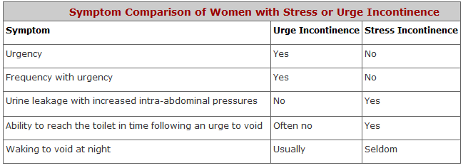

Slide 15
Overflow incontinence: more with menopause and muscle atrophy
Involuntary, continuous, urinary leakage or dribbling and
incomplete bladder emptying.
It is caused by 1- impaired detrusor contractility ( underactivity due to impaired sensation , DM , vit b12 def , Myasthenia Graves , multiple sclerosis) or due to impaired contractility with recurrent cystitis .
or 2- bladder outlet obstruction (rare in women)→ stage 3,4 prolapse ,bladder tumor , large stone in Trigone , fibroid . So this obstruction will increase the capacity and compliance → stimulates the tension wall receptor → insufficient contraction → incomplete bladder emptying with high residual volume .
If the bladder is over-distended:
An increases in intra-abdominal pressure can force urine past the urethral sphincter, causing stress incontinence
In some cases, bladder over-distention may provoke an uninhibited contraction of the detrusor muscle, leading to incontinence.

Slide 16
Causes of urethral incontinence :
Genitourinary
In older women, several physiologic changes occur in the lower urinary tract that can cause incontinence:
Involuntary detrusor contractions or overactivity
Decreased detrusor contractility
Low estrogen levels
Decrease in urethral closure pressure
Others:
Interstitial cystitis (painful bladder syndrome).
Pelvic organ prolapse (Cystocele)

Slide 17
Systemic conditions
Neurologic disorders: e.g. stroke, multiple sclerosis, Parkinson disease, disc herniation, spinal cord injury…
Diabetes mellitus: overflow incontinence and poor urinary stream can be present in patients with diabetic autonomic neuropathy
Cancers
Potentially reversible causes (Functional incontinence)
Medications ( alpha blockers, ACE inhibitors, Anti-depressant)
Decreased mobility (e.g., post-surgery)
Change in cognitive or mental status ( sedation from medications as Morphine & mepredine)
Stool impaction
Alcohol and caffeine intake
DIAPPERS : Dementia or Delirium → not aware , Infection (UTI , Vaginitis ), Atrophy , Pharmacological , Psychological , Excessive urination (DM) , Restricted movement (Fractures , post surgery ) , Stool impactation

Slide 18
Pharmacological :
ACEI : chronic cough , increase intra-abdominal pressure → Stress incontinence .
Alpha blocker : Prazosin antihypertensive .
Antidepressant ,Alpha 1 Agonist ( nasal decongestion ) , opioids (systemic analgesia ) , anti-psychotic : anti-cholinergic → increase contraction of internal sphincter → increase retention → overflow incontinence .
CCB : decrease contractility of muscle → retention and cause overflow + peripheral edema which cause nocturia due to venous redistribution with supine position.
Antihistamine : as buscopan , antispasmodic → anticholinergic → Retention.
IVF and high progesterone effect .

Slide 19
Extraurthral causes: The observation of urine leakage through channels other than the urethra.
*Congenital , normally the ureter opens in Trigone.
Bladder exstrophy ( abdominal wall defect ) and ectopic ureter
*Fistula : contact between two epithelium
Abnormal opening between the urinary tract and the outside
It has obstetric and gynaecologycal causes such as obstructed labor ( in developing countries , there is no access to CS → 2-3 days in labor → ishchemia and necrosis → Fistula ) , ( in developed countries : Surgeries→ most frequent one : Hyesterctomy ) malignancy and radiotherapy
→ Most common fistula : Vesico-Vaginal

Slide 20
EVALUATION : we have to check 4 things : Onset ( sudden → neuro or infection , because the incontinence progress gradually . 2- Associated symptoms ( change in urine color , dysuria , hematuria ) 3- Associated neurological symptoms ? Impaired gait ,sensation . 4- Bulging through vagina ? * if previous points were –ve , think of incontinence
History:
- Patient’s urinary symptoms (volume, onset of incontinence, timing, severity, hesitancy, precipitating triggers, nocturia, intermittent or slow stream, incomplete emptying, continuous urine leakage, and straining to void)
Voiding (bladder) diaries// Frequency- volume bladder charts are useful for assessing incontinence frequency, severity, and volume of urine loss during incontinent episodes.
Severity of symptoms & degree of bother and effect on quality of life (Questionnaires to assess quality of life and urinary incontinence) :
1- UDI-6: Urogenital Distress Inventory, short form.
2- IIQ-7 : Incontinence Impact Questionnaires, short form.
The severity increase with high score

Slide 21
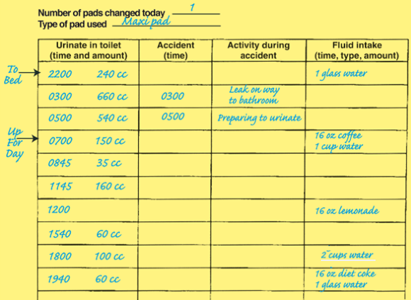
To keep record of voiding habit for 3 days , or just for one day is enough ( 24 hours ) to assess the cause and type , help in management.

Slide 22
History: past obstetric , past medical
- If there is indications to evaluate for underlying serious causes or potentially reversible conditions. Alarm symptoms on history include:
sudden onset of incontinence
the presence of abdominal or pelvic pain
Hematuria , bladder tumor
changes in gait or new lower extremity weakness,
cardiopulmonary or neurologic symptoms
mental status changes
Fibroid → change in menstrual cycle .
- Other: drug history, constipation, caffeine , tea intake , uncontrolled DM , vit b12 def , alcohol intake …etc.

Slide 23
Physical examination : by inspection : general look , age , gait , obese
Abdominal examination to rule out : organomegaly , Ascites , masses
All women presenting with incontinence need a pelvic examination→ lithotomy semi-sitting position , separate labia and insert the speculum on the posterior vaginal wall , ask her to cough : cough test or bladder stress test . Why we use speculum ? to avoid pelvic floor muscle contractions and false -ve results , because ladies usually come with advanced compensated stage , so to prevent the leakage they contract their pelvic floor muscle voluntarily .
In addition, a comprehensive examination is often necessary to detect potentially reversible factors and underlying serious conditions
- The detailed pelvic examination in women includes:with full bladder
Inspect the vaginal mucosa for signs of atrophy (thinning, pallor, loss of rugae), and inflammation, signs of menopause and irritation , the urine is a good media for Bactria and infections → itching and eczema
Palpate bimanually to evaluate for masses or tenderness.
Assess for pelvic organ prolapse: hold the blade firmly against the posterior vaginal wall. Ask the woman to cough once, looking for urethral leakage &/or cystocele. Specially with anterior wall prolapse
Bladder stress test: is performed by asking the patient, with a full bladder, to stand, relax, and give a single vigorous cough

Slide 24
Investigations: according to symptoms
Urine analysis : supra-pubic pain ,sudden onset , dysuria → UTI
Postvoid residual volume (PVR) with overflow type — In general, a PVR of < 50 mL is considered adequate emptying, and a PVR > 200 mL is considered inadequate and suggestive of either detrusor weakness or bladder outlet obstruction .
With other types ? PVR is normal
Urodynamic testing:تخطيط المثانة
group of tests used to assess function of the urinary tract. Some specific types of urodynamic testing are:
Cystometry (Cystometrogram) evaluates bladder function by measuring pressure and volume of fluid in the bladder during filling, storage, and voiding.
Uroflowmetry measures the rate of urine flow.
When to do URODYNAMIC study ? 1-mixed type 2- failure urge treatment with –ve cough test. 3-recurrence after anti- incontinence surgery 4-combined with prolapse so combined surgery ( mild 1,2 grades associated with incontinence ) but with 3,4 grades associated with obstruction and increase capacity so once we treat the 3,4 grades the incontinence will appear again.
→ Clinical evaluation with urodynamics may lead to a more accurate diagnosis of incontinence type

Slide 25
Normal observations and results —
The normal bladder should not have involuntary phasic contractions during filling despite provocation. It should initially expand without resistance or increased intraluminal pressure.
The urethral sphincter should relax and open when the patient wants to initiate voiding, accompanied by detrusor contractions.
During voiding, detrusor contraction should be smooth and lead to a steady urine stream.
With uroflowmetry we can detect :
1- Maximum urine amount
2- Residual volume
3- Voiding time
4- continuity of stream
→urine flow is a bell shape ( slow then reach the peak then slow , 30-40 seconds duration )
→ With obstruction , ladies make an effort to urinate so the diagram will be intermittent with high RV

Slide 26
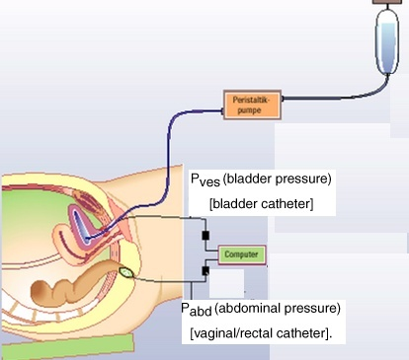
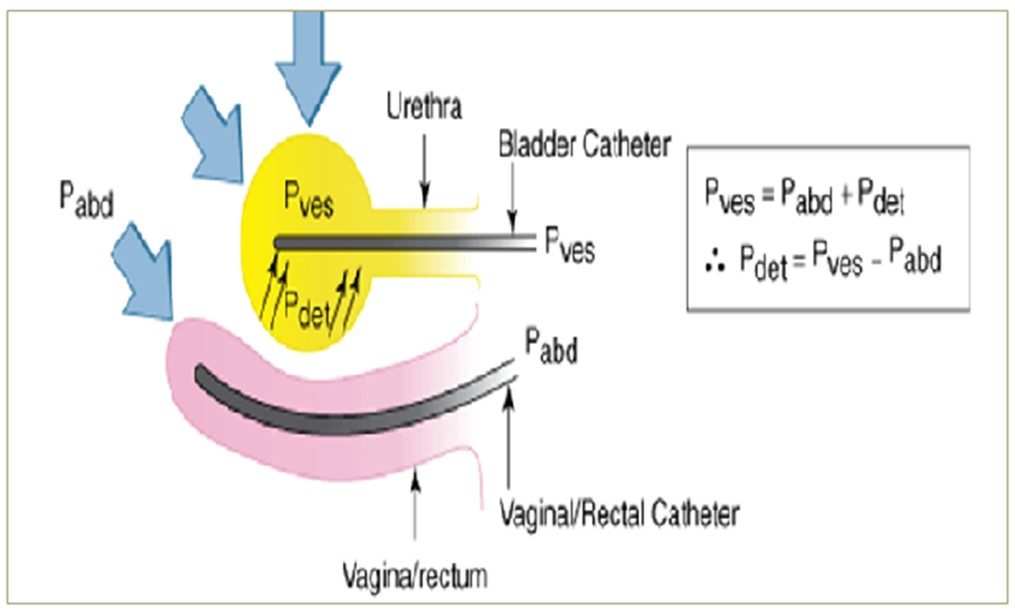
→ the difference between bladder and rectum pressures is the detrusor pressure

Slide 27
Technique
The patient begins by emptying her bladder as much as possible
A catheter is inserted into the bladder
Intravesical & rectal catheters are placed to measure detrusor and abdominal pressure
Water or normal saline is used to fill the bladder
the woman is asked to describe sensations during filling, including when the first feeling of bladder fullness occurs.
Provocative maneuvers, such as coughing, Valsalva, listening to running water are helpful for determining if they cause leakage and whether the leakage is related to uninhibited detrusor contractions or stress incontinence
Once the bladder is completely full, the woman is asked to begin voiding, and measurements are made of pressure, volume, and flow rate.

Slide 28
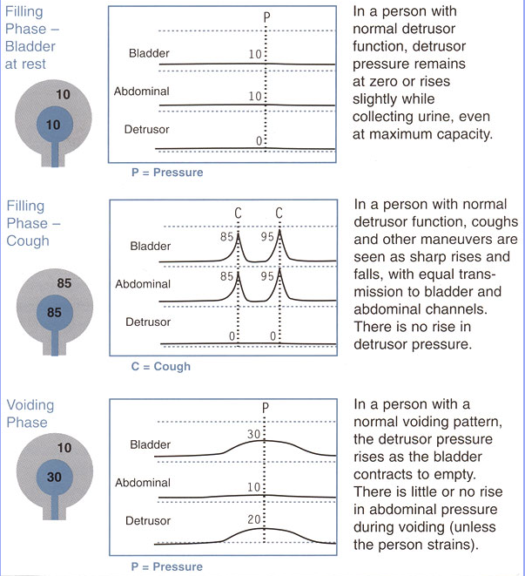
the only time we detect increase in detrusor pressure is directly before the voiding

Slide 29
- Approximate of normal cystometric values for women are:
Residual urine → < 50 mL
First desire to void → occur between 150 & 250 mL
Strong desire to void → doesn’t occur until > 250 mL→ she can hold herself
Bladder compliance → between 400 & 600 mL
No uninhibited destructor contraction during filling, despite provocation
No stress or urge incontinence
Voiding occurs because of voluntarily initiated & sustained detrusor contraction
Flow rate during voiding is > 15 mL / sec with detrusor pressure of < 25 cm H2O

Slide 30
Overactive bladder “Detrusor overactivity” urodynamic observation characterized
by involuntary detrusor contractions during the filling
phase which may be spontaneous or provoked.
Genuine stress incontinence (Urodynamic stress incontinence USI) is characterized by leakage that occurs with an increase in abdominal pressure, such as coughing or Valsalva, without a rise in true detrusor pressure

Slide 31
Prevention
Behavioral and lifestyle changes: weight loss for obesity, smoking cessation, increasing physical activity/exercise, improving diet.
Pelvic floor muscle exercises are effective in preventing and reversing some urinary incontinence in the first year after vaginal delivery or following pelvic surgery
Management of conditions associated with incontinence (Diabetes, constipation)
Specific medications and surgical procedures may adversely affect continence such as hysterectomy.

Slide 32
Treatment Stress incontinence
Non-surgical Treatment
Reduce factors that worsen the problem → obesity, smoking, medication, excessive fluid intake
Pelvic floor exercise & biofeedback, Electrical stimulation of pelvic floor muscle
Estrogen topical therapy (in postmenopausal women with urogenital atrophy)→ improve intrinsic factors .
Vaginal Pessaries.
Medication: Duloxetine cause liver toxicity (selective adrenaline – serotonin reuptake inhibitor → prolonged sympathetic action → relax muscle and close sphincter , the only approved one , use it with depression and incontinence ), , Imipramine → decrease ca influx → relaxation of muscle and contraction of alpha 1 , no difference with placebo .
Surgical Management
Anterior vaginal colporrhaphy ineffective
Retro-pubic bladder neck suspension operations (Burch, MMK)
Tension-free vaginal tape (TVT, TVT-O) the second choice
Sling operations (Miniarc, Monarc)→ gold standard
Peri-urethral injections→ Hyaluronic acid around urethra , intrinsic factors problem→ improve function and closure pressure
Notes:
For the elderly or frail patient with a scarred, narrowed vagina or in cases where other surgery has failed,
Periurethral bulking injections.
Early success at three-month follow up ranges from 80 to 90%, but there is a time-dependent decline to approximately 50% at three to four
years.
Complications are uncommon and minor: Dysuria, urinary tract infection and retention

Slide 33
Urge incontinence
Conservative measure: (effective in between 60 and 70%)
Cut down volume of fluid consumed – should consume between 1 & 1.5 liters a day → eg :no fluid intake after 6PM
Avoid caffeine based drinks
Bladder training: the patient is instructed to void on a timed schedule, starting with a relatively frequent interval → until the normal interval 3-4 hours
→ Medications:
Anti-muscarinic drugs (tolterodine and oxybutynin→ most common SE : dry mouth and the 2nd one is constipation , may also cause tachycardia , blurred vision )
Newer anticholinergic drugs include solifenacin, fesoterodine and darifenacin
B3 adrenergic receptor agonist: Mirabegron ( less SE in comparison with anti muscarinic )
Both cause retention →every 4-6 month check the PVR
Estrogen → less effective than with stress type
→ Intra-vesical therapy ( Botulinum toxin )
Sacral nerve root neuromodulation → new pacemaker .
Surgery (cystoplasty, urinary diversion→ ureter re-insertion or implantation in terminal ileum , suprapubic drainage → cause malabsorption ) in refractory cases

Slide 34
Overflow incontinence:
Medical therapy to enhance bladder emptying provided there is no obstruction :
In case of muscle hypoactivity :
→ alpha 1 blocker as phenoxybenzamine ( with pheochromocytoma ) → relaxation .
→Bethanechol Chloride → parasympathetic agonist
Treatment of the underlying cause of obstruction e.g. myomectomy or hysterectomy in the case of fibroid, removal of the urethral stricture …etc.
In case of retention After surgery→ Neostigmine (cholinestrase inhibitor ) → increase Ach level and contraction → complete emptying .
Intermittent self catheterization → the last choice

