Slide 1
HIV
acquired immunodeficiency syndrome (AIDS)
BY: AMMAR ALTITI & RAGHAD KREISHAN

Slide 2
01.
02.
03.
Transmission
Structure of virus and epidemiology
04.
Investigation
pathogenesis
outline
Immunology
clinical manifestations
05.
06.
07.
Management

Slide 3
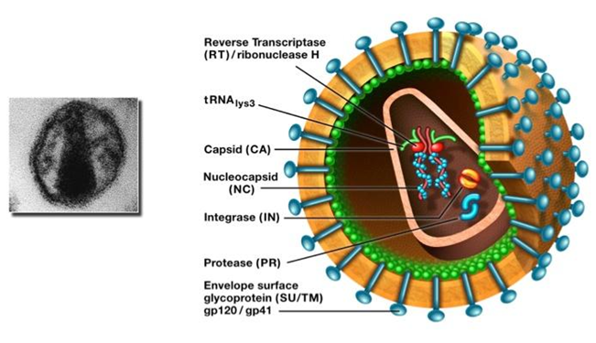
Structure and epidemiology
- HIV is a retrovirus from the lentivirus family its
genome → diploid of a ssRNA (+ve) polarity.
-Its RNA must be converted to DNA
-AIDS has become the second leading cause of disease world-wide and the leading cause of death in Africa.
-In the USA and northern Europe, the epidemic has until now predominantly affected men who have sex with men (MSM), whereas in southern and Eastern Europe, Vietnam and China the incidence has been greatest in injection drug-users and in Asia most transmission is from heterosexual and vertical transmission.

Slide 4
-HIV infects cells bearing the CD4 receptor; these are T-helper lymphocytes, monocyte–macrophages, dendritic cells, and microglial cells in the central nervous system (CNS). - Entry into the cell commences with binding of gp120 to the CD4 receptor which results in a conformational change in gp120 that permits binding to one of two chemokine co-receptors (CXCR4 or CCR5).
Immunology
-After mucosal exposure, HIV is transported via dendritic cells to the lymph nodes, where infection becomes established.
-This is followed by viraemia and dissemination to lymphoid organs, which are the main sites of viral replication.

Slide 6
Transmission
HIV is present in body fluids ( blood, semen, breast milk, saliva, rectal and vaginal fluids)
Exposure to infected fluid leads to a risk of infection, which is dependent on the integrity of the exposed site, the type and volume of body fluid, and the viral load.
Transmission risk after exposure to body fluid is : ->90% blood or its product - 15-40% vertical route -0.5-1% for injection drug use - 0.2–0.5% for genital mucous membrane spread -0.1%>for non genital mucous membrane

Slide 7
In developed nations, because of routine antibody screening, the likelihood of acquiring HIV from blood products is now <1 : 500 000 and arises from donors in the seroconverting phase of Infection .
HIV is not transmitted by air, food, or mosquito and does not survive long outside the body.

Slide 8
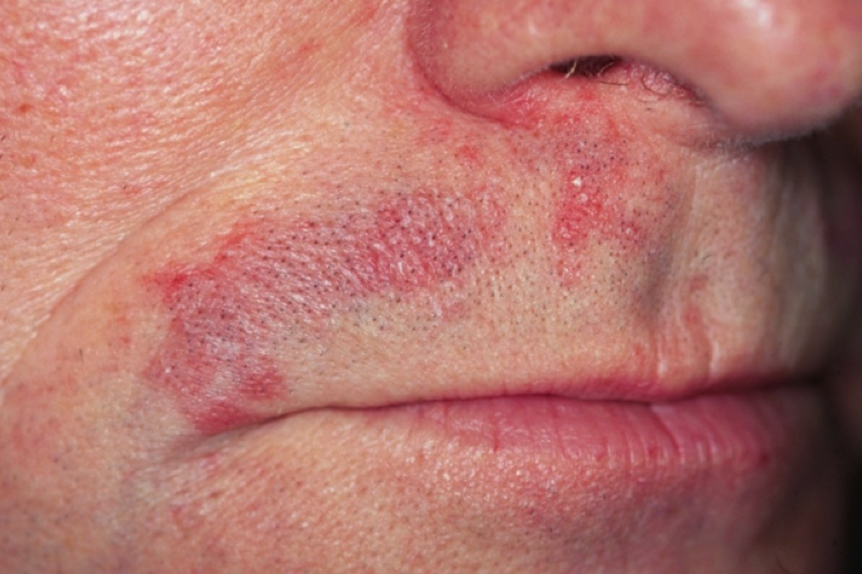
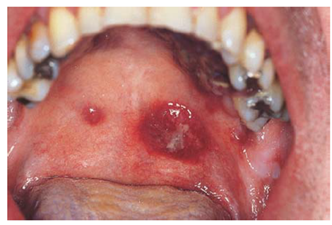
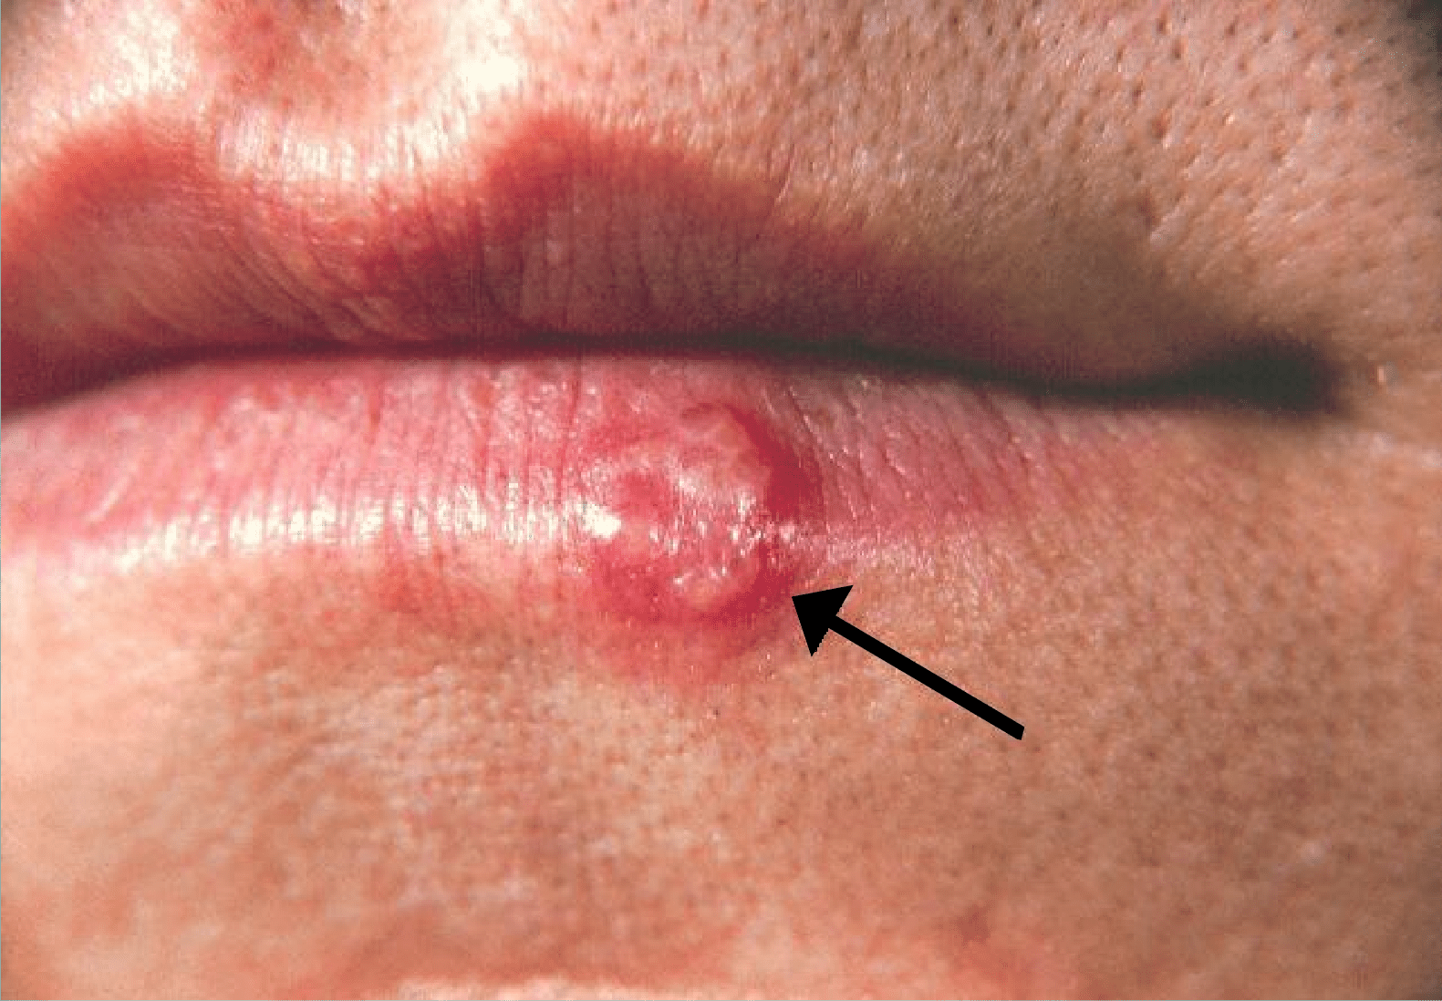
Clinical Manifestations
HIV itself is associated with a wide variety of clinical manifestations,
and opportunistic diseases. All body systems
can be affected by HIV. Skin and mucocutaneous tissue : -seborrheic dermatitis - Kaposi sarcoma
The skin and mouth must be carefully examined, as
mucocutaneous manifestations are extremely common in HIV
and many prognostically important conditions can be diagnosed
by simple inspection.
-Recurrences of herpes simplex infection are very common and
primarily affect the nasolabial and anogenital areas

Slide 9
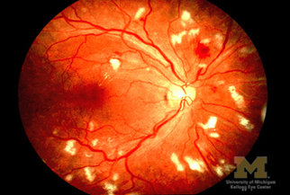
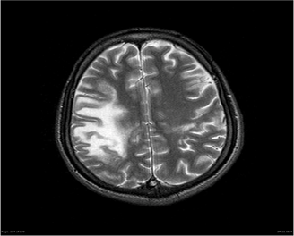
Eyes : -HIV retinopathy -progressive outer retinal necrosis
CNS: -HIV dementia -progressive multifocal leukoencephalopathy -cerebral toxoplasmosis
GIT:
-Oropharyngeal candidiasis is very common. It is nearly always caused by C. albicans
-Oesophageal candidiasis
-Chronic diarrhoea
-Hepatitis B and/or C (HBV and HCV) co-infection is common in HIV-infected people due to shared risk factors for transmission.

Slide 10
RS : Pulmonary disease is very common and is the major reason for hospital admission. Most patients who are admitted for respiratory diseases will have either bacterial pneumonia, pulmonary tuberculosis or PJP. Renal : Acute kidney injury is common, usually due to acute infection or nephrotoxicity of drugs (e.g. tenofovir) Blood : Normochromic, normocytic anemia is very common in advanced HIV disease.

Slide 11
Stages of HIV
Stage 01
stage 03
Primary infection
Mildly symptomatic
stage 02
Asymptomatic
AIDS

Slide 12
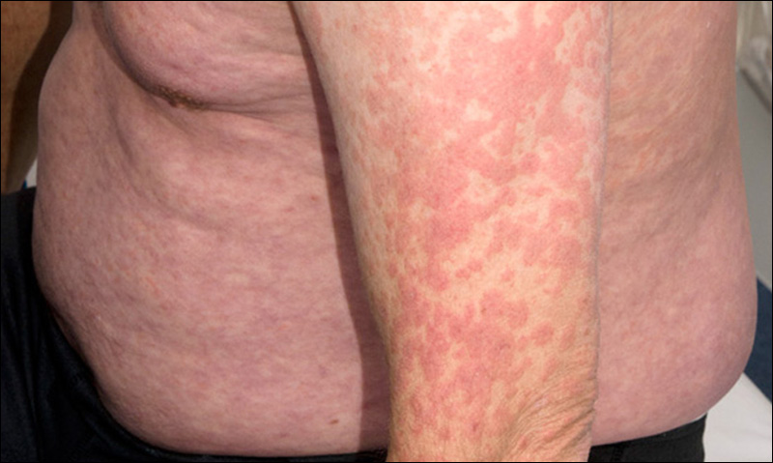
Pathogenesis
1-primary infection its clinical manifestation (2–6 wks after exposure):
mononucleosis-like symptoms (sore throat, lymphadenopathy, and a truncal maculopapular rash).
2-asymptomatic infection usually no clinical manifestation but seropositive (the longest phase last 4-7 years).
3-mildly symptomatic (pre AIDS) begins AIDS related complex (ARC):
Oral hairy leucoplakia – fever –rash -weight loss - Persistent generalized lymphadenopathy. Without treatment last 1-3 years

Slide 13
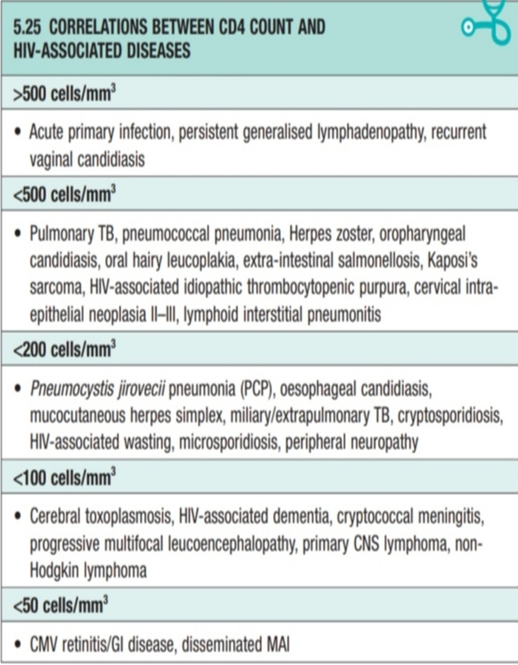
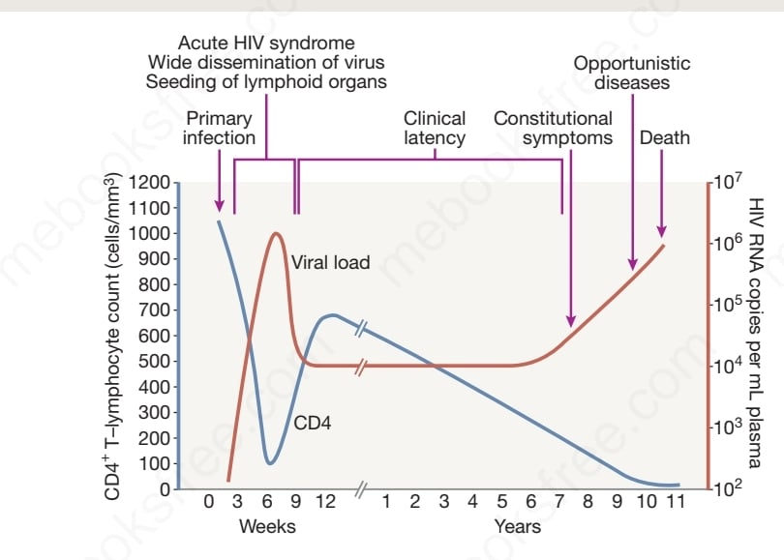
Pathogenesis
AIDS : is defined by the development of specified opportunistic infections, . This is accompanied by a fall in CD4 count to < 200 cells/mm3.

Slide 14
HIV is diagnosed by detecting host antibodies either with rapid point-of-care tests or in the laboratory, where enzyme-linked immunosorbent assay (ELISA) tests are usually done.
Most tests detect antibodies to both HIV-1 and HIV-2.
A positive antibody test from two different immunoassays
is sufficient to confirm infection.

Slide 15
Investigation
1 - PCR RNA viral load →→ test patients with acute HIV infection who have very high levels of viremia. This test is repeated to assess effectiveness of therapy
2 - p24 antigen assay
3 – ELISA →→ it’s a screening test for detecting antibody to HIV
If (+), Western blot test should be performed for confirmation. If (-), ELISA essentially excludes HIV (99% sensitive) if the patient has not had a subsequent exposure before testing (before seroconversion) note ::: ELISA → becomes positive 1 to 12 weeks after infection
4- Diagnosis of AIDS
. a. CDC definition of AIDS: A patient with HIV has AIDS if he or she has (1) a CD4+ T-cell count below 200 (2) a CD4+ T cell percentage of total lymphocytes below 14% (3) an AIDS-defining illness

Slide 16
ART has transformed HIV from a progressive illness with a fatal outcome into a chronic manageable disease with a near-normal life expectancy.
The targets for HIV treatment are : • Prolong life. • Prevent transmission. • Reduce the viral load to an undetectable level (50 copies/ml) for as long as possible. • Improve the CD4 count (above a level of 200 cells/mm3)
Many of the antiretroviral drugs that were initially used have
largely been abandoned because of toxicity or poor efficacy.

Slide 17
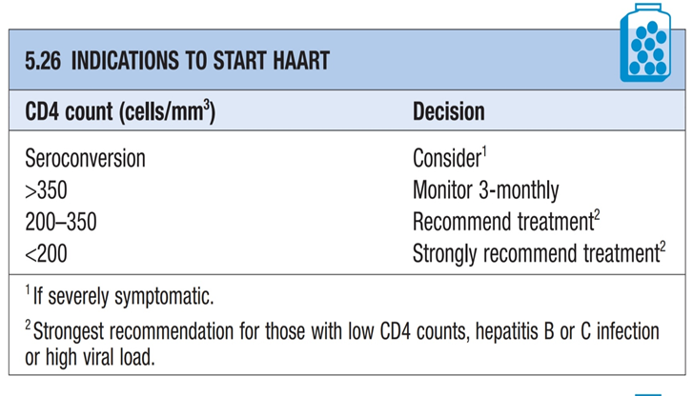
Management of HIV
Nucleoside reverse transcriptase inhibitors (NRTIs) : zidovudine, lamivudine. Toxixity: bone marrow suppression , peripheral neuropathy
Non-Nucleoside reverse transcriptase inhibitors (NNRTIs) : Efevirin, Etravirine. Toxixity: rash and hepatotoxicity
Protease inhibitor : Ritonavir, indinavir
Integrase inhibitor : Raltigravir
Fusion inhibitors :
Enfuvirtide, Maraviroc
The standard combination antiretroviral regimens are two NRTIs
together with an NNRTI, protease inhibitor (PI) or integrase
inhibitor.

Slide 18
Reverse transcription is error-prone, generating a large number of mutations. drug resistance is caused by changes in the virus's genetic structure. These mutations can lead to changes in certain proteins, most commonly enzymes, which help HIV reproduce (replicate). Mutations are very common in HIV.
Antiretroviral resistance
Minor deviations in triple-drug therapy may result in drug resistance, that’s why doctors should not initiate triple-drug therapy in a patient who is not willing or able to fully comply with the prescribed regimen .

Slide 19
Vaccination
An effective HIV vaccine remains elusive due to the extensive genetic diversity of HIV and the lack of a safe attenuated virus.
Other vaccination can be given to the patient to prevent other infections :
-pneumococcal polysaccharide vaccine (every 5-6 yrs)
-Influenza vaccine (yearly)
-Hepatitis B vaccine (if not already antibody-positive)

Slide 20
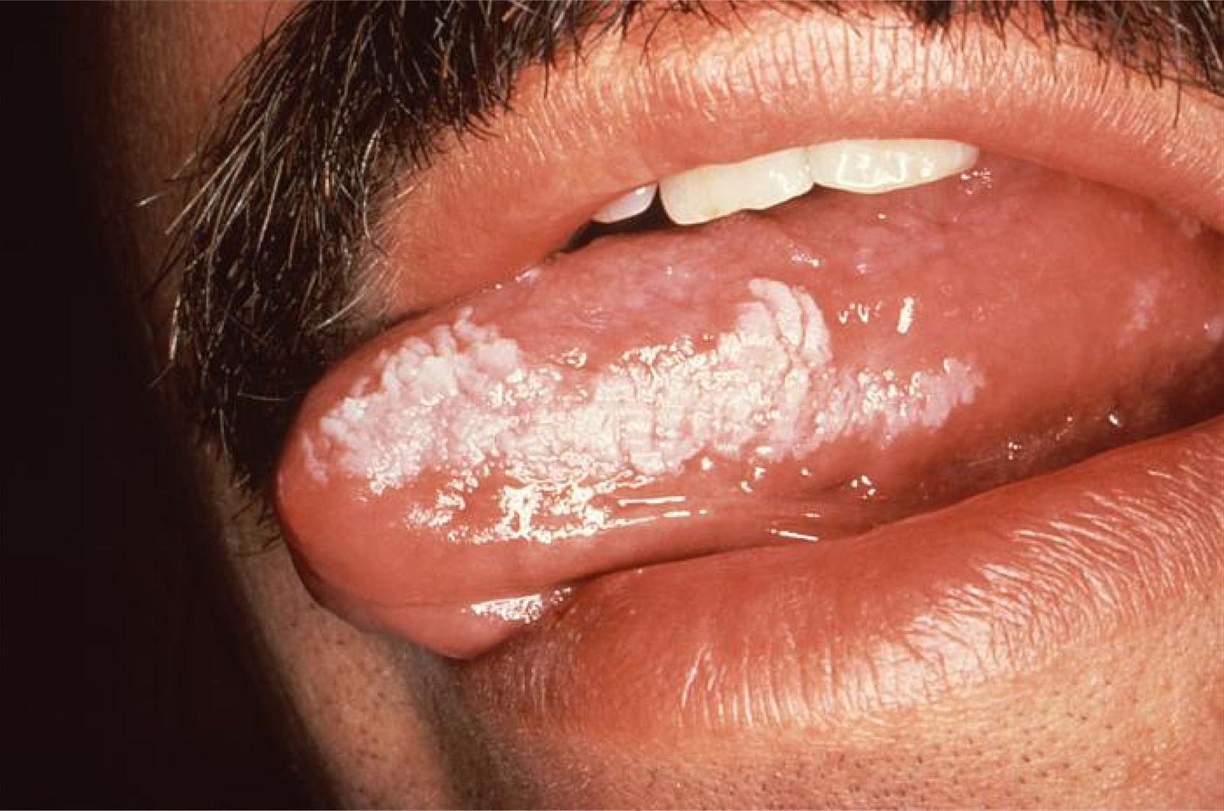
Clinical Case
A 62-year-old man presented with oral hairy leukoplakia , seborrheic dermatitis and tinea. He suffers from fever, cough and weight loss.
With no past surgical history. Before 8 years he was admitted to the hospital with fever, malaise, myalgia, pharyngitis and maculopapular rash , he was diagnosed with mononucleosis and given suppurative therapy.
Personal history : He was an IV drug abuser before approximately 8 years.
Q/in which stage of HIV did this patient came to clinic?

Slide 21
resources
Davidson's Essentials of Medicine
Step Up to Medicine

Slide 22
قال تعالى: اقْرَأْ وَرَبُّكَ الْأَكْرَمُ (3) الَّذِي عَلَّمَ بِالْقَلَمِ (4) عَلَّمَ الْإِنْسَانَ مَا لَمْ يَعْلَمْ (5) سورة العلق

