Slide 1
Diabetes mellitus

Slide 2
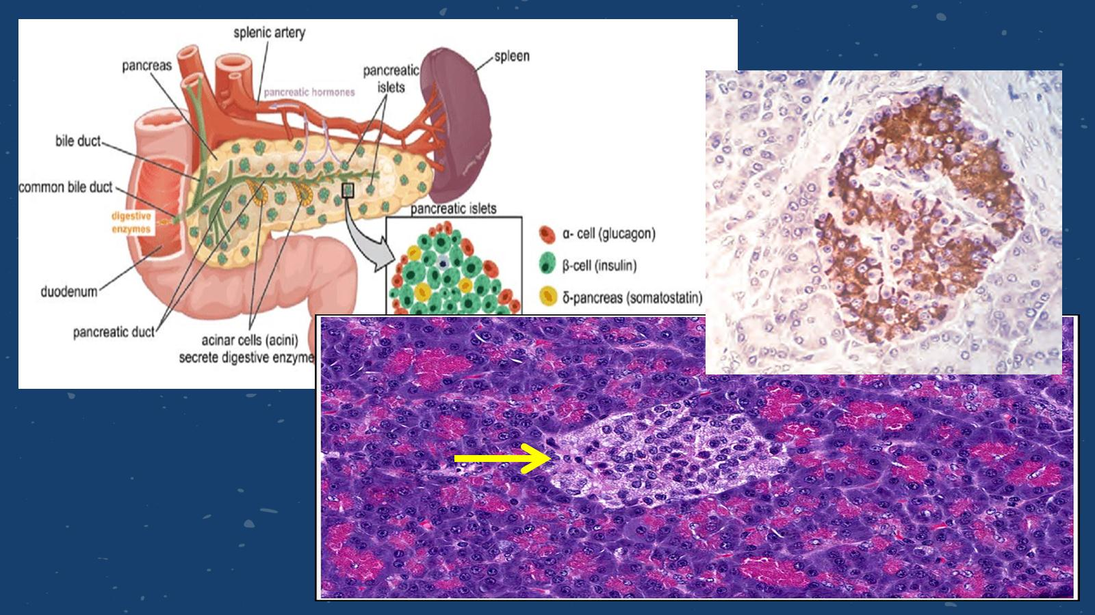

Slide 4
Classification:

Slide 5
Type 1 Diabetes

Slide 6
Type 1 Diabetes

Slide 7
Type 2 Diabetes

Slide 8
Obesity and insulin resistance

Slide 9
Obesity and insulin resistance

Slide 10
Obesity and insulin resistance

Slide 11
Beta Cell Dysfunction

Slide 12
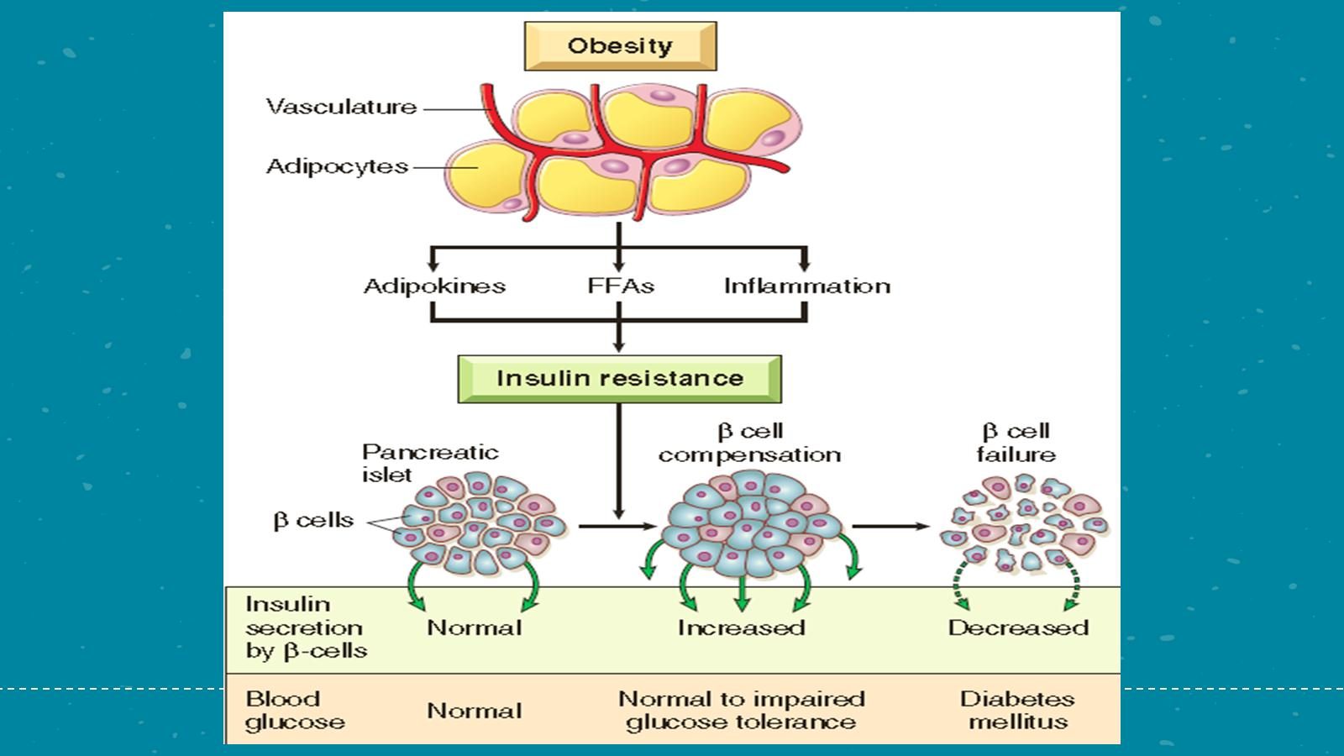

Slide 13
Morphology - Pancreas

Slide 14
Morphology - Pancreas

Slide 15
Clinical: Initial Presentation The classic triad of diabetes

Slide 16
Clinical: Diabetic ketoacidosis

Slide 17
Chronic Complications of Diabetes

Slide 19
Chronic Complications of Diabetes

Slide 20
Chronic Complications of Diabetes

Slide 21
Chronic Complications of Diabetes

Slide 22
Chronic Complications of Diabetes

Slide 23
Chronic Complications of Diabetes

