Slide 1
Nerve entrapement syndromes
بسم الله الرحمن الرحيم

Slide 2
Entrapment neuropathy
Definition
• Focal neuropathy due to restriction or
mechanical distortion of nerve within the
fibrous or fibro-osseous tunnel

Slide 3
The nerve is injured by
1. chronic direct compression,
-external
-internal
2. angulations
3. stretching forces
causing mechanical damage to
the nerve.

Slide 11
treatment
In early cases, simple measures such as advising the patient to avoid compromising postures of the affected limb, or preventing flexion of the wrist or elbow with a light-weight splint, may help.
If an inflammatory disorder is suspected, corticosteroid injection into the entrapment area can reduce local tissue swelling.
If symptoms persist, or if there is muscle weakness and wasting, operative decompression is indicated.
Once axonal degeneration occurs, tunnel decompression may fail to give complete relief.

Slide 12
Conservative
• CONSERVATIVE TREATMENTS
– GENERAL MEASURES
– SPLINTS
– MEDICATIONS
– LOCAL INJECTION/BLOCKS
– PHISIOTHERAPY

Slide 13
SURGICAL MANAGEMENT
• Removing the offending structure
• Release/decompression/exploration
• Neuroma excision
• Nerve resection
• Nerve repair
• Nerve grafting
• Nerve or muscle transfer

Slide 16
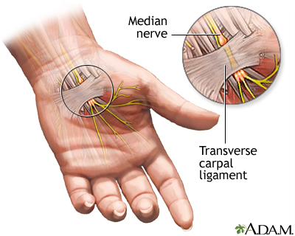
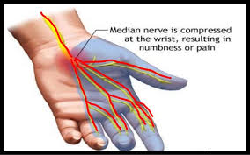

Slide 17
Diagnosis
There are two helpful tests: sensory symptoms can often be reproduced by
1- percussing over the median nerve (Tinel’s sign)
2-or by holding the wrist fully flexed for a minute (Phalen’s test).
In late cases there is wasting of the thenar muscles, weakness of thumb abduction and sensory dulling in the median nerve territory.
Electrodiagnostic tests, which show slowing of nerve conduction across the wrist, are reserved for those with atypical symptoms.

Slide 18
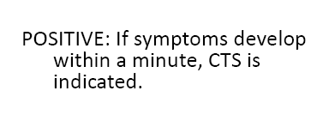

Slide 19
Radicular symptoms of cervical spondylosis may confuse the diagnosis and may coincide with carpal tunnel syndrome>> These can be identified by
pain in the neck,
Reduced reflexes,
weakness outside median nerve distribution,
sensory loss in the thenar eminence.

Slide 20
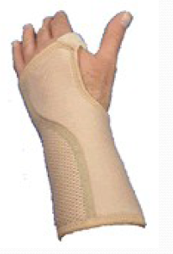
Remove causative factors
Splints (night) to prevent wrist flexion
NSAIDs
Steroid injection (beware >3 may
=> tendon rupture) may be
particularly helpful during
pregnancy or other
reversible condition i.e.
Hypothyroidism
Surgical decompression>>
division of the transverse carpal
ligament
Endoscopic carpal tunnel release

Slide 25
occurs more commonly in middle-aged men (as opposed to carpal tunnel syndrome which is more common in women). It is sometimes associated with a post-traumatic valgus deformity of the elbow or swelling from arthritis.

Slide 26
On examination there is usually a positive Tinel’s sign when percussing the nerve behind the elbow (but be aware: even normal people may experience sharp ‘tingling’ when they suffer a bump on the ‘funny bone’ at the medial edge of the elbow – so always examine the normal side for comparison).
Treatment may simply be a matter of avoiding the provocative posture
If there is established numbness or muscle wasting, the nerve should be released through an incision behind the epicondyle.
If the nerve is unstable it can be gently transposed in front of the epicondyle.

Slide 27
At wrist :
The ulnar nerve is occasionally compressed as it runs in front of the wrist just radial to the pisiform.
The cause is usually a ganglion from the underlying joint, but neurological symptoms may also be produced by external pressure – e.g. in cyclists who lean too heavily on their handlebars.
MRI may define a local compressive lesion; the nerve can then be carefully explored and any causal pathology removed.

Slide 28
Thoracic outlet syndrome
Neurological and vascular symptoms and signs in the upper limbs may be produced by compression of the lower trunk of the brachial plexus (C8 and T1) and subclavian vessels between the clavicle and the first rib.
These neurovascular structures are made taut when the shoulders are braced back and the arms held tightly to the sides;
an extra rib (or its fibrous equivalent extending from a large costal process) exaggerates this effect by forcing the vessel and nerve upwards.
Such anomalies are present at birth, yet symptoms are rare before the age of 30. This is probably because, with increasing age, the shoulders sag, thus putting more traction on the neurovascular bundle.

Slide 29
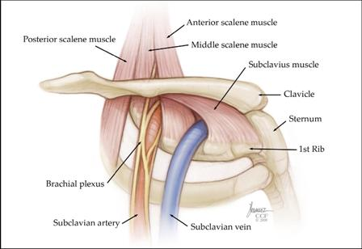

Slide 30
Clinical features
The patient, typically a woman in her 30s, complains of pain and paraesthesiae extending from the shoulder, down the ulnar aspect of the arm and into the medial two fingers.
Symptoms tend to be worse at night and are also aggravated by bracing the shoulders (wearing a back-pack) or working with the arms above shoulder height.
Examination may show weakness and slight wasting of the intrinsic muscles in the hand. Vascular signs are uncommon, but there may be cyanosis, coldness of the fingers and increased sweating. Symptoms and signs can sometimes be reproduced by certain provocative manoeuvres.
In Adson’s test the patient’s neck is extended and turned towards the affected side while he or she breathes in deeply; this compresses the interscalene space and may cause paraesthesia and obliteration of the radial pulse.
In Wright’s test the arms are abducted and externally rotated; again, the symptoms recur and the pulse disappears on the abnormal side.

Slide 31
Investigation
X-rays of the neck
a cervical rib
an abnormally long C7 transverse process
Equally important are x-rays of the lungs (is there an apical tumour?) and the shoulders (to exclude any local lesion).
Electrodiagnostic tests are helpful mainly to exclude peripheral nerve lesions such as ulnar or median nerve compression which may confuse the diagnosis.
Angiography and venography are reserved for the few patients with vascular symptoms.

Slide 32
Treatment
Conservative treatment suffices for most patients: exercises to strengthen the shoulder-girdle muscles; postural training; instruction in work practices; and other ways of preventing shoulder droop and muscle fatigue.
Analgesics may be needed for pain.
Operative treatment is indicated if pain is severe, if muscle wasting is obvious or if there are vascular disturbances.
The thoracic outlet is decompressed by removing the first rib (or the cervical rib). This can be accomplished by either a supraclavicular approach or a transaxillary approach

Slide 36
Sometimes it is initially mistaken for plantar fasciitis which also causes pain from the inside heel and throughout the arch of the foot.
Neural symptoms (such as tingling or numbness) as well as the location of tenderness when touching the area should help to easily distinguish between the conditions.

Slide 37
Treatment
Rest from any aggravating activities and apply cold therapy whilst in the acute phase when the foot or ankle is painful and inflamed. Your Doctor may prescribe anti-inflammatory medication to help reduce pain and inflammation.
Once the initial pain and inflammation has gone then a full rehabilitation program which includes stretching exercises and strengthening exercisesfor the foot can begin.
Surgery to decompress is a last option and should only be considered if conservative treatment has failed for 6-12 months

Slide 38
Thank you

