Slide 1
Thyroid disorders
Made by:
Qais Al-Matarneh
Mohammad Nairat
Supervised by: Dr. Ahmad Al-tarawneh

Slide 2
Introduction
Largest endocrine gland.
Butterfly shaped organ comprising of two lobes
Located inferior to cricoid cartilage.
Weighs 15-25 gms in adults.
Histologically it is made up of follicular and parafollicular cells.

Slide 3
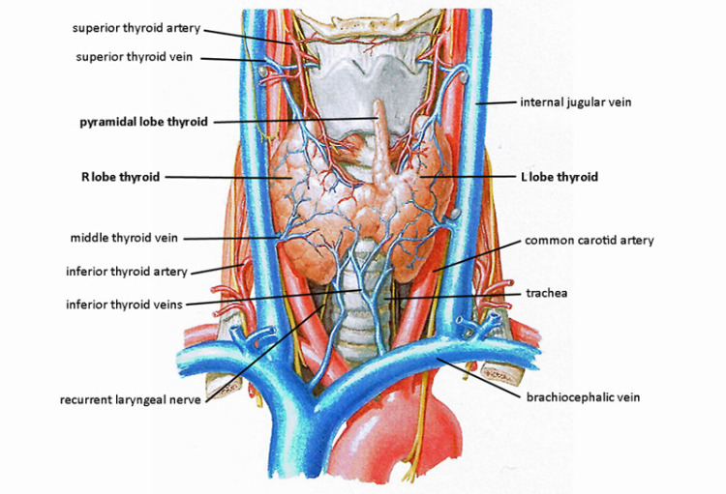
Blood supply
-Arterial supply: - superior thyroid artery
- inferior thyroid artery
-Venous supply: - superior thyroid vein
- middle thyroid vein
- inferior thyroid vein
Nerve supply
Superior laryngeal nerve
Recurrent laryngeal nerve
Lymphatic drainage
Lateral deep cervical lymph node
Pretracheal/para tracheal lymph nodes

Slide 4
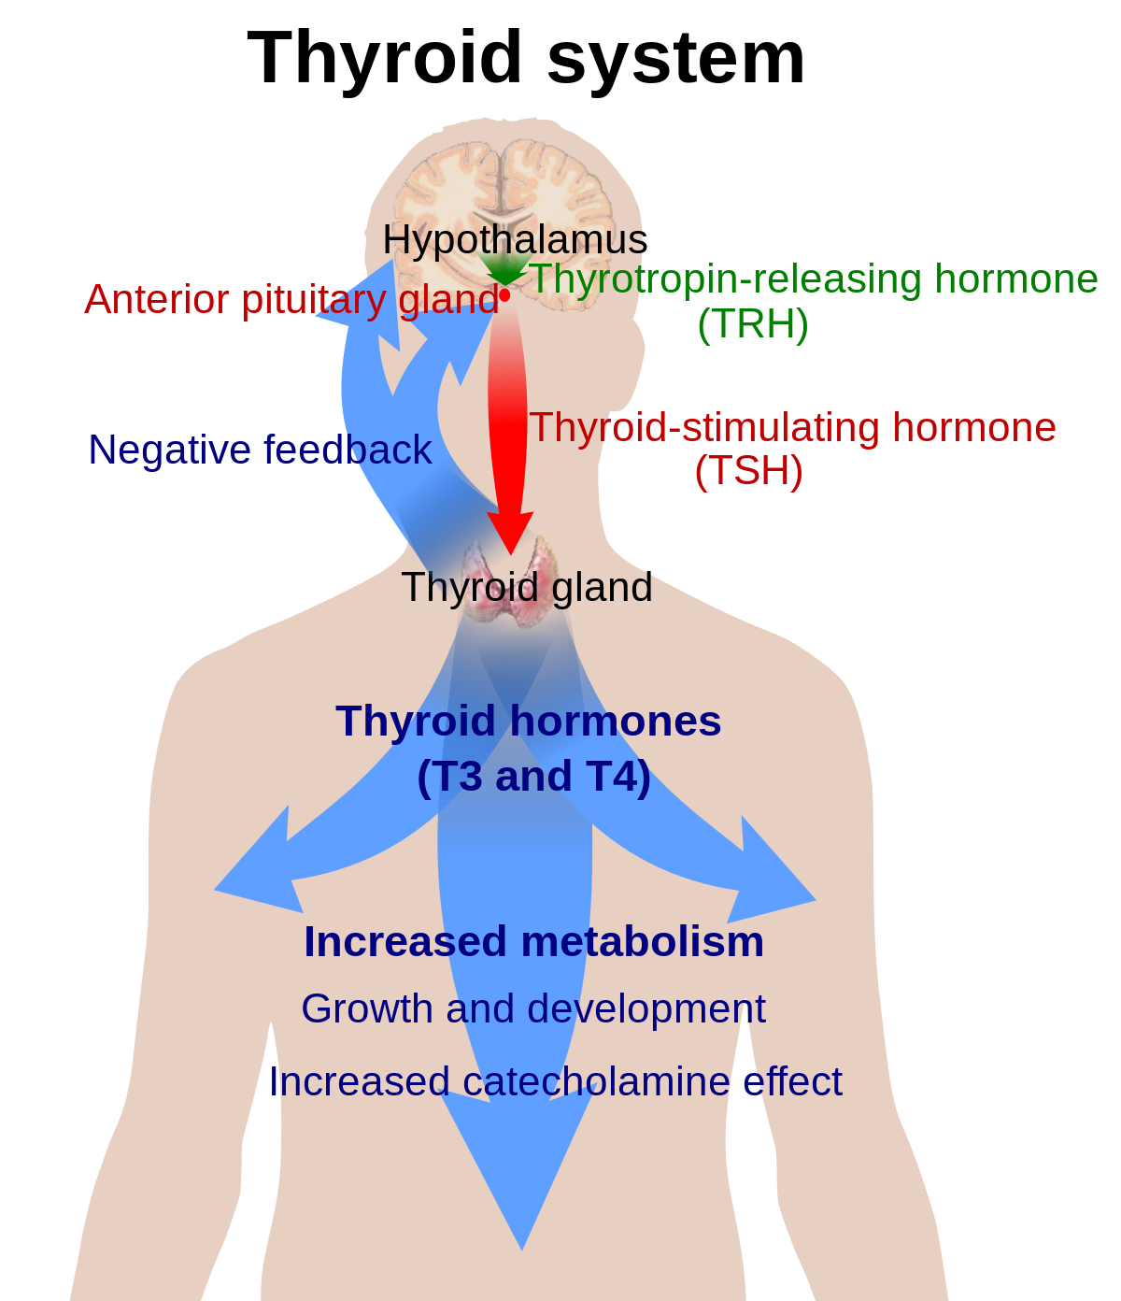

Slide 5
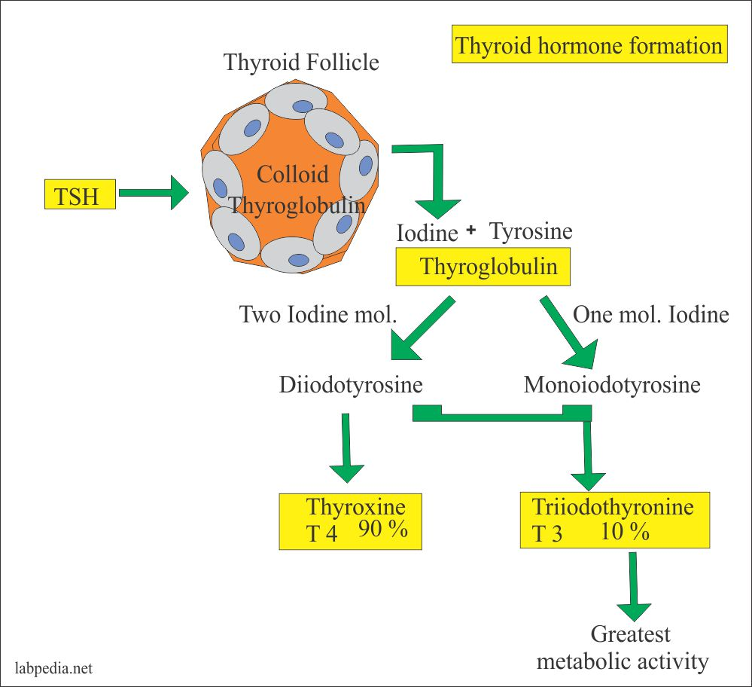

Slide 8
Function of T3 and T4

Slide 9
Thyrotoxicosis
Clinical manifestations of increase circulating T3, T4.
Classification
I) Disorders with increased Iodine uptake (thyrotoxicosis with hyperthyroidism ):
1. Graves’ disease
2. Toxic MNG/adenoma
3. Inherited non-immune hyperthyroidism
4. Hyperthyroidism due to thyrotropin secretion (TSH-oma).
5. HCG-induced hyperthyroidism –Associated with pregnancy or Trophoblastic Tumors

Slide 10
II) Disorders with decreased Iodine uptake (Thyrotoxicosis without hyperthyroidism ) :
1. Thyroiditis
2. Iatrogenic thyrotoxicosis
3. Struma ovarii
4. Metastatic thyroid carcinoma

Slide 11
Symptoms of hyperthyroidism
1. MSS: Myalgia, Heat intolerance, sweating, hair loss, and onycholysis or skin changes.
2. GIT: Diarrhea, increased appetite, weight loss.
3. RS: dyspnea
4. CVS: palpitations and peripheral edema.
5. Neuro: aggressiveness, Irritability.
6. Eye: diplopia, eyelid swelling
7. UG: female: Amenorrhea, Oligomenorrhea.
male: impotence and loss of libido

Slide 12
Grave’s disease
Autoimmune disease
Thyroid stimulating antibodies produced (TSH-R Ab)
Most common cause of hyperthyroidism
Female : male ratio – 5:1 or 10:1
Has a strong hereditary component.

Slide 13
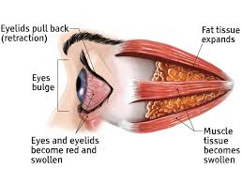
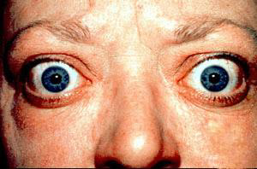
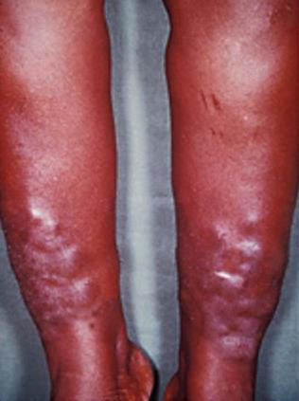
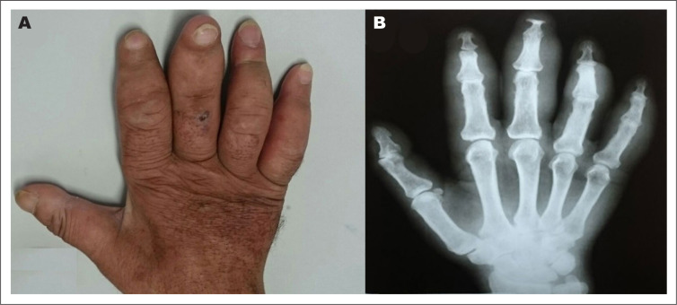
Symptoms
Symptoms of hyperthyroidism occur
Special features
• Exophthalmos (bulging eyes)
Proptosis (protrusion of eye) and periorbital edema
Retroocular fibroblast and adipocyte activation
• Pretibial myxedema (shins)
Fibroblasts contain TSH receptor
Stimulation → secretion of glycosaminoglycans
Draws in water → swelling
• Thyroid acropachy
nail clubbing
swelling of digits and toes

Slide 14
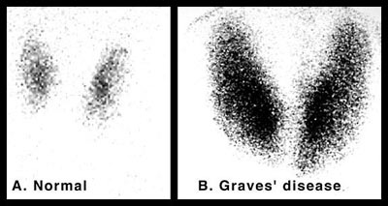
Diagnosis
Often clinical: hyperthyroid symptoms and labs, goiter plus exophthalmos
TSH: Low
T3,T4: High
TSH receptor antibodies: positive
Radioactive iodine uptake
Increased due to overactive thyroid
Scan shows diffuse uptake

Slide 15
Treatment
Symptom control: beta blockers
Used for initial treatment of symptoms
Improves tachycardia, tremor, heat intolerance, and nervousness
Decrease thyroid hormone synthesis

Slide 16
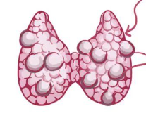
Multinodular goitre
Excess production of thyroid hormones from functionally autonomous thyroid nodules which do not require the stimulation from TSH.
Occurs in individual over 60 years of age and females are mostly affected.

Slide 17
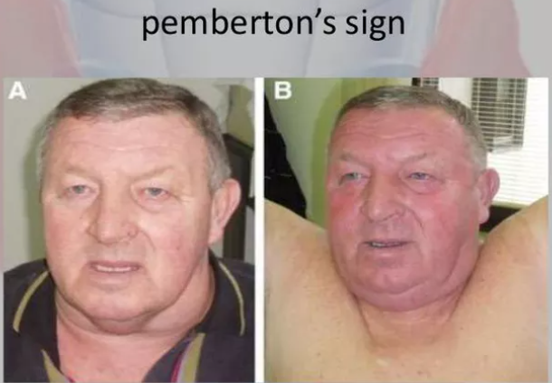
Symptoms
Large goitre with or without tracheal compression.
Goitre is nodular or lobulated, often palpable.
Large goitre cause mediastinal compression with stridor, dysphagia and obstruction of superior vena cava.
Hoarseness

Slide 18
Investigations
1. TSH: Low
2. T3,T4: High
3. Radioactive iodine uptake: hot nodule (Hyperthyroidism). 4. Antibodies: Thyroid stimulating antibodies is negative.

Slide 19
Mangement
Not functionally active
Toxic (functionally active )
Small size /no symptoms
Large / compression symptoms
Radioactive iodine
Partial thyroidectomy
No treatment
Annual followup
Partial thyroidectomy

Slide 20
Thyroidectomy
Surgical removal of all or a part of the gland.
Indications:
Thyroid carcinoma.
Hyperthyroidism.
Very enlarged thyroid.
Symptomatic obstruction.
Complications
Hypothyroidism.
Laryngeal nerve injury.
Hypoparathyroidism.
Infection.
Chyle leak.
Surgical scar.

Slide 21
Subacute Thyroiditis (de Quervain thyroiditis)
Often preceded by viral infection
Clinical features
a. Prodromal phase that lasts a few weeks (fever, flu-like illness)
b. It can cause transient hyperthyroidism due to leakage of hormone from inflamed thyroid gland. This is followed by a euthyroid state and then a hypothyroid state (as hormones are depleted).
c. Painful, tender thyroid gland (may be enlarged).

Slide 22
Investigation 1. TSH: high (stimulated by negative feedback) 2. T3,T4: Low (except in the initial phase; thyrotoxicosis) 3. I123 uptake scan: decrease uptake (Hypothyroidism). 4. Antibodies: antithyroid peroxidase “Anti-TPO” and antithyroglobulin antibodies are negative. 5. ESR: High
Treatment
a. Use NSAIDs and aspirin for mild symptoms; corticosteroids, if the pain is more severe.
b. Most patients have recovery of thyroid function within a few months to 1 year.

Slide 23
Subacute Lymphocytic Thyroiditis (painless thyroiditis)
1. A transient thyrotoxic phase of 2 to 5 months may be followed by a hypothyroid phase. The hypothyroid phase is usually self-limited and may be the only manifestation of this disease if the hyperthyroid phase is brief.
2. Low radioactive iodine uptake—differentiates it from Graves disease during thyrotoxic phase.
3. Similar to subacute (viral) thyroiditis, only without the pain or tenderness of the thyroid gland.

Slide 24
THYROID STORM
This is a rare, life-threatening complication of thyrotoxicosis characterized by an acute exacerbation of the manifestations of hyperthyroidism.
There is usually a precipitating factor, such as infection, DKA, or stress (e.g., severe trauma, surgery, illness, childbirth).
High mortality rate: up to 20% of patients enter a coma or die.

Slide 25
41 C

Slide 26
Thyroid storm treatment
Management approach: management should be immediately following clinical diagnosis and patients should be managed at the intensive care unit (ICU) due to high mortality
Provide supportive therapy with IV fluids, cooling blankets, and glucose
1. β-blocker: control the symptoms and signs (e.g., tachycardia) induced by increased adrenergic tone (propranolol).
2. Thionamide (PTU): blocks new hormone synthesis & effective within 1-2 hours post administration
3. Iodine solution: blocks release of thyroid hormone (known as the Wolff-Chaikoff effect) effective within 1-2 hours post administration.
4. Glucocorticoid: reduces T4 to T3 conversion & promotes vasomotor stability & reduce autoimmune process in Graves disease & treat associated relative adrenal insufficiency

Slide 27
HYPOTHYROIDISM
Insufficiency synthesis of thyroid hormones
More common than hyperthyroidism
Hashimoto disease (chronic thyroiditis)—most common cause of primary hypothyroidism.

Slide 30
HASHIMOTO’S THYROIDITIS
Most common cause of hypothyroidism
Most common cause of autoimmune thyroid disorder
more common in women.

Slide 32
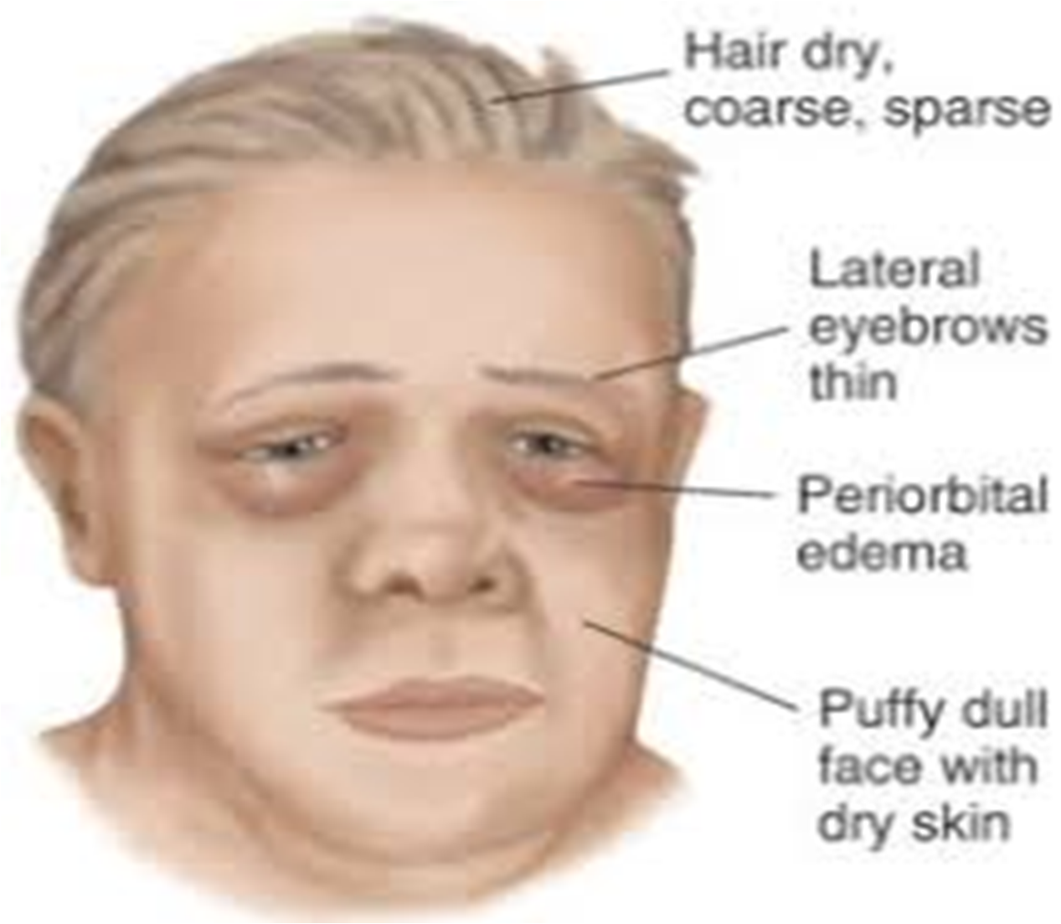
MYXOEDEMA : Severe hypothyroidism in which there is accumulation of hydrophilic mucopolysaccharides in the skin and other tissues
Common in women

Slide 34
Treatment
LEVOTHYROXINE
Helps in both hypothyroidism and goitre shrinkage
Thyroid medication should be taken 1 hour before meals
Should be taken in the morning to reduce possibility of insomnia.
Lifelong treatment of hypothyroidism is necessary.

Slide 36
MYXOEDEMA COMA
Uncommon but life threatening form of untreated hypothyroidism with physiological decompensation.
Occurs in patients with long standing hypothyroidism.
Precipitating factors are trauma, infection, cold exposure, and narcotics.
A medical emergency, with a high mortality rate (50% to 75%) even with treatment.

Slide 38
Management of Myxedema Coma
Initiate therapy if presumptive clinical diagnosis after TSH, FT3 FT4 drawn.
Also draw serum cortisol, ACTH, glucose.
General (supportive) measures:
–Patient should be in ICU setting
–Support ventilation as respiratory failure is the major cause of death in myxedema coma
–monitors ABG`s
–support blood pressure; hypotension may respond poorly to pressor agents until thyroid hormone is replaced
–hypothermia will respond to thyroxin therapy ; in interim use passive warming only
–hyponatremia will also be corrected by thyroxine therapy in majority of cases
–hypoglycemia requires IV glucose
–avoid fluid overload

Slide 39
Specific measure:
L-thyroxine 0.2-0.5 mg IV bolus, followed by 0.1 mg IV OD until oral therapy is tolerated
Adrenal-insufficiency may be precipitated by administration of thyroid hormone therefore hydrocortisone 100 mg IV q 8h is usually given until the results of the initial plasma cortisol is known.

Slide 40
Euthyroid Sick Syndrome
Known as non-thyroidal illness syndrome
This condition is often seen in patients with severe critical illness, deprivation of calories, and following major surgeries (esp in ICU patients)
Etiology: Causes vary to include several critical illnesses of different etiology….. Pneumonia, starvation, anorexia nervosa, sepsis, stress, myocardial infarction, malignancies, burns, organ transplantations ,etc…
Euthyroid sick presentation after COVID-19 infection

Slide 41
Pathophysiology
It is not a true syndrome, but it represents significant alterations in the hypothalamic-pituitary-thyroid axis in hospitalized patients
There are many proposed mechanisms regarding the pathogenesis of ESS:
1. cytokines such as IL-1, IL-6 and TNF-alpha affecting the hypothalamus and pituitary glands, thus inhibiting TSH, TRH, thyroglobulin (TG), T3, and thyroid-binding globulins (TBG) production.
2. Inhibition of 5'-monodeiodination, causing a decrease in the concentration of serum total T3 levels in patients with high serum cortisol and the use of exogenous corticosteroid therapy, as well as other medications like amiodarone and propranolol.

Slide 42
Evaluation
The most common hormone pattern is a low total T3 and free T3 levels with low or normal T4 and TSH levels
Increased serum level of reverse T3 (rT3).
Low T3 level is correlated with an increased length of hospitalization.
Low total T4 correlates with a bad prognosis

Slide 43
Management and Treatment
Treatment of the underlying medical illness (main focus)
Thyroid hormone replacement is generally not needed
After discharge from the hospital, thyroid function abnormalities may persist for several weeks ( Repeat TFT after 6 weeks)

Slide 44
THANK YOU

