Slide 1
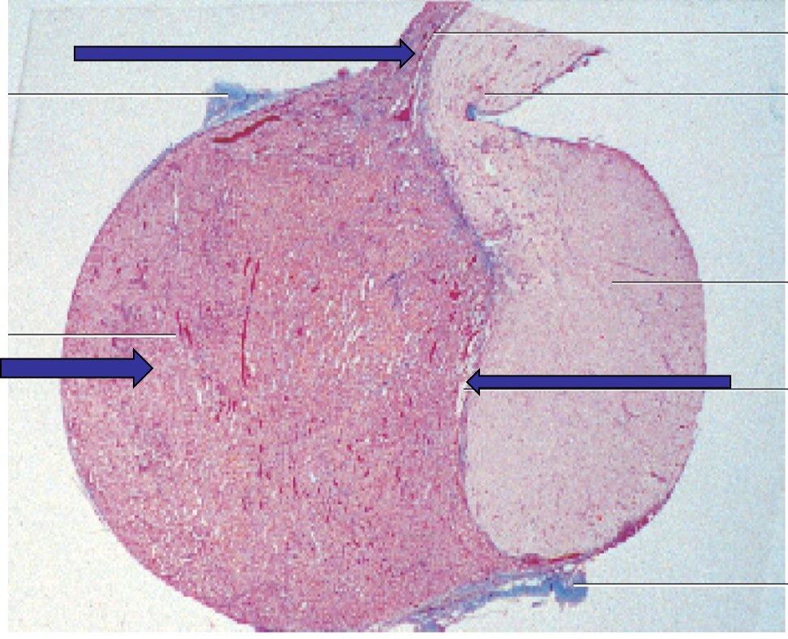
PITUITARY GLAND
Pars tuberalis
Infundibular stalk
Pars nervosa
Pars distalis
Pars intermedia

Slide 2
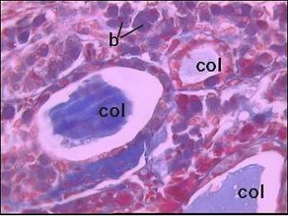
Pars Intermedia
Human/ unclear function
animals / the basophilic cells produce melanocyte stimulating hormone (MSH

Slide 3
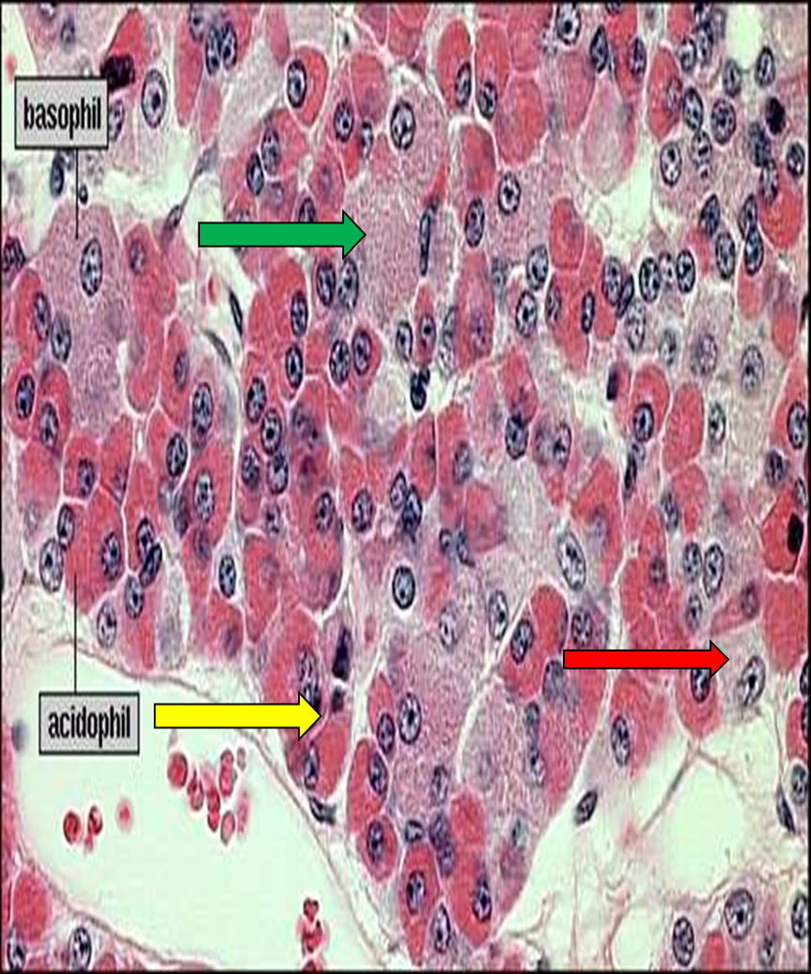
Pars distalis
Chromophils
1- Acidophils 37%
2- Basophils 11%
3- Chromophobes 52%
4- Fenestrated sinusoids

Slide 4
Acidophils
Somatotrophs
Growth H.
Mammotrophs
Prolactin
Small in ♂and non preg ♀
Large irregular in pregnant and lactating ♀(Erdheim cells)
Crinophagy:
when suckling is terminated, lysosomes eliminate the excess secretory granules
Basophils :
TSH
FSH,LH
ACTH

Slide 5
PITUITARY GLAND

Slide 6
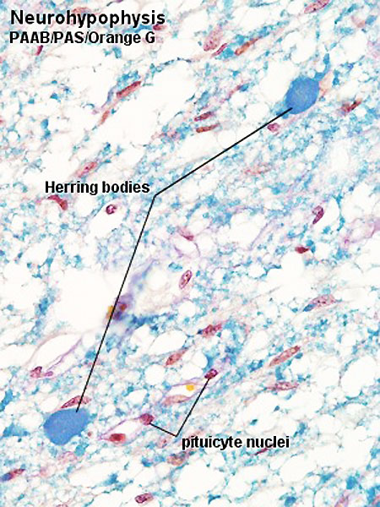
Neurohypophysis
Unmyelinated axons
Herring bodies (ADH, Oxytocin)
Pituicytes.
Rich blood capillary plexus

Slide 7
Where is oxytocin stored ?
a. Pars intermedia b. Pars tuberalis c. Infundibulum d. Pars distalis e. Pars nervosa
2
1
3

Slide 8
Blood supply of pituitary gland Releasing and inhibiting hormones Pass to hypophyseal portal system to pars distalis

Slide 9
1.Follicular cells 2. Parafollicular (clear) cells 3. Interfollicular cell
Thyroid

Slide 11
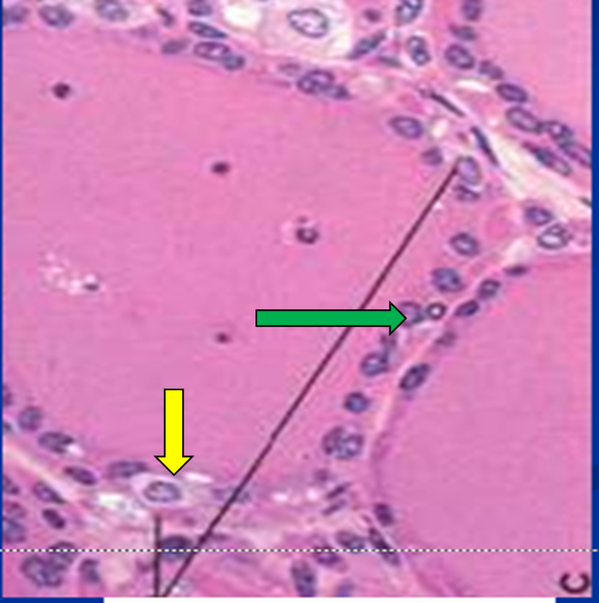
Thyroid
Follicular cells
Parafollicular (clear) cell
Interfollicular cells

Slide 12
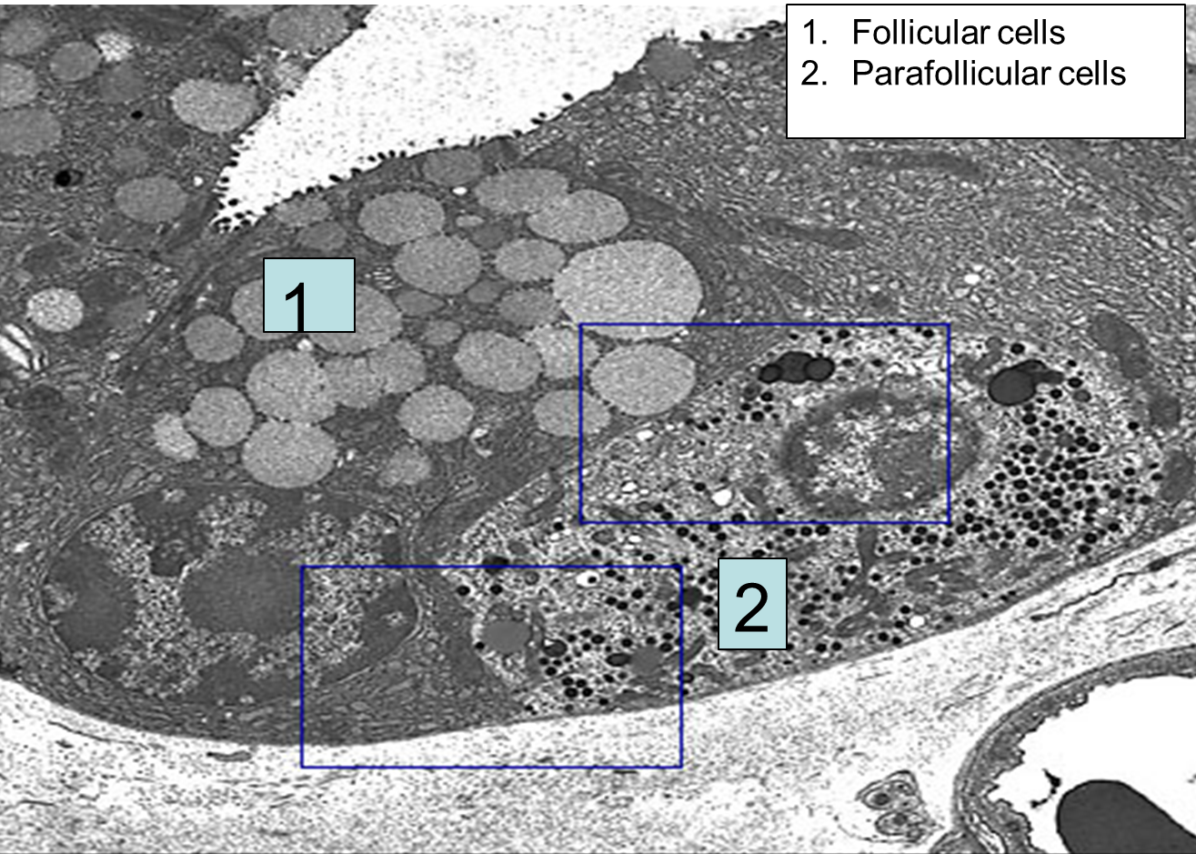
EM of thyroid follicle
1
Notes:
12

Slide 13
Interfollicular cells

Slide 14
Thyroid

Slide 15
Formation of thyroid hormones

Slide 16
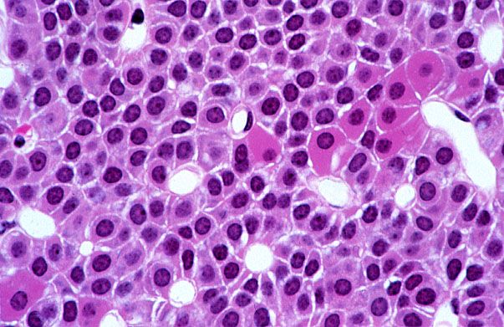
Parathyroid gland
Two types of cells:
Chief cells
Oxyphil cells
Oxyphilic cells
Capillaries
Chief cells

Slide 17
Parathyroid gland

Slide 18
Parathyroid gland in old people

Slide 19
Pineal gland (Epiphysis cerebri)
1- pinealocytes
2- Astrocytes
3- Blood vessel
Brain sand with old age

Slide 20
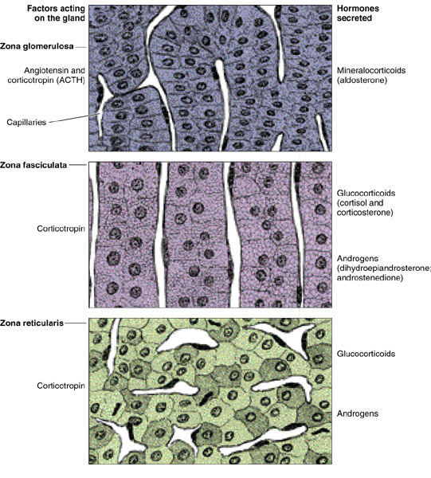
Suprarenal gland
glomerulosa
fasciculata
reticularis

Slide 21
Suprarenal gland

Slide 22
Zones of the cortex
zona glomerulosa (15%)
small rounded cells groups (clusters) or curved columns.
mineralocorticoid
2- zona fasciculata (65%)
consists of radially arranged cell cords separated by fenestrated sinusoid capillaries.
has a characteristic foamy or spongy appearance (lipid droplets) spongiocytes
Glucocorticoids
3- zona reticularis (7%).
like zona fasciculata but with fewer lipid droplets
Irregular cords
glomerulosa
fasciculata
reticularis

Slide 24
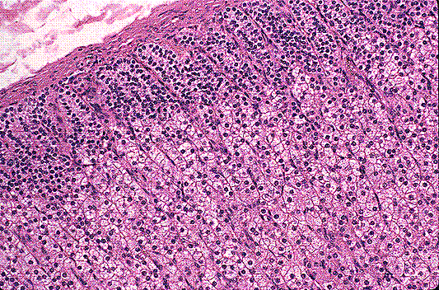
Suprarenal gland
G
G
G
G
G
G
G
G
G
F
F
F
F
F
F
F
F

Slide 25
Suprarenal gland
G
F
F

Slide 26
Suprarenal gland
G
R
M
F

Slide 27
Blood supply of adrenal gland
The adrenal glands are supplied by several arteries ,these arteries can be divided into:
Cortical arteries, arteries that irrigate the capsule; branching into capillaries and eventually reach the medullary capillaries;
medullary arteries, which pass through the cortex and form an extensive capillary network in the medulla.
The cells of the medulla are, thus, bathed with both arterial blood from the medullary arteries and venous blood originating from the capillaries of the cortex.
Glucocorticoids produced in the cortex, which reach the medulla through capillaries that bathe cells of the cortex, constitute another mechanism of control.

Slide 28
Regulation of blood calcium level
↓ Blood Ca level ↑ PTH → ↑ Blood Ca level through:
bone: ↑ osteoclasts
kidney: ↑ Ca reabsorption
intestine: ↑ Ca absorption
↑↑ Blood Ca level ↑ Calcitonin ↓↓ Ca level by ↓activity of osteoclast
Notes:
28

Slide 29
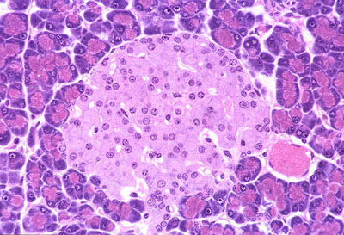
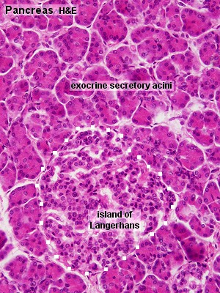
PANCREAS
exocrine and endocrine gland.
The exocrine part produces about 1.5L of pancreatic juice every day.
The endocrine part, ~1% , consists of the cells of the islands of Langerhans.
The pancreas has thin capsule
cellular composition of the islands
- 70% beta-cells, insulin. Insulin stimulates
- 20% alpha-cells, glucagon.
- 5- 10 % delta-cells which secrete somatostatin,

Slide 30
Diffuse neuroendocrine system
Apudocytes or APUD cells
Classification according to staining activity
Argentaffin cells: ppt silver in absence of reducing agent
Argyrophilic cells: ppt silver in presence of reducing agent
Chromaffin like cells: bind K dichromate
Mode of action
Endocrine → target organ
Paracrine → surrounding tissue
Autocrine → themselves
Neuroendocrine → neurosecretion

Slide 31
Distribution of APUD cells
GIT (enteroendocrine cells) :
G cells EC cells
ECL cells D cells
S cells
Respiratory system
Bronchial Kulchitsky cells
Small granule cells
Neuroepithelial bodies
among tracheobronchial epithelium.
Other sites
Myocardium: → cardiodilatins and atrial naturetic polypeptides
Hypothalamus: supraoptic and paraventricular nuclei → oxytocin and vasopressin
Endocrine system: pinealocytes,parafollicular cells, chief cells, cells of islets of Langerhans and some adenohypophyseal and adrenal medullary chromaffin cells

Slide 32
Microscopic features
Two types:
Open type
Closed type
Electrolucent cytoplasm
Few small secretory granules at the base or vascular pole
Small infranuclear Golgi
Sparse rER
Apical part
APUD of small intestine

Slide 33
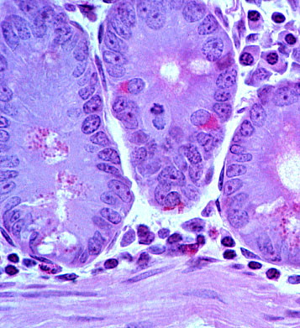
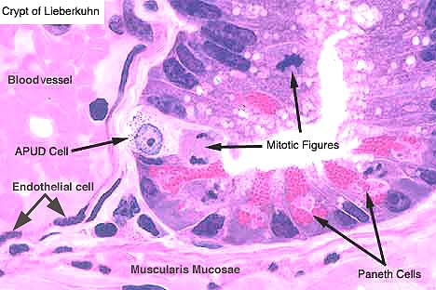
Enteroendocrine cells
Notes:
33

Slide 34
Opened type
Closed type
APUD of small intestine
Apical part

Slide 35
Thank you

