Slide 1
Skin Tumors
Presented by:
Eman Talafha
Sereen Mohawesh
Rahaf Qatawneh
supervised by:
Dr.osama alsallaq

Slide 2
Skin embryology
A. Epidermis: Ectoderm
B. Dermis: Mesoderm
C. Other cells
1. Melanocytes: Neural crest
2. Merkel cells: Neural cells
3. Langerhans cells: Mesenchymal

Slide 3
Skin histology
A. Epidermis
1. Keratinocytes
a. Primary cell in epidermis
b. Start in basal layer (stratum germinativum or basale)
2. Melanocytes
a. Found in basal layer
b. Protect against ultraviolet (UV) radiation
3. Merkel cells: Mechanoreceptors
4. Langerhans cells: Antigen-presenting cells in stratum spinosum

Slide 4
B. Dermis
1. Cell types: Fibroblast, macrophage, and mast cell
2. Papillary dermis
a. Similar thickness to epidermis
b. High content of type III collagen, less type I
c. Site of collagenase activity.
d. Intertwines with the rete ridges of the epidermis.
e. Contains terminal networks of Meissner corpuscles and capillaries.
3. Reticular dermis
a. Majority of the dermal layer
b. Mostly type I collagen bundles with elastic fibers between
c. Contains roots of the hair, sebaceous glands, sweat glands, receptors, nails, and blood vessels

Slide 5
Skin malignancies
A. Generally grouped into three types (listed from most common to least)
B. Basal cell carcinoma (BCC)
C. Squamous cell carcinoma (SCC)
D. Melanoma
E.Merkel Cell Carcinoma

Slide 6
Basal Cell Carcinoma (BCC) (rodent ulcer)
Incidence
Basal cell carcinoma represents the most common tumor
diagnosed in the United States,with an estimated one million
new cases occurring each year. and the nodular variant is
the most common subtype.

Slide 7
Epidemiology
the most common form of skin cancer in white people. It occurs usually in elderly subjects, in males twice as commonly as in females
The strongest predisposing factor to BCC is ultraviolet radiation.
It occurs in the middle aged or elderly with 90 per cent of lesions found on the face above a line from the lobe of the ear to the corner of the mouth.

Slide 8
Other predisposing factors include immune suppression, chemical exposure, and ionizing radiation exposure. There are also genetic susceptibilities to development of BCC in conditions such as xeroderma pigmentosa, unilateral basal cell nevus syndrome, and nevoid BCCsyndrome.

Slide 9
BCC disease biology and characteristics
Basal cell carcinoma is Usually a slow growing, locally
invasive malignant tumour of pluripotential epithelial cells arising from basal epidermis and hair follicles, hence affecting the pilosebaceous skin and thus >90% are found on the head and neck.
Metastasis is rare—termed “barely a cancer” by some researchers

Slide 10
Pathology
Macroscopic, the tumour has raised, rolled but
not everted edges. It consists of pearly nodules over
which fine blood vessels can be seen to course (telangiectasia)
BCC can be divided into localised *(nodular, nodulocystic,
cystic, *pigmented and naevoid) and generalised lesions. These
lesions can be superficial (multifocal or superficial spreading) or
infiltrative (*morphoeic, ice pick and cicatrising)
Nodular and nodulocystic variants account for 90 per cent of BCC.

Slide 11
A nodulocystic basal carcinoma (BCC). Note the characteristic pearly papules with telangectasia
*An ulcerating BCC on
the lower eyelid.

Slide 12
A recurrent morphoeic BCC

Slide 13
Prognosis
There are ‘high risk’ and ‘low risk’ BCCs.
High risk BCCs are the ones that are large (>2 cm) and located at specific sites (near the eye, nose, ear) and have ill-defined margins.
Recurrent tumours and those forming in the presence of immunosuppression are also higher risk.

Slide 14
Treatment can be surgical or non-surgical.
Treatment of BCC varies according to size, location, type, and high- or low-risk. Treatment options include surgical excision, medical, or destructive therapies. Surgical excision should include 4 mm margins for small, primary BCC on cosmetically sensitive areas, and 10 mm margins otherwise.
Mohs’ micrographic surgery : Sequential horizontal excision with immediate frozen section testing by dedicated Mohs dermatopathologist.
Indications include morpheaform BCC and/or lesions in aesthetically sensitive areas (nose, eyelid, lip,ears, etc.)
It has been demonstrated in suitable skin tumours to minimise recurrence rates and maximise conservation of surrounding normal tissue.

Slide 15
Other destructive techniques include cryosurgery and laser ablation.
Radiation therapy can be used as adjuvant therapy following
surgery, or as primary therapy in poor surgical candidates with
low-risk lesions,deeply invasive BCC
Topical Pharmaceuticals
Topical imiquimod or 5-fluorouracil have been used for
periods of 6 to 16 weeks for small, superficial BCC of the neck,
trunk or extremities.

Slide 16
squamous cell carcinoma
Second most common skin cancer after BCC.

Slide 17
Risk factor:
1. Marjolin’s ulcer: SCC arising in a chronic wound (i.e.,
chronic burn scars and
2. pressure sores) secondary to genetic changes caused by
chronic inflammation.
3. Viral infection: Some types of human papillomavirus (HPV);
herpes simplex virus...especially in oral cavity

Slide 18
4. UVradiation:Sunexposureandtanningboothuse;PUVA therapy for psoriasis
5. Chemical exposure,including some pesticides,organic hydrocarbons such as coal tar, fuel oil, paraffin oil, and arsenic (in welding materials)
6. Radiation: Long latency between exposure and disease.

Slide 19
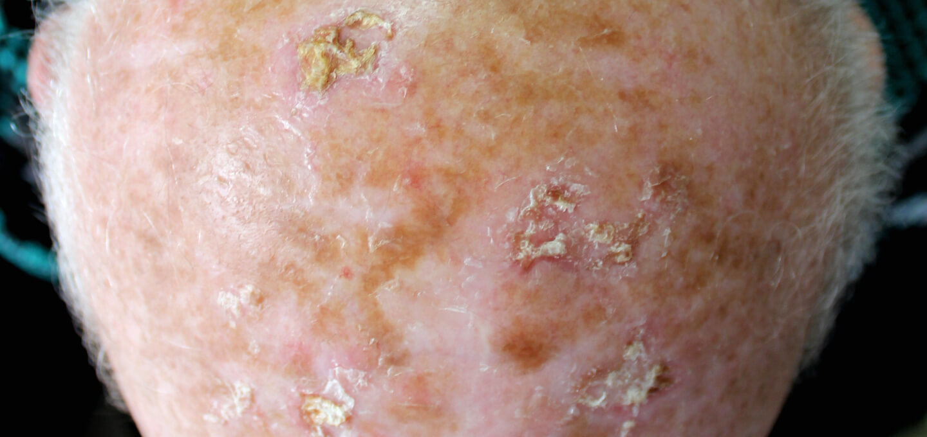
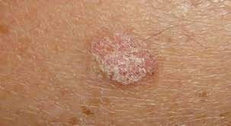
SCC precursor lesion (premalignant)10%risk
1. Actinic keratoses (AKs, or solar keratoses)
Erythematous macules and papules with coarse, adherent scale
Histologically resembles SCC in situ (pre-malignant
AK is considered a precursor lesion; up to 5% progress to SCC; in turn, 65% of all SCC arise from sites of Aks

Slide 20
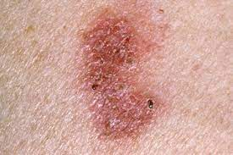
2. Bowen’s disease (SCC in situ)
Exhibits full-thickness cytologic atypia of the keratinocytes

Slide 21
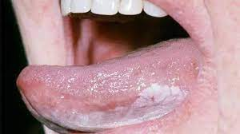
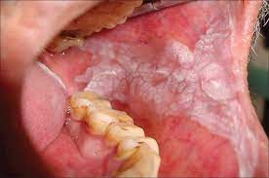
Leukoplakia
Presents as a white patch on oral or other mucosa.
Malignant transformation occurs in 15%.

Slide 22
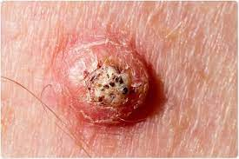
5. Keratoacanthoma ( not pre malignant )
· Benign skin tumor that is composed of squamous cells and keratin; may clinically resemble SCC.
· Etiology is unknown but thought to originate from hair follicles.
· Typically has a rapid 6-week growth phase followed by involution over the next 6 months. However, can progress to SCC in 5% to 10% of cases.
Tx :excision

Slide 23
Type of scc

Slide 24
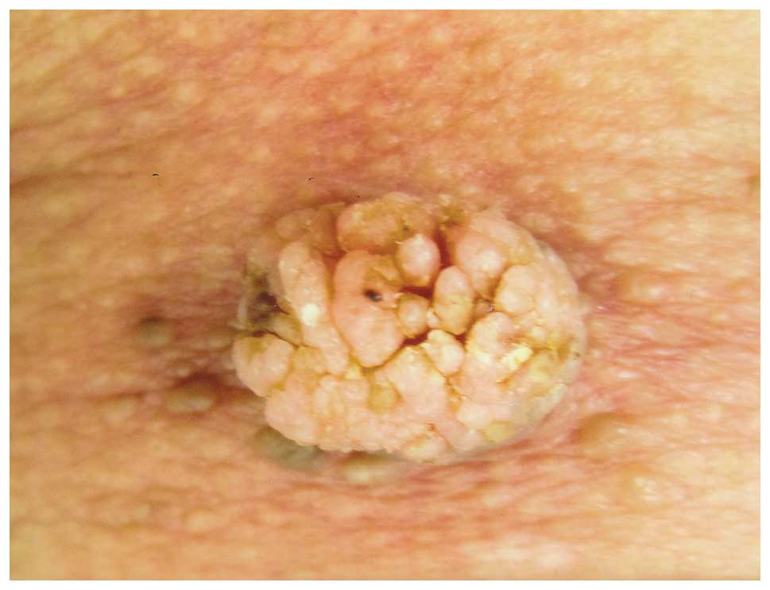
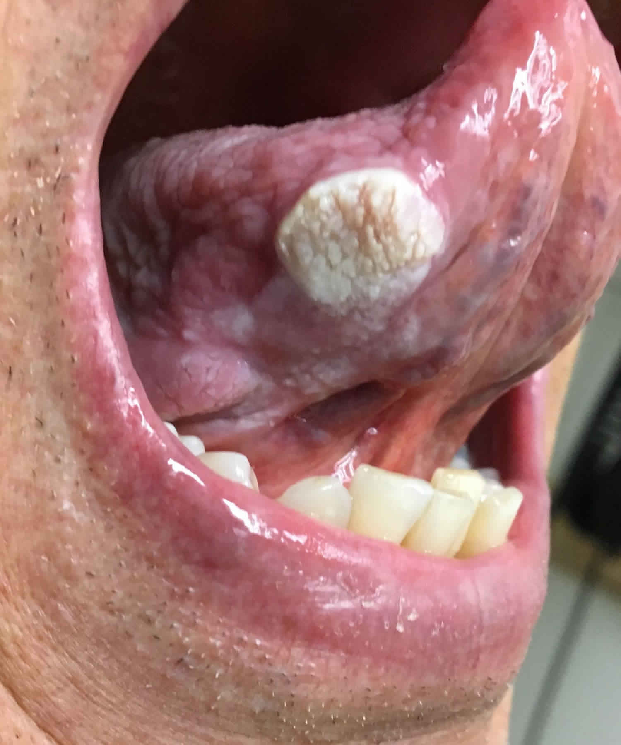
Verrucous scc
Slow-growing, exophytic, and less likely to metastasize.
The most frequently affected site is the oral cavity.

Slide 25
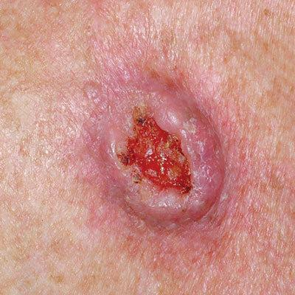
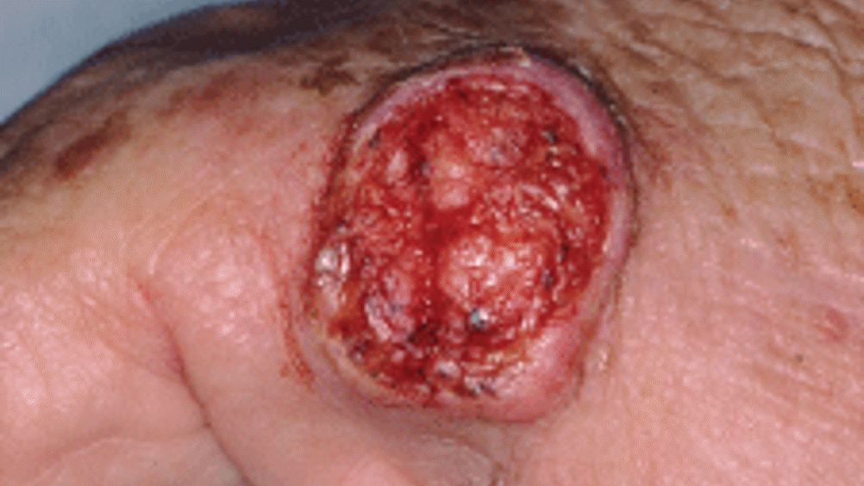
Ulcerative scc ( most common)
Grows rapidly and is locally invasive.
has very aggressive growth, raised borders, and central ulceration.
<50% 5-year survival if spread to lymph nodes in the head and neck
SCCs arising spontaneously (de novo) begin as small nodules on the skin. As they enlarge, the centre becomes necrotic, sloughs, and the nodule turns into an ulcer.

Slide 26
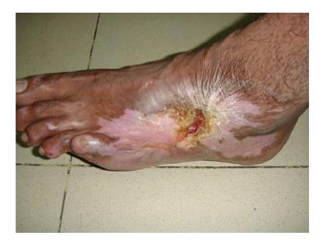
Majorline ulcer
Arise from chronic wounds (burn, pressure ulcer, fistula, osteomyelitis tracks)
Commonly metastasize to lymph nodes.
The period between the initial injury and the development of majorline ulcer is 10 - 25 year
Acute majorline ulcer is extremely rare
Ulcer in post burned lesion

Slide 27
Prognosis
There are several independent prognostic variables for SCC:
1 Invasion:
a. Depth: the deeper the lesion, the worse the prognosis.
For SCC <2 mm, metastasis is highly unlikely; whereas
if >6 mm, 15 per cent of SCCs will have metastasised.
b. Surface size: lesions >2 cm have a worse prognosis than
smaller ones.
2 Histological grade: the higher the Broders’ grade, the worse
the prognosis.
3 Site: SCCs on the lips and ears have higher local recurrence
rates than lesions elsewhere and tumours at the extremities
fare worse than those on the trunk.
4 Aetiology: SCCs that arise in burn scars, osteomyelitis skin
sinuses, chronic ulcers and areas of skin that have been irra- diated have a higher metastatic potential.
5 Immunosuppression: SCC will invade further in those with impaired immune response.

Slide 28
The overall rate of metastasis is 2 per cent for SCC – usually to regional nodes –

Slide 29
Treatment
1. Standard surgical techniques:
90% to 95% cure rates
1. Wide local excision of SCC: 5- to 10-mm margins are usually sufficient.
Frozen sections may be used to confirm negative margins intraoperatively.
a. If <2 cm, low grade and extends to dermis, 4-mm margin
b. If >2 cm, grade 2 to 4, high risk or extension into fat, 6-mm margin

Slide 30
2. Mohs surgery: Sequential horizontal excision with frozen section testing.
Highest cure rate for SCC: 94% to 99%.
. Indications, include recurrent, high-risk SCC, and/or lesions in aesthetically
sensitive areas (nose, eyelid, lip, etc.)

Slide 31
Field therapies
are used much less in SCC than in BCC treatment, because of higher risk associated with missed deep tumor portions, and the risk of scarring obscuring SCC recurrences.
Radiation is reserved for unresectable lesions or for the very elderly. Cure rates vary widely. Cosmetic damage and long-term risk of radiation must be considered.

Slide 32
Regional lymphadenectomy
1. Indicated for clinically positive (palpable) nodes.
2. FNA: Confirm spread of SCC to palpable lymph node.
3. ELND: Indicated for a tumor extending down to parotid capsule or a large lesion contiguous with a draining nodal basin.
4. SLN biopsy: Considered for high-risk SCC without palpable nodes controversial).
Adjuvant radiation therapy: Used postexcision for high-risk cutaneous SCC.

Slide 33
Melanoma
Least common ,most aggressive

Slide 34
Risk factor
1. Phenotypic include fair skin (Fitzpatrick I and II) :freckling, light eye color, and light hair color (stronger risk factor than eye color). Darker skin is protective against melanoma.
2. Geographic: High altitudes, lower latitudes have increased UV exposure, and therefore increased risk
3. Gender: Females have lower risk and better prognosis
4. Race: for African-Americans Incidence is lower, but prognosis is worse, due to delayed diagnosis and/or worse disease subtype
5. Previous melanoma is a strong predictive factor and confers a 3% to 5% chance of developing a second melanoma.

Slide 35
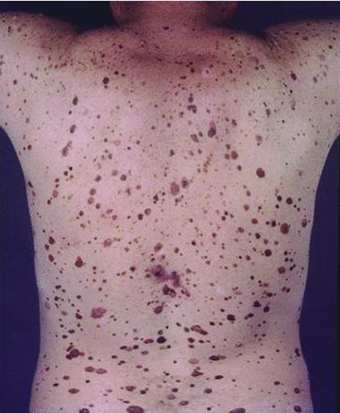
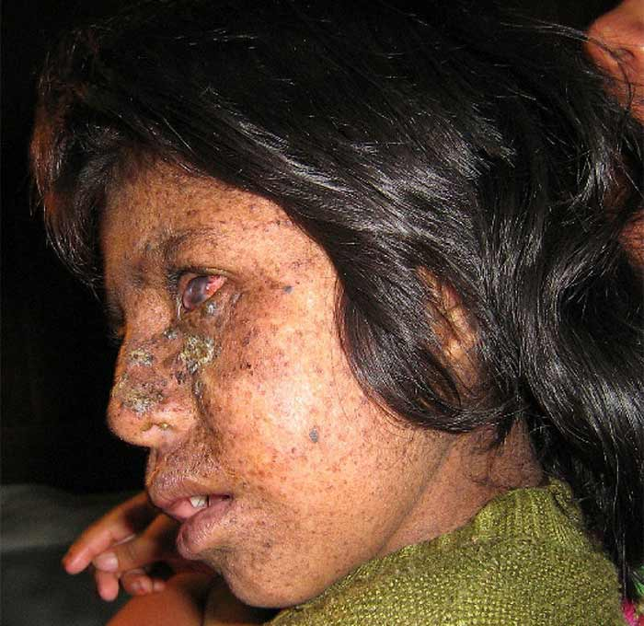
Family history: Vast majority of melanomas are sporadic; however, some
hereditary forms exist
Familial melanoma (aka hereditary melanoma):
Two or more cases of melanoma in first-degree relatives may indicate familial melanoma, autosomal dominant transference with variable penetrance.
b. Dysplastic nevus syndrome (also known as familial atypical multiple mole and melanoma [FAMMM] syndrome):
Patients have a first- or second-degree relative with malignant melanoma and typically have at least 50 melanocytic nevi. Mutations in CDKN2A typical. Patients need vigilant screening.
c. Xeroderma pigmentosum (XP)
i. Heterogeneous group of syndromes; due mutations in various DNA repair genes.
ii. DNA damage by UV leads to early death secondary to metastatic spread
of skin tumors.
iii. Typically presents in childhood with multiple BCCs; SCCs and melanomas
typically cause death.
iv. Restriction from sunlight exposure is mandatory, with aggressive surveillance/ treatment of skin lesions.

Slide 36
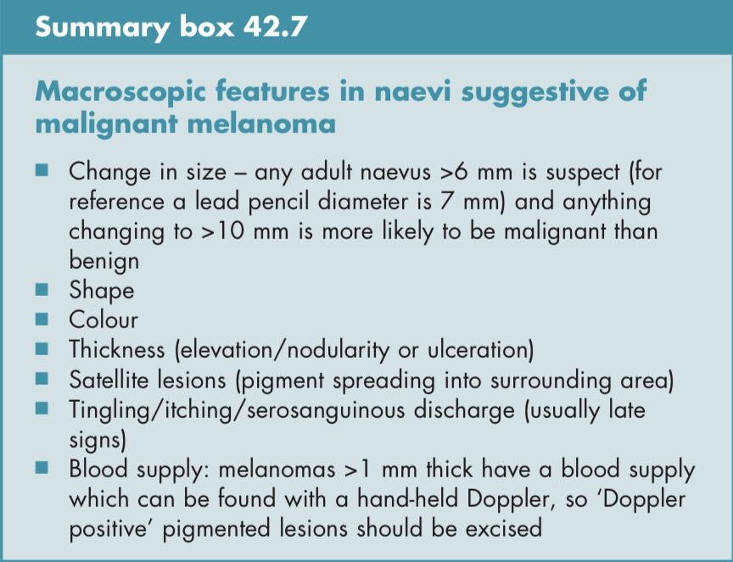
Precursor lesion
1- Congenital nevi
2-acquired melanocytic nevi
3-dysplastic atypical nevi

Slide 37
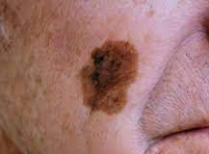
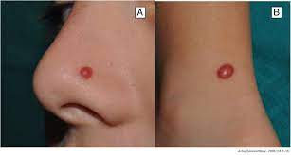
4- Melanoma in situ / atypical junctional melanocytic hyperplasia (AJMH) Also termed “lentigo maligna”; Hutchinson freckle
5- Spitz nevus
. Benign lesion most commonly found in children and young adults (formerly called juvenile melanoma).

Slide 38
What is the genetic basis of melanoma?
mutation in BRAF gene
germline mutations in CDKN2A/ p16 gene and CDK4 gene
Mutation in MC1R gene

Slide 39
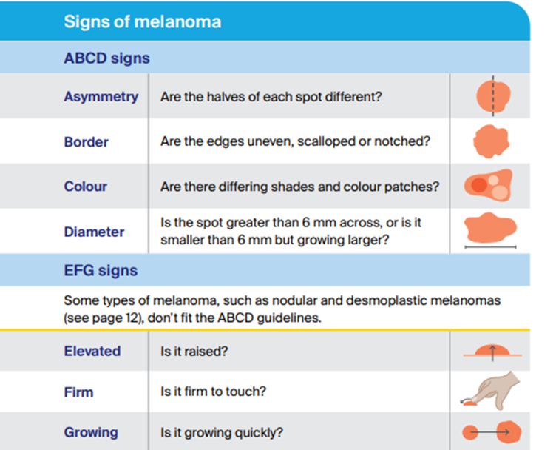

Slide 40
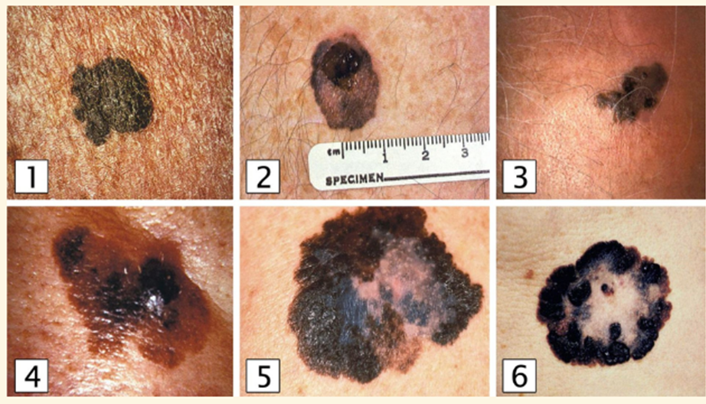
Classification of melanoma types
Superficial spreading melanoma can have a variable presentation. According to the ABCDE criteria, these include irregular margins and subtle asymmetry (image 1). In images 2–6, prominent findings are irregular pigmentation and an expanding lesion.
1. Superficial spreading melanoma
This accounts for 50% to 70% of melanomas and typically arises from a precursor melanocytic nevus.
Affects both genders equally
. Median age at diagnosis is 50 years
Upper back in men and lower legs in women are most common sites
Radial growth phase early, vertical growth phase late

Slide 41
Nodular melanoma
Second most common: 15% to 30% cases
. Most aggressive type
Typically do not arise from preexisting nevi
. Men are affected twice as frequently as women
Median age at diagnosis is 50 years
No clear association with sunlight exposure
Resemble blood blisters or other non-cancerous lesions
Have regular, symmetrical borders
They typically appear as blue/black papules, 1–2cm in diameter, and because they lack the horizontal growth phase, they tend to be sharply demarcated. Up to 5% are amelanotic
Vertical growth phase is a hallmark feature; no radial growth

Slide 42
Lentigo maligna melanoma (LMM)=
Lentigo maligna=is an in situ cutaneous melanoma
M that has invaded the dermis or beyond (i.e., that is no longer in situ), is known as lentigo maligna melanoma
was previously also known as Hutchinson’s melanotic freckle
They are positively correlated with prolonged, intense sun exposure, affecting women more than men. They account for between 5% and 10% of MM. LMM are thought to have less metastatic potential than other variants as they take longer to enter a vertical growth phase. Nonetheless, when they have entered the vertical growth phase their metastatic potential is the same as any other melanoma.
The median age at diagnosis is 70 years
g. Usually greater than 3 cm in diameter; irregular, asymmetric with color
variegation, areas of regression may appear hypopigmented.
most common location is the cheek.

Slide 43
Acral lentiginous melanoma
LM is the most common subtype of melanoma in darker skinned populations,
affects the soles of feet and palms of hands. It is rare in white-skinned individuals (2–8% of MM) but more common in the Afro-Caribbean, Hispanic and Asian population (35–60%).
It usually presents as a flat, irregular macule in later life. 25% are amelanotic and may mimic a fungal infection or pyogenic granuloma.
d. Irregular pigmentation, large size (>3 cm) common
e. Most common site is great toe or thumb
f. Long radial growth phase, transition to vertical growth phase occurs with high risk of metastasis.

Slide 44
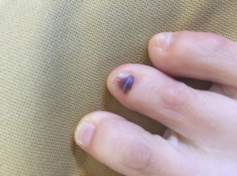
Keep in mind
MM under the finger nail are usually SSM rather than ALM. For finger or toe nail lesions it is vital to biopsy the nail matrix, rather than just the pigment on the nail plate

Slide 46
Noncutaneous melanoma
1. Mucosal melanoma
Mucosal melanomas represent <2% of melanomasMelanoma of the mucous membranes most commonly presents in the oral cavity, oropharynx, nasopharynx, paranasal sinus, anus, rectum, and female genitalia.
Patients with this presentation have a worse prognosis (10% 5-year survival)
Management should be excision to negative margins, and radical resections should be avoided because the role of surgery is locoregional control, not cure. Generally speaking, lymph node dissection should be avoided because the benefit is unclear
2. Ocular melanoma
Represent 2% to 5% of melanomas (most commonly noncutaneous melanoma)
Interference with vision leads to earlier diagnosis.
Melanomas of iris are similar to cutaneous melanomas in genetics/behavior; melanomas of the posterior uvea act more like mucosal melanomas and have a worse prognosis.
treatment of this condition includes photocoagulation, partial resection, radiation, or enucleation.
Ocular melanomas exclusively metastasize to the liver and not regional lymph nodes, and some patients benefit from liver resection
. The eye has no lymphatic drainage; therefore, no nodal metastasis is seen
The liver is the main site of metastatic disease
Treatment is by enucleation

Slide 47
Melanoma with an unknown primary
1. Represent 3% of melanomas
2. Diagnosis is by exclusion
3. Nodal metastases are the most common presentation
4. Prognosis is similar to metastatic melanomas with a known primary.

Slide 48
Diagnosis and staging of melanoma
A. Physical examination is only 60% to 80% sensitive for diagnosing melanoma.
Full-body photography to monitor atypical nevi may increase sensitivity.
B. Common clinical features of melanoma lesions: (ABCDE)
1. Asymmetry
2. Border irregularity
3. Color variation
4. Diameter >6 mm
5. Enlarging/evolving lesion

Slide 49
Diagnosis of primary melanoma is made by histologic analysis of full-thickness
biopsy specimens
Excisional biopsy is preferred for lesions <1.5 cm in diameter. If possible,
excise lesion with 1- to 3-mm margins.
Incisional biopsy is appropriate when suspicion is low, the lesion is large
(>1.5 cm) or is located in a potentially disfiguring area (face, hands, and feet),
or when it is impractical to perform complete excision. Incisional biopsy does
not increase risk of metastasis or affect patient survival.
Permanent sectioning is used to determine tumor thickness
Avoid shave biopsies, since they forfeit the ability to stage the lesion based
on thicken
Clinically suspicious lymph nodes should undergo fine-needle aspiration (FNAss
Orientation of biopsy incisions should also take definitive surgical therapy
into consideration.
Extremity biopsies should use longitudinal incisions.
Transverse incisions are sometimes preferable for preventing contractures
over joints.
Head and neck incisions should be placed within relaxed skin tension lines,
keeping facial aesthetic units in mind.
Do not cauterize or freeze the specimen: Tissue destruction makes impossible to evaluate thickness and margins

Slide 50
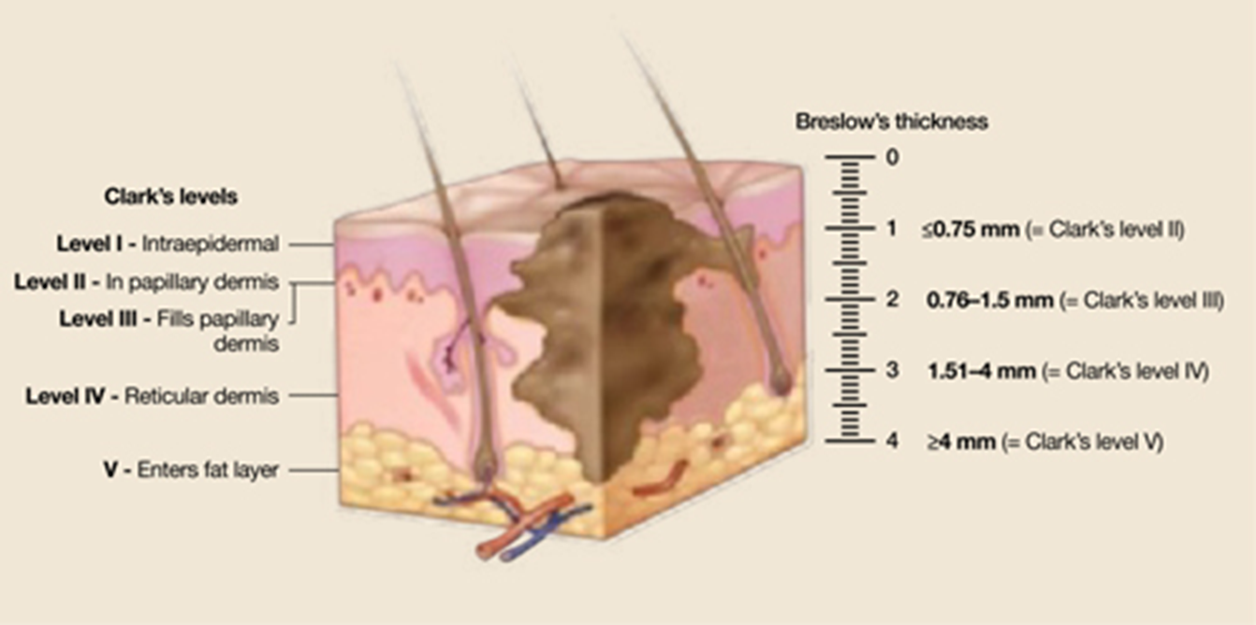
Major prognostic factors:
Tumor thickness, Nodal status, and Metastases—TNM
Breslow thickness is reported in millimeters; thus, it is more accurate and reproducible than Clark level and is a better prognostic indicator.
2. Clark level is based on invasion through the histologic layers of the skin; more subjective

Slide 51
E. Other significant prognostic factors
1. Anatomic location: Trunk lesions generally carry worse prognosis than those
on the extremities.
2. Sex: For a given melanoma, women generally have a better prognosis; women
are also more likely to have extremity melanomas which carry a better prognosis.
3. Ulceration is a poor prognostic sign
4. Lymph node involvement or in-transit metastases are more significant than
any other prognostic factors.

Slide 52
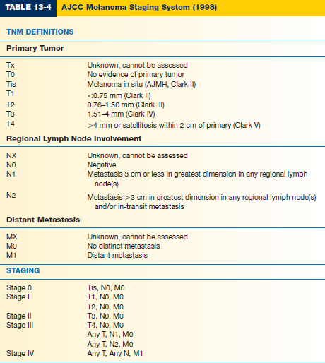

Slide 53
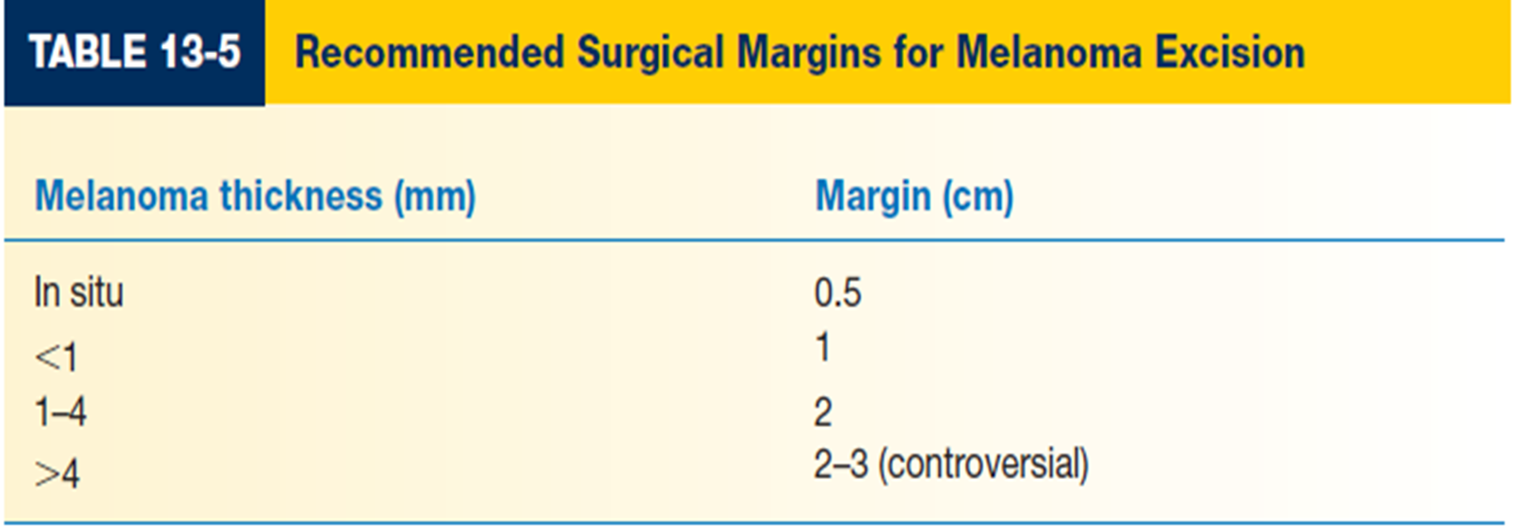
melanoma treatment
A. Definitive management of melanoma
1. Wide local excision is the treatment of choice.
2. Recommended surgical margins depend on tumor thickness
3. Subungual melanoma requires amputation proximal to the DIPJ for fingers and proximal to IP joint for the thumb.

Slide 54
2. Sentinel lymph node biopsy (SLNB)
SLNB is performed in conjunction with wide local excision of the primary tumor. Lymphatic mapping is performed to determine the first lymph node that drains the primary tumor site (sentinel node).
SLNB-positive patients undergo staged regional lymphadenectomy and may be candidates for adjuvant therapy.
d. Preoperative nuclear imaging is performed with radiolabeled colloid solution (technetium-99) injected intradermally at the primary tumor. This can be done on the day of or day prior to surgery. Lymphoscintigraphic imaging localizes the sentinel node basin(s) (some tumor sites can drain to multiple basins).

Slide 55
e. In the operating room, a lymphangiography dye (lymphazurin or methylene blue) can be injected intradermally at the periphery of the primary tumor site prior to excision of the primary tumor.
i. Mark edges of the lesion before injection to avoid obscuring them with the dye and take care with the dye because spills are difficult to manage.
ii. Potential sentinel nodes will appear blue when exploring the nodal basin, giving secondary confirmation to localization with Geiger counter detection of Tc99.
iii. Dye injection may briefly interfere with pulse-oximeter readings; alert anesthesiologist at the time of injection.
iv. Caution: Risk of allergy or anaphylaxis with dye injection
f. Following excision of the primary tumor All radioactive (“hot”) and/or blue nodes are excised.
g. Histologic analysis of sentinel node with immunohistochemical staining identifies micrometastases. Permanent sections are required; frozen sections cannot reliably differentiate normal from neoplastic melanocytes.

Slide 56
The most common sites of recurrence are the skin, subcutaneous tissues, distant lymph nodes, then other sites (lung, liver, brain, bone, GI tract).

Slide 57
S-100 and HMB-45 usually used for the monitoring of patients with melanoma,
- Subsequent immunostaining was positive for S-100 (a protein expressed in cells derived from the neural crest such as melanocytes) and HMB-45 (a monoclonal antibody that binds to immature melanosomes found in melanocytic tumors) indicating melanoma.
Mean survival with disseminated disease is 6 months. Respiratory failure and CNS complications are the most common causes of death

Slide 58
Chemotherapy: Complete remission is rare. a. Dacarbazine (DTIC), carmustine, cisplatin, and tamoxifen in combination are most frequently used.
b. Isolated hyperthermic limb perfusion for extensive cutaneous disease(melphalan and tumor necrosis factor) is used at some centers
Cytokine therapy has been demonstrated to produce relatively high levels of tumor response, albeit transient. FDA-approved regimens include interferon-α (IFN-α) for stage III disease and interleukin-2 (IL-2) for stage IV disease; however, these therapies demonstrate little or no improvement in overall survival.

Slide 59
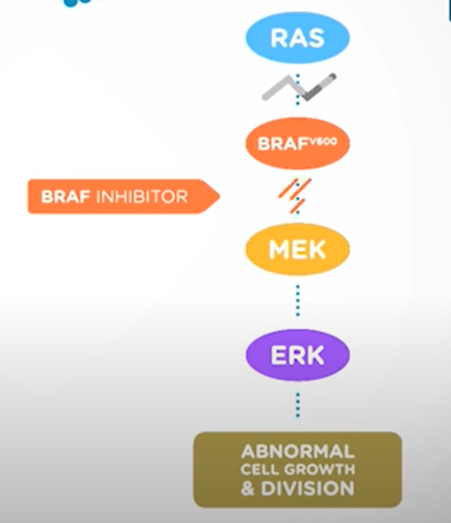
Targeted therapy
. Selective cell-signaling inhibitors (e.g., vemurafenib
If a person has a BRAF mutation, they will get both a BRAF inhibitor and a MEK inhibitor. commonly used combinations include vemurafenib and cobimetinib
Drugs for NRAS and C-KIT mutations may be available through clinical trials
Immunotherapy
Immunotherapy drugs called checkpoint inhibitors use the body’s own immune system to fight cancer. Some people who use checkpoint inhibitors have had very encouraging results, but they do not work for everyone with advanced melanoma

Slide 61
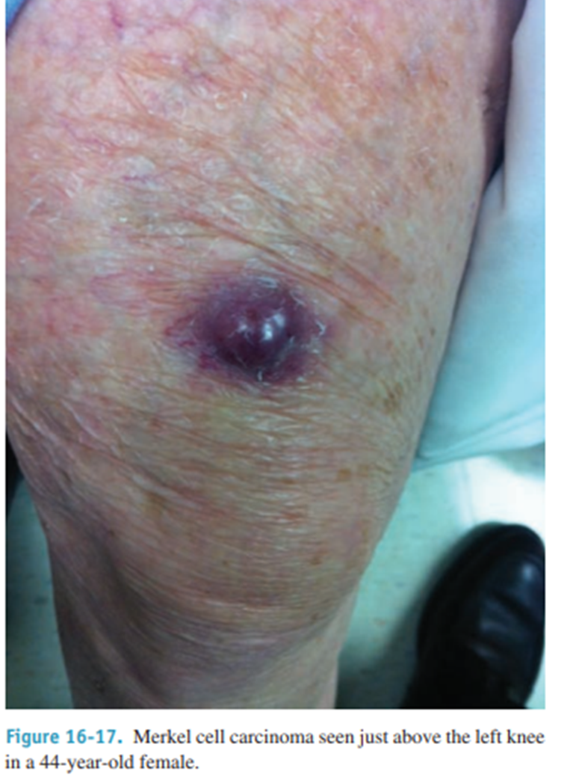
Less common skin cancers
Merkel cell (dermal mechanoreceptor) tumour This is an aggressive malignant tumour of Merkel cells and usually affects the elderly. It is four times more common in women than men
Risk factors include age over 65; history of extensive sunlight exposure; fair skin; and immunosuppression (HIV; organ transplants).
Recent research has implicated Merkel cell polyomavirus in 80% of MCC cases
Presents as a purple to red papulonodule or indurated plaque; 50% involve the head and neck, 40% the extremities, and 10% the trunk.
MCC is aggressive, with radial spread, high local recurrence, and regional and systemic metastasis.
Treatment involves local excision with wide (up to 3 cm) margins; SLN biopsy, and postoperative radiation started several weeks later.
Poor prognosis; 50% survival at five years.

Slide 62
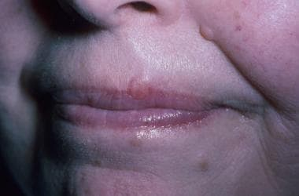
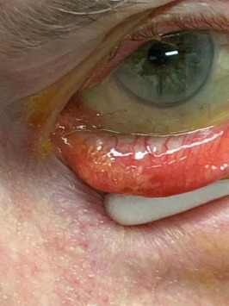
B. Microcystic adnexal carcinoma
Microcystic adnexal carcinoma (MAC) is a rare, malignant appendage tumor commonly classified as a low-grade sweat gland carcinoma that typically occurs on the head and neck, particularly the central face. Microcystic adnexal carcinoma shows aggressive local invasion with rare reports of lymph node metastases. ^{[1]} The image below depicts MAC on the left upper cutaneous lip.
C. Sebaceous gland carcinoma
is a rare skin cancer. It is considered an aggressive skin cancer because it can spread.
Most SCs begin on an eyelid.
You may notice a painless, round, firmly implanted tumor on your upper or lower eyelid.
SC tends to develop in and around the eyes because we have the greatest number of sebaceous glands in that area.
When this cancer begins in an eyelid, a dermatologist may refer to it as a meibomian gland carcinoma. This is a unique type of sebaceous gland found in the eyelids.
Yellowish to pink, slowly growing papulonodule on eyelid (resembles chalazion).

Slide 63
Sources and references
THANK YOU
‪Schwartz’s Principles of Surgery eleventh edition.
Bailey & Love's Short Practice of Surgery
Lecture Notes: Dermatology uptodate
Past material

