Slide 1
Axilla & brachial plexus
By
Dr Abulmaaty Mohamed Assistant professor Anatomy & Embryology Mutah University

Slide 6
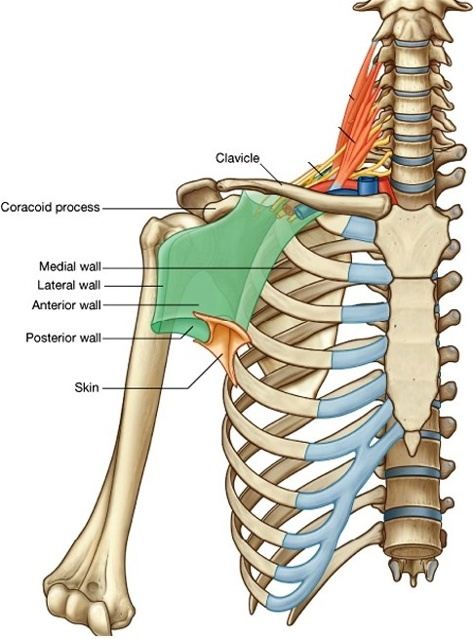
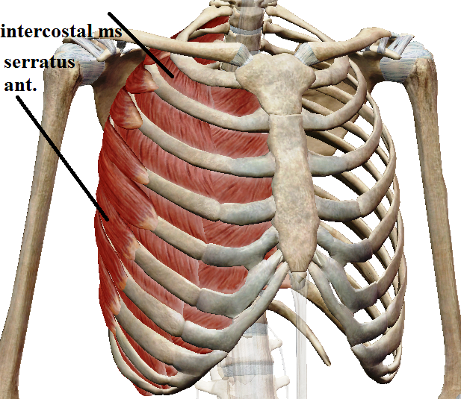
AXILLA
Def.: space between upper parts of chest & arm
Shape: - pyramidal with apex & base & 4 walls
Boundaries:
1-medial wall:
Formed by
1-upper 5 ribs
2- ,, ,, intercostal muscles.
3- ,, ,, digitations of serratus ant.

Slide 7
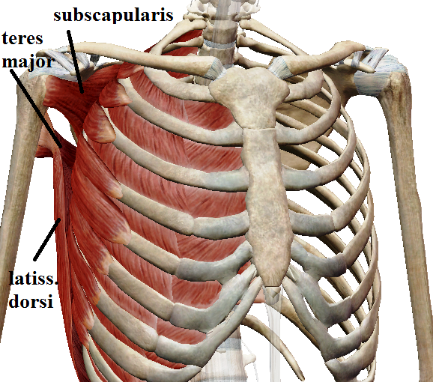
AXILLA
Boundaries:
2-post. wall:
Formed by
1-Subscapularis
2-Teres major
3-Latissimus dorsi
N.B.:-The lower border
of the posterior wall
is called post. axillary fold,
formed by teres major & latissimus dorsi

Slide 8
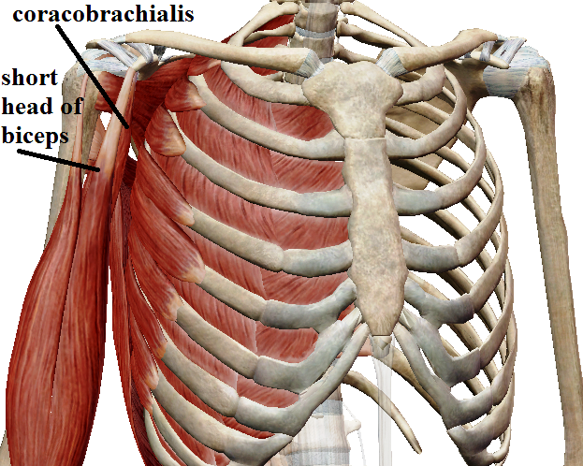
AXILLA
Boundaries:
3-Lateral wall:
Formed by
1-upper part of humerus.
2-coracobrachialis.
3-short head of biceps.
N.B.:- this wall is considered the dangerous wall of axilla as it's related to nerves & vessels of upper limb

Slide 9
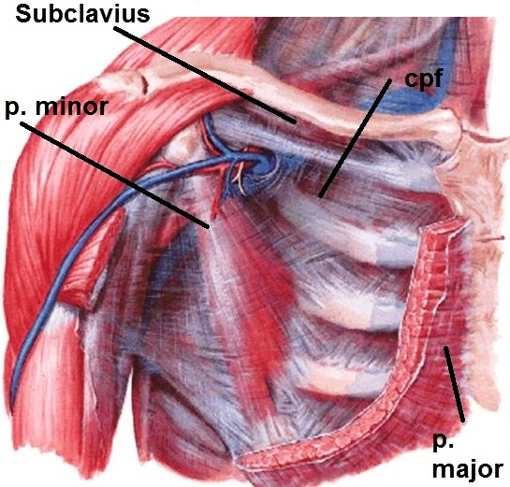
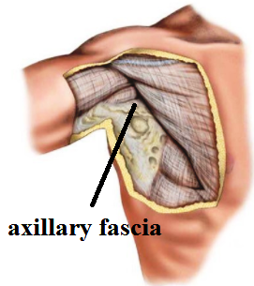
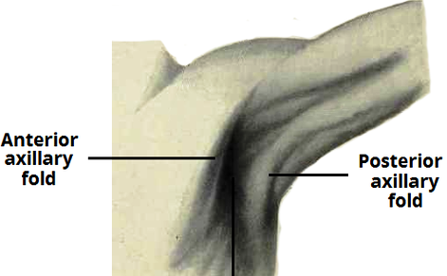
AXILA
Boundaries:
4-Ant. wall: Formed of 2 layers
Deep: 1- subclavius.
2- Clavipectoral fascia.
3- Pectoralis minor
Superficial: pectoralis major.
N.B.:-The lower border of the anterior wall is called ant. axillary fold, formed by pectoralis major only. It is higher in position than post. axillary fold
5-Base (floor): Formed by
1-Skin
2-superficial fascia
3-Axillary fascia

Slide 10
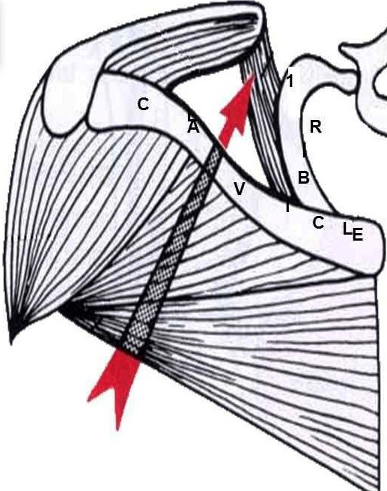
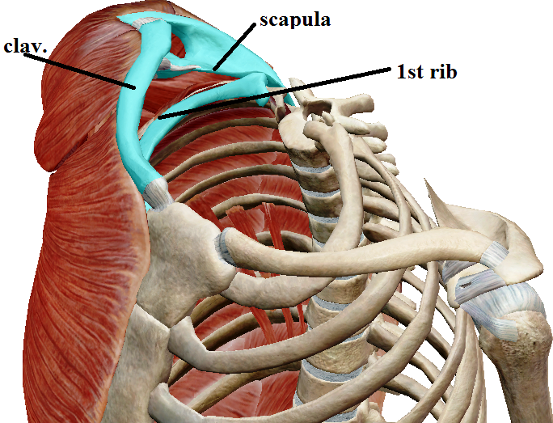
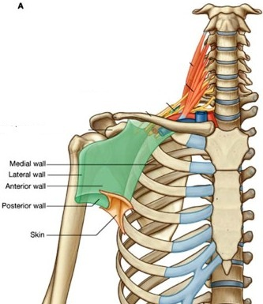
axilla
Boundaries:
6-Apex:
connect axilla with the neck so called Cervicoaxillary canal
Boundaries:
Ant.:- middle part of clavicle
Post. - Upper border of scapula
Medial: - outer border of 1st rib
Function: Passage for the axillary vessels & cords of brachial plexus.
So all its boundaries are bony to protect its structures from compression.

Slide 11
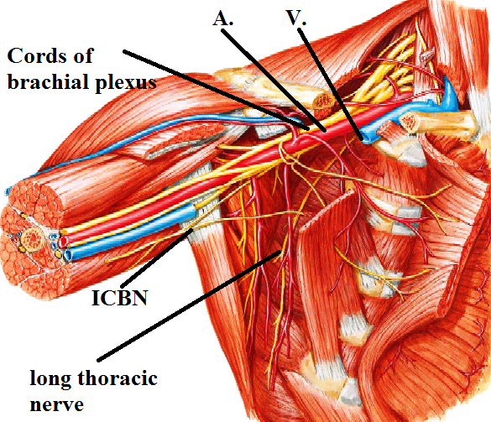
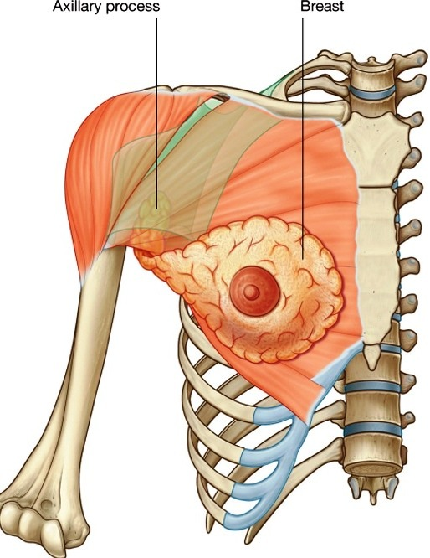
axilla
Contents
1-axillary fat
2-axillary artery & its branches
3- axillary v. & its tributaries
4-axillary L.Ns
5-axillary tail of female breast.
6-cords of brachial plexus & its branches
7-long thoracic n.:- on serratus anterior
8-intercosto-brachial n.:-
crosses the axilla to supply its floor

Slide 13
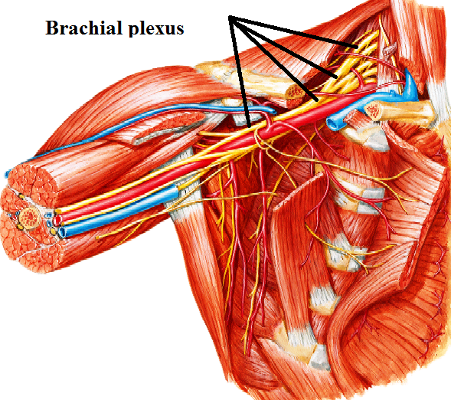
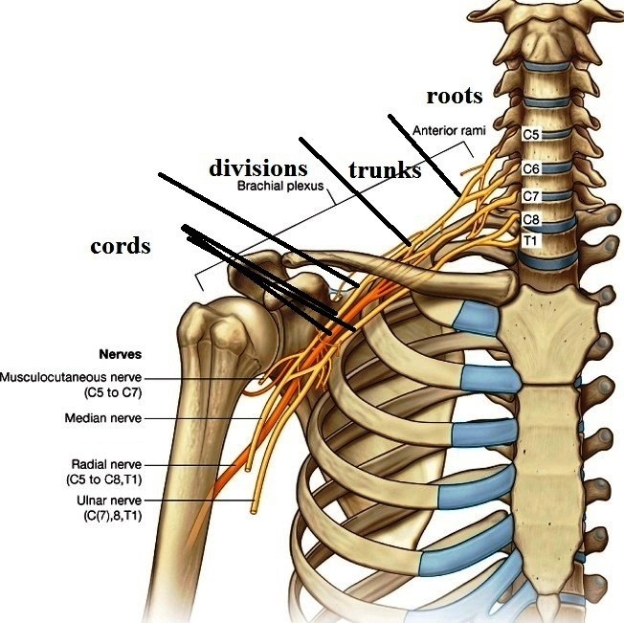
Brachial plexus
Def.: network of nerves
descend from neck to axilla
supply upper limb.
Formation: 4 stages
1-Stage of Roots (in the neck)
Ventral rami of C5, 6, 7, 8 & T1 nerves.
2-Stage of Trunks (in the neck):
Upper trunk: formed by union of C5 & 6
Middle ,, : formed as continuation of C7
Lower ,, : formed by union of C8 & T1
3-Stage of divisions (behind the clavicle):
Each trunk divides into ant. & post. divisions.
4-Stage of cords (in the axilla):
Posterior cord:
formed by union of post. divisions of all trunks.
Lateral cord: formed by union of
ant. divisions of upper & middle trunks.
Medial cord: ant. division of lower trunk.

Slide 14
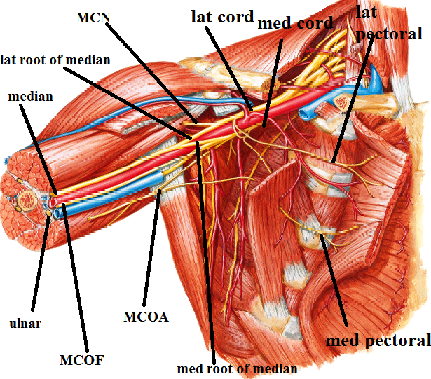
Brachial plexus
Branches:
1-From lateral cord:
Lateral pectoral n. C5, 6, 7
Lateral root of median n. C5, 6, 7
Musculocutaneous n. C5, 6, 7
2-From medial cord:
Medial pectoral n. C8, T1
Medial root of median n.C8, T1
Ulnar n. C8, T 1 + C7
Medial cutaneous n. of arm. C 8, T 1
,, ,, ,, ,, forearm.
C8, T1

Slide 15
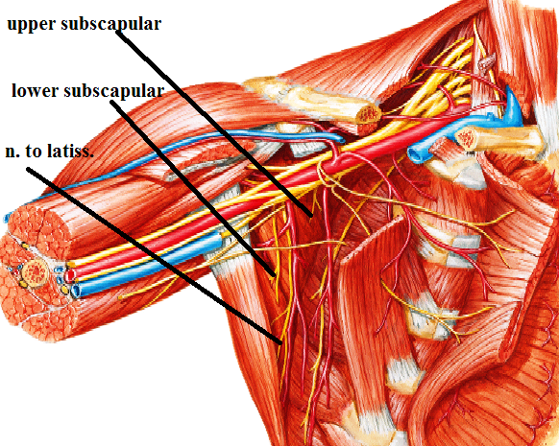
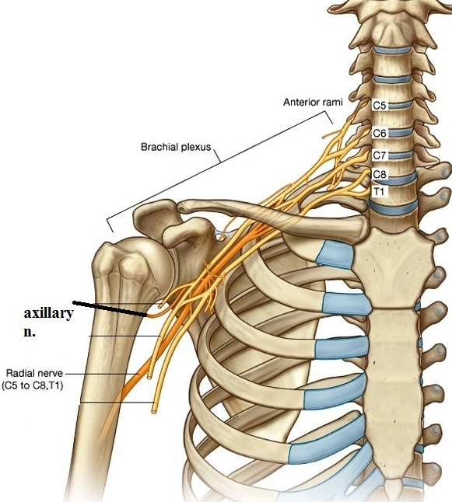
Brachial plexus
Branches:
3-From posterior cord:
Upper subscapular n. C5, 6
Lower ,, ,,. C5, 6
N. to latissimus dorsi (thoracodorsal n.) C6, 7, 8
Axillary n. C5, 6
Radial n. كلووووووووووووووووووووو

Slide 16
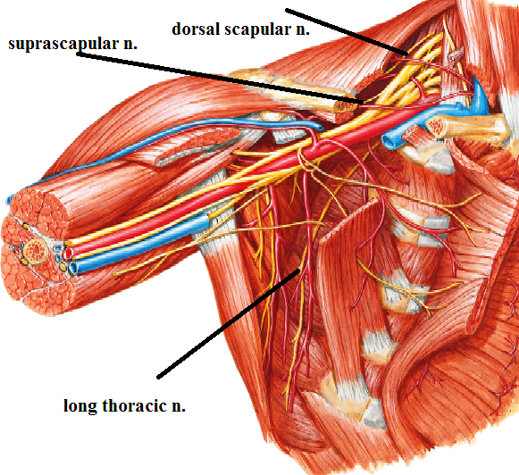
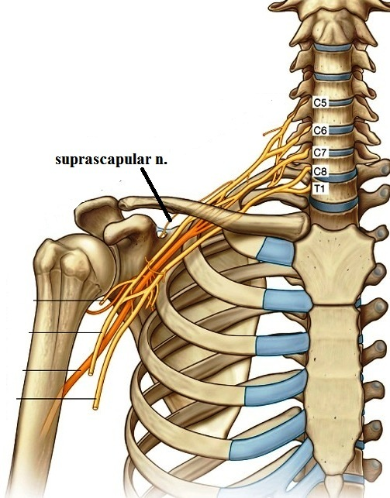
Brachial plexus
Branches:
4-From trunks: (from upper trunk only)
N. to subclavius. C5, 6
Suprascapular n. C5, 6
5-From roots:
N. to serratus ant. (long thoracic n.) C5, 6, 7
N. to Rhomboids (dorsal scapular n.) C5.

Slide 17
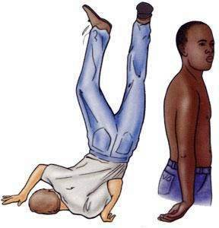
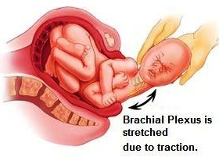
Brachial plexus
Injury of the brachial plexus:
injury of upper trunk (C5,6)
(Erb's paralysis)
Deformity:
Policeman's tip position:
Adducted medially rotated arm,
extended elbow,
pronated forearm.

Slide 18
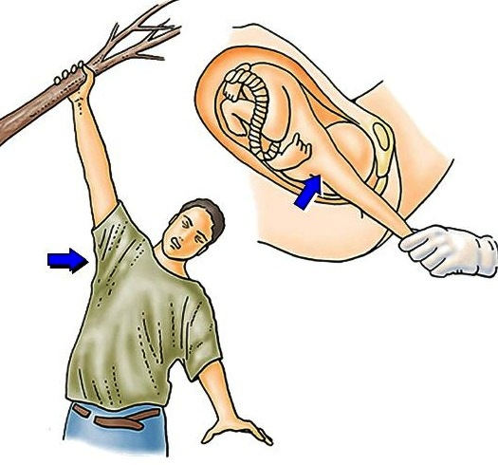
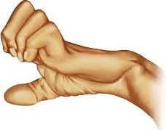
Brachial plexus
Injury of the brachial plexus:
injury of lower trunk (C8 & T1 nerves)
(Klumpkes' paralysis)
Deformity
claw hand
extension of metacarpo- phalangeal joints
flexion of inter phalangeal joints

Slide 19
THANQ

