Slide 1
Done BY:
Alhareth Mistarihi Khaled Alamrat Ahmad Daradkah
Supervised BY:
Dr.Meeran Bataineh

Slide 3
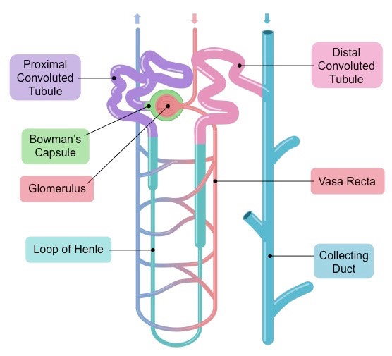

Slide 4
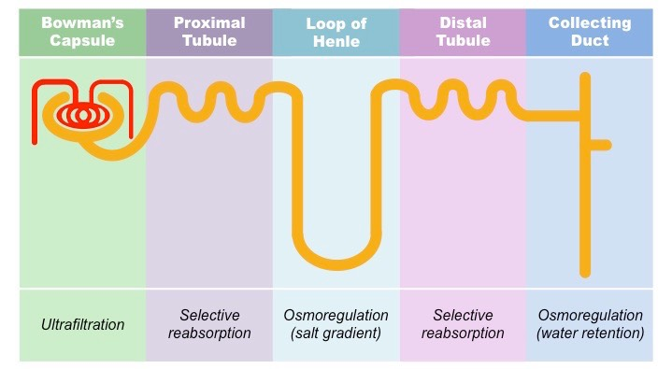

Slide 5
Definition
is an uncommon disorder that causes an imbalance of water in the body. This imbalance leads to intense thirst even after drinking fluids (polydipsia), and excretion of large amounts of diluted urine (polyuria).

Slide 6
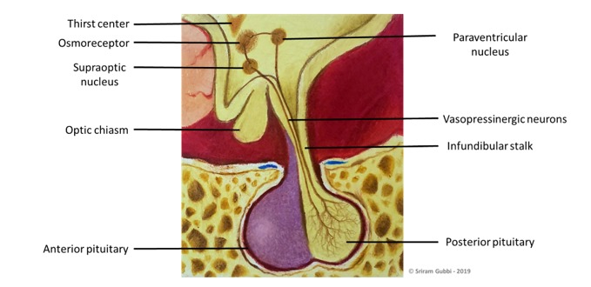
Types
1)central:I is the most common form—due to low ADH secretion by posterior pituitary or impaired production of ADH in hypothalamus.
Causes:
Idiopathic—50% of all cases
Trauma—surgery, head trauma
Tumor:craniopharyngioma and pineal tumor in children
Familial hypothalamic DI (autosomal dominant)
Other destructive processes involving the hypothalamus, including , sarcoidosis, tuberculosis, syphilis, Hand–Schüller–Christian disease, eosinophilic granuloma, and encephalitis

Slide 7
2)Nephrogenic DI :ADH secretion is normal but tubules cannot respond to ADH.
Causes:
the most common cause in adults is chronic lithium use.
Other causes include electrolyte abnormalities (hypercalcemia more than 11mg\dl ,hypokalemia
less than 3.5 mmol/L), pyelonephritis(UTI), and demeclocycline use.
It may also be congenital—caused by mutations in the ADH receptor gene or the aquaporin-2 gene.(X-linked mutation).
Acquired: from sickle cell disease, amyloidosis, polycystic kidney disease.

Slide 8
3)gestational DI (transient):
This type of DI occurs only during pregnancy when an enzyme made by the placenta destroys a mother’s ADH. It may also be caused by an increased level of a hormone-like chemical that makes the kidneys less sensitive to ADH. The condition should resolve after pregnancy.

Slide 9
Clinically
The predominant manifestations of DI are as follows:
Nocturia :usually is the first symptom
Polyuria: The daily urine volume is relatively constant for each patient but is highly variable between patients (3-15 L/d) This is of low specific gravity and osmolality.
Polydipsia
The most common differential diagnosis is primary polydipsia(seen in patients with psychiatric disturbances), caused by drinking excessive amounts of fluid in the absence of a defect in vasopressin or thirst control.
other differential for polydipsia :DM(proteinuria) ,intrinsic renal disease(hematouria), diuretics use.
hypernatremia
high serum osmolality (concentrated serum)
Low urine osmolality (dilute urine because ADH is not concentrating it to try to store it)

Slide 10
Diagnosis
Diagnosis:
1. Urine—low specific gravity and low osmolality indicate DI.(dilute)
2. Plasma osmolality
a. Normal: 270 to 290 mOsm/kg
b.Primary polydipsia: 255 to 280 mOsm/kg
c.DI: more than 290 mOsm/kg
3. A water deprivation test (dehydration test) is required to make the diagnosis

Slide 11
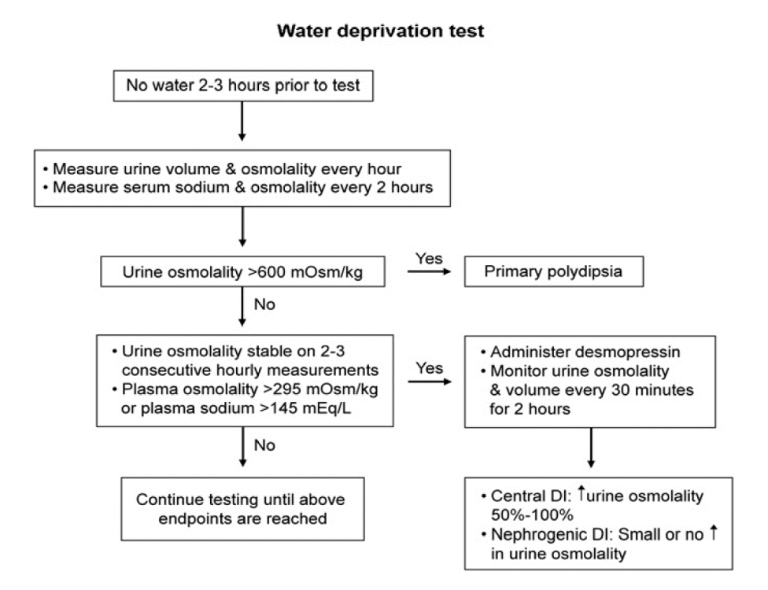

Slide 12
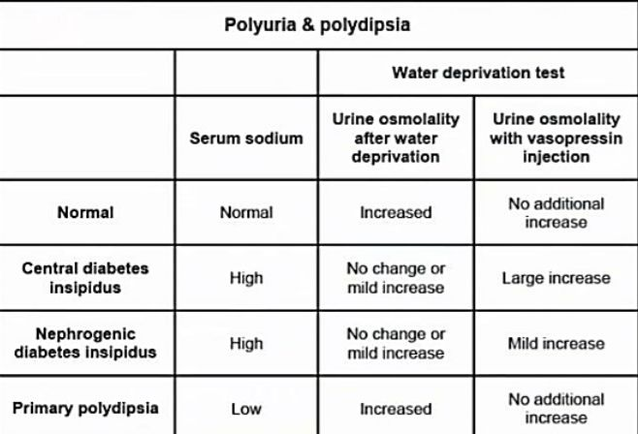

Slide 13
An inappropriately low urine osmolality in the setting of an elevated serum osmolality and hypernatremia in a patient with polyuria (>50 mL/kg/24 hours in the absence of glycosuria) is diagnostic of DI
Water deprivation test can be performed when the diagnosis is uncertain Serum osmolality >295 mOsm/kg H2O and/or serum sodium >145 mEq/L (145 mmol/L) with inappropriately dilute urine (urine osmolality/plasma osmolality <2) is diagnostic of DI. Desmopressin challenge can differentiate Central DI from nephrogenic DI by giving desmopressin 2 µg subcutaneously then follow Urine osmolality over the next 4 hour
Complete Central DI is diagnosed if >50% increase in urine osmolality
Complete Nephrogenic DI if No increase in urine osmolality

Slide 14
Treatment
1.Central DI
a. Desmopressin (DDAVP) is the primary therapy and can be given by nasal spray, orally, or by injection.
b. Treat the underlying cause.
2. Nephrogenic DI
a. Thiazide diuretics lead to sodium depletion in distal convoluted tubules, which causes compensatory sodium and water reabsorption in the proximal tubules. As a result, less water reaches the distal tubules and volume of urine decreases
b.Prostaglandin inhibitors such as NSAIDs

Slide 15
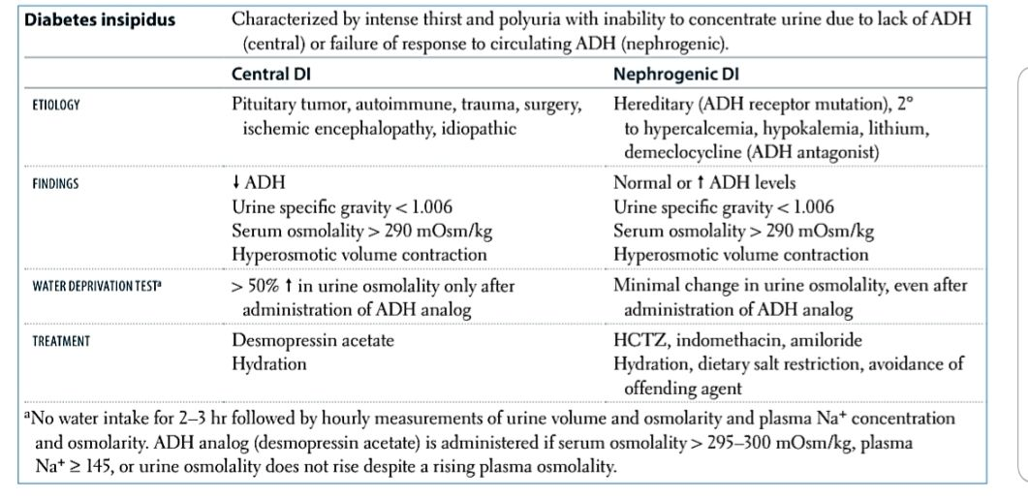

Slide 16
References
-kaplan
-Davidson

