Slide 2
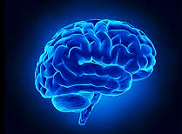
Bacterial Meningitis
By:
Prof. Dr. Ghada Fahmy Helaly
Microbiology Department
Faculty of Medicine
Mu’tah University
NS1 Module

Slide 3
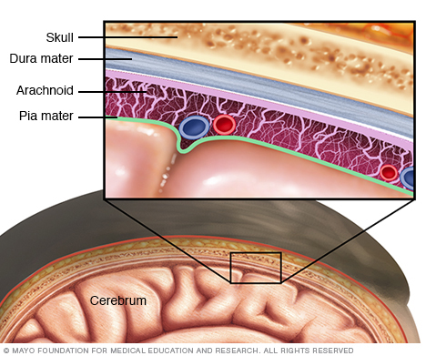
General aspects of meningitis
Meningitis : inflammation of the protective membranes covering the brain and spinal cord known as the meninges.
The inflammation is usually caused by an infection of CSF.
The most common are Viral meningitis, followed by bacterial and, rarely, fungal infections. , but meningitis can also be caused by physical injury, cancer or certain drugs.

Slide 4
General aspects of meningitis
Bacterial meningitis:
Either community or hospital acquired. Identifying the cause is essential.
Acute meningitis (<1 d), chronic meningitis (weeks to months).
Bacteria can directly invade the meninges ( ear or sinus infection, a skull fracture, or, rarely, after some surgeries).
Serious complications, such as brain damage, hearing loss, or learning disabilities.
Treatment must be started quickly. Untreated → mortality rate of 50%.

Slide 5
Common causes of bacterial meningitis by age group:
Age Group | Causes
Newborns: Birth to 3 months | Group B Streptococcus, S. pneumoniae, E. coli, Listeria monocytogenes
Infants and Children: 3-60 months | S. pneumoniae, Neisseria meningitidis, H. influenzae type b, Group B Streptococcus
Adolescents and Young Adults | Most common: S. pneumoniae, Others: N. meningitidis, L. monocytogenes Other G- organisms
The elderly | S. pneumoniae S. aureus* L. monocytogenes Gram-negative bacteria

Slide 6
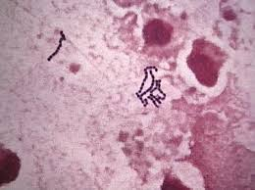
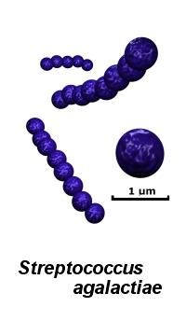
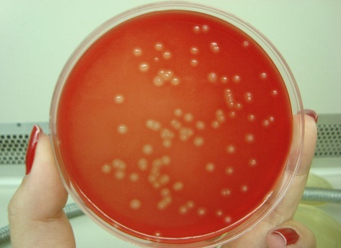
Neonatal meningitis/Streptococcus agalactiae (Group B streptococcus [GBS]).
Beta-hemolytic, Gram-positive cocci in chains.
Vaginal and oral flora in adult women (15- 40% of women).
Vaginal colonization→ respiratory infections and septicemia → meningitis in newborns.
Prolonged labor after the rupture of the membranes → ↑ transmission risk.
Disease:
Early-onset GBS neonatal sepsis (birth to 7 days) → respiratory distress reduced by intra-partum antibiotics.
Late-onset neonatal sepsis (7 ds to 4 ms) → meningitis.

Slide 7
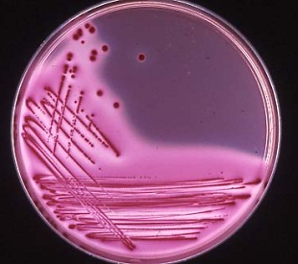
Neonatal meningitis/E. coli.
This disease is caused by birth exposure to encapsulated (primarily K1) strains of E. coli. K1 antigen (polysaccharide) prevents the phagocytosis, ↑ adhesion.
Lactose-fermenting, member of the Enterobacteriaceae
Colonic normal flora (NF) (nonpathogenic strains)
May colonize lower end of urethra and vagina→ neonatal sepsis, meningitis

Slide 8
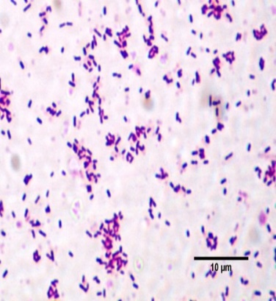
Neonatal meningitis or meningitis in compromised persons Listeria monocytogenes.
Beta-hemolytic, Gram-positive, facultative intracellular coccobacillus , tumbling motility in broth at room temperature and is a psychrophile.
Found in vertebrate feces, unpasteurized dairy products, deli meats, soft cheeses, unheated hot dogs, and uncooked cabbage.
Mother →through food; fetus →placenta infection or exposure to feces at birth.
Disease:
Listeria produces listeriolysin O.
In healthy individuals: transient diarrhea and fecal carriage.
In pregnant women→ septicemia possibility of neonatal infection.
In immuno-compromised patients: septicemia and meningitis.

Slide 9
Pneumococcal meningitis / Streptococcus pneumoniae .
Septicemia and meningitis in the very young, bacterial meningitis in older adults.
Vaccination reduces the risk of infection
A13-valent polysaccharide-protein conjugate vaccine for infants.
A 23-valent polysaccharide vaccine for patients 65 years or older.

Slide 10
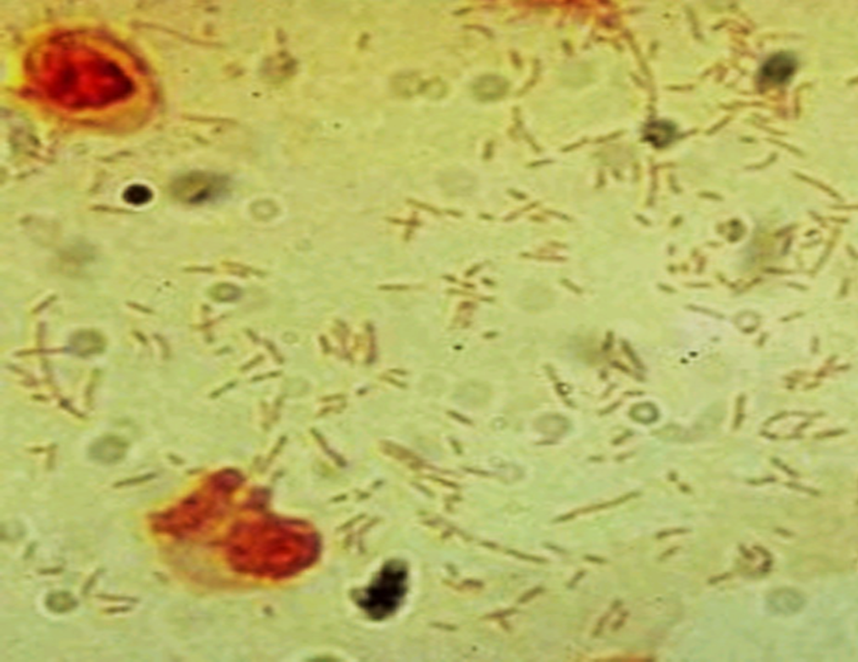
Meningitis in unvaccinated children under 2 years H. influenzae type b.
Gram-negative, pleomorphic coccobacilli in CSF.
Meningitis, osteomyelitis, and epiglottitis →unvaccinated children “3 ms to 2 ys of age”.
Strains have the type b polyribitol capsule →childhood meningitis.
Non-typeable strains “normal oropharyngeal flora”→ no disease.
Lab ID: Gram stain of CSF; growing on chocolate agar.
Prevention: capsular polysaccharide-protein conjugate vaccine at 2, 4, 6 months.

Slide 11
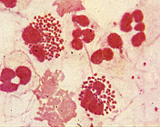
Meningococcal meningitis/Neisseria meningitidis.
Gram-negative, oxidase-positive, diplococci with a polysaccharide capsule, use both glucose and maltose. Twelve types of N. meningitides, called serogroups, have been identified, six of which (A, B, C, W, X and Y) can cause epidemics.
Colonizing upper respiratory membranes; (10% of healthy people are Carriers).
Pili, the capsule, IgA protease. If it reaches the BBB., pili and the outer membrane endotoxins (lipo-oligosaccharides)→ fulminant meningococcemia, fatal in 1 to 5 ds.

Slide 12
Disease:
Meningococcal meningitis in children 6 months to 2 years, in young adults, (college students and military recruits).
Waterhouse-Friderichsen syndrome is a fulminating meningococcemia with hemorrhage, circulatory failure, and adrenal insufficiency.
Eighth-nerve deafness, learning disabilities and seizures, and severe skin necrosis .

Slide 13
Lab ID:
Gram stain CSF. Culture of CSF and blood on chocolate agar in high CO2.
Treatment:
IV ceftriaxone
Rifampin.
Manage shock and intravascular coagulation.
Prevention:
The meningococcal conjugate vaccine, recommended for high-risk children and military recruits or college students .

Slide 14
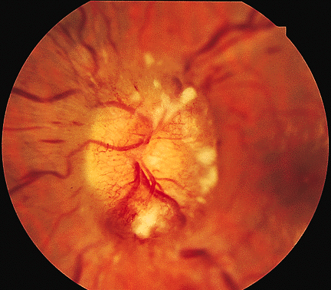
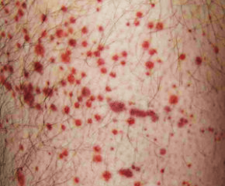
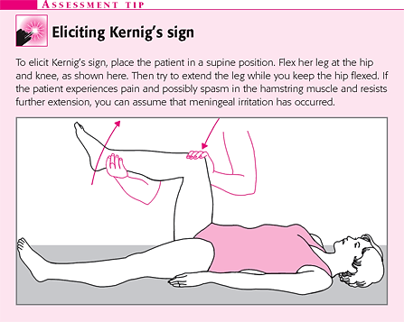
Clinical picture / signs
Fever, headache, and neck rigidity.
Nausea, vomiting, photophobia.
Papilledema
Petechial rash on skin.
Seizures and Focal neurologic signs.
Cerebral dysfunction
Lethargy, temperature Instability.
Respiratory distress.
Kernig’s sign.
Brudzinski’s sign.
Petechial rash
Papilledema

Slide 15
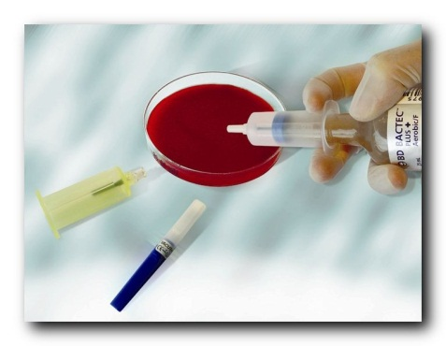
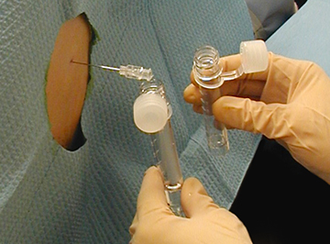
Diagnosis
1. History and examination.
2. Laboratory:
Full blood count (FBC), Liver and Kidney function tests.
Coagulation profile.
Blood culture and throat swabs.
Lumbar puncture → definitively test for the presence of bacteria in the CSF.
3. Radiology:
Chest X rays.
CT scan.
LP tubes:
Tube (1): Gram stain & Culture.
Tube (2): Protein & Glucose.
Tube (3): Cell count & differential.
Tube (4): Store (PCR, viral studies if available, or for repeat cell count if needed)

Slide 16
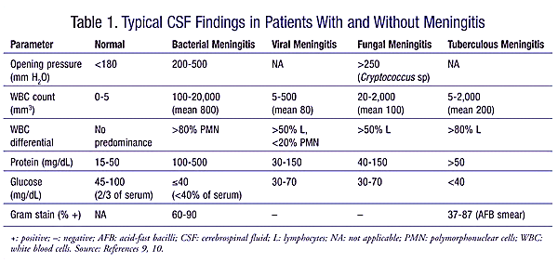
CSF findings:

Slide 17
Treatment
If you suspect meningitis start antibiotic treatment as fast as possible !!!!!
General:
Stabilize the patient (antipyretics, fluid, anti seizures if there...)
Specific:
Antibiotics.
Empiric treatment consists of bactericidal antibiotics that have good CSF penetration, such as cefotaxime, ceftriaxone, ceftazidime , Ampicillin, vancomycin.
2. Steroids (dexamethasone).
3. If TB meningitis → anti TB medications.
Change according to clinical response and CSF results.
Duration 10-14 days, 3 weeks in Listeria.

