Slide 1
Epistaxis
Dr. Islam Alzayadneh MD
Otolaryngology, Head and Neck Surgeon Mutah University School of Medicine-Special Surgery Department Undergraduate Seminars 2020

Slide 2
Learning objectives
By the end of this lecture, you will be able to:
Describe the Pathophysiology of Epistaxis
Be familiar with relative Nasal anatomy
Outline initial patient assessment of the Epistaxis patient
Describe nasal exam and management techniques for Epistaxis
Formulate an appropriate evaluation and treatment plan

Slide 3
INTRODUCTION
Most common Otolaryngological emergency in the U.S.
Presents in 7-14% of general population each year
Estimated lifetime incidence 60%
Most of the time, bleeding is self-limited, but can often be serious and life threatening.
Epistaxis should never be treated as a harmless event.

Slide 4
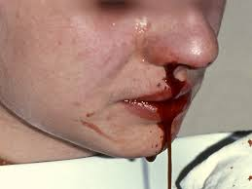
INTRODUCTION
Bimodal incidence (2-10)& (60-80) yrs
Males>females
Winter.

Slide 5
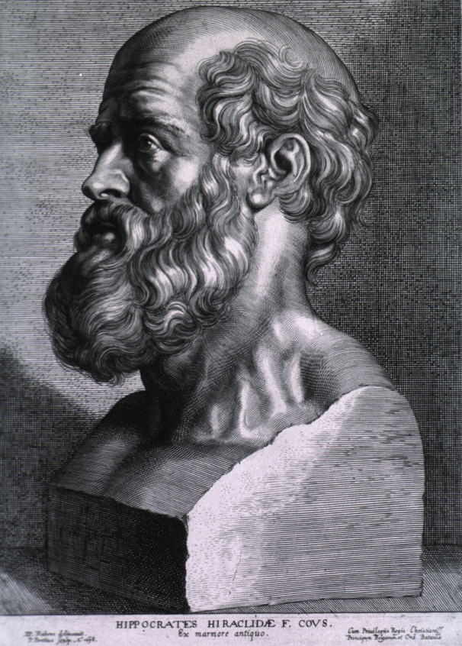
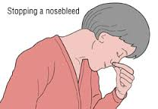
INTRODUCTION
History, folklore, & Myth!
Hippocrates

Slide 6
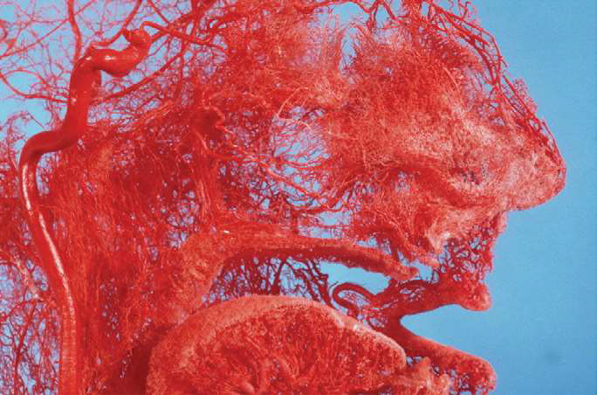
Why bleeding from the nose ?

Slide 7
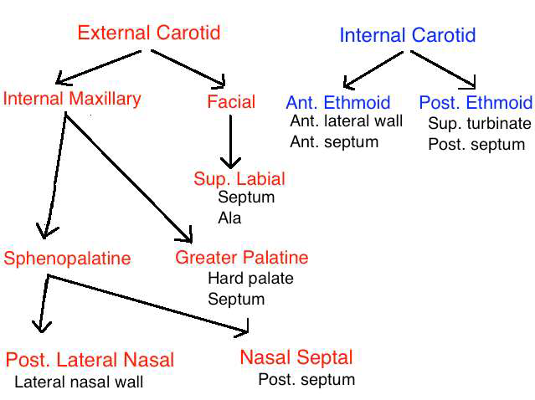
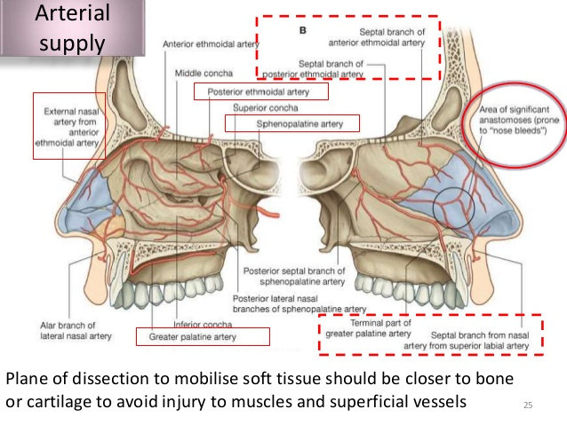
VASCULAR ANATOMY

Slide 8
VASCULAR ANATOMY

Slide 9
Anterior Vs Posterior epistaxis
Epistaxis can be divided into 2 categories, anterior bleeds and posterior bleeds, on the basis of the site where the bleeding originates.

Slide 10
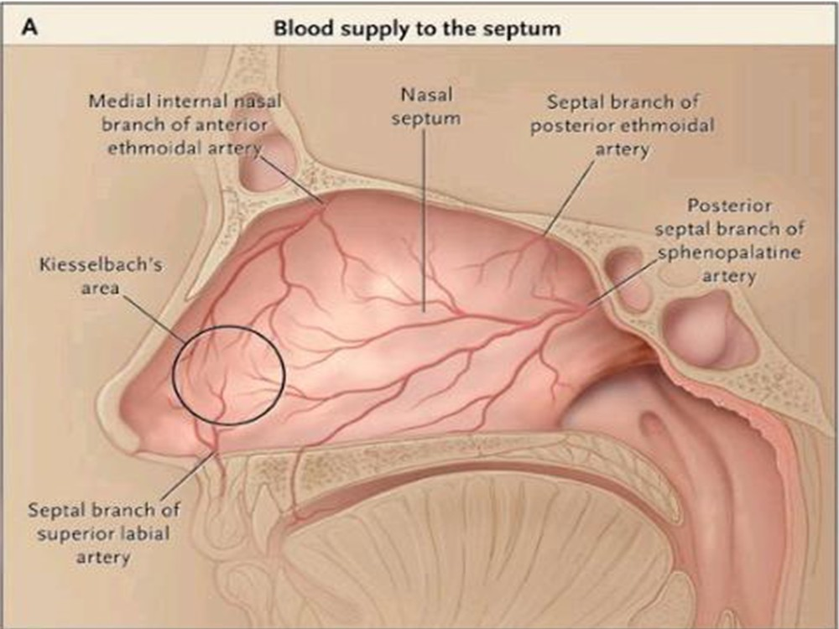
Kiesselbach’s Plexus

Slide 11
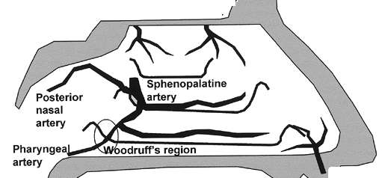
Woodruff’s Plexus

Slide 12
ETIOLOGY
LOCAL FACTORS
Traumatic (fractures, foreign body, nose picking).
Inflammatory (rhinitis, sinusitis).
Neoplastic (tumors of the nose, sinuses and nasopharynx).
Environmental (high altitude, air conditioning).
Iatrogenic
DNS
Chemical irritants

Slide 13
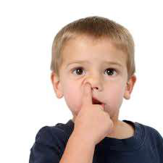
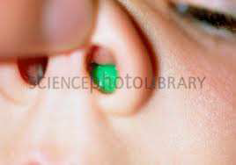

Slide 14
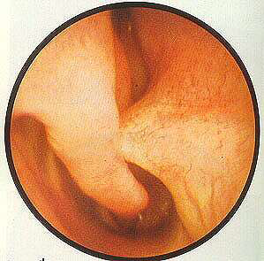
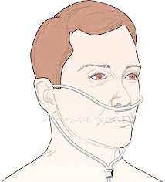
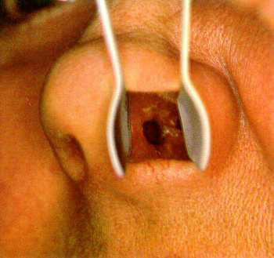

Slide 15
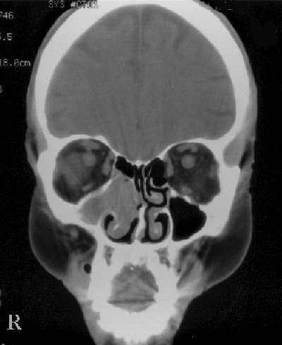
Neoplasms
Juvenile nasopharyngeal angiofibroma
Inverted papilloma
SCCA
Adenocarcinoma
Melanoma
Esthesioneuroblastoma
Lymphoma

Slide 16
ETIOLOGY
SYSTEMIC FACTORS
- Coagulopathies (haemophilia, leukaemia).
Anticoagulant medications
ASA & NSAIDS
Vascular abnormalities
Renal \ liver failure
HTN ?

Slide 17
HTN as a cause of epistaxis
systematic review was done by Kikidis et al. March 2013 -European Archives of Otolaryngology –
although multiple studies exist that examine this relationship, no consensus has been achieved.
The primary issue is that there are multiple confounding factors such as age and use of anticoagulation medication that may be the cause of epistaxis and not the hypertension itself.
Increased age induces fibrosis of the tunica media of the arteries, which may lead to inadequate vasoconstriction after rupture of a blood vessel.

Slide 18
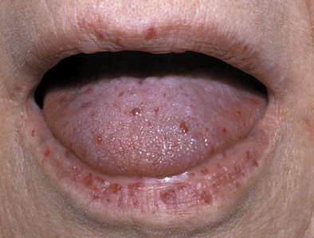
Hereditary Hemorrhagic Telangiectasia (HHT)
AKA Osler-Weber- Rendu disease
Autosomal dominant
Widespread cutaneous, mucosal, and visceral telangiectasias (arteriovenous malformations) in the brain, lungs, liver, and gut
Manifests in nose as raised
lesions

Slide 19
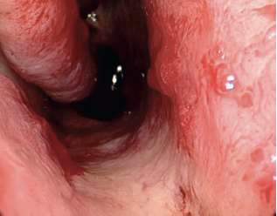
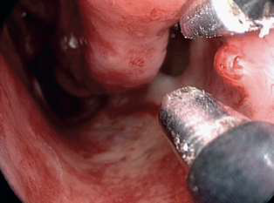
HHT

Slide 20
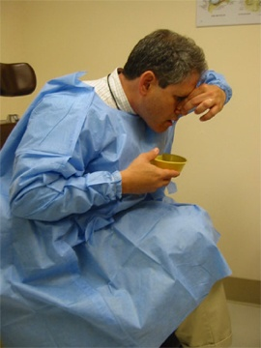
Initial Management
ABC
Is your patient in shock ? IV access
Hippocratic technique

Slide 21
HISTORY
Amount, duration
Previous bleeding episodes
Nasal trauma, obstruction
Easy bruise ability
Family history of bleeding
HTN- current medications and how tightly controlled
Use of anticoagulants
Renal \ Hepatic diseases
Other medical conditions - DM, CAD, etc.

Slide 22
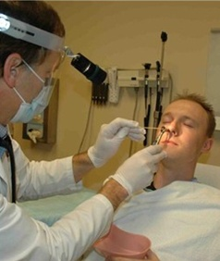
PHYSICAL EXAMINATION
Sitting position
Wear protective clothing
Equipments :
couch or reclining chair,
headlight, suction , vasoconstrictor solutions,
packs, tampons, cautery, nasal endoscopy

Slide 23
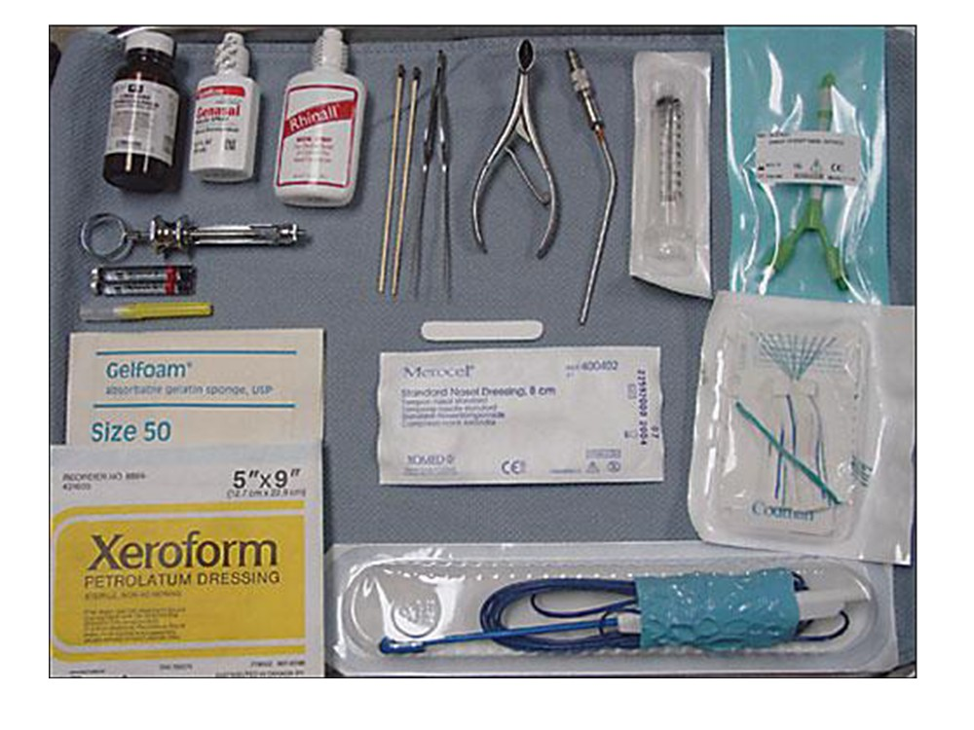

Slide 24
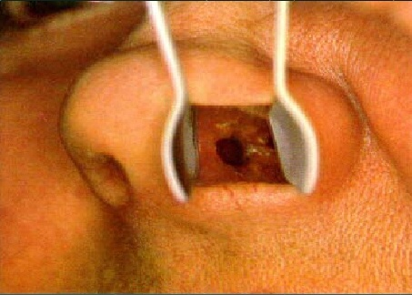
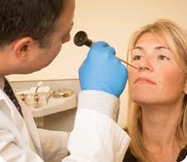
PHYSICAL EXAM
Anterior rhinoscopy :
Suck out any clots
Side of bleeding
Anterior vs. posterior
Local anesthesia & vasoconstriction
Posterior rhinoscopy :
Endoscopic visualization

Slide 25
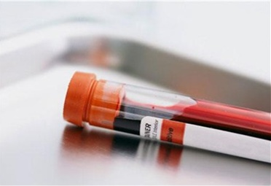
LAB STUDY
CBC ( including platelet )
X-Match
KFT
LFT
Coagulation profile

Slide 26
Treatment
Non surgical
Topical vasoconstrictors
Packing
Cauterization
blocks (i.e. transpalatine)
Surgery/ interventional radiology (IR)

Slide 27
Treatment
Control of hypertension
Correction of coagulopathies/thrombocytopenia
FFP or whole blood/reversal of anticoagulant/platelets

Slide 28
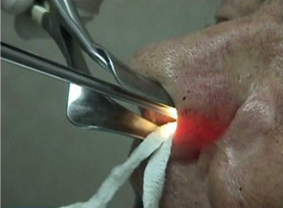
TREATMENT
- Topical vasoconstriction: anesthetic solutions (lignocaine & pseudoephedrine or cocaine) 1% phenylephrine or 0.05% oxymetazoline

Slide 29
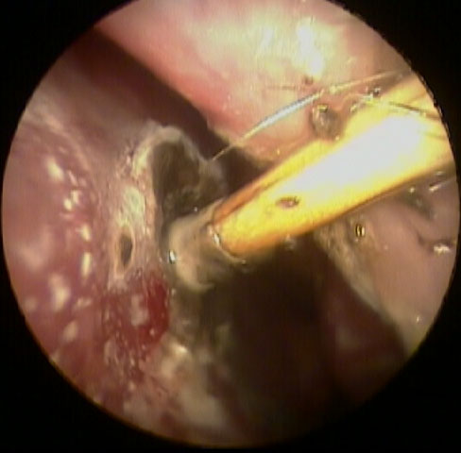
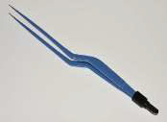
Treatment
Cauterization
Chemical: Silver nitrate .
Thermal: Bipolar suction diathermy
After cauterization advise patient to:
Avoid nose blowing for at least 1 week
Apply greasy antiseptic barrier ointment
three times a day for 1-2 weeks

Slide 30
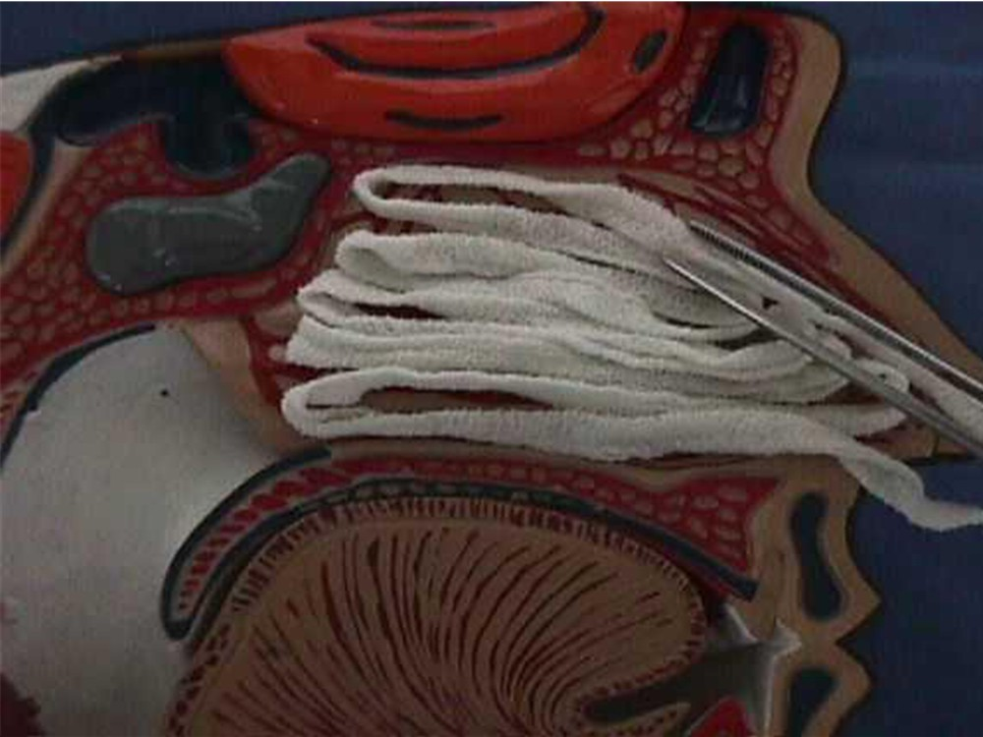
Treatment
Nasal Packs
Intranasal device which applies constant local pressure
Anterior, posterior, or anterior and posterior
Systemic or topical antibiotics
Precautions to admit patient with
comorbidities to ICU if a posterior pack is placed
Packs should be removed within
2-3 days of initial placement

Slide 31
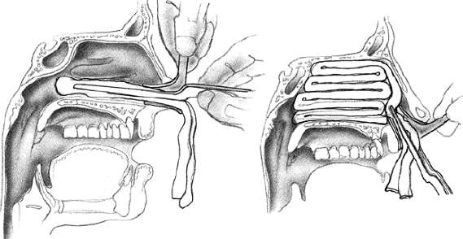
Anterior Nasal Packs

Slide 32
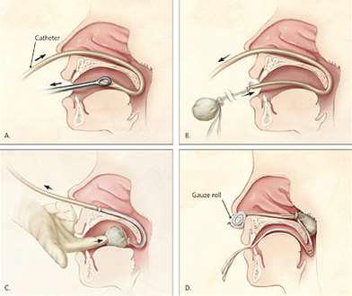
Posterior Nasal Packs

Slide 33
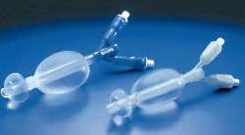
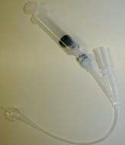
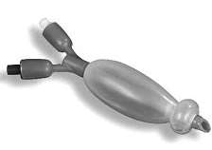
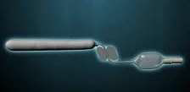
Posterior Nasal Packs

Slide 34
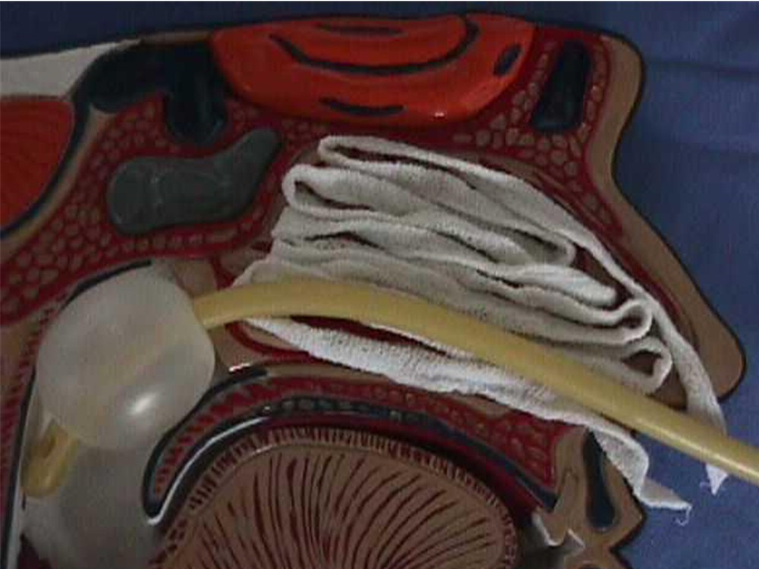
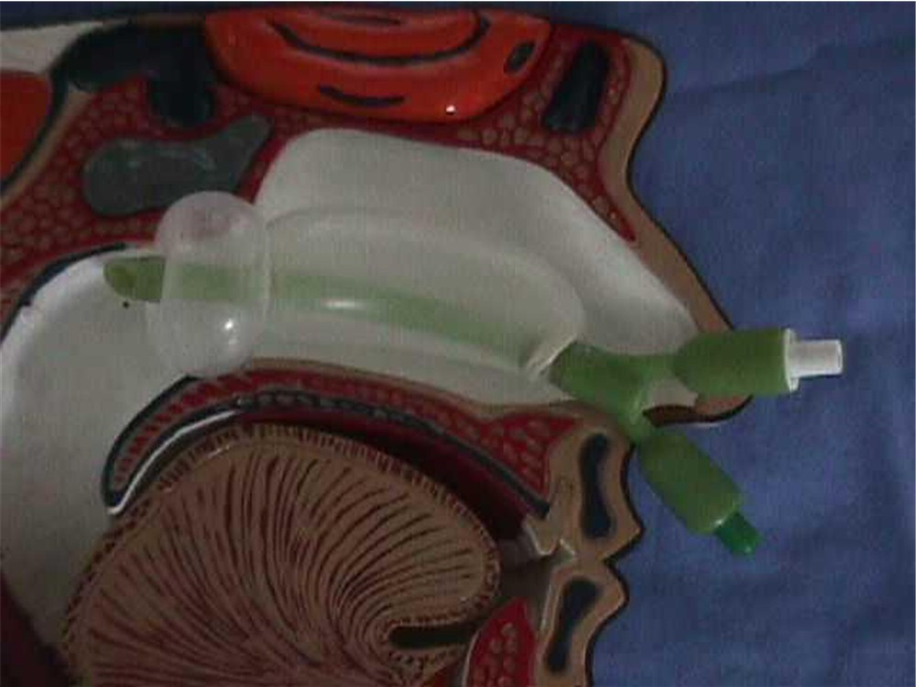

Slide 35
Complications of packing
Sinusitis
hypoxia
Septal perforation
Mucosal pressure necrosis
Alar necrosis
Balloon migration
Aspiration
Vasovagal attacks
TSS

Slide 36
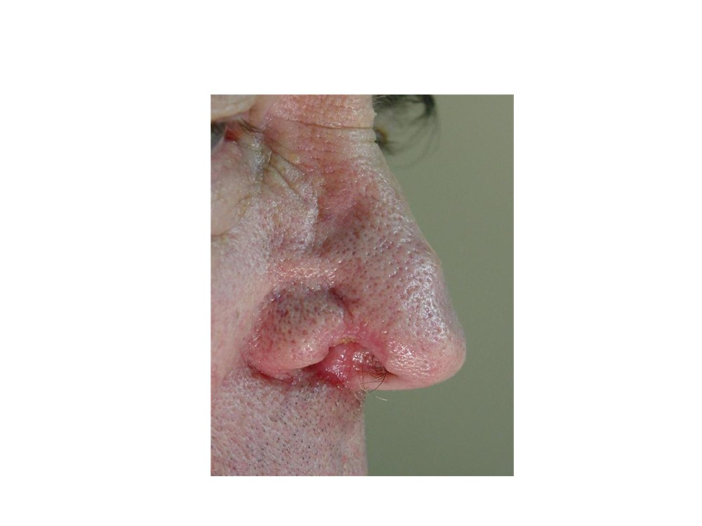
Alar necrosis from posterior pack placement

Slide 37
Posterior pack admission :
Elderly & those with chronic medical illness may need ICU admission.
Continuous cardiorespiratory monitoring
IVF
Oxygen supplment maybe needed
Abx
Analgesia \mild sedation
Blood transfusion & FFP if needed

Slide 38
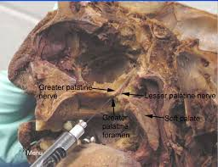
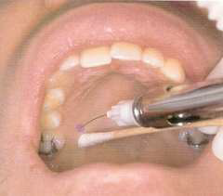
Greater Palatine Injection
Injection into pterygopalatine fossa through greater palatine foramen
Particularly effective for posterior epistaxis (origin of bleeding from SPA)

Slide 39
Surgery/IR
Endoscopic sphenopalatine artery (SPA) ligation
Anterior/posterior ethmoidal artery ligation
Transantral ligation of IMAX
Embolization of the IMAX

Slide 40
Endoscopic Cauterization of Sphenopalatine Artery (SPA)
Newer Method – Endoscopic
Older method – Caldwell-Luc approach
Allows direct cauterization of vessels and is highly effective as a second-line treatment
Low morbidity
Complications are rare
Fast, not technically difficult
Good alternative to embolization
Highly effective – 96-100%

Slide 42
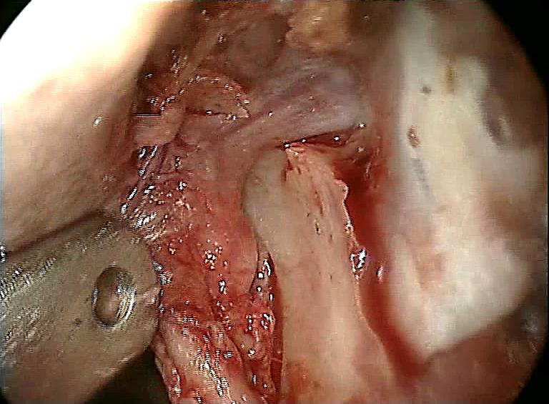

Slide 43
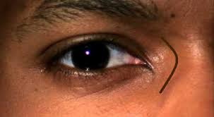
Anterior/Posterior Ethmoidal Artery Ligation
Henry Goodyear performed the first anterior ethmoid artery ligation
Can be performed externally (Lynch incision) or endoscopically
Anterior ethmoid artery is located 24mm from the anterior lacrimal crest,
posterior ethmoid artery is 36mm from anterior lacrimal crest
Complications of procedure include
stroke, blindness, ophthalmoplegia, and
epiphora

Slide 44
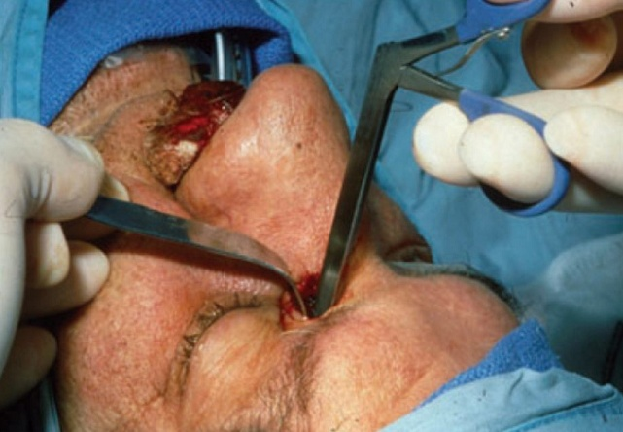

Slide 45
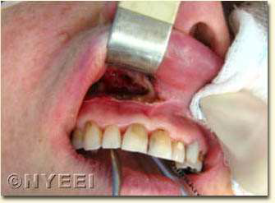
Transantral Ligation of IMAX
Older method (more recently replaced by SPA ligation)
Performed via Caldwell-Luc approach
expose pterygopalatine fossa
Tortuous IMAX is identified and ligated
High failure rate 11%-20%
High complication rate 14%-20%
Facial paresthesia, facial pain, dental pain and numbness, hematoma, ophthalmoplegia, blindness

Slide 46
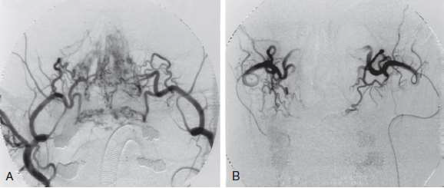
Embolization of IMAX
Alternative to SPA ligation for control of posterior epistaxis
Good for poor surgical candidates
Back-up to unsuccessful surgical ligation
Requires highly skilled interventional radiologist
Complications are high (i.e. stroke, facial pain, numbness)
Higher failure rate than surgical ligation
Less cost effective than surgical ligation

Slide 47
Thank you !

