Slide 1
Parathyroid glands disorders
DR.AHMAD ALTARAWNEH

Slide 3
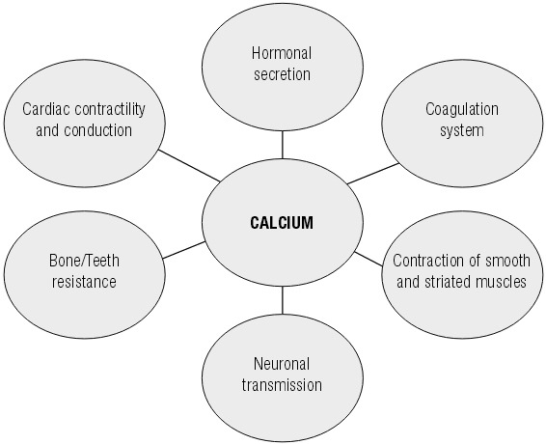
Calcium
Ca concentration is tightly regulated

Slide 4
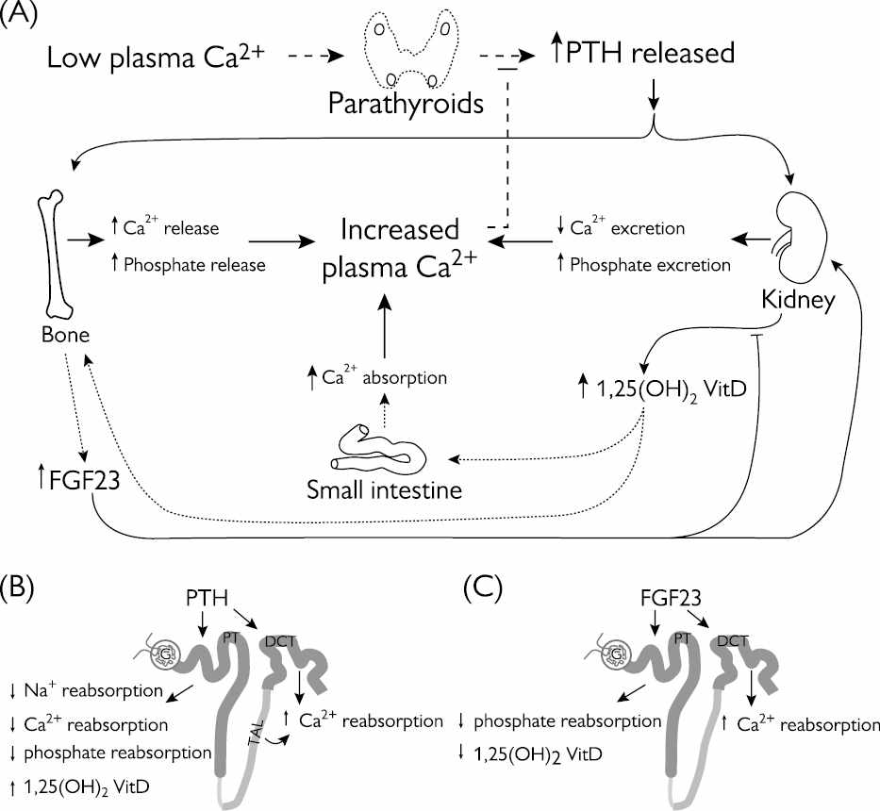

Slide 5
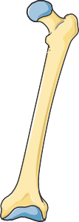
Different forms of calcium
99%
Most of the calcium in the body is stored in the bones as hydroxyapatite
Calcium in the serum:
45% - free ionised form ← physiologically active 45% - bound to proteins (predominantly albumins) 10% - complexed with anions (e.g. citrate, sulfate,
phosphate)
Typically measured in routine blood tests
The total serum calcium concentration is adjusted to reflect any abnormality in
albumin, the major calcium binding protein. The formula to use is:
corrected calcium = measured total serum calcium in mg/dL + 0.8 x (4.0 - patient’s serum albumin concentration in g/dl).

Slide 6
Normal laboratory values
Test | Specimen | Conventional Units | SI Units
Calcium | serum | 8.5-10.3 mg/dL | 2.12-2.57 mmol/L
Ionised calcium | plasma | 4-5.2 mg/dL | 1.0-1.3 mmol/L
Calcium | urine | M < 300 mg/d F < 250 mg/d | M < 7.5 mmol/d F < 6.2 mmol/d
Phosphorus | serum | 2.5-4.5 mg/dL | 0.81-1.45 mmol/L
PTH (intact) | serum | 11-67 pg/mL
M-male, F-female

Slide 7
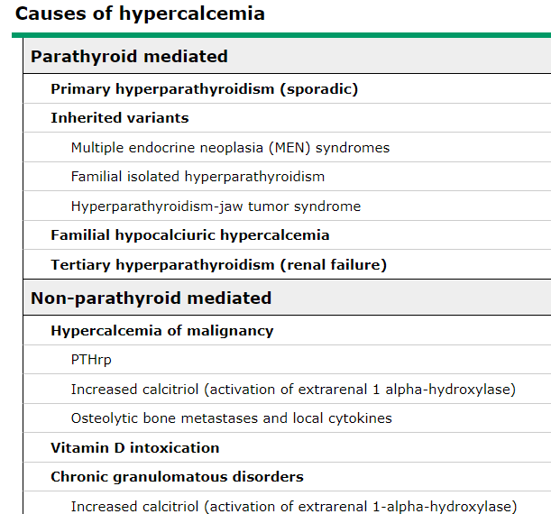
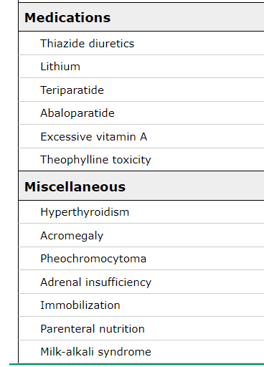

Slide 8
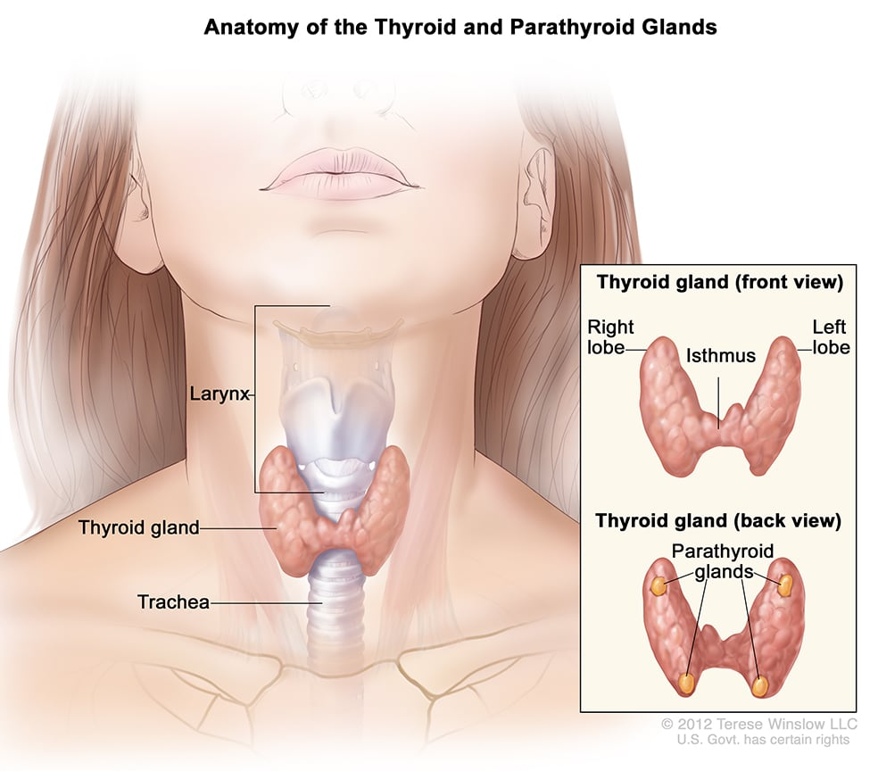
The parathyroid glands are two pairs of glands usually positioned behind the left and right lobes of the thyroid. Each gland is a yellowish-brown flat ovoid that , usually about 6 mm long and 3 to 4 mm wide, and 1 to 2 mm anteroposteriorly.
There are typically four parathyroid glands
.

Slide 9
Major mediators of calcium and phosphate balance
Serum |  | Parathormone (PTH)
Ca_{s} | P_{s}
 |  | increases the release of calcium and phosphate from bones stimulates the formation of active vitamin D in the kidneys (activation of 1 α hydroxylase) reduces calciuria and increases phosphaturia
Vitamin D
 |  | increases the uptake of Ca and P in the gastrointestinal tract
Calcitonin (low physiological importance)
 |  | decreases the uptake of Ca in the gastrointestinal tract increases calciuria reduces bone resorption
FGF 23(Fibroblast Growth Factor 23)
 |  | increases phosphaturia

Slide 10
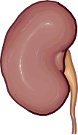
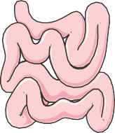
The effect of parathyroid hormone
↓Ca⁺²
+
PTH
-
↑ blood Ca⁺²
↑ osteoblasts activity (PTHr)
↑ number of osteoclasts
↑ release of calcium and phosphate
↑ Ca⁺² reabsorption
↑ phosphate secretion
↑ 1,25(OH)₂D production
↑ Ca⁺² and phosphate absorption (vitamin D)

Slide 11
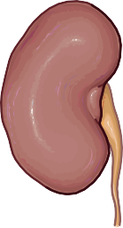
Synthesis and regulation of active vitamin D (calcitriol)
↓ Serum phosphate
↑ Serum
phosphate
+
PTH
+
FGF 23
Vitamin D 25-hydroxylase
Vitamin D 1α-hydroxylase
(-)
+
+
+
Cholecalciferol (Vitamin D3)
25(OH) cholecalciferol (Calcidol)
1,25(OH)₂ cholecalciferol
(Calcitriol) Active vitamin D
7-dehydrocholesterol
+
Ergocalciferol (Vitamin D2)
Dietary sources

Slide 12
Hyperparathyroidism
Primary - PTH secretion is disproportionately high in relation to the serum calcium concentration.
Secondary to kidney failure, severe vitamin D and calcium deficiency. Reversible, after removing the cause of the disorder.
Tertiary - is excessive autonomous secretion of parathyroid hormone after a long period of secondary hyperparathyroidism.

Slide 13
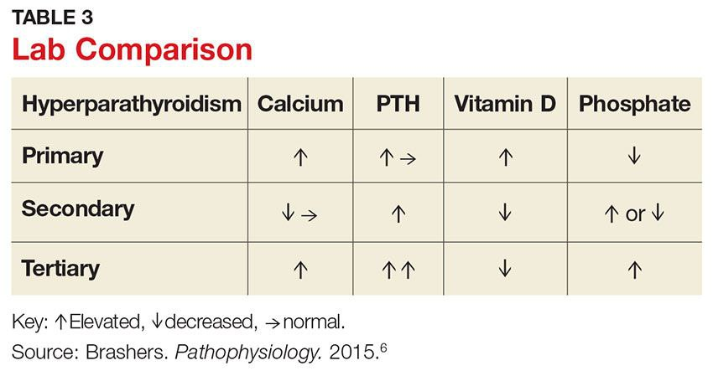

Slide 14
Primary hyperparathyroidism (PHPT (
Primary hyperparathyroidism is characterised by secretion of PTH that is excessively disproportionate to serum calcium levels, resulting from a primary defect of parathyroid cells.
PHPT results from:
one or more adenomas
hyperplasia of all parathyroid glands
parathyroid carcinoma
80-85%
10-15%
fewer than 1%

Slide 15
PHPT - familial hereditary syndromes
Hereditary forms of PHPT account for 5% of cases:
Multiple endocrine neoplasia (MEN(1,2A
Familial non-MEN hyperparathyroidism
Hereditary hyperparathyroidism – jaw tumor
syndrome

Slide 16
Primary hyperparathyroidism – clinical forms
The most common clinical presentation of PHPT is asymptomatic or low symptomatic disease
Atypical occurences include normocalcemic PHPT and parathyroid crisis.

Slide 17
Classical clinical consequences of PHPT
Bone destruction | Hypercalcemia | Hypercalciuria
Osteopenia | Peptic ulcer disease | Urolithiasis
Osteoporosis | Pancreatitis | Nephrocalcinosis
Bone deformities and fractures | Constipation, nausea, vomiting or loss of appetite | Nephrogenic diabetes insipidus
Osteitis fibrosa cystica, brown tumors | Polydipsia and polyuria Bone pain , myalagia
 | Renal failure
 | Cardiovascular features: hypertension, arrhythmia, ventricular hypertrophy, and vascular and valvular calcification
 | Tiring easily or weakness
 | Neuropsychiatric disorders
 | Parathyroid crisis

Slide 18
Normocalcemic primary hyperparathyroidism (a variant of PHPT(
↑PTH
Normal serum total and ionized calcium concentration
The features of PHPT may be present (e.g. low BMD)
All secondary causes for hyperparathyroidism must be ruled out
Normocalcemic PHPT is considered to be an early form of asymptomatic PHPT or represent a unique phenotype of the disease.

Slide 19
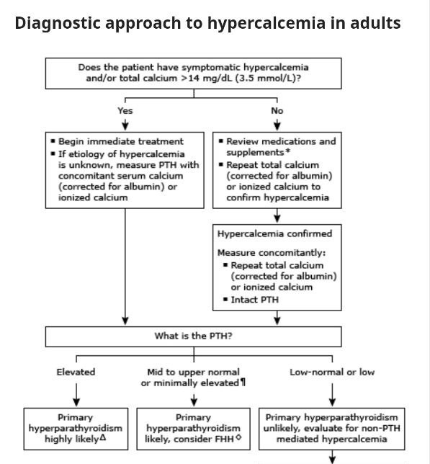

Slide 20
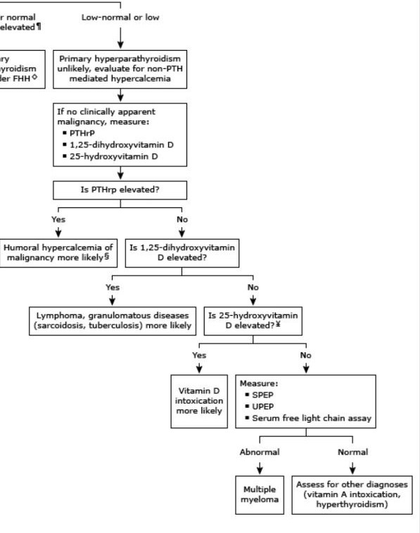

Slide 21
Diagnosis of primary hyperparathyroidism
additional evaluation to determine management
Bone densitometry (DXA( | lumbar spine Hip total or femoral necK radius (distal 1/3 site(
Ultrasound abdominal examination | renal imaging

Slide 22
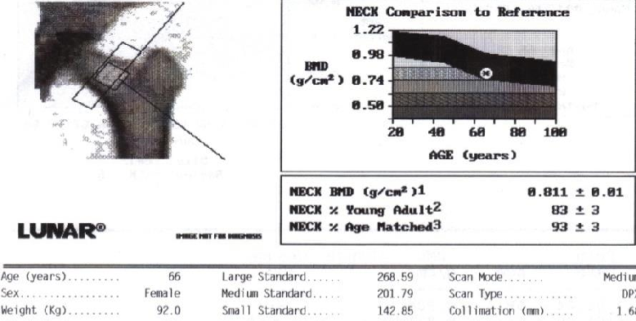
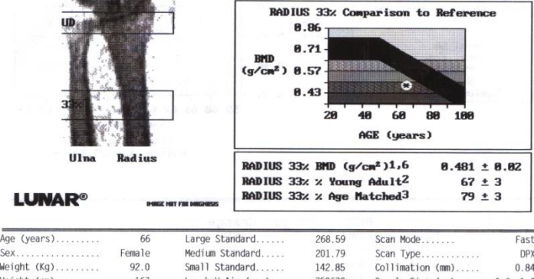
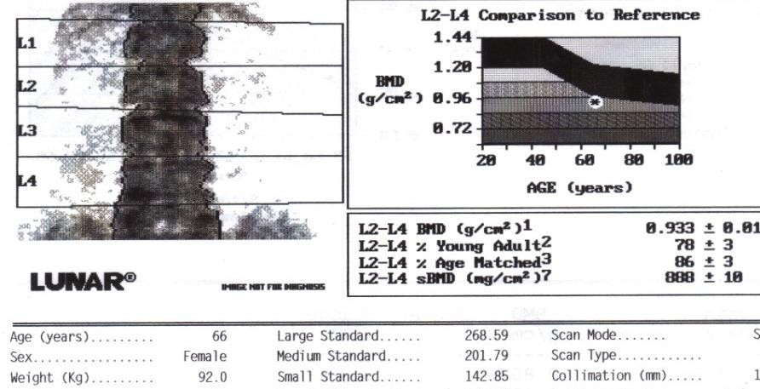
Primary hyperparathyroidism - bone mineral density (DXA(
 | T- score
Femoral neck | -1.41
Lumbar spine | -2.23
Forearm ( 1/3 distal) | -3.26

Slide 23
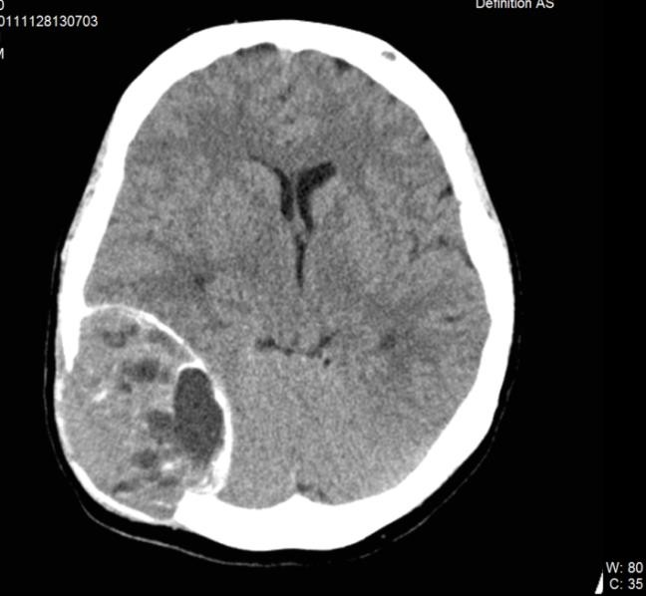
Primary hyperparathyroidism – bone destruction
Brown tumor of the skull of a young woman (CT)

Slide 24
Familial Hypocalciuric Hypercalcemia (FHH(
The reason of FHH is inactivating mutation of the calcium sensing receptor in parathyroid glands.
↑Serum calcium and ↑ N PTH
but
Urine calcium is low less than 100 mg/24H
FHH is a rare, lifelong, benign condition.

Slide 25
Calculation of calcium/creatinine excretion ratio
CaE = [Urine Ca (mmol)/urine Cr (mmol)]
× [(plasma Cr (micromol)/1000)/plasma Ca (mmol)]
= <0.01 in FHH
= >0.02 in PHPT
These numeric parameters are not fully sensitive or specific and genetic

Slide 26
Common causes of secondary hyperparathyroidism
Disorder | Comment
Chronic kidney disease (CKD) GFR below 60 ml/min) | Impaired 1,25(OH)₂D production, hyperphosphatemia
Decreased calcium intake
Calcium malabsorption | Vitamin D deficiency, celiac disease, chronic pancreatitis, post gastrectomy syndrome, bariatric surgery
Renal calcium loos | Renal hypercalciuria
Drugs | Bisphosphonates (inhibiton of bone resorption), anticonvulsants, furosemide, phosphorus

Slide 27
Primary hyperparathyroidism
- differential diagnostics
 | PHPT (Primary hyperpara- thyroidism) | FHH (Familial Hypocalciuric Hypercalcemia) | Secondary hyperparathyroidism |  | Malignancy
 |  |  | Chronic renal failure | Malabsorption, Ca & Vit.D deficiency
PTH | N ↑ | N ↑ | ↑ ↑ ↑ | ↑, N | ↓
Ca_{s} | ↑↑ | ↑ | ↓, N | ↓, N | ↑
^{Ca}u24h | ↑↑ | ↓ | ↓ | ↓ | ↑↑
Phosphate_{s} | ↓ | N | ↑ | ↓, N | ↓, N
BMD (DXA) | ↓ ↓ | N | ↓ | ↓ | ↓, N

Slide 28
Primary hyperparathyroidism - treatment
1. Selective parathyroidectomy
The treatment of choice for symptomatic disease is surgical removal of the
hyperactive parathyroid glands.
Surgery may be also recommended in some asymptomatic or low symptomatic patients.
Parathyroidectomy (PTX) should only be performed by highly experienced surgeons.
2 . Pharmacotheraphy
In many people, the disease may remain mild or asymptomatic for a long period. In these patients, as well as in those after an unsuccessful PTX, who are unwilling to undergo or considered unsuitable for surgery it attempts to apply a symptomatic pharmacotherapy.
So far treatment with calcimimetics or bisphosphonates seems to be the most promising.

Slide 29
Primary hyperparathyroidism - indications for surgery in asymptomatic PHPT
Measurement | Surgery Recommended ª
Serum Calcium | > 1.0 mg/dl (0.25 mmol/L) above normal
Skeletal | Bone Mineral Density by DXA T score < -2.5 SD at lumbar spine, hip (total or femoral neck) or radius (distal 1/3 site)^{b} or presence of fragility fracture Vertebral fracture by X-ray, CT, MRI or VFA
Renal | Creatinine clearance < 60 ml/min 24h urine for calcium > 400 mg/d (>10 mmol/d) and increased stone risk by biochemical stone risk analysis Presence of nephrolithasis or nephrocalcinosis by X-ray, US, or CT
Age | < 50 years
ª Surgery is also indicated in patients for whom medical surveillance is neither desired nor possible. ^{b} the use of Z-scores instead of T scores is recommended in evaluating BMD in premenopausal women and men younger than 50 y
*According to: Guidelines for the Management of Asymptomatic Primary Hyperparathyroidism: Summary Statement from the Fourth International Workshop. Bilezikian et al.,JCEM,2014,99

Slide 30
Localisation studies
Localisation studies should not be used to establish the diagnosis of PHPT or to determine management.
They should be done after a decision for surgery has been made.
.
.

Slide 31
PHPT - localisation tests
The type of imaging | Comments | Sensitivity*
Ultrasonography | Usually a hypoechoic parathyroid adenoma posterior to the thyroid parenchyma with peripheral vascularity seen on colour Doppler. US provides additional anatomic information about the thyroid gland. | up to 80%
Technetium-99m sestamibi scintigraphy | Planar image | 60-90%
SPECT — Sestamibi-single photon emission computed tomography | Is a three-dimensional sestamibi scan. The multidimensional images illustrate the depth of the parathyroid gland or glands in relation to the thyroid. | ~ 90%
SPECT-CT | SPECT and CT fusion. Adds the ability to discriminate parathyroid adenomas from other anatomic landmarks.

Slide 32
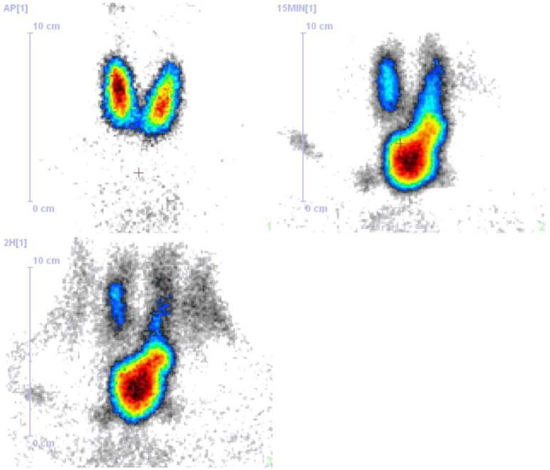
Parathyroid scintigraphy
(99mTc+MIBI and 99mTc)

Slide 33
“The most important preoperative localisation
challenge in PHPT is to locate the parathyroid surgeon!”
John Doppman, 1975

Slide 34
PHPT - postoperative hypocalcemia
Hypocalcemia | The cause of hypocalcemia
Transient and mild | suppression of the remaining normal parathyroid tissue
Prolonged and accompanied by hypo- or euphosphatemia and high PTH levels )hungry bone syndrome( | rapid deposition of serum calcium into demineralised bone
Accompanied by hyperphosphatemia and low PTH levels | hypoparathyroidism

Slide 35
Medical Management of Primary Hyperparathyroidism
Pharmacotherapy may be used in mild or asymptomatic PHPT and in in patients after an unsuccessful parathyroidectomy (PTX), or in those who are unwilling to undergo or considered unsuitable for surgery.
Pharmacological treatment should be reserved for those patients in whom it is desirable to lower the serum calcium or increase BMD.

Slide 36
Medical Management of Primary Hyperparathyroidism
Medicine | Effect
Calcimimetics (cinacalcet) | Decrease calcemia and calciuria Reduce, but not normalise PTH Do not affect BMD
Bisphosphonates (alendronate) | Improve BMD Do not alter serum calcium
Denosumab (?) | RANKL antagonist - decrases bone resorption
Patients with low serum 25-hydroxyvitamin D should be repeatedely administered with doses of vitamin D that bring its serum levels to 20 ng/ml at a minimum (with caution, so as not to aggravate hypercalcemia).

Slide 37
Treatment of severe hypercalcemia (parathyroid crisis(
Hydration with normal saline
Bisphosphonates iv. (pamidronate, zoledronic acid)
Calcitonin sc., im.

Slide 38
Hypoparathyroidism
Hypoparathyroidism is the state of decreased secretion or activity of parathyroid hormone (PTH).
This leads to decreased blood levels of calcium (hypocalcemia) and increased levels of blood phosphorus (hyperphosphatemia).

Slide 39
differential diagnosis(Hypocalcemia (etiologies by mechanism
Hypoparathyroidism | Vitamin D deficiency | Low dietary intake of Ca ⁺² | Miscellaneous mechanisms
PTH ↓, N | PTH ↑
Thyroidectomy or other neck surgery | Low calcitriol: ↓ intake of dietary Vit. D Inadequate sunlight exposure Malabsorption syndrome |  | Osteoblastic bone metastases
I 131 therapy for G-B disease or thyroid cancer |  |  | Pancreatitis
Autoimmune hypoparathyroidism | ↓ conversion of 25OHD to 1,25(OH)₂D Renal failure Hyperphosphatemia Vitamin D dependent rickets, type 1
 |  |  | Hungry bones syndrome
Infiltration of parathyroids |  |  | Hyperphosphatemia
Hypomagnesemia | Calcitriol resistance Vitamin D resistant rickets |  | Multiple transfusions
Congenital /genetic
 |  |  | Acute respiratory alkalosis
PTH resistance (pseudo hypoparathyroidism) PTH ↑) | ↑ inactivation of vit. D (e.g. carbamazepine, phenytoin )

Slide 40
Causes of deficient PTH secretion or activity in hypoparathyroid disease states
1. Acquired deficiency of parathyroid hormone secretion (> 99% of all cases):
Surgical removal of the parathyroid glands (usually unintentionally)
Radiation therapy to the neck, infiltration of parathyroids
Hypomagnesemia
Calcimimetics
Autoimmune:
isolated hypoparathyroidism
APS 1 (autoimmune polyendocrine syndrome caused by mutations of the autoimmune regulator (AIRE) gene) → antibodies anty CaSR
Resistance to parathyroid hormone (pseudo-hypoparathyroidism), (extremely rare). Inability of the kidneys and bones to respond to the PTH being produced by normal parathyroids.

Slide 41
Diagnostics of hypoparathyroidism
Blood tests:
↓ calcium levels
↑ phosphorus levels
↓ PTH levels (but normal or elevated in pseudohypoparathyroidism)
↔ ALP
↔ magnesium
↔ creatinine
↓ 1,25(OH)₂D
24 urine low calcium excretion
ECG: prolonged QT interval

Slide 43
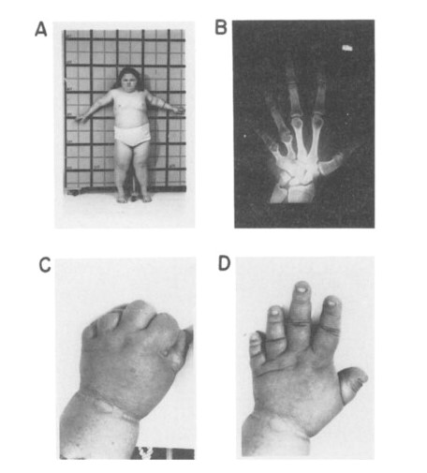
pseudo-hypoparathyroidism

Slide 44
Hypoparathyroidism – symptoms
The major clinical manifestations of hypoparathyroidism are referable to hypocalcemia and are related to the severity and chronicity of the hypocalcemia.
Subjects who develop severe hypoparathyroidism quickly (for example, after neck surgery) can feel tired, irritable, anxious or depressed and demonstrate spontaneous or latent tetany.

Slide 45
Clinical features
↑neuromuscular excitability. In order of ↑ severity, these include:
Tingling—especially of fingers, toes, or lips.
Numbness—especially of fingers, toes, or lips.
Cramps.
Carpopedal spasm.
Stridor due to laryngospasm.
Seizures.
The symptoms of hypocalcaemia tend to reflect the severity and rapidity of onset of the metabolic abnormality.
ECG : LONG QT

Slide 46
Signs
Chvostek’s sign is elicited by tapping the facial nerve in front of the ear.
A +ve result is indicated by twitching of the corner of the mouth. Slight
twitching is seen in up to 15% of normal ♀ , but more major
involvement of the facial muscles is indicative of hypocalcaemia or
hypomagnesaemia.
Trousseau’s sign is produced by occlusion of the blood supply to the
arm by inflation of a sphygmomanometer cuff above the arterial
pressure for 3min. If +ve, there is carpopedal spasm, which may be
accompanied by painful paraesthesiae.

Slide 47
The methods of treatment of hypoparathyroidism:
Calcium carbonate 1-4 g/d orally, during and between meals
Activated vitamin D analogues e.g. alfacalcidolum 1-3 µg/d
Vitamin D supplementation 400–800 IU/d to patients treated with
activated vitamin D analogues
Magnesium supplementation in case of deficiency
Treatment of acute severe hypocalcaemia
Iv calcium

Slide 48
CASE 1
46 yrs old female pt , present to the clinic as she incidently found that she has high serum calcium 11.6 mg/dl (8.5-10.5) she reports no symptoms
What is your approach to this pt ??

Slide 49
CASE 1
Albumin 4.2 g/dl
Pth 55 pg/ml (10-65) , kft nl , vitamin d3 nl
Deffrential ????
Manegemnt ???

Slide 50
CASE 2
A 68-year-old female with a background of stage four chronic kidney disease (CKD) presents with the following blood results to the nephrology clinic. She has had progressive CKD over many years
PTH 19.1 pmol/l (1.05 - 6.83)
Adjusted calcium 2.84 mmol/l (2.1-2.6)
What endocrine abnormality is she most likely to have given her background?
Tertiary hyperparathyroidism
Secondary hyperparathyroidism
Multiple endocrine neoplasia 1 (MEN1)
Pseudohypoparathyroidism
Primary hyperparathyroidism

Slide 51
CASE 3
37 yrs old m pt , known to have crohns dx , he underwent ileo-cecal resection one month ago
He presents to ER complaining of numbness , perioral parasthesia , muscle twitching
Labs show hypocalcemia ca 6.5 pth 20
He was given multiple calcium infusions , which fail to releive sx and to raise calcium to desired level
What is your explanation

Slide 52
Case 4
A 60-year-old man who is known to have lung cancer comes for review. For the past three weeks he has lost his appetite, has been feeling sick and generally feels tired. On examination he appears to be
mildly dehydrated. You order some blood tests:
Calcium 11.5 mg/dl
Albumin 40 g/l
Glucose (random) 6.7 mmol/l
Creatinine 115 μmol/l
Which one of his existing medications is most likely to be contributing to his presentation?
Amlodipine
Simvastatin
Bendroflumethiazide
Aspirin
Lisinopril

