Slide 1
Small and Large Intestinal pathology, part 3
Dr, Sura Al Rawabdeh, MD
April 13 2022

Slide 2
COLONIC POLYPS AND NEOPLASTIC DISEASE
◆ Colon is most common site for polyps:
Flat
◆ Sessile polyp: no stalk
◆ Pedunculated polyp: stalk.

Slide 4
COLONIC POLYPS
◆ Non neoplastic polyps:
1. Inflammatory,
2. Hamartomatous
3. Hyperplastic.
◆ Neoplastic polyps: adenoma.

Slide 5
Hyperplastic Polyps
◆ Common
◆ 5th-6th decade.
◆ Decreased epithelial turnover and delayed shedding of surface epithelium >>> pileup of goblet cells & epithelial overcrowding
◆ No malignant potential

Slide 6
Hyperplastic polyp
◆ Left colon
◆ Rectosigmoid.
◆ Small < 5 mm
◆ Multiple
◆ Crowding of goblet & absorptive cells.
◆ Serrated surface: hallmark of these lesions

Slide 7
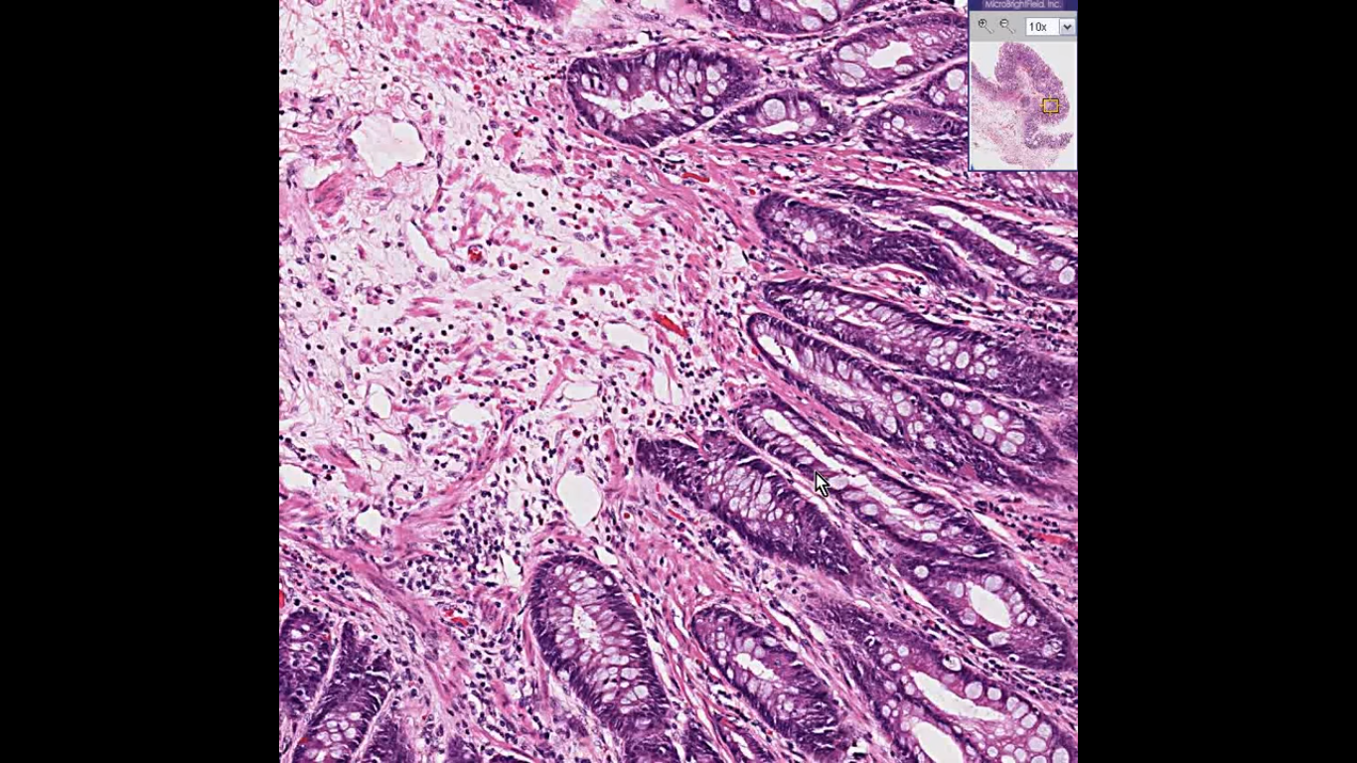

Slide 8
Inflammatory Polyps
◆ Solitary rectal ulcer syndrome.
◆ Recurrent abrasion and ulceration of the overlying rectal mucosa.
◆ Chronic cycles of injury and healing give a polypoid mass of inflamed and reactive mucosal tissue.

Slide 10
Hamartomatous Polyps
◆ Sporadic or syndromatic.
◆ Disorganized, tumor-like growth composed of mature cell types normally present at that site.
◆ Juvenile Polyps
◆ Peutz-Jeghers Syndrome

Slide 11
Juvenile Polyps
◆ Most common hamartomatous polyp
◆ Sporadic are solitary.
◆ Children younger than 5 years of age
◆ Rectum.
◆ Syndromic are multiple.
◆ 3 to as many as 100. Mean age 5 years
◆ Autosomal dominant syndrome of juvenile polyposis
◆ Transforming growth factor-β (TGF-β) mutation.
◆ Increased risk for colonic adenocarcinoma.

Slide 12
Juvenile Polyps
◆ Pedunculated
◆ Reddish lesions
◆ Cystic spaces on cut sections
◆ Dilated glands filled with mucin and inflammatory debris.
◆ Granulation tissue on surface.

Slide 15
Peutz-Jeghers Syndrome
◆ AD
◆ Mean age: 10-15 years.
◆ Multiple gastrointestinal hamartomatous polyps
◆ Most common in the small intestine.
◆ Mucocutaneous hyperpigmentation
◆ Increased risk for several malignancies: colon, pancreas, breast, lung,
ovaries, uterus, and testes,
◆ LKB1/STK11 gene mutation.

Slide 18
Peutz-Jeghers polyp
◆ Large.
◆ Arborizing network of connective tissue, smooth muscle, lamina propria
◆ Glands lined by normal-appearing intestinal epithelium
◆ Christmas tree pattern.

Slide 19
Adenomas
◆ Most common and clinically important
◆ Increase with age.
◆ Definition: presence of epithelial dysplasia (low or high).
◆ Precursor for majority of colorectal adenocarcinomas
◆ Most adenomas DO NOT progress to carcinoma.
◆ USA: screening colonoscopy starts at 50 yrs.
◆ Earlier screening with family history.
◆ Western diets and lifestyles increase risk.

Slide 20
Pedunculated or sessile

Slide 21
Colon adenoma
◆ Hallmark: epithelial dysplasia
◆ Dysplasia: nuclear hyperchromasia, elongation, stratification, high N/C ratio.
◆ Size : most important correlate with risk for malignancy
◆ High-grade dysplasia is the second factor

Slide 22
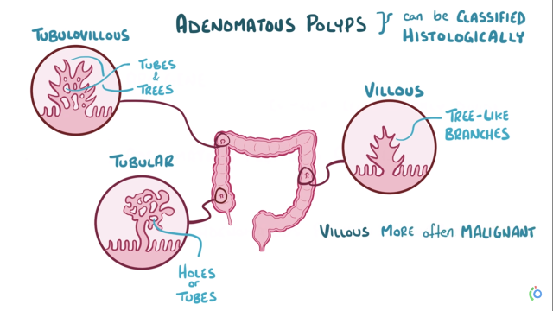

Slide 23
Tubular adenoma

Slide 25
Villous adenoma.
◆ Long slender villi.
◆ More frequent invasive foci
◆ Architecture:
◆ Tubular.
◆ Tubulovillous.
◆ Villous.
Notes:
haracterized by more than 75% villous features, where villous refers to finger-like or leaf-like epithelial projections.

Slide 26
Villous adenoma

Slide 27
Familial Syndromes
◆ Syndromes associated with colonic polyps and increased rates of colon cancer
◆ Genetic basis.
◆ Familial Adenomatous Polyps (FAP)
◆ Hereditary Nonpolyposis Colorectal Cancer (HNPCC)

Slide 28
Familial adenomatous polyposis (FAP)
◆ Autosomal dominant.
◆ Numerous colorectal adenomas: teenage years.
◆ Mutation in APC gene.
◆ At least 100 polyps are necessary for a diagnosis of classic FAP.
◆ Morphologically similar to sporadic adenomas
◆ 100% of patients develop colorectal carcinoma, IF UNTREATED, often before age of 30.
◆ Standard therapy: prophylactic colectomy before 20 Year of age.
◆ Risk for extraintestinal manifestations,

Slide 30
◆ Variants of FAP: Gardner syndrome and Turcot syndrome.
◆ Gardner syndrome: intestinal polyps + osteomas (mandible, skull, and long bones); epidermal cysts; desmoid and thyroid tumors; and dental abnormalities.
◆ Turcot syndrome: intestinal adenomas and CNS tumors (medulloblastomas
>> glioblastomas )

Slide 33
Hereditary Nonpolyposis Colorectal Cancer (HNPCC, Lynch syndrome)
◆ Clustering of tumors: Colorectum, endometrium, stomach, ovary, ureters, brain, small bowel, hepatobiliary tract, and skin
◆ Colon cancer at younger age than sporadic cancers
◆ Right colon with excessive mucin production .
◆ Adenomas are present, BUT POLYPOSIS IS NOT.
◆ Inherited germ line mutations in DNA mismatch repair genes.
◆ Accumulation of mutations in microsatellite DNA (short repeating sequences)
◆ Resulting in microsatellite instability
◆ Majority of cases involve either MSH2 or MLH1.

Slide 34
Cecal polyps in HNPCC.

Slide 35
Colonic Adenocarcinoma
◆ Most common malignancy of the gastrointestinal tract
◆ Small intestine is uncommonly involved by neoplasia.
◆ Peak: 60 to 70 years
◆ 20% under 50 years.
◆ Low intake of vegetable fibers and high intake of carbohydrates and fat.
◆ Aspirin or other NSAIDs have a protective effect.
◆ Cyclooxygenase-2 (COX-2) promotes epithelial proliferation.

Slide 37
Pathogenesis
◆ Sporadic >>>> familial.
◆ Two pathways:
◆ APC/β-catenin pathway >> increased WNT signaling.
◆ Microsatellite instability pathway >> defects in DNA mismatch repair.
◆ Stepwise accumulation of multiple mutations.

Slide 38
The APC/β-catenin pathway: chromosomal instability
◆ Classic adenoma carcinoma sequence.
◆ 80% of sporadic colon tumors
◆ Mutation of the APC tumor suppressor gene: EARLY EVENT
◆ APC is a key negative regulator of β-catenin, a component of the WNT signaling pathway.
◆ Both copies of APC should be inactivated for adenoma to develop (1st and 2nd hits).

Slide 39
◆ Loss of APC >>> accumulation of B-catenin >> enters nucleus >> MYC and cyclin-D1 transcription >> promote proliferation.
◆ Additional mutations >> activation of KRAS (LATE EVENT) >> inhibits
apoptosis.
◆ SMAD2 and SMAD4 mutations (tumor suppressor genes.)
◆ TP53 is mutated in 70% -80% of colon cancers (LATE EVENT IN INVASIVE)
◆ TP53 inactivation mutation
◆ Expression of telomerase also increases as the tumor advances.

Slide 41
The microsatellite instability pathway
◆ DNA mismatch repair deficiency
◆ Loss of mismatch repair genes
◆ Mutations accumulate in microsatellite repeats
◆ Microsatellite instability
◆ Silent if microsatellites located in noncoding regions
◆ Uncontrolled cell growth if located in coding or promoter regions of genes involved in cell growth and apoptosis (TGF-B and BAX genes)

Slide 44
MORPHOLOGY
◆ Proximal colon tumors: polypoid, exophytic masses
◆ Proximal colon: rarely cause obstruction.
◆ Distal colon: annular lesions “napkin ring” constrictions & narrowing
◆ Tall columnar cells of dysplastic epithelium forming GLANDS with strong desmoplastic response.
◆ Necrotic debris are typical.
◆ Some tumors give abundant mucin.
◆ Some form signet ring cells.

Slide 45
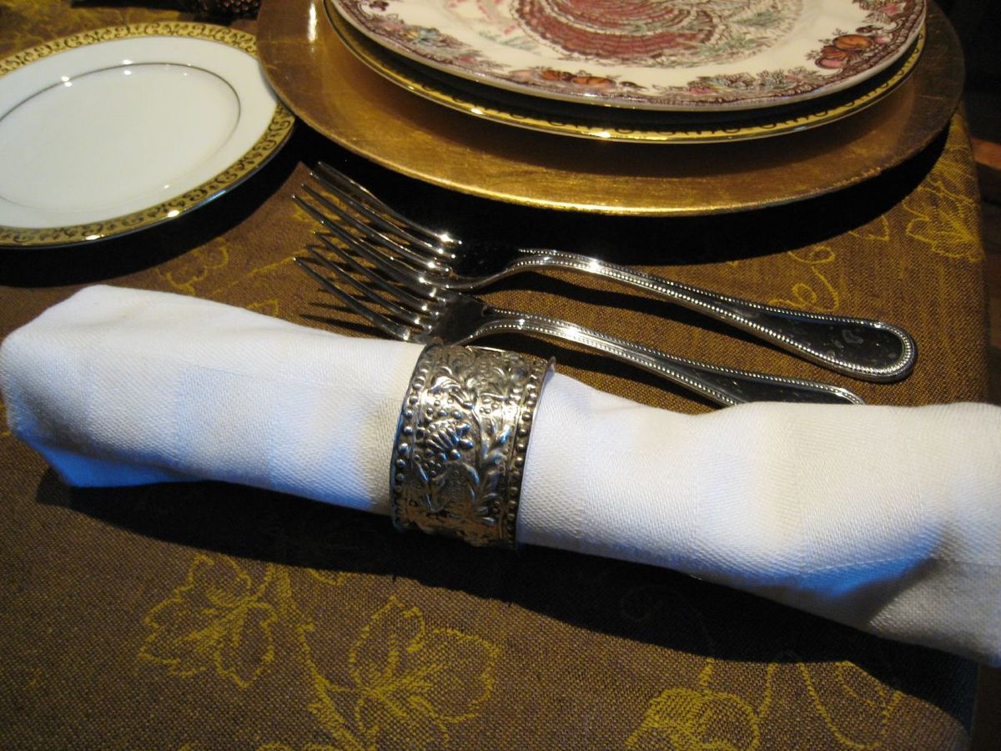
Rectosigmoid adenocarcinoma, napkin ring

Slide 46
Exophytic adenocarcinoma

Slide 47
Adenocarcinoma with necrosis

Slide 48
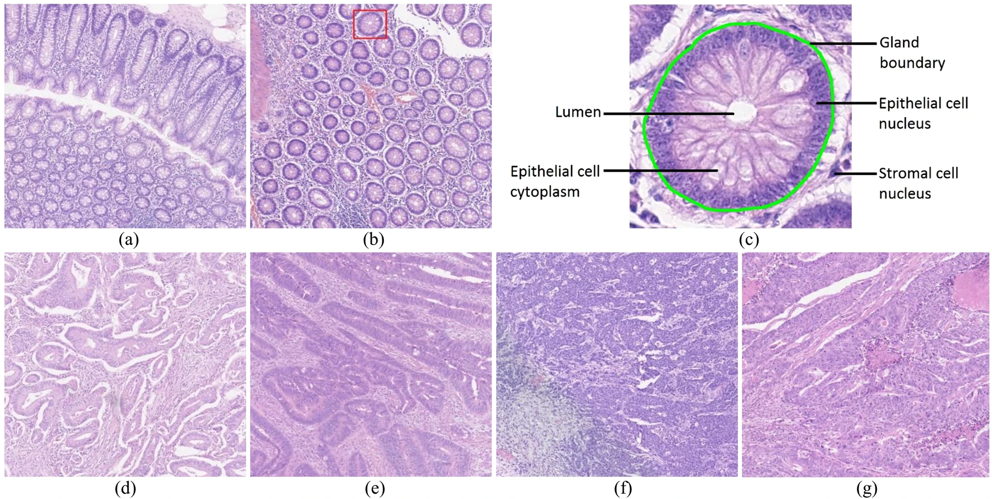

Slide 49
Clinical Features
◆ Endoscopic screening >> cancer prevention
◆ Early cancer is asymptomatic !!!!!!!!
◆ Cecal and right side cancers: Fatigue and weakness (iron deficiency anemia)
◆ Iron-deficiency anemia in an older male or postmenopausal female is gastrointestinal cancer until proven otherwise.
◆ Left sided carcinomas: occult bleeding, changes in bowel habits, cramping
left lower-quadrant discomfort.

Slide 51
◆ Poor differentiation and mucinous histology >> poor prognosis
◆ Most important two prognostic factors are
◆ Depth of invasion
◆ Lymph node metastasis.
◆ Distant metastases (lung and liver) can be resected.

Slide 52
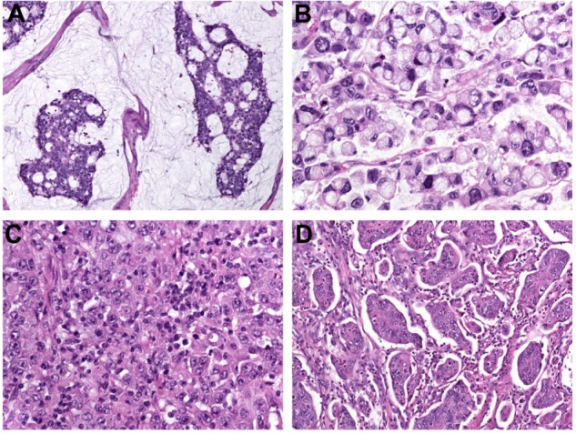

Slide 53
Liver metastasis.

Slide 55
Appendix
◆ Normal true diverticulum of the cecum
◆ ACUTE APPENDICITIS
◆ TUMORS OF THE APPENDIX

Slide 56
ACUTE APPENDICITIS
◆ Most common in adolescents and young adults.
◆ May occur in any age.
◆ Difficult to confirm preoperatively
◆ DDx:
◆ Mesenteric lymphadenitis,
◆ Acute salpingitis,
◆ Ectopic pregnancy,
◆ Mittelschmerz (pain associated with ovulation),
◆ Meckel diverticulitis.

Slide 57
◆ Luminal obstruction in 50-80% of cases >> increased luminal pressure >> impaired venous drainage >> ischemic injury & stasis associated bacterial proliferation >>> inflammatory response rich in neutrophils & edema.
◆ Obstruction by fecalith (A fecalith is a stone made of feces), less commonly : gallstone, tumor, worms….
◆ Diagnosis requires neutrophilic infiltration of the muscularis propria
◆ Acute suppurative appendicitis >> more severe >> focal abscess formation.
◆ Acute gangrenous appendicitis >> necrosis and ulceration.

Slide 58
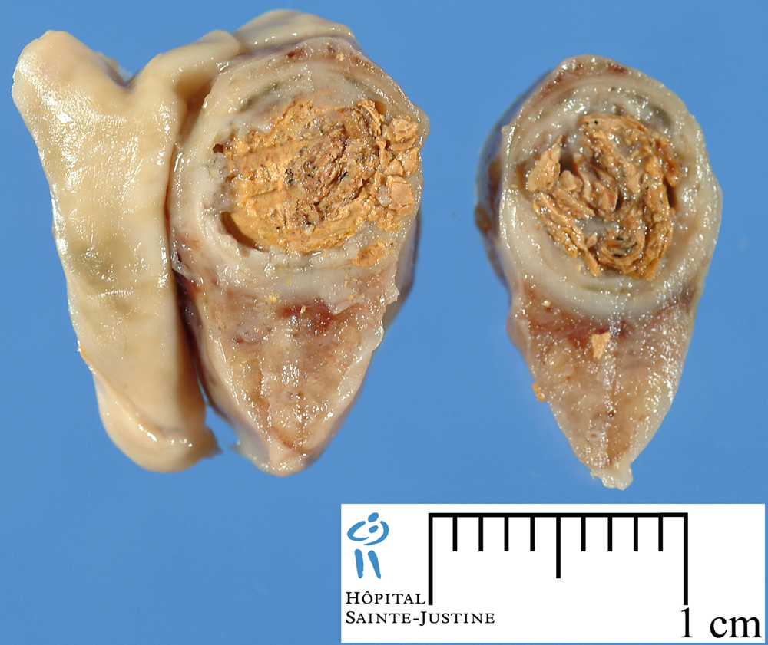

Slide 59
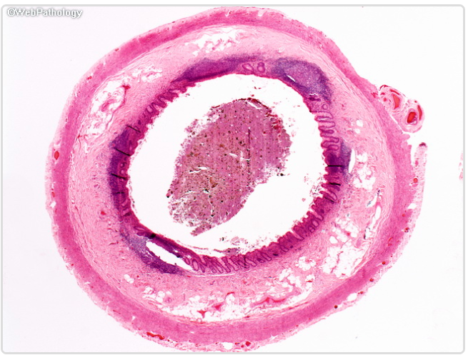
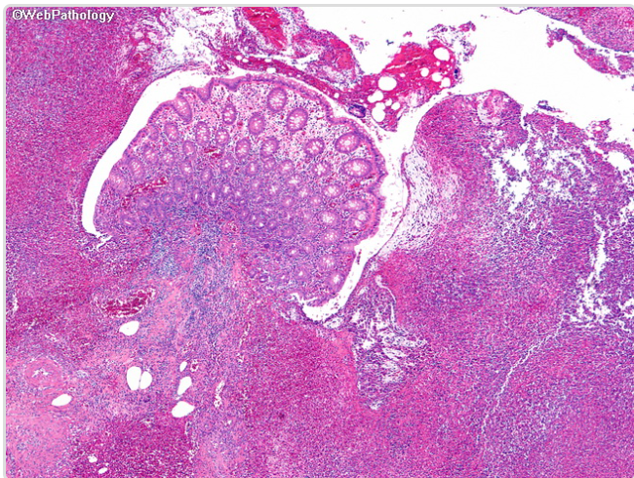

Slide 60
Clinical Features
◆ Early acute appendicitis: periumbilical pain
◆ Later: pain localizes to the right lower quadrant,
◆ Nausea, vomiting, low-grade fever, mildly leukocytosis.
◆ A classic physical finding is McBurney’s sign (McBurney’s point).
◆ Signs and symptoms are often absent, creating difficulty in clinical diagnosis.

Slide 61
TUMORS OF THE APPENDIX
◆ The most common tumor: carcinoid (neuroendocrine tumor)
◆ Incidentally found during surgery or on examination of a resected appendix
◆ Distal tip of the appendix
◆ Nodal metastases & distant spread are rare.

