Slide 1
Lower Limb Fractures
Suhaib Moseley, MD
Mutah university
2022

Slide 2
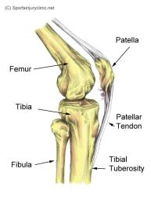
Patella

Slide 3
Mechanism of injury
Direct impact injury occurs from fall or dashboard injury
causes failure in compression.
Indirect eccentric contraction occurs from rapid knee flexion against contracted quads muscle causes failure in tension

Slide 5
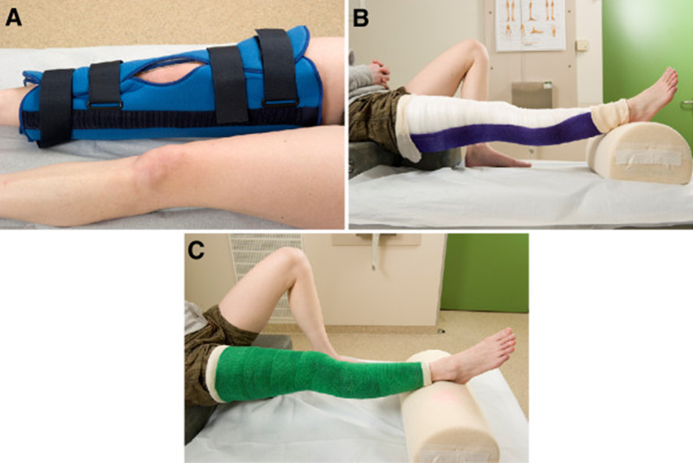
Management
Intact extensor mechanism (patient able to perform straight leg raise)
Non-displaced or minimally displaced fractures

Slide 6
Management

Slide 7
Complications
Loss Range of motion ( most common )
Loss of reduction
Infection
Patellofemoral arthritis
Hardware removal

Slide 8
Proximal Tibia fracture

Slide 10
CT scan

Slide 11
Management

Slide 12
Tibial shaft fracture
Since approximately one third of the tibia lies directly beneath the skin, open fractures are common compared to other long bones.
These open fractures are most commonly caused by high velocity trauma (e.g. motor vehicle collisions), while closed fractures most commonly occur from sports injuries or falls.

Slide 14
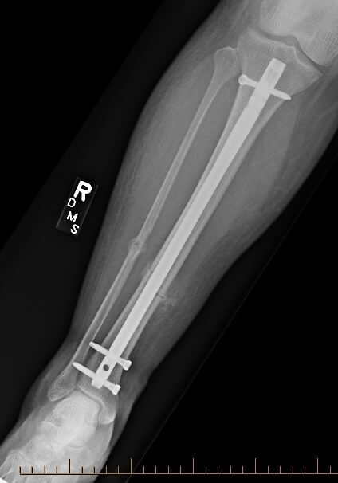
Mangement

Slide 15
Ankle Fracture

Slide 17
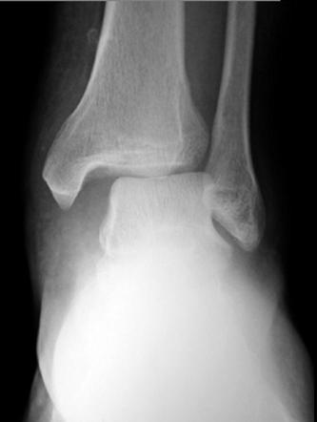

Slide 18
Injury patterns
Isolated medial malleolus fracture.
Isolated lateral malleolus fracture.
bimalleolar and bimalleolar-equivalent fractures
Posterior malleolus fractures
Trimalleolar fracture

Slide 20
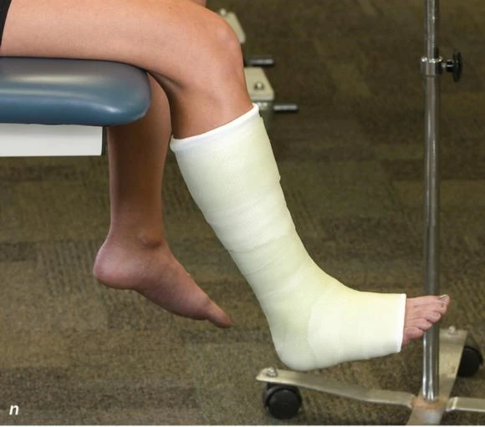
Nonoperative
Isolated nondisplaced medial malleolus fracture or tip avulsions
Isolated lateral malleolus fracture with < 3mm displacement and no talar shift
Bimalleolar fracture if elderly or unable to undergo surgical intervention
Posterior malleolar fracture with < 25% joint involvement or < 2mm step-off

Slide 21
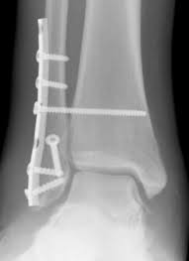
Open reduction internal fixation
Any talar displacement
Displaced isolated medial malleolar fracture
Displaced isolated lateral malleolar fracture
Bimalleolar fracture and bimalleolar-equivalent fracture
Posterior malleolar fracture with > 25% or > 2mm step-off
Open fractures
Malleolar nonunions

Slide 22
Complications
Soft tissue complications
Infection
Mal union
Non union
Secondary post traumatic arthritis

Slide 23
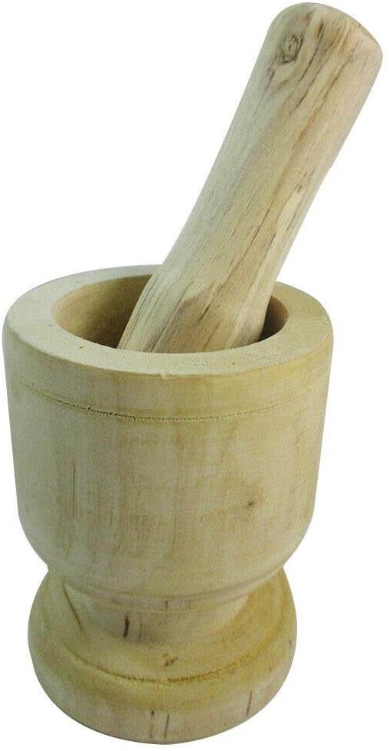
Pilon fracture Tibial Plafond Fracture

Slide 25
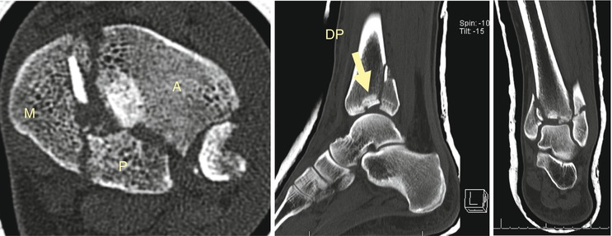
CT scan
Articular involvement
Surgical planning

Slide 26
Ruedi and Allgower Classification

Slide 27
Extra-articular (25%)
Intra-articular (75%)
Sanders classification
Based on the number of articular fragments seen on the coronal CT image at the widest point of the posterior facet

Slide 28
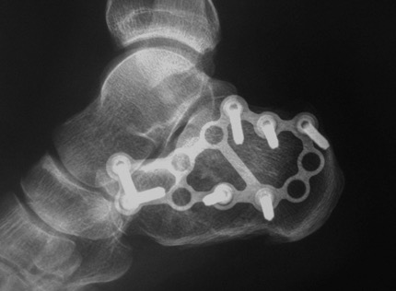
Management
Non operative
Operative

Slide 29
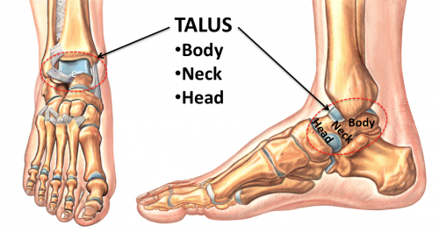
Talus fracture

Slide 30
Talar body fractures
account for 13-23% of talus fractures
Lateral process fractures
account for 10.4% of talus fractures
Talar head fracture
least common talus fracture

Slide 31
Nonoperative
Non displaced < 2mm
SLC for 6 weeks
Operative

Slide 32
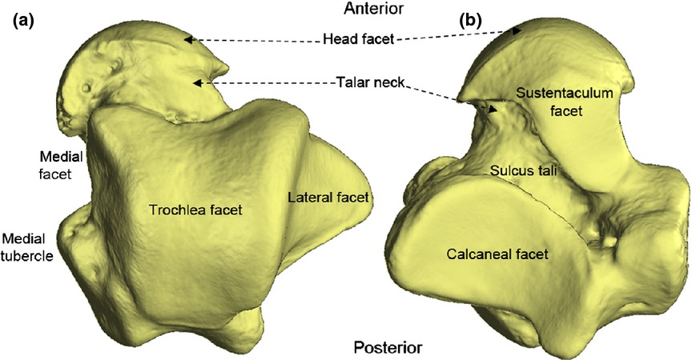
Talar neck fracture
Most common fracture of talus ( 50%)
Mechanism
High-energy injury forced dorsiflexion with axial load

Slide 33
Hawkins Classification

Slide 34
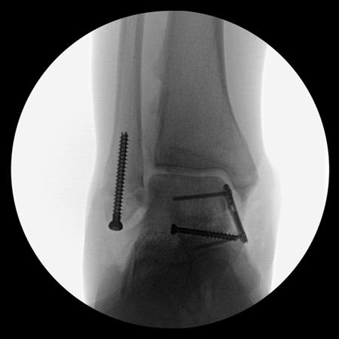
Management
Non operative; short leg cast for 8-12 weeks (NWB for first 6 weeks)
Hawkins type 1
Operative

Slide 35
Cimplications
AVN
Talonavicular arthritis
Chronic pain from symptomatic nonunion
Subtalar arthritis
Malunion and Non union

Slide 36
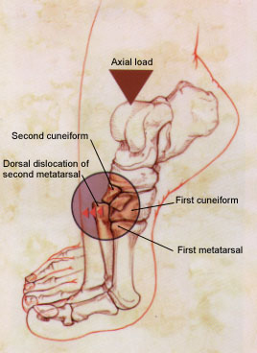
Lisfranc Fracture

Slide 37
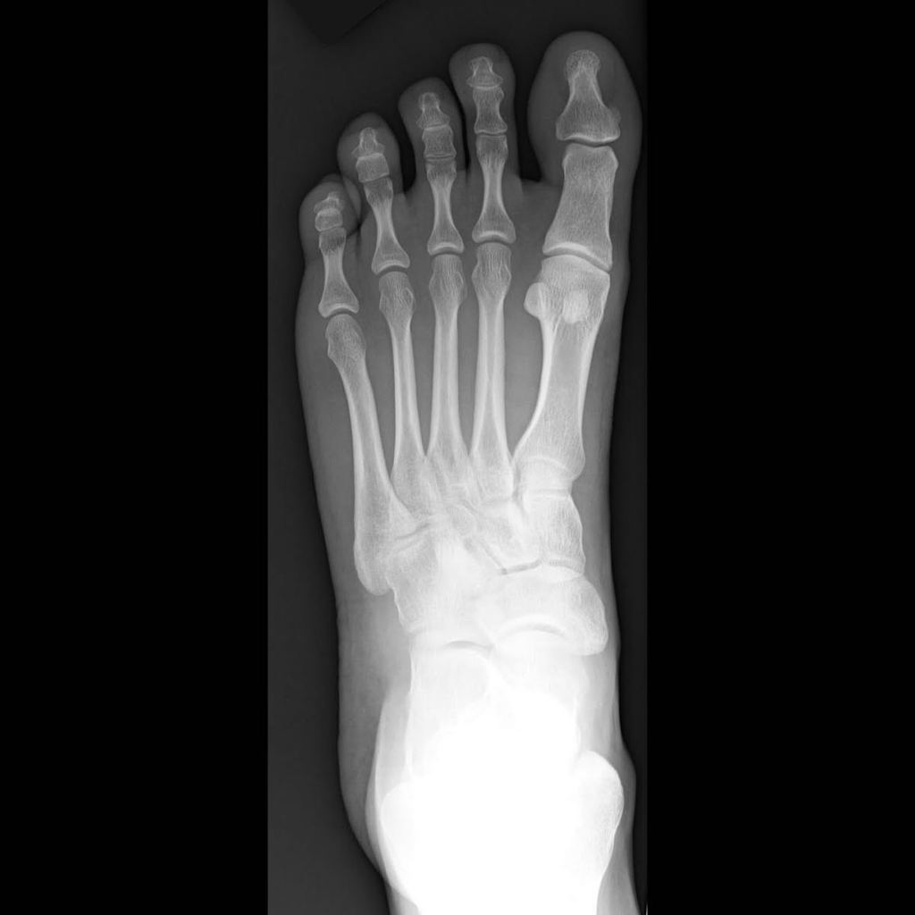

Slide 38
Nonoperative; cast immobilization for 8 weeks
No displacement on weight-bearing and stress radiographs and no evidence of bony injury on CT (usually dorsal sprains)
Nnonambulatory patients
Presence of serious vascular disease
Severe peripheral neuropathy
Operative

Slide 39
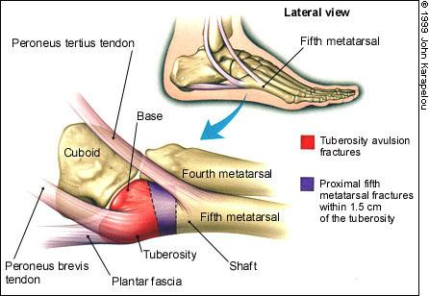
Metatarsal fracture

Slide 40
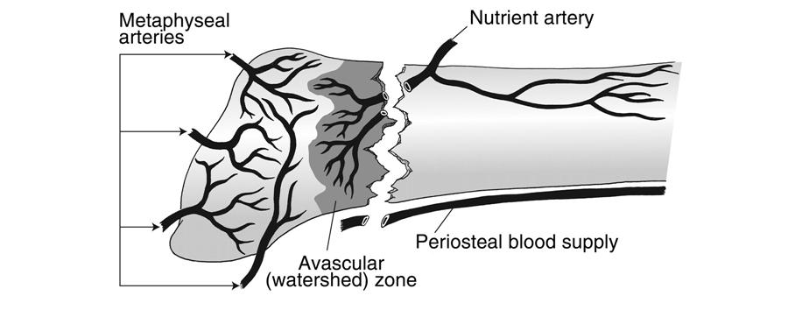
Fifth metatarsal bone fracture

Slide 41
Metatarsal Fractures

Slide 42
Management
Metatarsal fractures are among the most common injuries of the foot
Goals of treatment include:
Maintenance of transverse and longitudinal arches of forefoot
Restore alignment to allow for normal force transmission across metatarsal heads

Slide 43
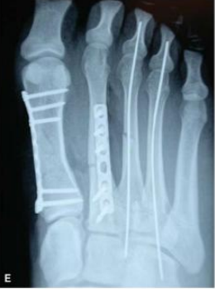
Non operative
Operative
Open fractures
First metatarsal ; any displacement(no intermetatarsal ligament support and 30-50% of weight bearing with gait)
Central metatarsals
sagittal plane deformity more than 10 degrees
>4mm translation
Multiple fractures

Slide 44
Phalangeal fracture

Slide 45
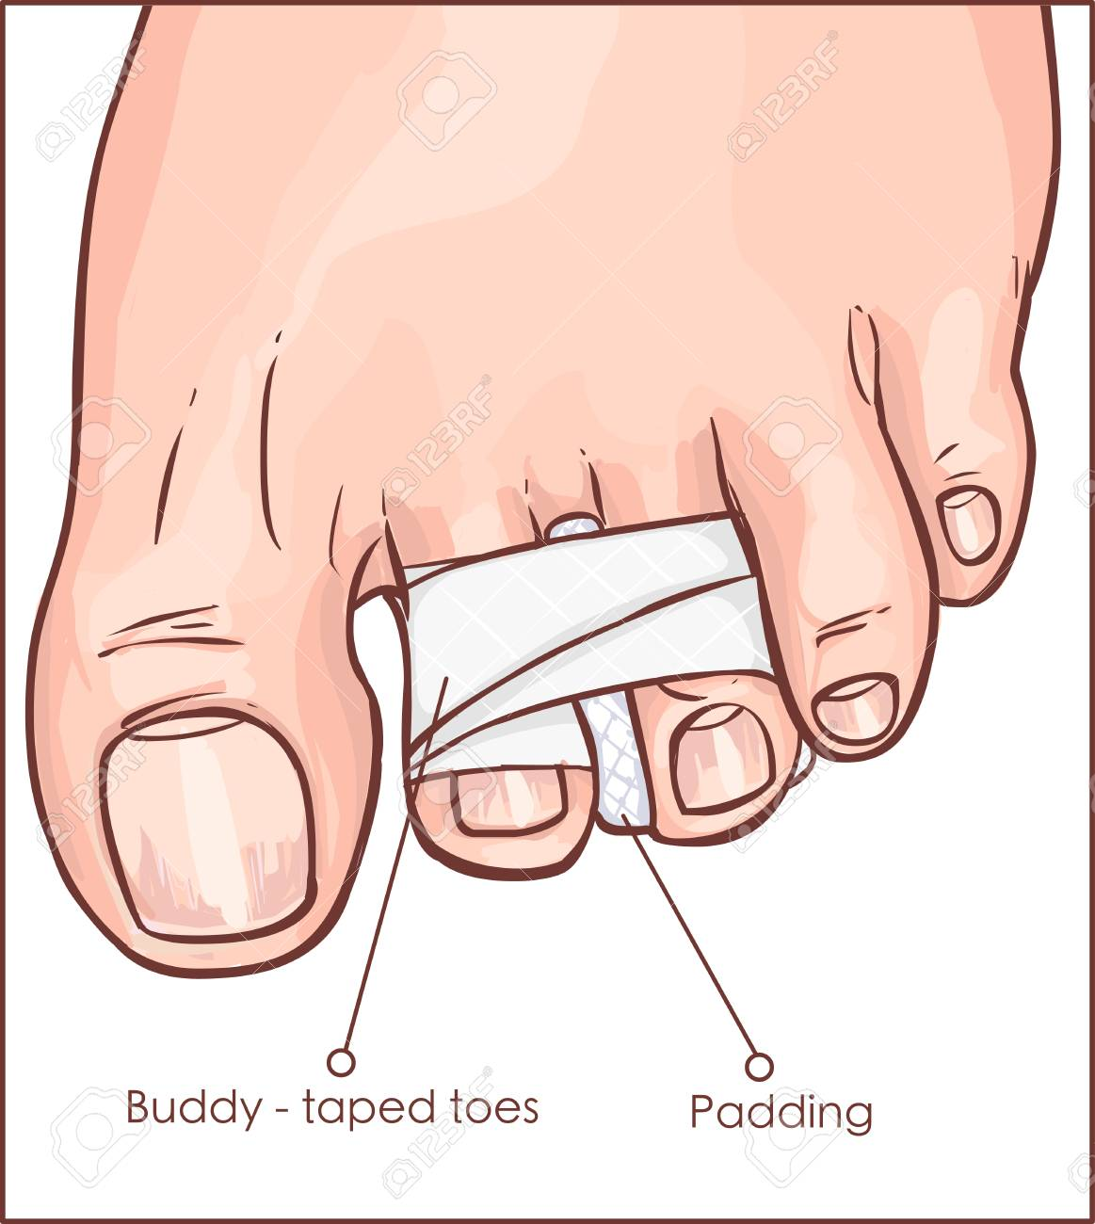
Management
Displaced fractures of the lesser toes should be treated with reduction and buddy taping.
Patients with displaced fractures of the first toe often require rigid stabilization of the reduction.

Slide 46
Thank You

