Slide 1
KNEE DISORDERS
Mohammad Said Dawood, M.D.
Orthopedics And Reconstructive Surgery Consultant
Faculty of Medicine , Mut'ah University
2020
Edited by;
Lana Sabateen
Malak Al-Majali
Sara Khreisat

Slide 2
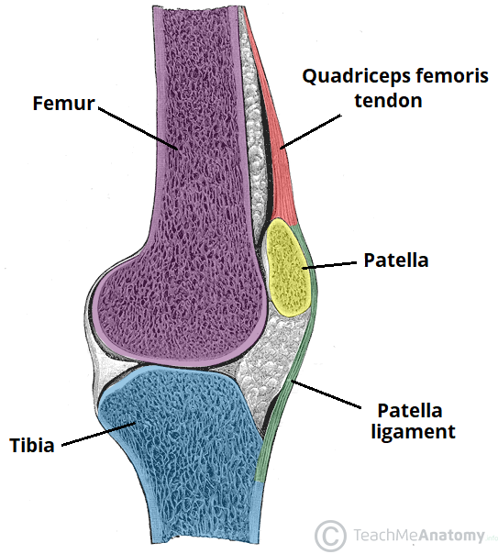
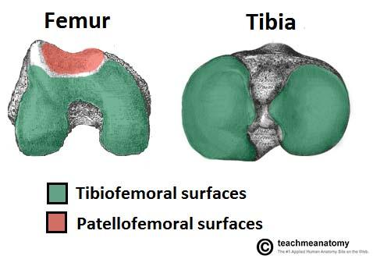
KNEE JOINT – ANATOMY
A hinge type synovial joint, which mainly allows for flexion and extension (and a small degree of medial and lateral rotation). Its surfaces are lined with hyaline cartilage and are enclosed within a single joint cavity.
Articulating Surfaces
Tibiofemoral: medial and lateral condyles of the femur articulate with the tibial condyles. It is the weight-bearing component of the knee joint.
Patellofemoral: anterior aspect of the distal femur articulates with the patella.
It allows the tendon of the quadriceps femoris (knee extensor) to be inserted directly over the knee; increasing the efficiency of the muscle. As the patella is both formed and resides within the quadriceps femoris tendon, it provides a fulcrum to increase power of the knee extensor and serves as a stabilizing structure that reduces frictional forces placed on femoral condyles.
Neurovascular Supply
The blood supply is through the genicular anastomoses around the knee, which are supplied by the genicular branches of the femoral and popliteal arteries.
The nerve supply, according to Hilton’s law, is by the nerves which supply the muscles which cross the joint. These are the femoral, tibial and common fibular nerves.

Slide 3
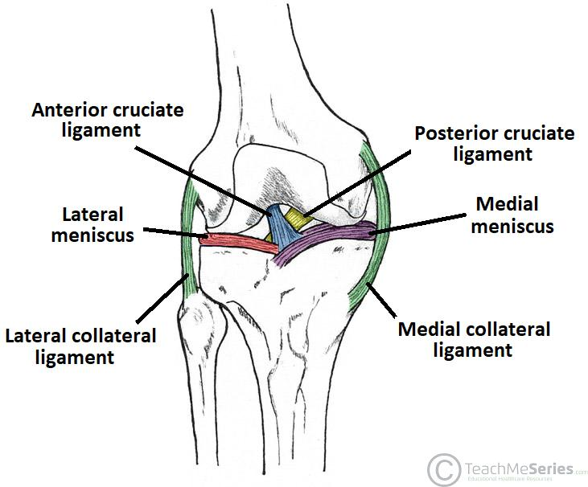
LIGAMENTS OF THE KNEE– ANATOMY
Patellar ligament
A continuation of the quadriceps femoris tendon distal to the patella. It attaches to the tibial tuberosity.
Collateral ligaments
Two strap-like ligaments. They act to stabilize the hinge motion of the knee, preventing excessive medial or lateral movement
Tibial (medial) collateral ligament: wide and flat ligament, found on the medial side of the joint. Proximally, it attaches to the medial epicondyle of the femur, distally it attaches to the medial condyle of the tibia.
Fibular (lateral) collateral ligament: thinner and rounder than the tibial collateral, this attaches proximally to the lateral epicondyle of the femur, distally it attaches to a depression on the lateral surface of the fibular head.
Cruciate Ligaments
These two ligaments connect the femur and the tibia. In doing so, they cross each other, hence the term ‘cruciate’ (Latin for like a cross)
Anterior cruciate ligament.
Posterior cruciate ligament.

Slide 4
NORMAL X-RAY OF THE KNEE

Slide 5
NORMAL X-RAY OF THE KNEE

Slide 6
NORMAL MRI OF THE KNEE

Slide 7
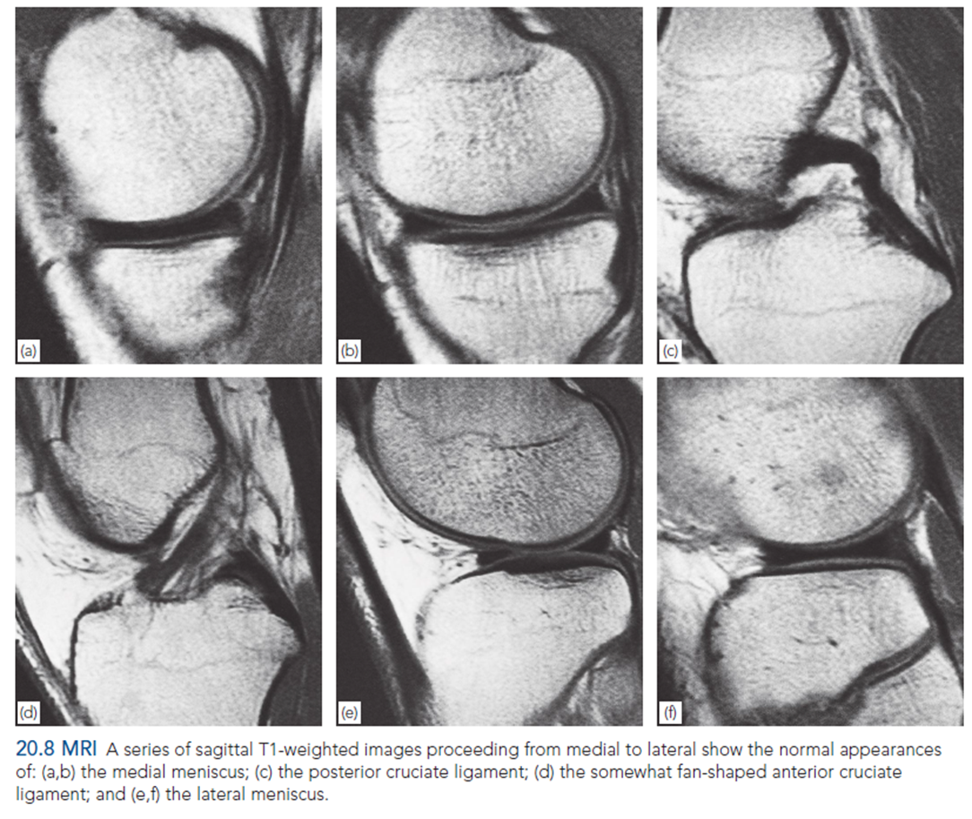
KNEE LIGAMENTS – MRI

Slide 8
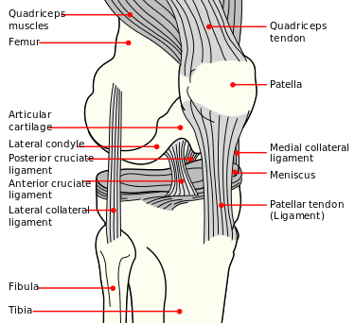
ANTERIOR CRUCIATE LIGAMENT - OVERVIEW
Function
Prevents anterior translation of the tibia relative to the femur
Anatomy
Origin
Arises from the posteromedial corner of medial aspect of lateral femoral condyle in the intercondylar notch
Insertion
Anterior to the intercondylar eminence of the tibia, being blended with the anterior horn of the medial meniscus.
Structure
There are two components of the (ACL), named according to where the bundles insert into the tibial plateau.
The smaller anteromedial bundle is tight in flexion; both bundles will be crossed.
The larger posterolateral bundle (PLB) tight in extension; both bundles will be parallel
Blood supply
The major blood supply of the cruciate ligaments arises from the middle geniculate artery. The distal part of both cruciate ligaments is vascularized by branches of the lateral and medial inferior geniculate artery
Innervation
From the posterior articular branches of the tibial nerve.

Slide 9
ACL – MECHANISM OF INJURY
1- Non-contact Pivoting Injury (Most common)
2- Blow to the Lateral Aspect of the Knee
The tibia translates anteriorly while knee is in slight flexion and valgus

Slide 10
ACL – CLINICAL FEATURES
The patient gives a history of a twisting or wrenching injury and may even claim to have heard a ‘pop’ as the tissues snapped.
The knee is painful and swollen (Hemarthrosis), and, in contrast to meniscal injury, the swelling appears almost immediately.
The knee may be too painful to permit deep palpation or much movement. Tenderness is most acute over the torn ligament and stressing one or other side of the joint may produce excruciating pain.
After some time, the symptoms will go away, and the patient will complain of a “Giving away” sensation (indicating instability of the knee joint).

Slide 11
ACL – EXAMINATION
The Anterior Drawer Test
Used for testing for abnormal gliding movements in the anteroposterior (sagittal) plane.
With the patient’s knees flexed 90 degrees and the feet resting on the couch. The foot is anchored by the examiner sitting on it (provided this does not cause pain); then, using both hands, the upper end of the tibia is grasped firmly and rocked forward to see if there is any anteroposterior glide.
Excessive anterior movement, a positive anterior drawer sign, indicates anterior cruciate laxity.
Mostly examines the anteromedial bundle.

Slide 12
ACL – EXAMINATION
Lachman test
The patient’s knee is flexed 20 degrees; with one hand grasping the lower thigh and the other the upper part of the leg, the joint surfaces are shifted backwards and forwards upon each other. If the knee is stable, there should be no gliding.
More sensitive, but difficult if the patient has big thighs (or the examiner has small hands).
Mostly examines the posterolateral bundle.

Slide 13
ACL – EXAMINATION
Pivot shift test
The patient lies supine with the lower limb completely relaxed.
The examiner lifts the leg with the knee held in full extension and the tibia internally rotated. A valgus force is then applied to the lateral side of the joint as the knee is flexed; a sudden posterior movement of the tibia is seen and felt as the joint is fully re-located (a ‘click’ can be heard). The test is sometimes quite painful.
Highly sensitive and specific.

Slide 14
ACL - IMAGING
Plain x-rays:
Usually normal.
May show that the ligament has avulsed a small piece of bone from the tibial spine by the anterior cruciate ligament.
Or Avulsion from the near edge of the lateral tibial condyle by the iliotibial tract or capsule (a Segond fracture, which is often associated with anterior cruciate ligament and meniscal injuries).

Slide 15
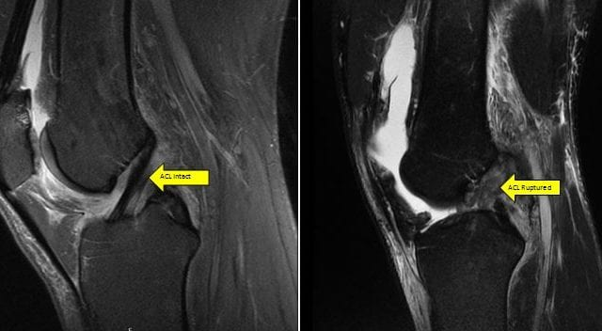
ACL - IMAGING
MRI:
Gold Standard
Helpful in distinguishing partial from complete ligament tears.
In Rupture; the ACL will be torn, and the PCL is redundant.
It may also reveal ‘bone bruising’ on lateral femoral condyle or tibial plateau.
Two pathognomonic for ACL injury: a Segond fracture and bone bruises.

Slide 16
ACL - TREATMENT
Treatment is decided according to the lifestyle of the patient.
Office works are usually treated conservatively while young adults and athletes undergo surgery.
Non-Operative:
Physical Therapy & Lifestyle Modifications.
Strengthening of the Hamstrings muscles.
Indicated in
Low demand patients with decreased laxity.
Recreational athlete not participating in cutting/pivoting activities
Outcome is an increased meniscal/cartilage damage
Loss of meniscal integrity, the frequency of buckling episodes, level I and II activity (e.g. jumping, cutting, side-to-side sports, heavy manual labor)

Slide 17
ACL - TREATMENT
Operative
ACL reconstruction using a graft from the hamstring tendon
Indications
Must have full motion of knee restored following injury (unless meniscal tear causing mechanical block).
Lack of pre-operative motion risk factor for post-operative arthrofibrosis.
Younger, more active patients (reduces the incidence of meniscal or chondral injury)
Children (activity limitation is not realistic)
Older active patients (age >40 is not a contraindication if high demand athlete)
Partial/single bundle tears with clinical and functional instability.
Prior ACL reconstruction failure.
Outcome is a return to play largely influenced by psychological, demographic and functional outcomes.

Slide 18
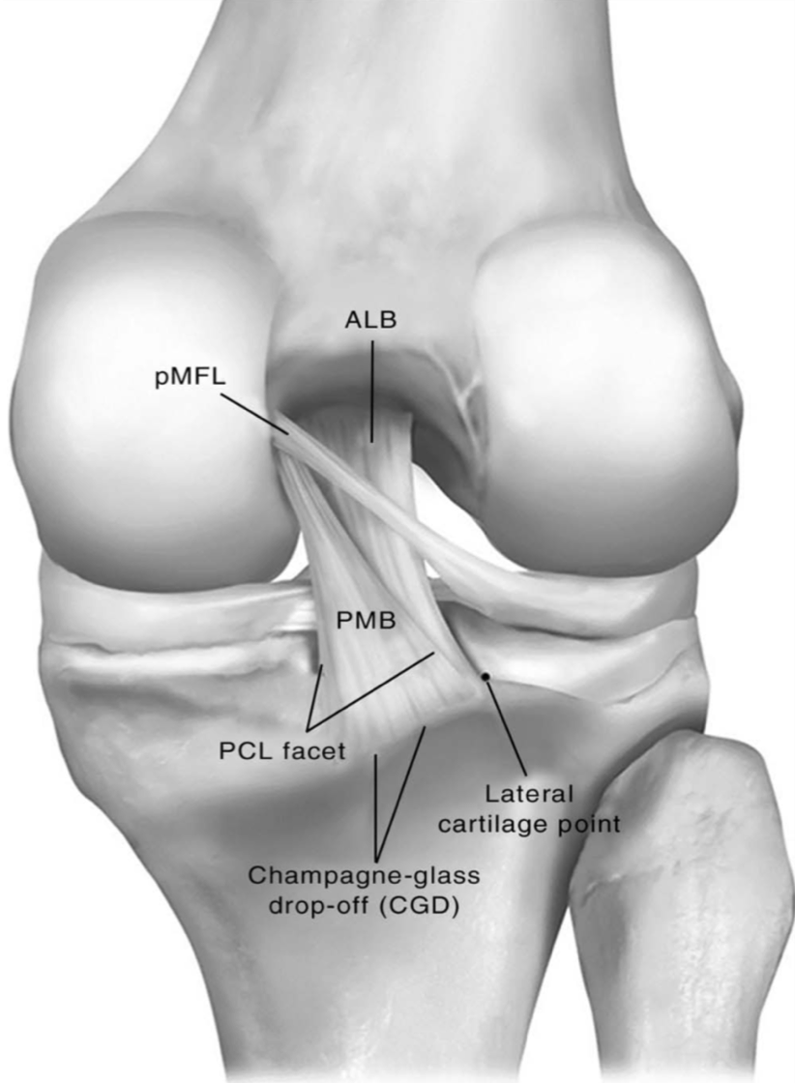
POSTERIOR CRUCIATE LIGAMENT - OVERVIEW
Function
Prevents posterior translation of the tibia relative to the femur
Anatomy
Origin
Arises from antero-lateral aspect of medial femoral condyle.
Insertion
Posterolateral aspect of proximal tibia (tibial sulcus).
Structure
There are two components of the PCL
Anterolateral Bundle.
Posteromedial Bundle.
Blood supply
The major blood supply of the cruciate ligaments arises from the middle geniculate artery. The distal part of both cruciate ligaments is vascularized by branches of the lateral and medial inferior geniculate artery
Innervation
From the posterior articular branches of the tibial nerve.

Slide 19
PCL – MECHANISM OF INJURY
1- Dashboard injury
A direct blow to proximal tibia with a flexed knee.
2- Noncontact hyperflexion with a plantar-flexed foot
3- Hyperextension injury

Slide 20
PCL – CLINICAL FEATURES
Posterior knee pain
Instability “Giving away’
Often subtle or asymptomatic in isolated PCL injuries.
Rarely an isolated injury.
Look for associated lateral collateral ligament injury &/or posterolateral corner injury.

Slide 21
PCL - EXAMINATION
Posterior drawer test
Used for testing for abnormal gliding movements in the anteroposterior (sagittal) plane.
With the patient’s knees flexed 90 degrees and the feet resting on the couch. The foot is anchored by the examiner sitting on it (provided this does not cause pain); then, using both hands, the upper end of the tibia is grasped firmly and rocked backward to see if there is any anteroposterior glide.
Excessive posterior movement, a positive posterior drawer sign, indicates posterior cruciate laxity.

Slide 22
PCL – IMAGING
Plain x-rays
Usually normal.
May show that the ligament has avulsed a small piece of bone from the back of the upper tibia.

Slide 23
PCL - IMAGING
MRI
Gold Standard.
Shows disruption of the posterior cruciate ligament.

Slide 24
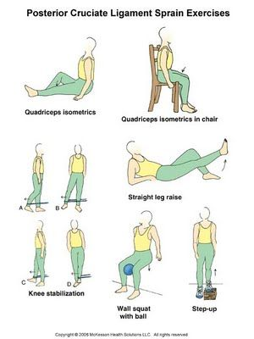
PCL - TREATMENT
Non-operative
Protected weight bearing & Rehab
Indications; Isolated Grade I (partial) and II (complete isolated) injuries.
Modalities; quadriceps rehabilitation with a focus on knee extensor strengthening

Slide 25
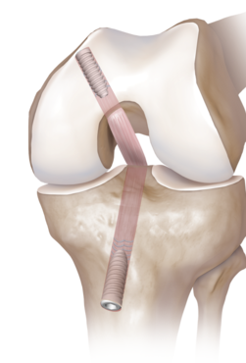
PCL - TREATMENT
Operative
PCL repair of bony avulsion fractures or reconstruction using a graft, and rehabilitation.
Indications:
Combined ligamentous injuries.
Isolated Grade II or III injuries with bony avulsion.
Isolated chronic PCL injuries with a functionally unstable knee

Slide 26
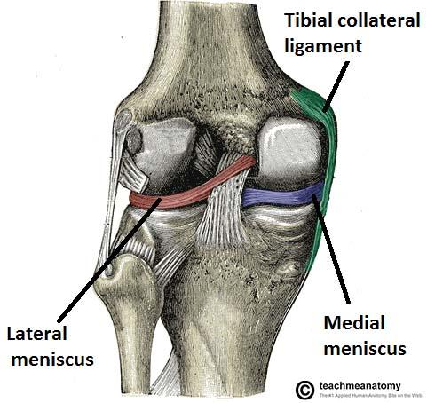
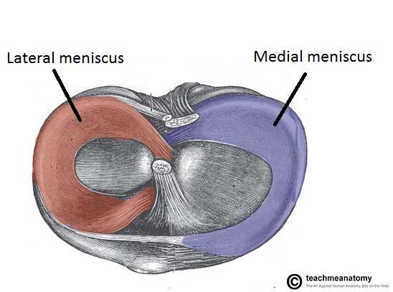
MENISCI - ANATOMY
They are C-shaped fibrocartilage structures in the knee that serve two functions:
To deepen the articular surface of the tibia, thus increasing stability of the joint.
To act as shock absorbers by increasing surface area to further dissipate forces.
They have a thick outer (peripheral) border attached to the capsule and a thin concave inner that forms a free edge.
The medial menisci is semicircular while the lateral menisci is almost a complete circle.

Slide 27
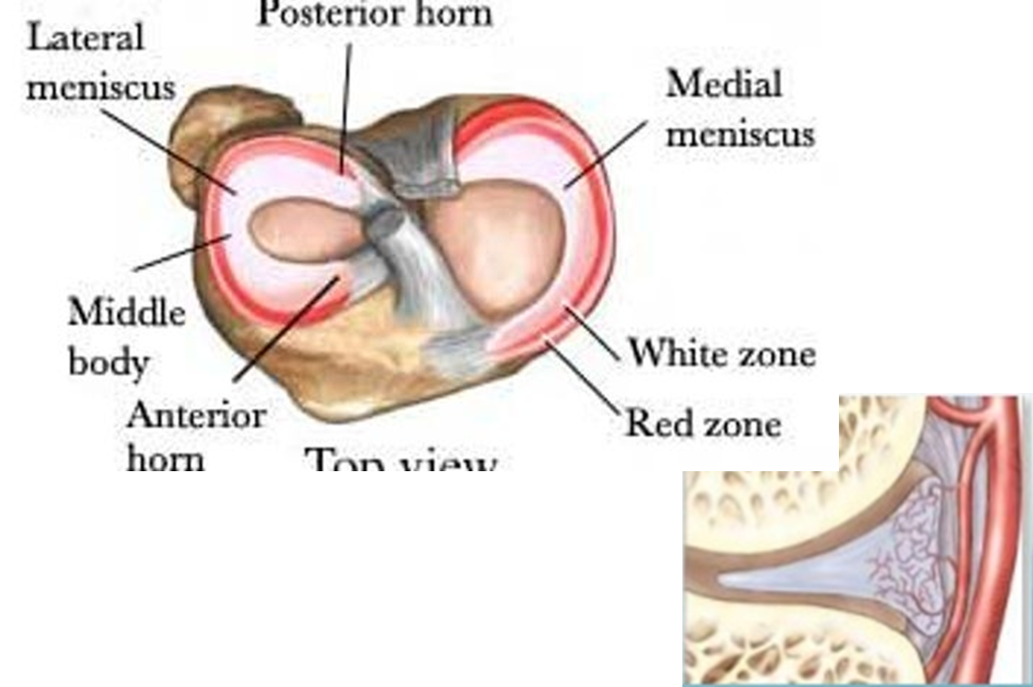
MENISCI - ANATOMY
Their upper surface is in contact with the femoral condyles and their lower surface with the tibial condyles (attached at both ends by posterior and anterior horns)
In addition, the medial meniscus is fixed to the medial collateral ligament and the joint capsule. Damage to the MCL usually results in a medial meniscal tear.
The lateral meniscus is smaller and does not have any extra attachments, rendering it fairly mobile.
It is supplied by the middle and inferior genicular artery. Most of the meniscus is avascular (white zone) and spontaneous repair does not occur unless the tear is in the outer third (red zone), which is vascularized from the attached synovium and capsule.

Slide 28
MENISCAL TEAR – MECHANISM OF INJURY
An acute twisting injury from impact during a sport.
Usually the foot stays fixed on the ground and the rest of body rotates.
Getting up from a squatting or crouching position.
Loading the knee from a fixed position.

Slide 29
MENISCAL TEAR - CLINICAL FEATURES
The patient is usually a young person who sustains a twisting injury to the knee.
Pain is often severe and further activity is avoided.
Occasionally the knee is ‘locked’ in partial flexion.
Locking, the sudden inability to extend the knee fully, suggests a bucket-handle tear. The patient sometimes learns to ‘unlock’ the knee by bending it fully or by twisting it from side to side.
Almost invariably swelling appears a few hours later, or perhaps the following day.
With rest the initial symptoms subside, only to recur periodically after trivial twists or strains.
Sometimes the knee gives way spontaneously and this is again followed by pain and swelling.
In patients aged over 40 years the initial injury may be unremarkable, and the main complaint is of recurrent ‘giving way’ or ‘locking’.

Slide 30
MENISCI TEAR - PHYSICAL EXAMINATION
On examination the joint may be held slightly flexed and there is often an effusion. In late presentations, the quadriceps will be wasted.
Tenderness is localized to the joint line (a sensitive but not specific finding), in most cases on the medial side. Flexion is usually full, but extension is often slightly limited.
Special Tests

Slide 31
MENISCAL TEAR – EXAMINATION
McMurray’s test:
It based on the fact that a loose meniscal tag can sometimes be trapped between the articular surfaces and then induced to snap free with a palpable and audible click.
The knee is flexed as far as possible; one hand steadies the joint and the other rotates the leg medially and laterally while the knee is slowly extended. The test is repeated several times, with the knee stressed in valgus or Varus, the examiner all the time feeling and listening for the click.
A positive test is helpful but not pathognomonic and a negative test does not exclude a tear.

Slide 32
MENISCAL TEAR – EXAMINATION
Apley’s grinding test
The meniscus is forcibly compressed, and the leg is rotated from side to side between the articular surfaces; a painful response signifies the likelihood of a torn or degenerate meniscus.

Slide 33
MENISCAL TEAR – EXAMINATION
The Thessaly test
It is based on a dynamic reproduction of load transmission in the knee joint under normal or trauma conditions. With the affected knee flexed to 20 degrees and the foot placed flat on the ground, the patient is told to put full weight on that leg while being supported by the examiner (for balance).
The patient is then instructed to twist his or her body to one side and then to the other three times; with each turn, a rotational force is exerted on the knee. Patients with meniscal tears experience medial or lateral joint line pain and may have a sense of the knee ‘locking

Slide 34
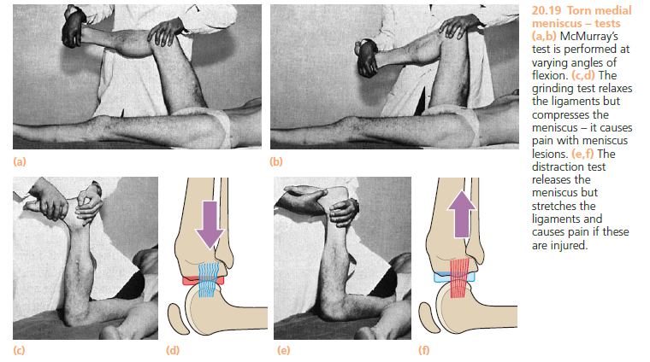
MENISCAL TEAR - EXAMINATION

Slide 35
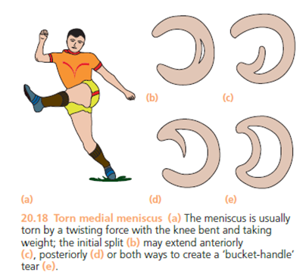
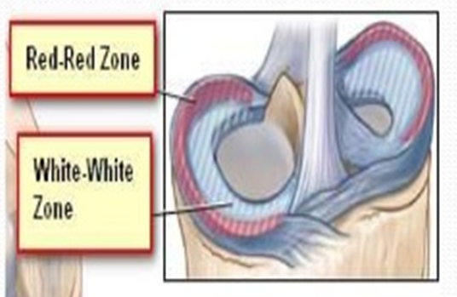
MENISCAL TEAR – CLASSIFICATION
Location
Red Zone(outer third, vascularized)
Red-White Zone (middle third)
White Zone(inner third, avascular)
Position
Anterior
Middle
Posterior Third
Root
Size

Slide 36
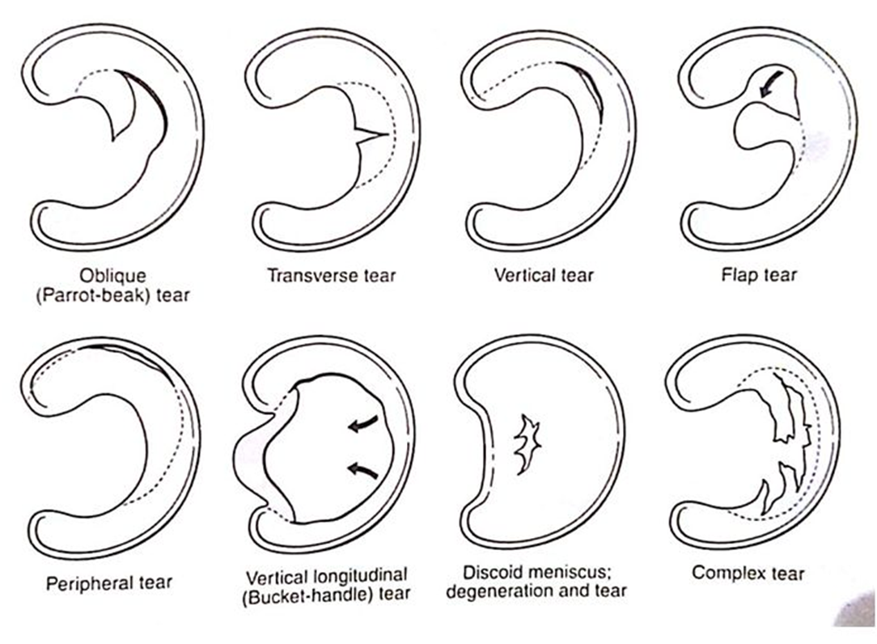
MENISCAL TEAR – CLASSIFICATION
Pattern
Vertical
Bucket Handle
Oblique (Parrot-beak)
Radial
Flap
Horizontal (Transverse)
Complex
Root (Peripheral)

Slide 37
MENISCAL TEAR – IMAGING
MRI
Most sensitive diagnostic test, but also has a high false positive rate.
The bucket handle pattern produces a double PCL sign on MRI.

Slide 38
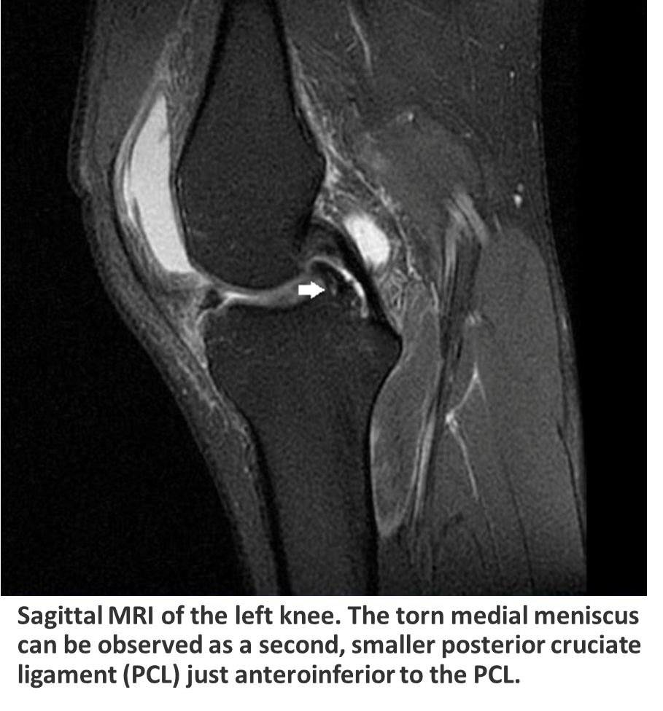
MENISCAL TEAR – IMAGING

Slide 39
MENISCAL TEAR - TREATMENT
Nonoperative
Rest, NSAIDS, Rehabilitation
Indicated as first line treatment for degenerative tears
Outcomes:
Improvement in knee function following physical therapy.
“Noninferior" when compared to arthroscopic partial meniscectomy.

Slide 40
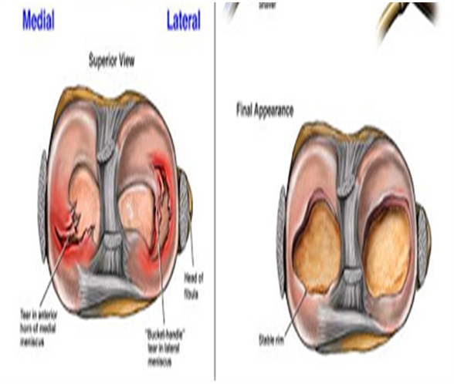
MENISCAL TEAR – TREATMENT
Operative; Partial Meniscectomy
Indicated in:
Tears that are not amenable to repair (complex, degenerative, radial tear patterns)
Repair failure >2 times
Outcome: >80% satisfactory function at minimum follow-up

Slide 41
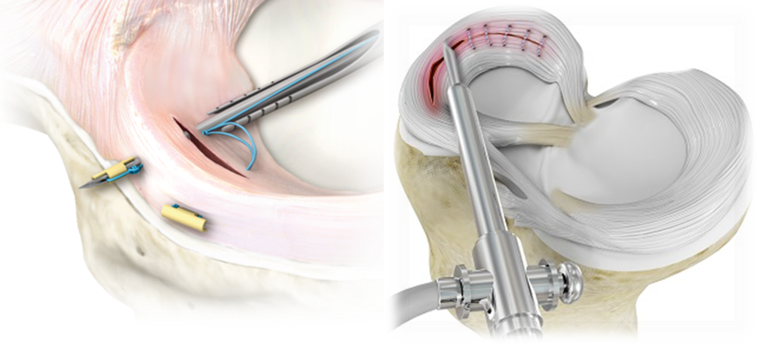
MENISCAL TEAR – TREATMENT
Operative; Meniscal Repair
Indicated in
Peripheral tears in the red-red zone (vascularized region)
Vertical and longitudinal tears .
Root tear
Acute repair combined with ACL reconstruction
Outcome: 70-95% successful

Slide 42
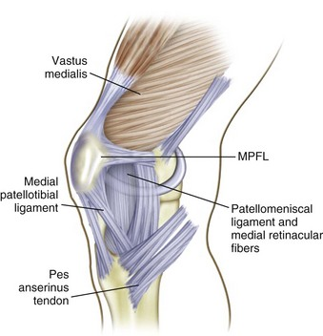
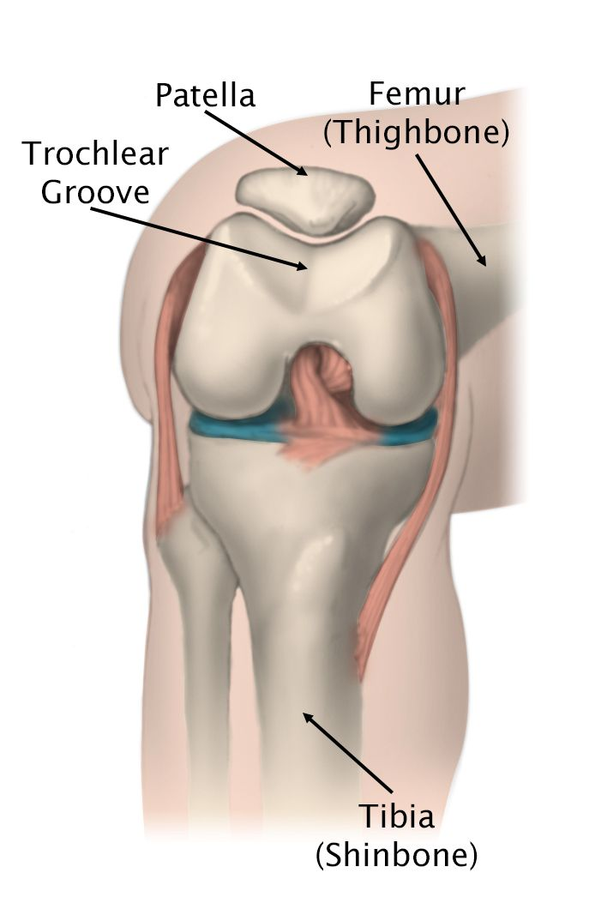
PATELLOFEMORAL DISLOCATION - OVERVIEW
The Quadriceps muscle moves the patella upwards and laterally upon flexion.
The Patellofemoral ligament, Patellotibial ligament and medial retinaculum as well as the anteriorly larger lateral femoral condyle prevent the patella from moving to the other side.

Slide 43
PATELLOFEMORAL DISLOCATION – RISK FACTORS
General Factors
Ligamentous Laxity (Ehlers-Danlos syndrome)
Previous Patellar Instability Event
“Miserable Malalignment Syndrome" (A term named for the 3 anatomic characteristics that lead to an increased Q angle)
Femoral Anteversion
Genu Valgum
External Tibial Torsion/ Pronated Feet
Anatomical Factors
Patella Alta causes patella to not articulate with sulcus, losing its constraint effects (High patella)
Trochlear Dysplasia
Lateral Femoral Condyle Hypoplasia

Slide 44
PATELLOFEMORAL DISLOCATION – MECHANISM OF INJURY
Noncontact twisting injury with the knee extended and foot externally rotated
Patient will usually reflexively contract quadriceps thereby reducing the patella
Direct blow
Less common; knee to knee collision in basketball, or football helmet to side of knee

Slide 45
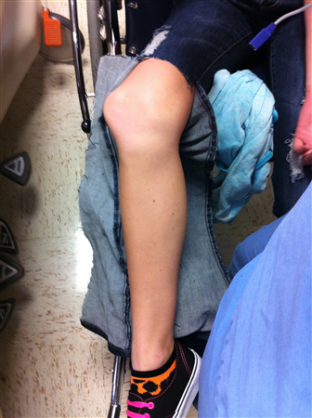
PATELLOFEMORAL DISLOCATION - SYMPTOMS
Girls are affected more commonly than boys and the condition may be bilateral.
Dislocation occurs unexpectedly when the quadriceps muscle is contracted with the knee in flexion. There is acute anterior pain, the knee is stuck in flexion and the patient may fall to the ground (Complains of instability.)

Slide 46
PATELLOFEMORAL DISLOCATION – PHYSICAL EXAMINATION
Acute dislocation usually associated with a large hemarthrosis
Medial sided tenderness (over MPFL)
Patellar Apprehension test.
Pressing the patella laterally with the thumb while flexing the knee (passive lateral translation) slowly may induce anxiety and sharp resistance to further movement

Slide 47
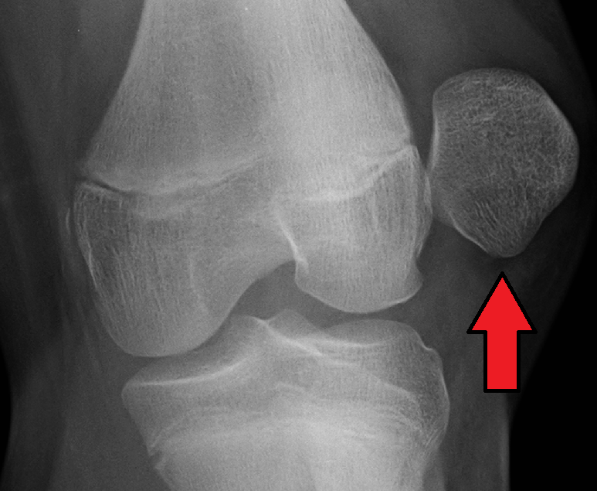
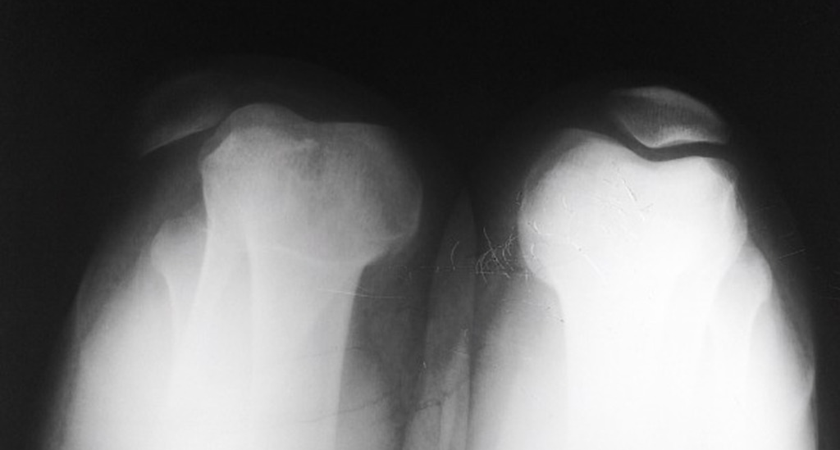
PATELLOFEMORAL DISLOCATION - IMAGING
X-ray
AP
Skyline View; dislocations are readily diagnosed.

Slide 48
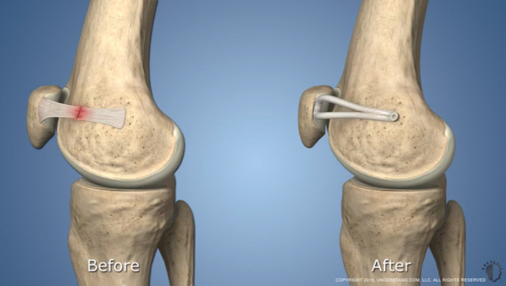
PATELLOFEMORAL DISLOCATION – TREATMENT
Sedation and Relocation
1st Time dislocation; Slab for 1 month with NSAIDS, Activity modification and Physical therapy (to strengthen vastus medialis).
Recurrent; Address risk factors and treat them, if untreatable then operative treatment is indicated.
Operative
MPFL repair
MPFL reconstruction with autograft vs allograft
Fulkerson-type osteotomy (anterior and medial tibial tubercle transfer)
Lateral release
Trochleoplasty

Slide 49
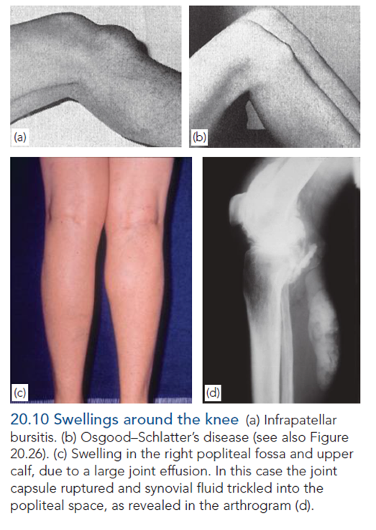
SWELLINGS OF THE KNEE
Swelling of the Entire Joint.
Swellings in Front of the Joint.
Swellings Behind the Joint.
Swelling at the Side of the Joint.

Slide 50
SWELLING OF THE ENTIRE JOINT
Acute
Hemarthrosis
Posttraumatic; Fracture or Ligament Injury
Coagulation Disorder; Hemophilia
Septic Arthritis
Chronic
Non-infective (Rheumatoid or Osteo-) Arthritis
Chronic Infective Arthritis (TB)
Synovial Chondromatosis (Synovial Tumor); Multiple, pearly cartilaginous loose bodies enveloped in synovial folds.
Pigmented Villonodular Synovitis; Synovial tumor which causes erosion and excavation of the articular surfaces; at operation, the synovium is seen to be swollen, often covered in villi and golden-brown in color, the effect of hemosiderin deposition.

Slide 51
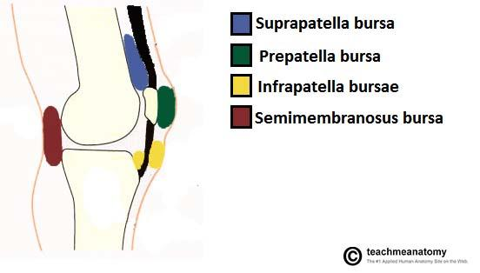
KNEE JOINT – ANATOMY
Bursa: is synovial fluid filled sac, found between moving structures in a joint (with the aim of reducing wear and tear on those structures). There are four bursae found in the knee joint:
Suprapatellar bursa: an extension of the synovial cavity of the knee, located between the quadriceps femoris and the femur.
Prepatellar bursa found between the apex of the patella and the skin.
Infrapatellar bursa: split into deep and superficial. The deep bursa lies between the tibia and the patella ligament. The superficial lies between the patella ligament and the skin.
Semimembranosus bursa located posteriorly in the knee joint, between the semimembranosus muscle and the medial head of the gastrocnemius

Slide 52
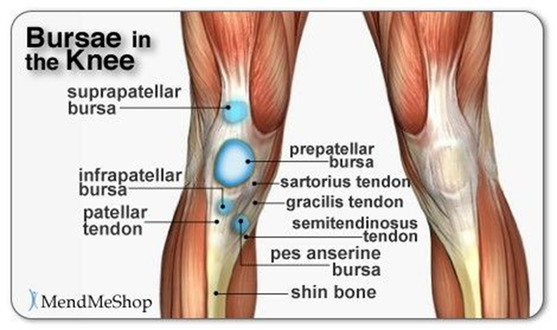
SWELLING IN FRONT OF THE KNEE
Housemaid’s Knee; prepatellar bursitis.
Clergyman’s Knee; Infrapatellar bursitis (Less Common).
Patient presents with swelling of the knee and pain.
Treatment;
Conservatively; NSAIDs.
If the symptoms become chronic then excision is indicated.
In case of an infection; incision and drainage followed by excision.

Slide 53
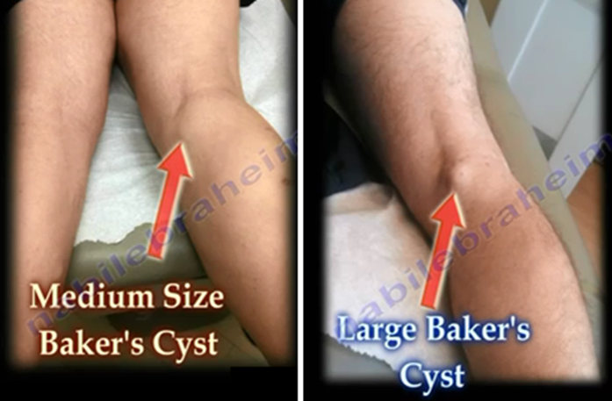
SWELLING AT THE BACK OF THE KNEE
Semimembranosus bursa
Popliteal Cyst (Baker’s cyst); Most common, usually secondary to a meniscal tear, rheumatoid arthritis or osteoarthritis.
A defect in the posterior aspect of the capsule allows the synovial fluid to leave forming the cyst.
Treated conservatively with treatment of the underlying cause.
Usually subsides or spontaneously disappears.
Excision is not indicated as the cyst will relocate.
Rarely, if the cyst is painful; aspiration and corticosteroid injection is indicated.
Popliteal Aneurysm.

Slide 54
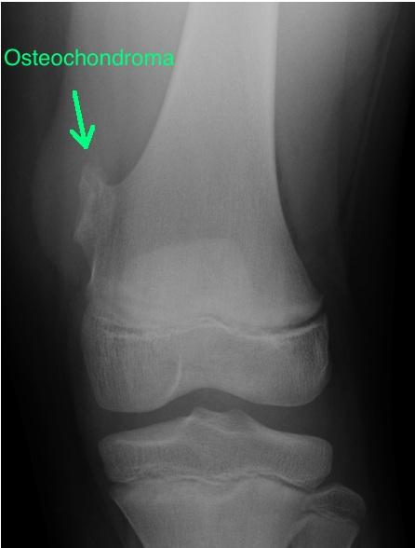
SWELLING AT THE SIDE OF THE KNEE
Meniscal cyst.
Calcification of the Collateral Ligament.
Bony swellings; Exostosis, Osgood–Schlatter disease.

Slide 55
OSGOOD–SCHLATTER DISEASE (‘APOPHYSITIS’ OF THE TIBIAL TUBERCLE)
Common disorder of adolescence where the tibial tubercle becomes painful and ‘swollen’.
Although often called osteochondritis or apophysitis, it is nothing more than a traction injury of the apophysis into which part of the patellar tendon is inserted (the remainder is inserted on each side of the apophysis and prevents complete separation).
There is no history of injury and sometimes the condition is bilateral.
Presents as a young adolescent complains of pain after activity, and of a lump.
More common in males (12-15 years old) than females (8-12 years old).
Notes:
.

Slide 56
OSGOOD–SCHLATTER DISEASE - DIAGNOSIS
Physical Examination
A tender, enlarged lump over the tibial tuberosity is diagnostic.
Provocative test; Active extension of the knee against resistance elicits pain.
Imaging; X-rays
Fragmentation of the apophysis.

Slide 57
OSGOOD–SCHLATTER DISEASE - TREATMENT
Nonoperative
Spontaneous recovery is usual but takes time.
NSAIDs, Rest, Ice.
Restrict activities as cycling, jumping and soccer (Activity Modification).
Occasionally, symptoms persist; Cast Immobilization (Back-splint during the day) for 6 weeks.
Operative; Ossicle Excision
Ossicle is an outgrowth of the tuberosity, presents as pain on kneeling at an older age (i.e. 27 years old)
Indicated in:
Refractory cases (10% of patients)
In skeletally mature patients with persistent symptoms

Slide 58
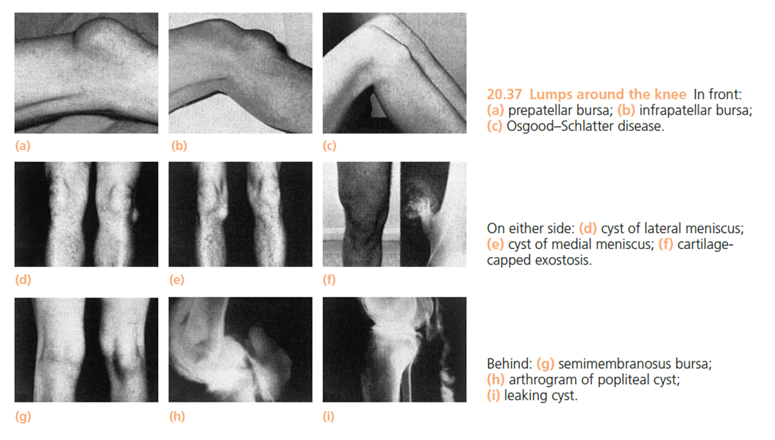
SWELLINGS OF THE KNEE

