Slide 1
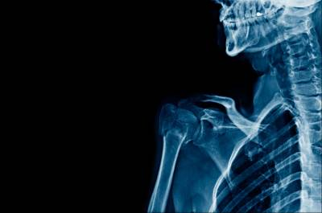
Spinal Congenital Anomalies ( Spinal Dysraphism )
Done by :
Tala Sarayreh

Slide 2
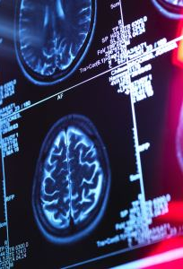
The nervous system is ectodermal in origin ( develops from neuro – ectoderm ) except the microglia and dura matter which are mesodermal in origin
Spinal cord development : 1. Gastrulation ( conversion of the embryonic disk from a bilaminar disk to a trilaminar disk composed of ectoderm , mesoderm and endoderm )

Slide 3
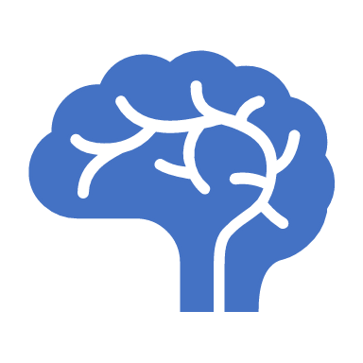
2. Primary neurulation ( notochord and overlying ectoderm interact to form the neural plate ) Neural plate bends and folds to form the neural tube, which then closes bidirectionally in a zipperlike manner 3. Secondary neurulation ( neural tube is formed by the caudal cell mass ) Abnormalities in any of these steps can lead to spine or spinal cord malformations.

Slide 4
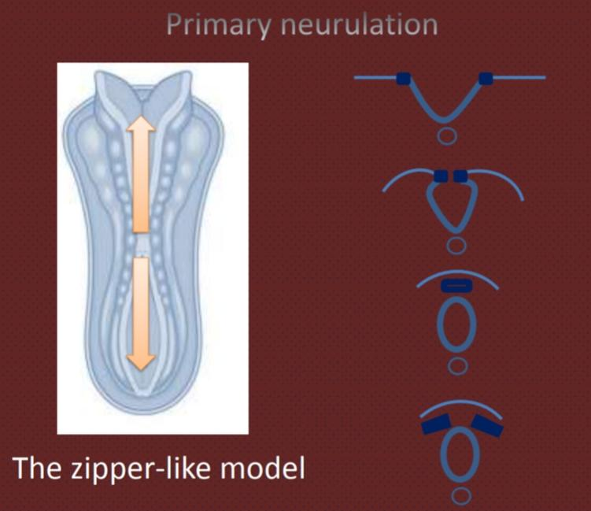

Slide 5
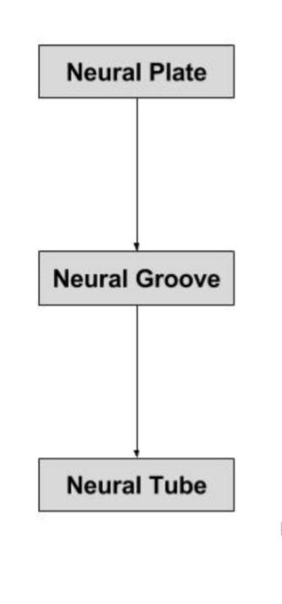
1. Formation of neural plate
2. Shaping of the neural plate
3. Bending of the neural plate
4. Fusion

Slide 7
Spinal Dysraphism :
Heterogeneous group of anomalies resulting from incomplete midline closure of osseous, mesenchymal and nervous tissue ( Failure of normal fusion of the neural plate to form neural tube during the first 28 days following conception )
Prevalence : Neural tube defects (NTDs) are one of the most common birth defects, occurring in approximately one in 1000 live births in the United States. Neural tube defects (NTDs) cause infant mortality (death) and serious disability

Slide 8
Categorization of Spinal Dysraphisms ( neural tube defects ) :
1. Open spinal dysraphism there is a defect in the overlying skin, and the neural tissue is exposed to the environment ( caused by defective closure of the primary neural tube and are characterized clinically by exposure of the neural placode through a midline skin defect on the back ) . All OSDs are anomalies of 1ry neurulation
2. Closed spinal dysraphism neural tissue is covered by skin ( may be abnormal skin ) , but with or without associated subcutaneous mass

Slide 9
Spina bifida ( Spine split )
Due to failure of fusion of the dorsal parts of vertebra “ absence of vertebral arch or part of them “ 1. Occulta . Most common and mildest form . Mostly / typically affects the lumbosacral area
. May associated with overlying skin lesions as : Skin dimples , Heamangioma or red spot , Abnormal tuft of hair , sinus tract , fatty mass or lipomas

Slide 10
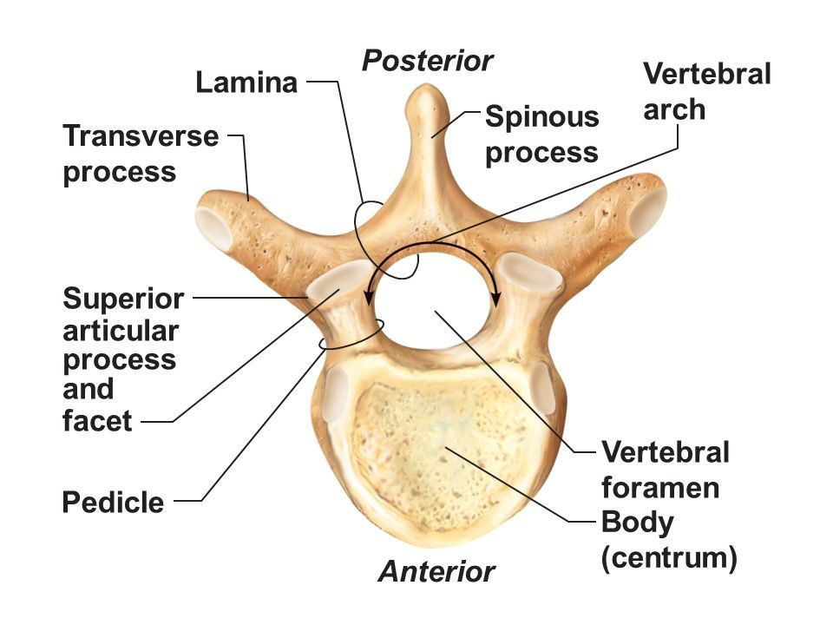

Slide 11
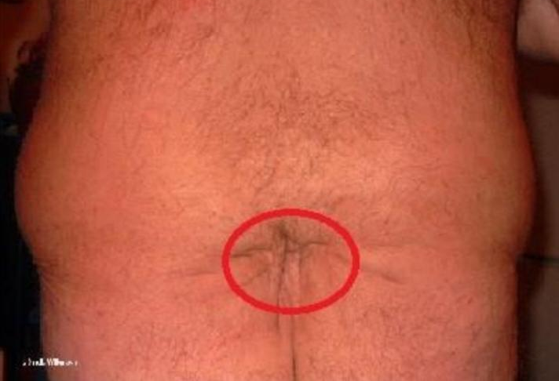
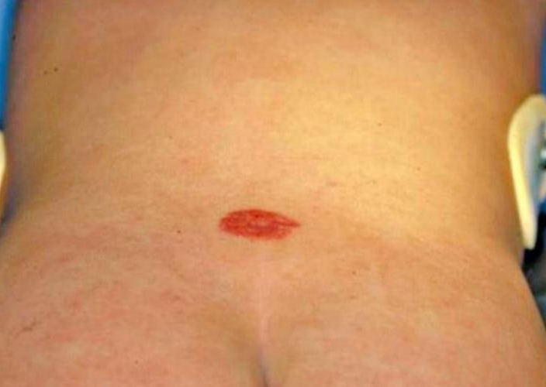
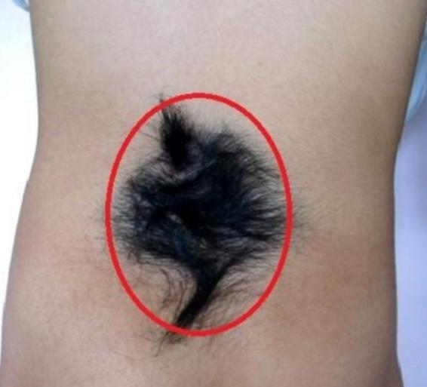
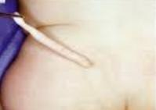
Overlying skin lesions as :
1. Skin dimples
2. Heamangioma /red spot
3. Abnormal tuft of hair
4. Sinus tract
5. Lipomas

Slide 12
2. Cystica 1 →Meningocele ( meningeal cyst ) . The meninges herniates through the spina bifida and forming subcutaneous sac / cyst filled with CSF 2 → Myelomeningocele . The spinal cord herniates through the Meningocele . May associated with other neurological anomalies as : Chiari 2 malformation , hydrocephalus * Myelocele ( Rachischisis ) . Failure of obliteration of the neural tube

Slide 13
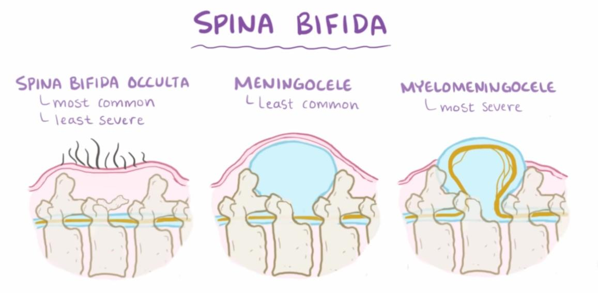
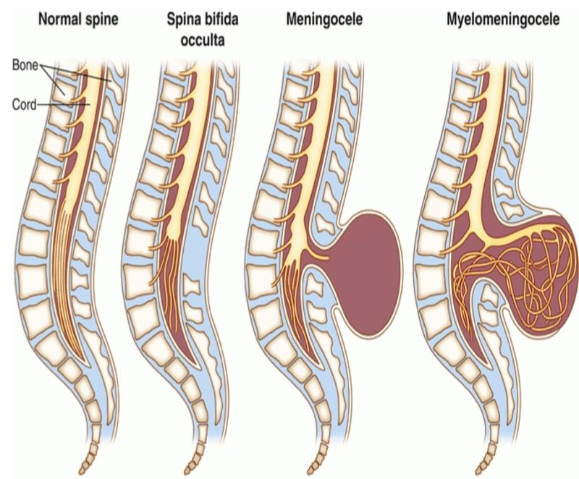

Slide 15
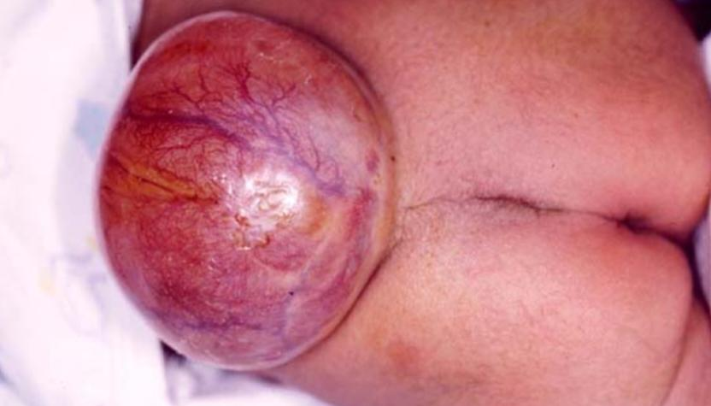
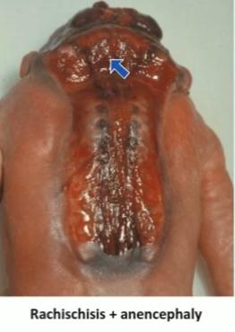
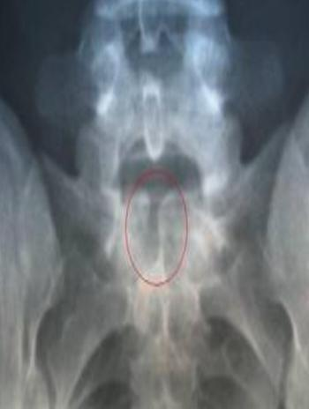
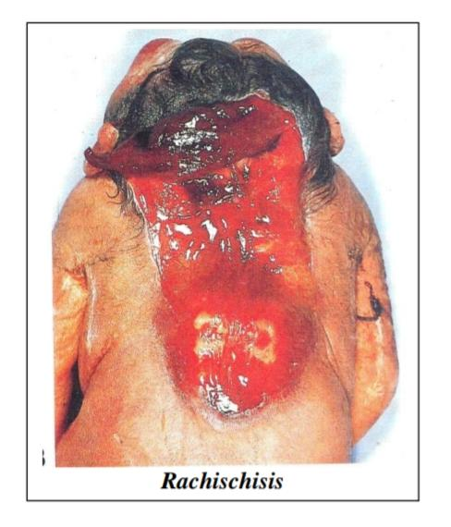

Slide 16
Unknown cause , but the risk factors include :
1. Folate deficiency ( Vitamin B9 ) 2. Obesity 3. Poorly controlled Diabetes 4. Medications that interfere with folate metabolism as : Anti- Seizure medications 5. Genetic predisposition and Family history 6. Previous pregnancy with same condition

Slide 17
Diagnosed :
1. Prenatally . Screening ( increased Alpha Fetoprotein “ AFP “ in mother’s serum , Acetylcholinesterase ) . US . Amniocentesis
2. Postnatally
. Neonatal Examination “ clinically “ + imaging (MRI)
. Get complications
. Incidentally by imaging

Slide 18
Treatment :
1. Prenatal ( with very high risk )
2. Postnatal surgical repair shortly after birth ( starting initially by covering the lesion with Gauze soaked with normal saline or ringer solution to prevent dryness , sac excision , emptying of CSF , exposure of the contents , tissue repair ) ⚠️ avoid antiseptic ( neurotoxic agents ) ⚠️ avoid mechanical trauma

Slide 21
Lipomyelomeningocele :
. Lipoma attached to dorsal surface of incompletely closed spinal cord
. Covered by skin

Slide 22
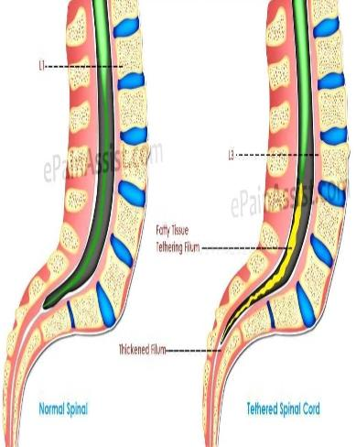
Tethered cord syndrome ( tight filum terminale syndrome ) :
The spinal cord could be caught against the vertebral by tight band , fibrosis or adhesions ( abnormally attached to tissue around ) resulting in abnormally low conus medullaris
Symptoms usually at age of puberty including ( 5 Ds ) : 1. Discomfort , back and leg pain 2. Deformities of spine ( scoliosis , kyphosis , lordosis ) and feets ( high arches , foot turned inward ) 3. Dysfunctions ( weakness , numbness , “ kidney , bladder and bowel dysfunctions “ ) 4. Decline of abilities
5. Dysraphisms of spine
Diagnosed by MRI to confirm the diagnosis and rule out Neoplasia
Treated surgically by Un- tethering surgery by cutting the filum terminale

Slide 23
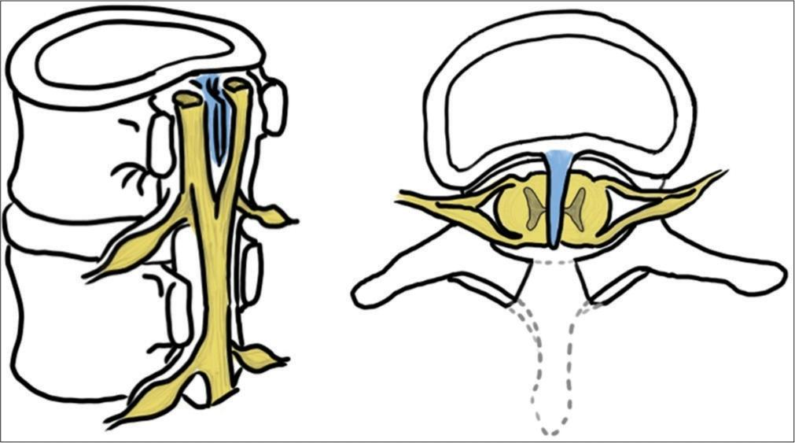
Split Cord Malformation ( SCM ) :
Rare anomaly characterized by a split along the midline of the spinal cord by fibrous or bony septum , which divides it into 2 symmetric or nonsymmetric entities
It NOT involving the whole length of spinal cord , but segment of it mostly at level of lumber or thoracic area
Mostly associated with Tethered cord , so share it’s symptoms
Diagnosed mainly by MRI
Treated by Un- tethering surgery ( but after removal of the bony septum and reconstitution of dura into single tube of affected segments until reaching the normal segments )

Slide 24
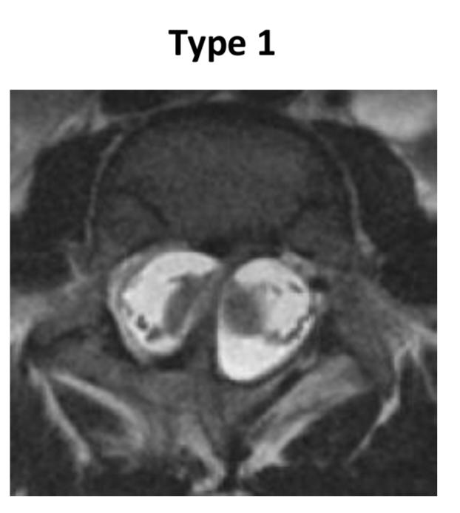
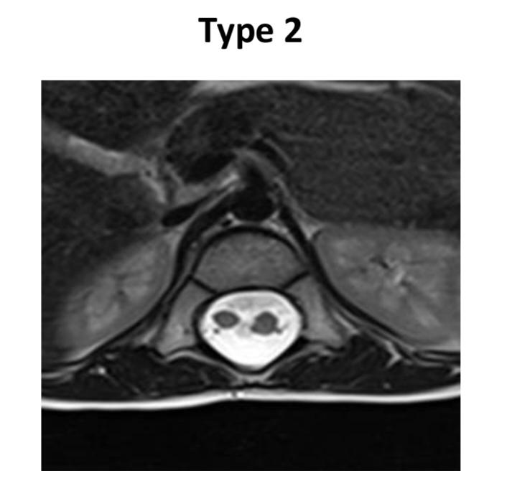
Two types of SCM :
1. Type 1 ( Diastematomyelia ) . Two hemicords , each with it’s own central canal , surrounding pia and dural tube , separated by rigid osseocartilaginous ( bony spur ) median septum . With abnormalities of spine at the level of split ( absent disc ) . ⅔ associated with overlying skin abnormalities 2. Type 2 ( Diplomyelia )
. Two hemicords within a single dural tube , separated by a nonrigid fibrous median septum
. Without abnormalities of spine at the level of split , but usually with spina bifida occulta

Slide 25
Impact of life :
1. Financial ( cost )
2. Physical ( paralysis , hydrocephalus , learning disabilities , bowel and bladder control problems , other congenital anomalies )
3. Emotional ( miscarriage , stillbirth , infant mortality , disability , feelings )

